Slide 1
Bright smile care agency
An agency determined to reach homes to educate parents on how they can prevent caries for brighter smiles

Slide 2
Presented by,
Parvina Akhmadalieva
Michelle Fernandez
Nazwa Munia
Oluwanifemi Omoijuanfo
Thalina Urena Martinez

Slide 3
Introduction Oluwanifemi Omoijuanfo
Everybody wants a beautiful, white, toothy smile. But the importance of good oral hygiene goes beyond beauty and looks. Our oral health is important to our overall health and bad oral hygiene can lead to disease and infection that cause irreparable damage. As the popular saying goes “prevention is better than cure”. We choose to educate parents on prevention, especially prevention of early childhood caries which is a very rampant amongst kids. A lot of parents don’t practice good oral hygiene and there are some factors that influence that lack of education, socio economic status, cultural influences. “personal experience here” Since parents are the primary caregiver for at least the 1st 3years of the child’s life, they are in the best position to teach and instill proper oral hygiene and help them build up their oral hygiene routine that can be beneficial well into their adulthood. We decided to educate parents so they can practice proper oral hygiene and be a good example to their kids. Our plan is to reach out to parents and guardians through social media because we want to reach a vast audience. Bright smile agency focuses on educating parents on the ins and outs of oral hygiene and different preventative measures that can be taken to prevent early childhood caries and other dental diseases in children. Although our main objective is prevention and education our other goals include providing resources and coming up with solutions and alternatives for parents or people who already have dental diseases but cannot afford dental care.

Slide 4
Caries education Michelle Fernandez
CONTENT:
What are cavities?
How do cavities form?
Short film

Slide 5
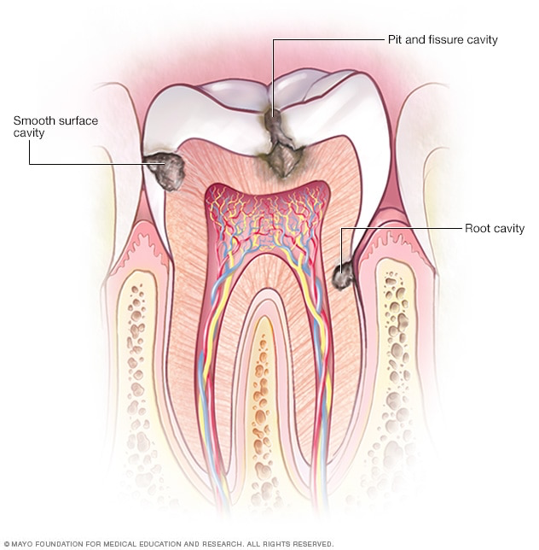
What are CAVities?
Cavities are permanently damaged areas in the hard surface of your teeth called enamel, that develop into tiny openings or holes.
Cavities, are also called tooth decay or caries, they are caused by a combination of factors, including bacteria in your mouth, frequent snacking, sipping sugary drinks and not having the correct oral hygiene.
Cavities can occur throughout life, both primary and permanent dentitions, and can damage the tooth crown and, in later life, exposed root surfaces.

Slide 6
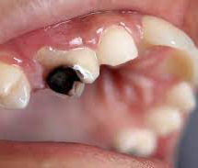
HOW DO CAVITIES FORM?
Cavities occur when a buildup of dental plaque eats at tooth enamel and causing a hole. Plaque is a sticky substance that covers teeth, and forms when bacteria is in the mouth.
Dental caries form through a complex interaction over time between acid-producing bacteria and fermentable carbohydrates, and many host factors including teeth and saliva.
Risk for caries include physical, biological, environmental, behavioral, and lifestyle related factors such as high numbers of cariogenic bacteria, inadequate salivary flow, insufficient fluoride exposure, poor oral hygiene, inappropriate methods of feeding infants, and low income.

Slide 7
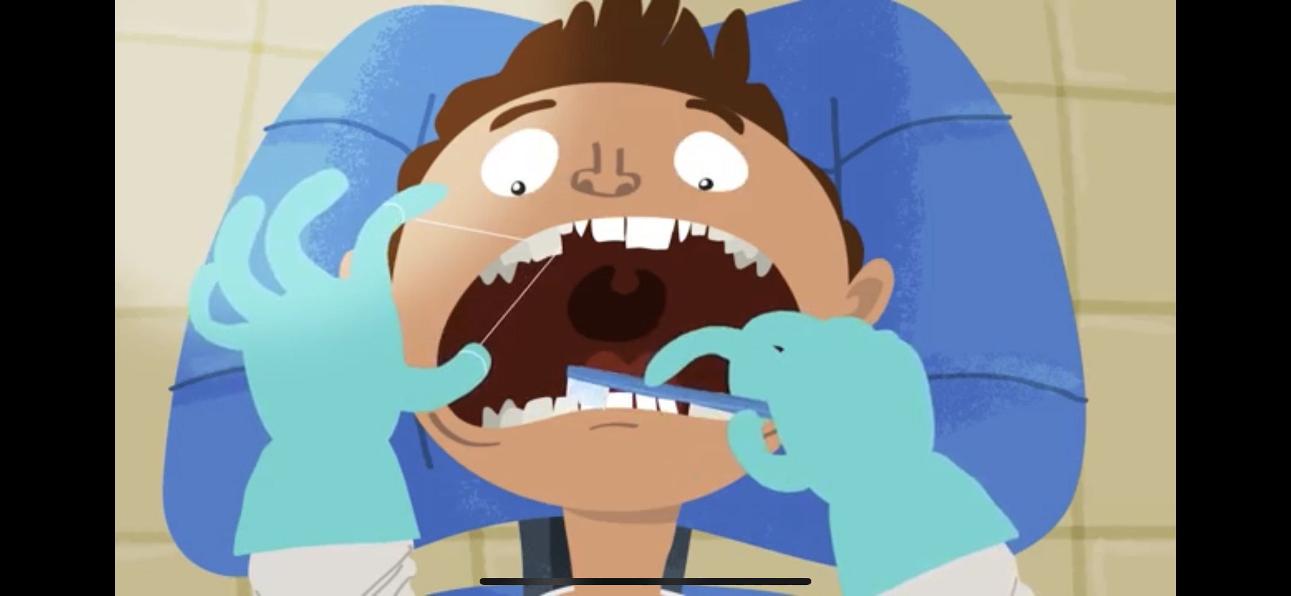
Caries prevention short film
https://youtu.be/zGoBFU1q4g0

Slide 8
CARIES PREVENTION THALINA URENA MARTINEZ
CONTENT:
How can we prevent cavities?
Brushing
Flossing
Mouthwash
Sealant
Short film about Fluoride

Slide 9
How can we prevent cavities?
Brush your teeth twice a day with a toothpaste that contains fluoride.
Use dental floss to reach those areas your toothbrush can’t reach.
Rinse daily with mouthwash that contains fluoride.
Drink plenty of water and reduce the consumption of sugary drinks.
Visit your dentist every 6 months to make sure everything is well.
Consider dental sealants and fluoride

Slide 10
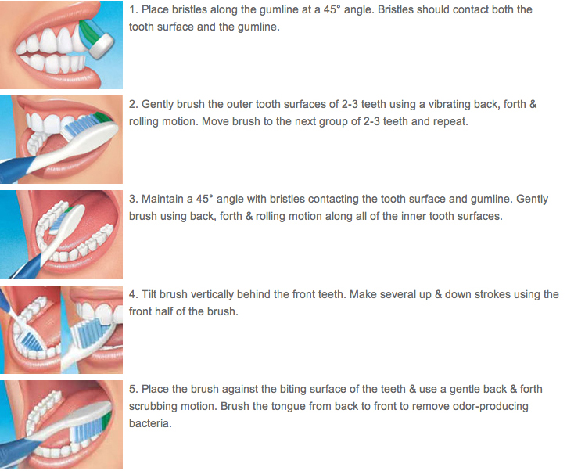
Modified bass toothbrushing technique
In addition, make sure to choose a soft-bristle toothbrush (it says it in the packaging when you purchase it) in order to prevent abrasion and gum recession.
Also, do not put too much pressure when brushing. You should be using 150 to 200 grams.

Slide 11
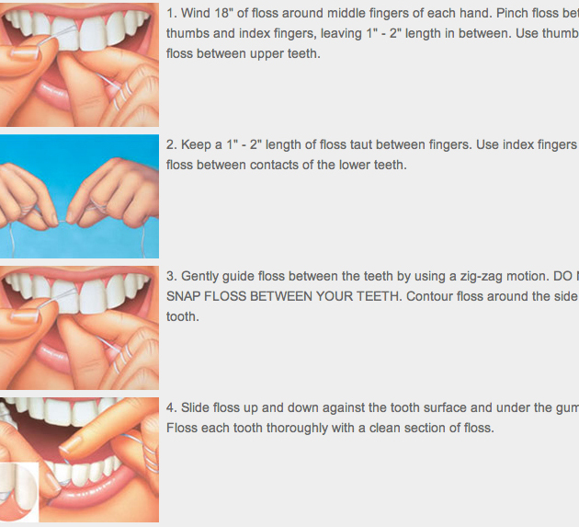
Flossing
Furthermore, if do not think the standard floss is right for you we recommend trying the following options:
Super-flosses
Dental Tape
Soft-Picks
Disposable Floss-picks
Electric Water flossers

Slide 12
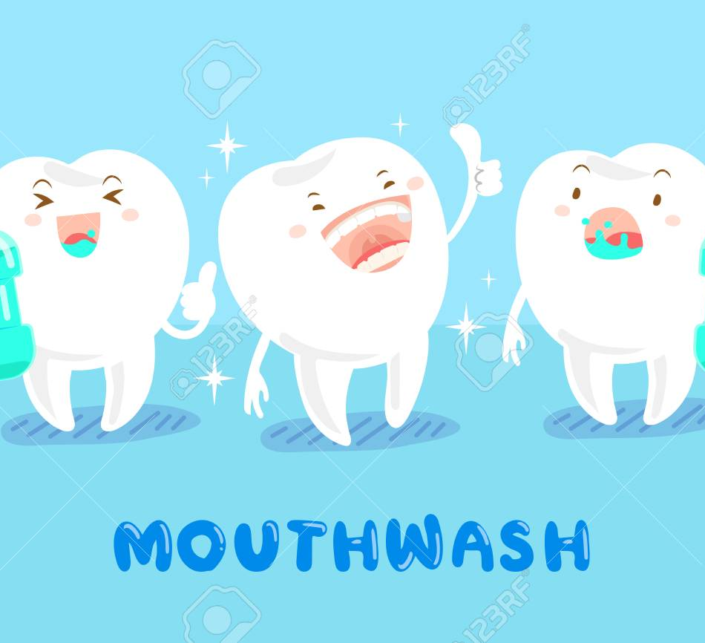
Mouthwash
Lastly, don’t forget to rinse with a fluoridated mouthwash before bed.

Slide 13
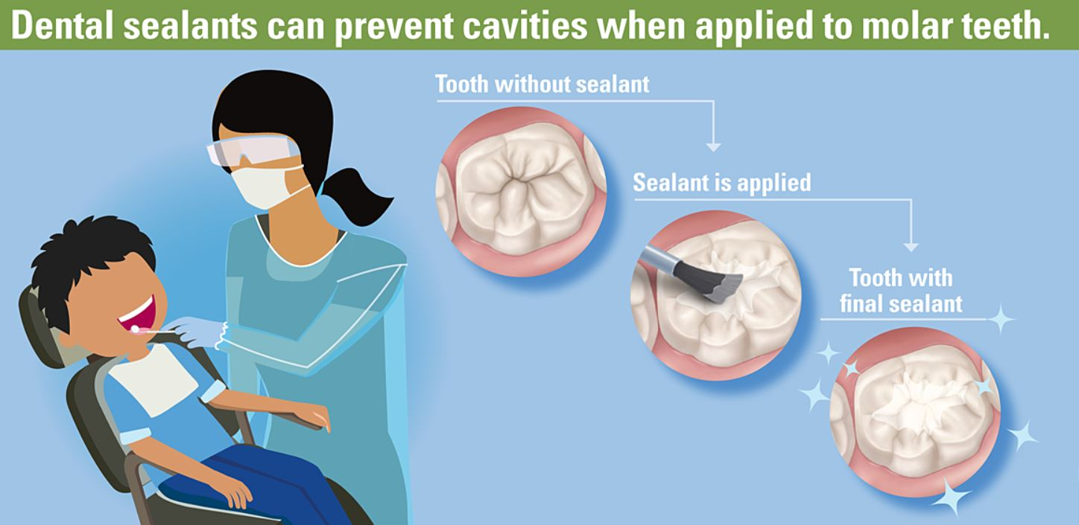
Sealants

Slide 14
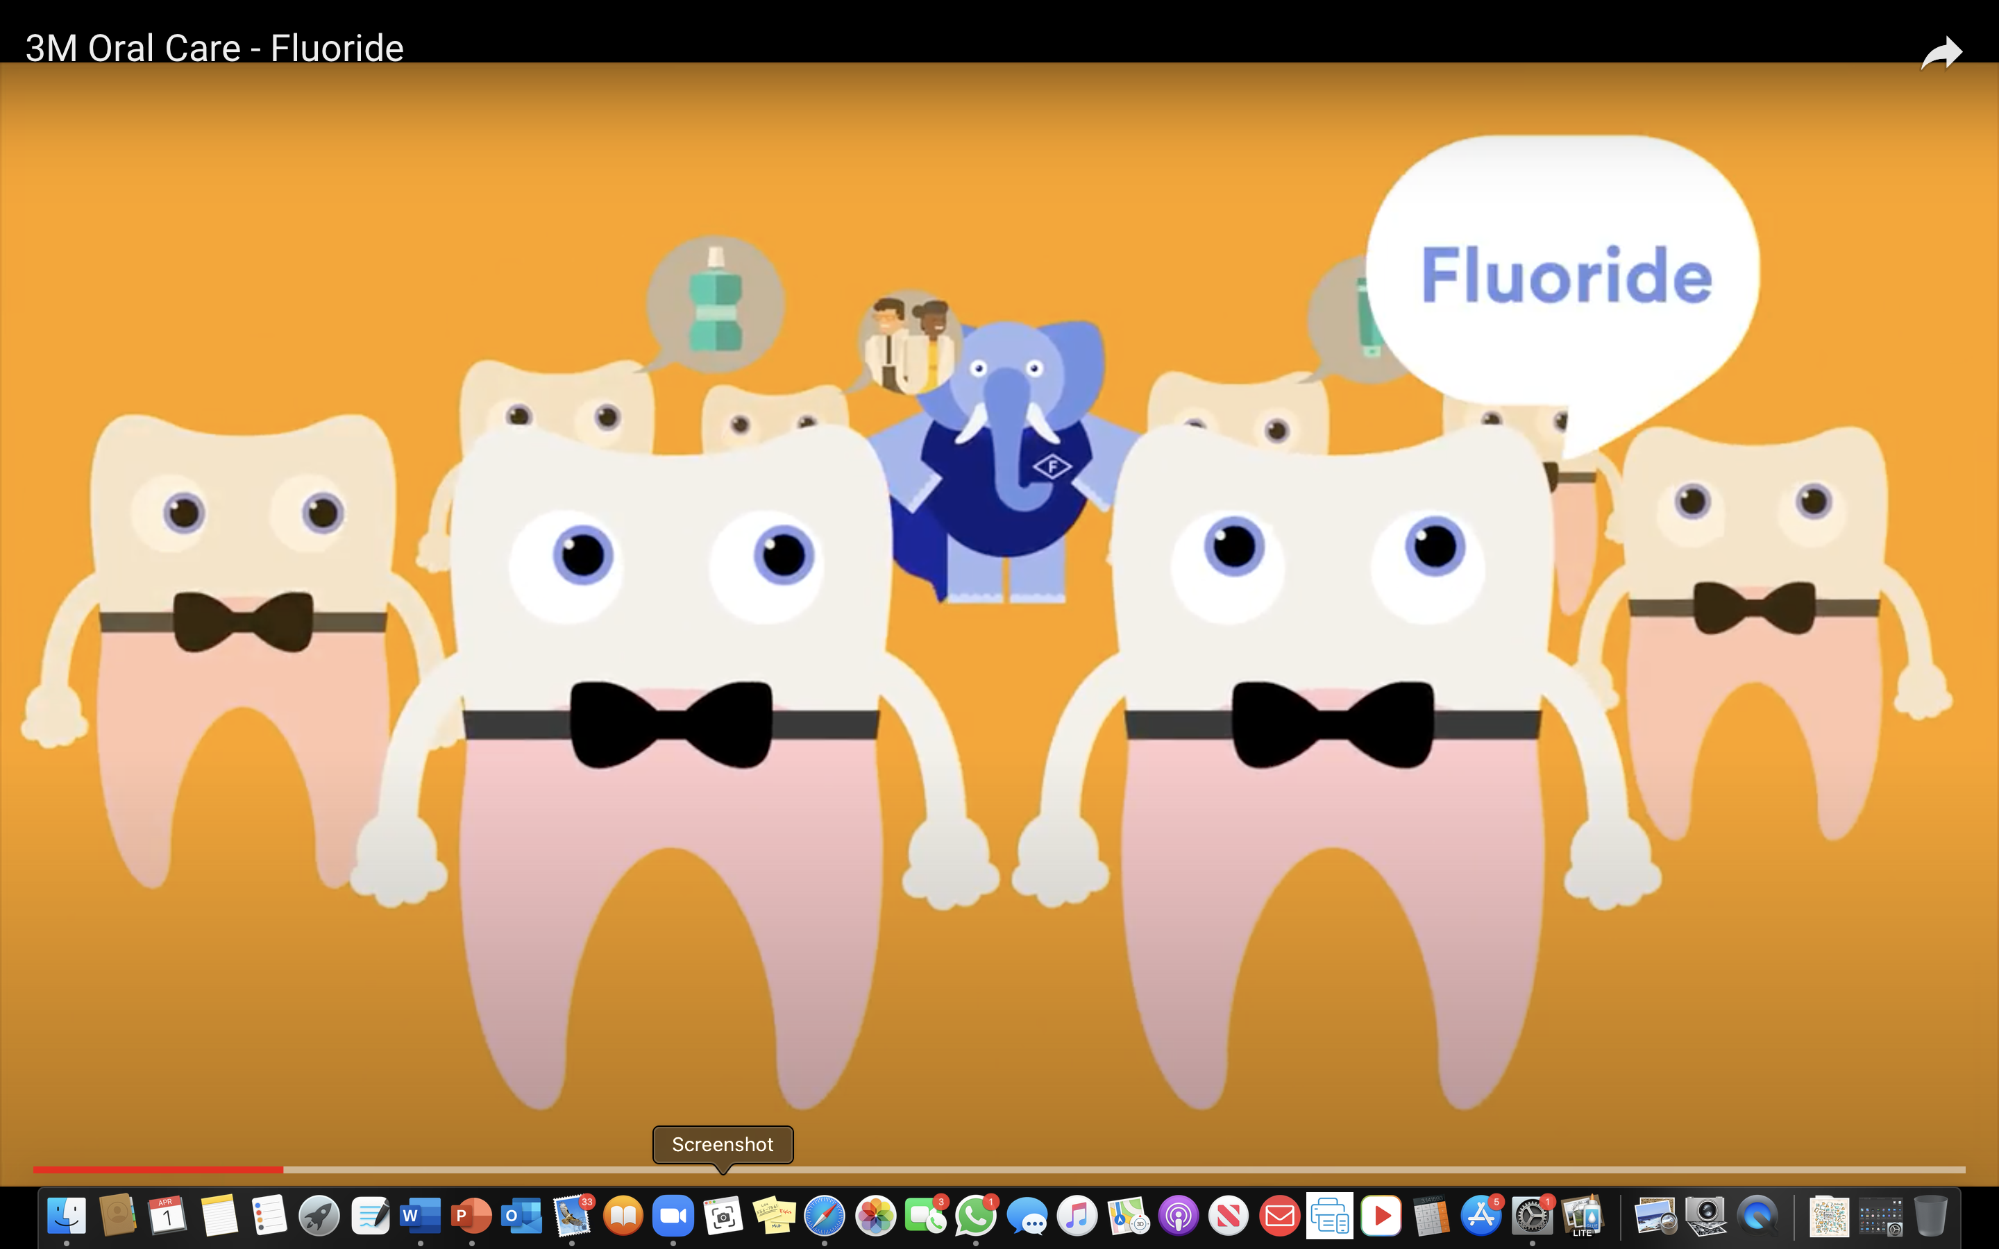
Short film about Fluoride
https://youtu.be/CCh8RRpWC90

Slide 15
Implementation Nazwa Munia
Since the program will be conducted online, the needed materials include an accessible social media platform that all parents can easily use. Therefore, the twiducate is the most appropriate for this program. All the parents enrolled in the program will be provided with a code to log in. This will ensure that privacy is maintained because only those with the code can access the information posted. Questionnaires will also be developed that contain a question to be used during zoom sessions to assess each parent's progress. Therefore, each parent must be informed of the particular time when zooming will be conducted so that no one misses out.

Slide 16
Video courtesy- American dental association (ADA) https://youtu.be/kuLxz5IrZ6Y

Slide 17
Let’s check what we remember!
What is the appropriate age for children to start brushing their teeth?
A) 1 year old
B) As soon as teeth appear

Slide 18
answer
B) As soon as teeth appear

Slide 19
What else do we remember?
For children between the age of 3-6 years, how much toothpaste should be used?
A) Rice grain size
B) Pea size

Slide 20
answer
B) Pea size

Slide 21
One more time…
At which angle toothbrush should be positioned for brushing?
A. 45-degree angle
B. 90-degree angle

Slide 22
answer
A) 45-degree angle

Slide 23
You have completed the quiz!

Slide 24
Evaluation & Resources Parvina Akhmadalieva
For parents who don’t have access to affordable dental care, we have provided educational facilities, hospitals or free clinics.
These affordable clinics and facilities prices ranges from $20-$80

Slide 25
Affordable clinics
NYC Free Clinic
230 W 17th St
(212) 206-5200
Emergency Dentist NYC
100 E 12th St
(646) 336-8478
209 NYC Dental
209 E 56th St1st floor
(212) 355-2290

Slide 26
Services that will be provided
Head and neck exam
Oral cancer screening
Dental prophylaxis
Home care education
Fluoride treatment
Dental check-up by a dentist.

Slide 27
Conclusion Parvina Akhmadalieva
The importance of oral health cannot be emphasized enough. The role that parents play in providing their children with good oral care at the beginning stages of their lives is also essential to the child’s quality of life. Caries are avoidable and as dental hygienists we believe in prevention rather than repairing and maintaining, that is why we choose to educate parents so that they can teach their young ones and help them develop a good oral hygiene routine that can be maintained into adulthood. It is our duty to educate the public on the importance of oral health, while being sympathetic to different economic status and different cultural beliefs.

Slide 28
Q & A
Does anyone have any questions?

