Slide 1
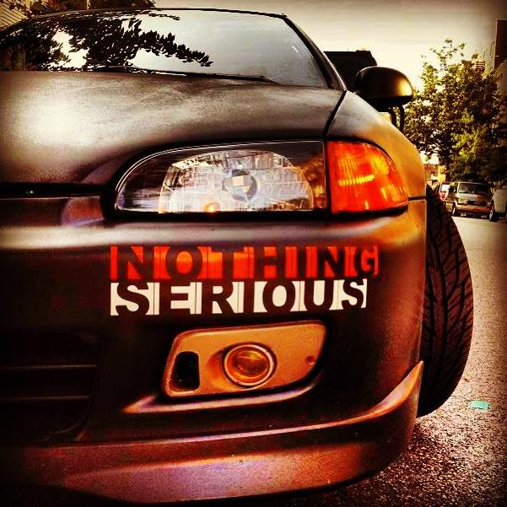
Nothingserious

Slide 2
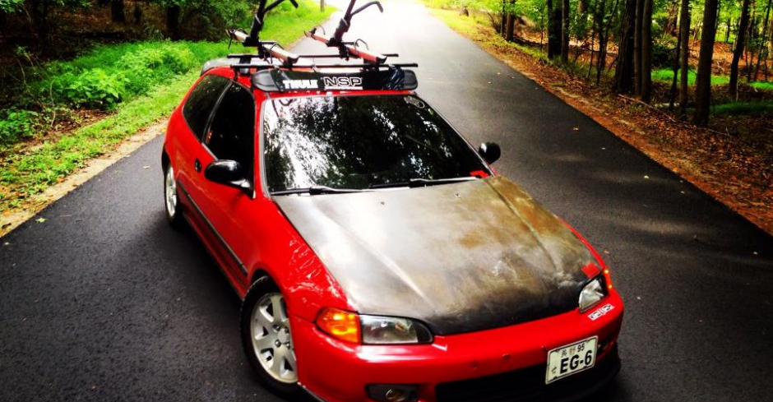
About the Blogger Under my hood
My name is Omkar Singh
1995 Honda Civic EG Hatch
The New York City College of Technology CUNY. Major in Advertising & Design
Vehicle History
NothingSerious Car Club

Slide 3
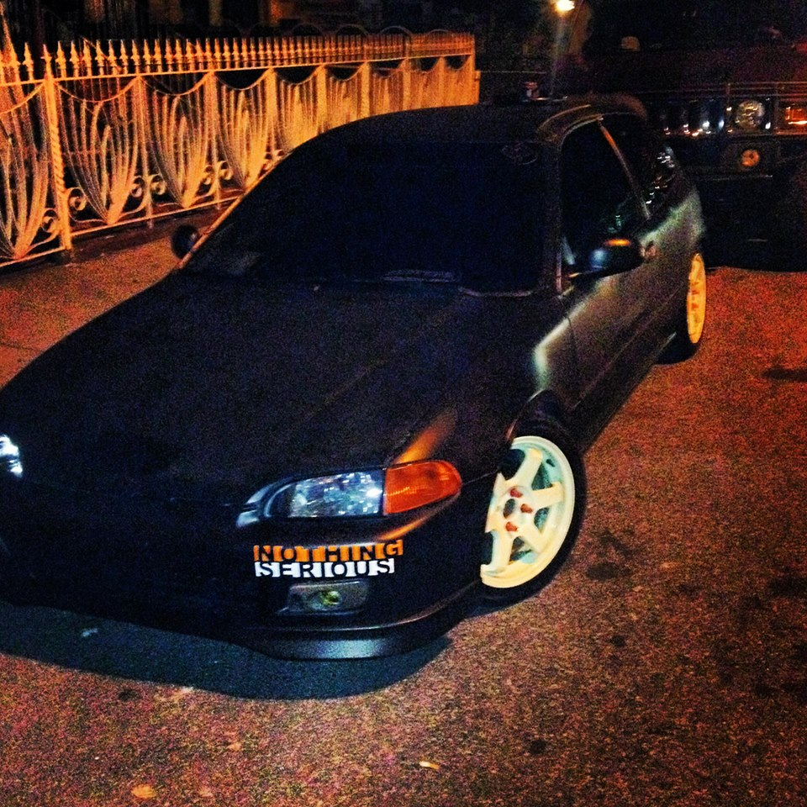
Mission statement @ the start line
The mission of this blog is to help you find everything you need to turn your vehicle into a speed machine all in one place. Going from site to site can be time consuming and frustrating. What I hope to accomplish with this blog is to help you find what your looking for easily and fast. What makes my blog different is that I am one of you, not a mechanic but someone who likes to be hands on with their car. Customizing your vehicle is a special bond that the owner of the car shares with his or her vehicle. With my blog, I will have all the information that I know as well as the members of the Nothing Serious Car Club as your disposal.

Slide 4
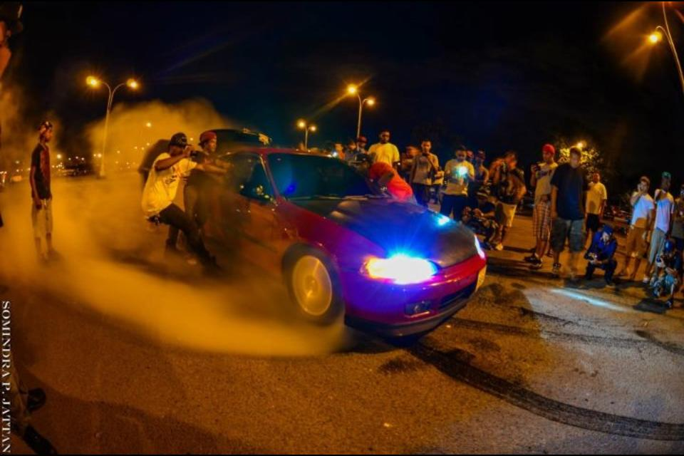
Typical single post I want to brag a minute
The kind of car I drive
The modifications that I did to the car
The reasons behind the modifications
I Want To Brag A Minute

Slide 5
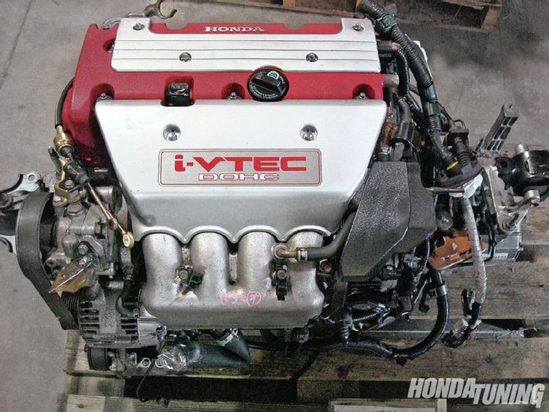
Typical blog series make it go faster 4 part series
Introduction into why most people swap out engines
Where you can purchase engines at reasonable prices
What you should be looking for when shopping for engines
Installation
Entire series based on personal experience

Slide 6
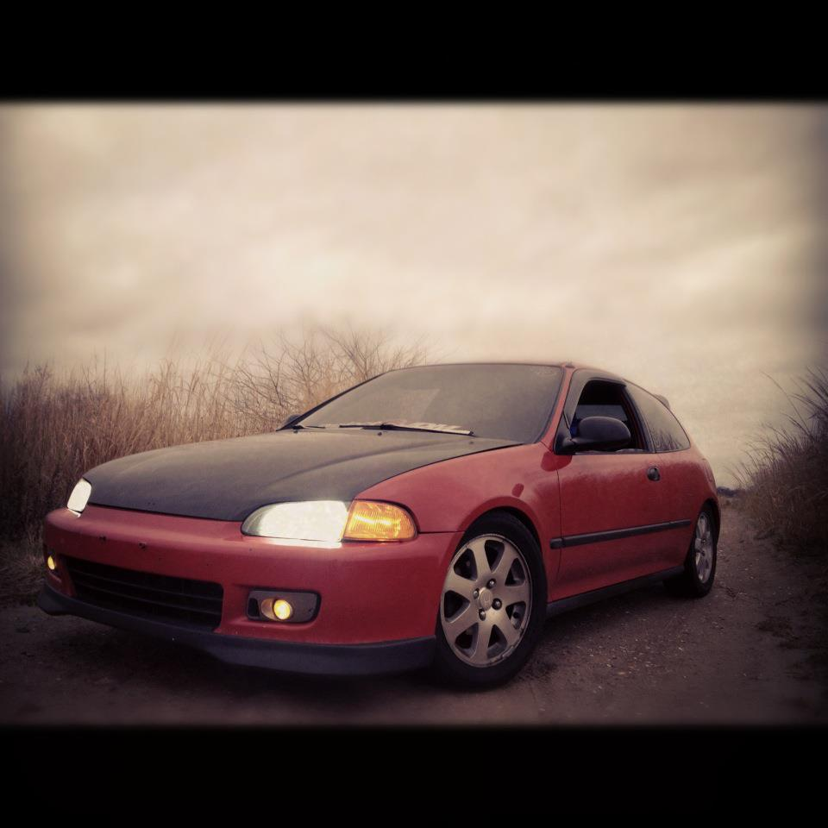
Closing Crossing the Finish Line
I wanted a blog that would help people who didn’t know what or how make their car faster. It basically was meant to show people the different ways you can modify your car for better performance and style. A racer’s style guide for dummies.

