Slide 1
Octavia Miles
Sociology Of Urban Poverty: Final Project
Have The Negative Stereo-types Of How African American Women Are Seen In The Media Changed?

Slide 2
Some History
During the 1900’s African Americans had specific stigmas attached to them know as their performance character names such as;
The Coon : Undignified Person
The Tragic Mulatto: A person who can pass for white, but they white heritage wants nothing to do with them.
Mammy: Often over-weight , servant like, protective of the interest of whites, fierce and independent.
Jezebel : Seen as alluring, sexual seductive lures men into her bed for sexual pleasure, and valuables

Slide 3
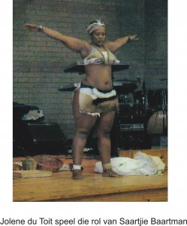
Where It All Started
Introducing Sarah Baartman
Sarah Baartman was know as the 1st what we know now as a video vixen. She was a slave in Cape Town , and was discovered by a British doctor who pursued her to travel with him to England . Sarah’s large buttocks and genitals had the Europeans obsessed with her body structure. Her physical body characteristics lead her to huge prejudice and granted her a one way ticket to being treated as a freak and put on display in London.
She gained the name Hottentot Venus , this name quickly gained derogatory connections. She began in London for four years and moved along to Paris where she continued her degrading shows and exhibitions. Once they became bored with her shows, she was forced to turn to prostitution. This life style was to much for her and she died of infection what can be know now as “Syphilis” at the age of 25.

Slide 4
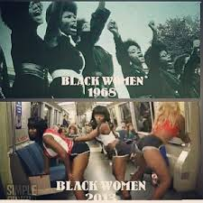
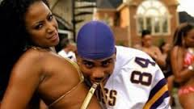
Derogatory Caption’s Today
What do these females call themselves today?
Bad B*tches
Barbie
Thot’s
Gold Digger
Video Vixen
Nympho

Slide 5
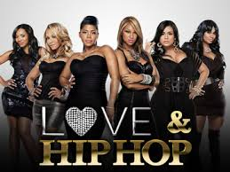
Has History Repeated Itself?
Females in today’s society seem to be very comfortable with these negative derogatory categories we are placed in. We are now watching music video's with young women being half necked and disrespected upon lyrics of many rap songs. Not only does the disrespect show in our music, but there are now popular high rating TV shows such as; VH1’s Love and Hip-Hop, and Oxygen’s Bad Girls Club. In my opinion the only thing that has change from the past to now is the technology in the way that these women are being exploited and we have a right to make a choice of participating or not. Main stream media outlets are becoming more popular and placing influence on our youth as technology grows. Have we really moved far from history? Or Are we just continuing on with these advancing stigma’s today?

Slide 6
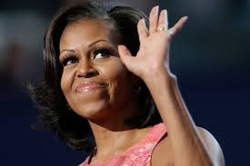
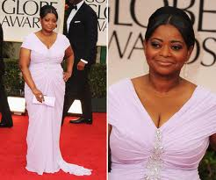
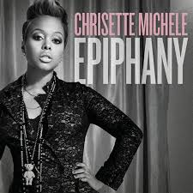
My Reason
I Choose this topic because it hits at home in some ways. As a young black female growing up in a house hold full of females I learn to value myself more than just my looks. As a young lady I feel I am not able to feel comfortable in my own skin because I have the media saying that its okay to be over sexualized in society. People of my generation seem to live there lives as if there on TV, and I believe the media has a lot of responsibility on how people act in my generation. Even though we have plenty of inspirational powerful African American females figures displayed on the media, these negative stigmas still sticks around. Will we rise up to promote change or will we continue selling our souls and degrading our race?

Slide 7
Social Media
http://instagram.com/p/hvyT5Bx4qy/
http://instagram.com/p/hy3hMZx4pc/
http://instagram.com/p/hzB7HXR4oT/
http://instagram.com/p/hzF7N7R4uN/
http://instagram.com/p/hzINOhx4hi/
http://instagram.com/p/hzNNkOx4oi/

Slide 8
Sources
http://jotwice.blogspot.com/2011/11/black-venus-sarah-baartman-story.html
http://msmagazine.com/blog/2011/02/02/how-nicki-minaj-stumbled-onto-black-history/
http://downtrend.com/71superb/la-times-critical-of-michelle-obama-no-really/
http://www.yazmar.com/2012/01/16/idris-elba-octavia-spencer-wins-golden-globe/
http://madnewsuk.com/tag/nicki-minaj/
https://kikospeaks.wordpress.com/tag/physical-representations/
http://awomynsworth.com/tag/black-women/

