Slide 1
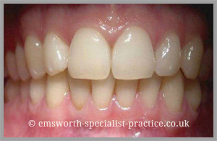
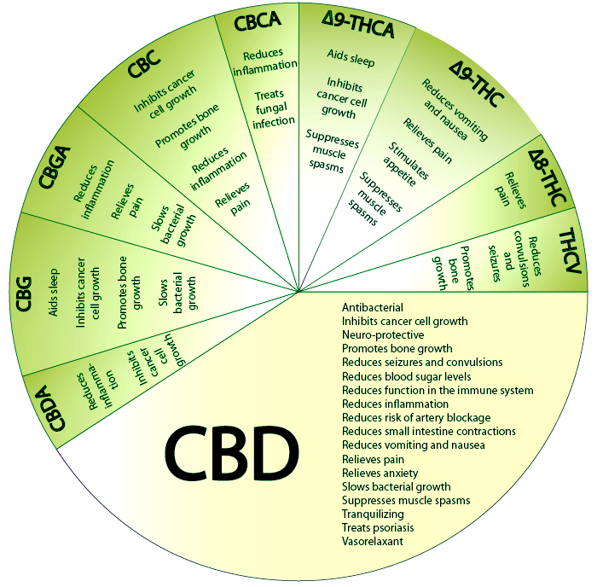
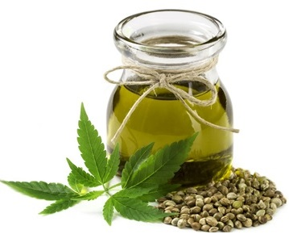
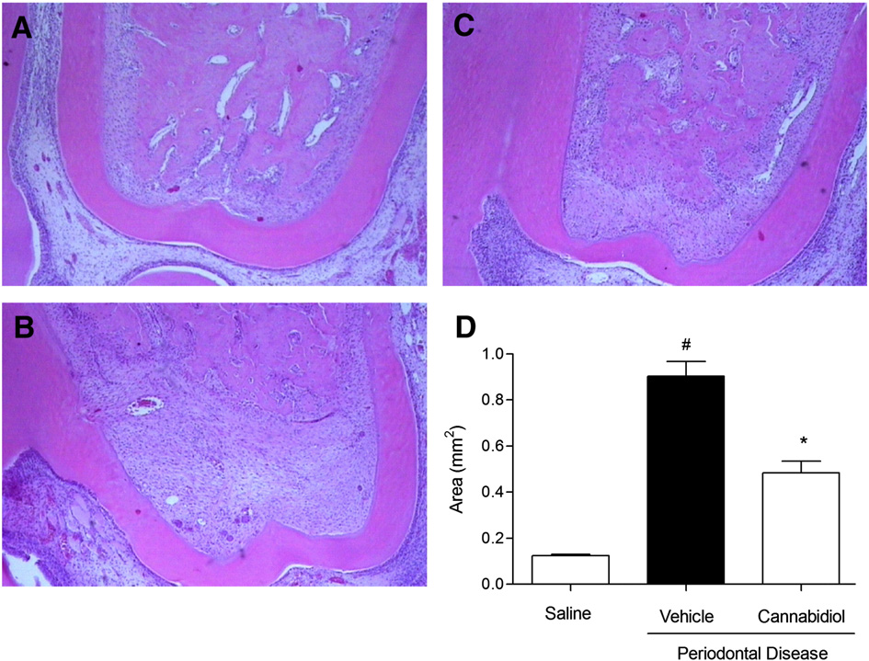
The Benefits of Cannabidiol in Dentistry
and Dental Hygiene
Olga Gorokhovskiy, Rachel Pinhas and Nazrin Akbarova, B.S.
New York City College of Technology
INTRODUCTION
CDB IN DENTAL HYGIENE
Cannabinoids are a group of bioactive organic molecules which work together with neurotransmitters, by connecting to special endocannabinoid receptors, and help to regulate different processes in a human body.
There are three types of cannabinoids:
Endocannabinoids –can be produced in a human body (anandamide AEA and 2-arachidonoylglycerol 2AG);
Phytocannabinoids, derivatives from plants (CBD and THC);
Synthetic cannabinoids produced in laboratory.
What is Cannabidiol(CBD)?
Cannabidiol, or CBD is a natural non-psychotropic
cannabinoid, which can be found in plants, particularly
in Cannabis sativa. This plant includes more than
545 substances, differently influencing the body.
Another cannabinoid –THC, or tetrahydrocannabinol, has psychoactive properties and is the reason why marijuana is the most commonly used drug in the world.
According to research, CBD has anti-inflammatory, antioxidant and immunomodulatory action and does not possess any psychoactive properties. Cannabidiol shows promising results in treatment of systemic diseases such as multiple sclerosis, chronic pain, diabetes, various types of cancer, epilepsy and Alzheimer’s disease.
Chemical constituents obtained from medicinal plants and other natural products have been increasingly used to treat many inflammatory diseases
Studies have proven that the administration of Cannabidiol significantly inhibited the volume of bone loss in experimental periodontitis
A study conducted showed that CBD was effective when administered I.P (immunoprecipitation) or orally in a collagen-induced arthritis model demonstrating clinical improvement associated with protection of the joints against severe damage.
Anti-inflammatory and anti-bone restorative CBD properties were able to reduce alveolar bone loss in ligature-induced periodontitis.
Role of the Dental Hygiene Professional
• The topic of cannabidiol in dentistry is fairly new, therefore dental professionals have a responsibility to research the topic and be familiar with new studies.
• The dental professional must educate patients on the different types of cannabinoids available and how they might be beneficial to the patient’s treatment and oral health.
Fig 3. Benefits of CBD Oil and
other Cannabinoids.
https://www.midwestcompassion.org/
2016/05/04/cbd-strain-information/
Fig 1. Difference in Chemical Makeup of CBD and THC
https://ars-els-cdn-com.citytech.ezproxy.cuny.edu/content/image/1-s2.0-S0968089615000838-fx1.jpg
CBD IN DENTISTRY
Anti-inflammatory action of CBD
Antioxidant
Control of symptoms of
burning mouth syndrome
In the area of dentistry, only one experimental
study of CBD was conducted, which was carried out
in a rat model with induced periodontitis.
After 30 days of treatment with 5mg/kg CBD daily, morphological analysis demonstrated that the animal treated with the compound exhibited a regional decrease of alveolar bone loss, which was measured by a decreased expression of bone related molecules RANK and RANKL and a decreased production of IL-1β, and TNF-α.
Further controlled studies in humans need to be done in order to research the most optimal clinical use for CBD in treatment of periodontal disease.
Endocannabinoid system can be also successfully used in periodontal healing. The study shows that cannabinoids facilitate proliferation of gingival fibroblasts via CB1/CB2 receptors in periodontal wound healing in experiments also conducted on rats.
The use of CBD in the area of dentistry has been studied little, and its effects in the treatment of oral diseases are not well known. Nonetheless, considering its properties, mechanisms of action and favorable results in treating other complex diseases, it is believed that it can exert a positive therapeutic effect on some pathologies like OM (Oral Mucositis) that are still challenging.
CONCLUSION
http://www.bodybutterlady.com/pure-hemp-seed-oil/
It is experimentally established that the CBD has a number of beneficial medical properties: antipsychotic, anticonvulsant, anti-inflammatory, antioxidant, anticancer, antidepressant and analgesic.
The studies investigating the beneficial effect of cannabidiol on oral health should be encouraged, although the data on the CBD use in dentistry is still scarce.
The Endocannabinoid system of the human body can be successfully used in treatment of a wide range of oral health problems.
Fig. 2. Decrease of the alveolar bone resorption in the experiment with artificially induced periodontitis.
Micro images of first molars after 30 days of experiments (staining with H&E). (A) Control animals, (B) ligature-induced periodontitis treated with vehicle (2% of Tween 80 and saline) for 30 days, (C) ligature-induced periodontitis treated with CBD (5 mg/kg; i.p.; daily for 30 days). (D) The mean areas of resorbtion (mm^2) on the graph. Results are expressed as mean±SD of 10 animals per group.
#p < 0.05 compared to control animals; *p < 0.05 compared to ligature-induced periodontitis animals treated with vehicle (ANOVA, followed by Bonferroni's test).
REFERENCES
Abidi, A.H., Presley, C.S., Dabbous, M., Tipton, D.A., Mustafa, S.M., & Moore, B.M. (2018). Anti-inflammatory activity of cannabinoid receptor 2 ligands in primary hPDL fibroblasts. Archives of Oral Biology, 87, 79-85. https://doi.org/10.1016/j.archoralbio.2017.12.005
Burstein, S. (2015). Cannabidiol(CBD) and its analogs: a review of their effects on inflammation. Bioorganic and Medicinal Chemistry,23, 1377-1385. https://dx.doi.org/10.1016/j.bmc.2015.01.059.
Cassol-Jr O.J, Comim C.M, Silva B.R, Her-mani F.V, Constantino L.S, Felisberto F et al. Treatment with cannabidiol reverses oxidative stress parameters, cognitive impairment and mortality in rats submitted to sepsis by cecal ligation and puncture. Brain Res, 2010;1348:128–138.
Cuba, L.F., Salum, F.G, Cherubini, K., & Figueiredo, M.A.Z. (2017). Cannabidiol: an alternative therapeutic agent for oral mucositis? Journal of Clinical Pharmacy and Therapeutics,42, 245-250. https://doi:10.1111/jcpt.12504.
Kozono, S., Matsuyama, T., Biwasa, K.K., et al. (2010) Involvement of the endocannabinoid system in periodontal healing. Biochemical and Biophysical Research Communications , 394 (2010) 928–933.
Napimoga, et al. (2009) Cannabidiol decreases bone resorption by inhibiting RANK/RANKL expression and pro-Inflammatory cytokines during experimental periodontitis in rats. International Immunopharmacology, Vol. 9, no. 2, 2009, pp. 216–222.
Pan H, Mukhopadhyay P, Rajesh M, Patel V, Mukhopadhyay B, Gao B et al. Cannabidiol attenuates cisplatin-induced nephrotoxicity by decreasing oxidative/ni-nitrosativestress, inflammation, and cell death. J PharmacolExpTher, 2009;328:708–714.
Tweed, V. (2018). Best way to use Hemp CBD oil. Betternutrition,Feb.2018, 10. http://issuu.com/aimmedia/docs/betternutrition_feb2018_supplementc?e=1877032/58846700
Presented at the 94th Annual Session of the Greater New York Dental Meeting in 2018

