Slide 1
Case 2
By Orlane Fontalvo

Slide 2
Patient profile
K.C is a 26-year-old Hispanic female.
Patient notes to not have dental insurance and has not gotten cleanings in a while.

Slide 3
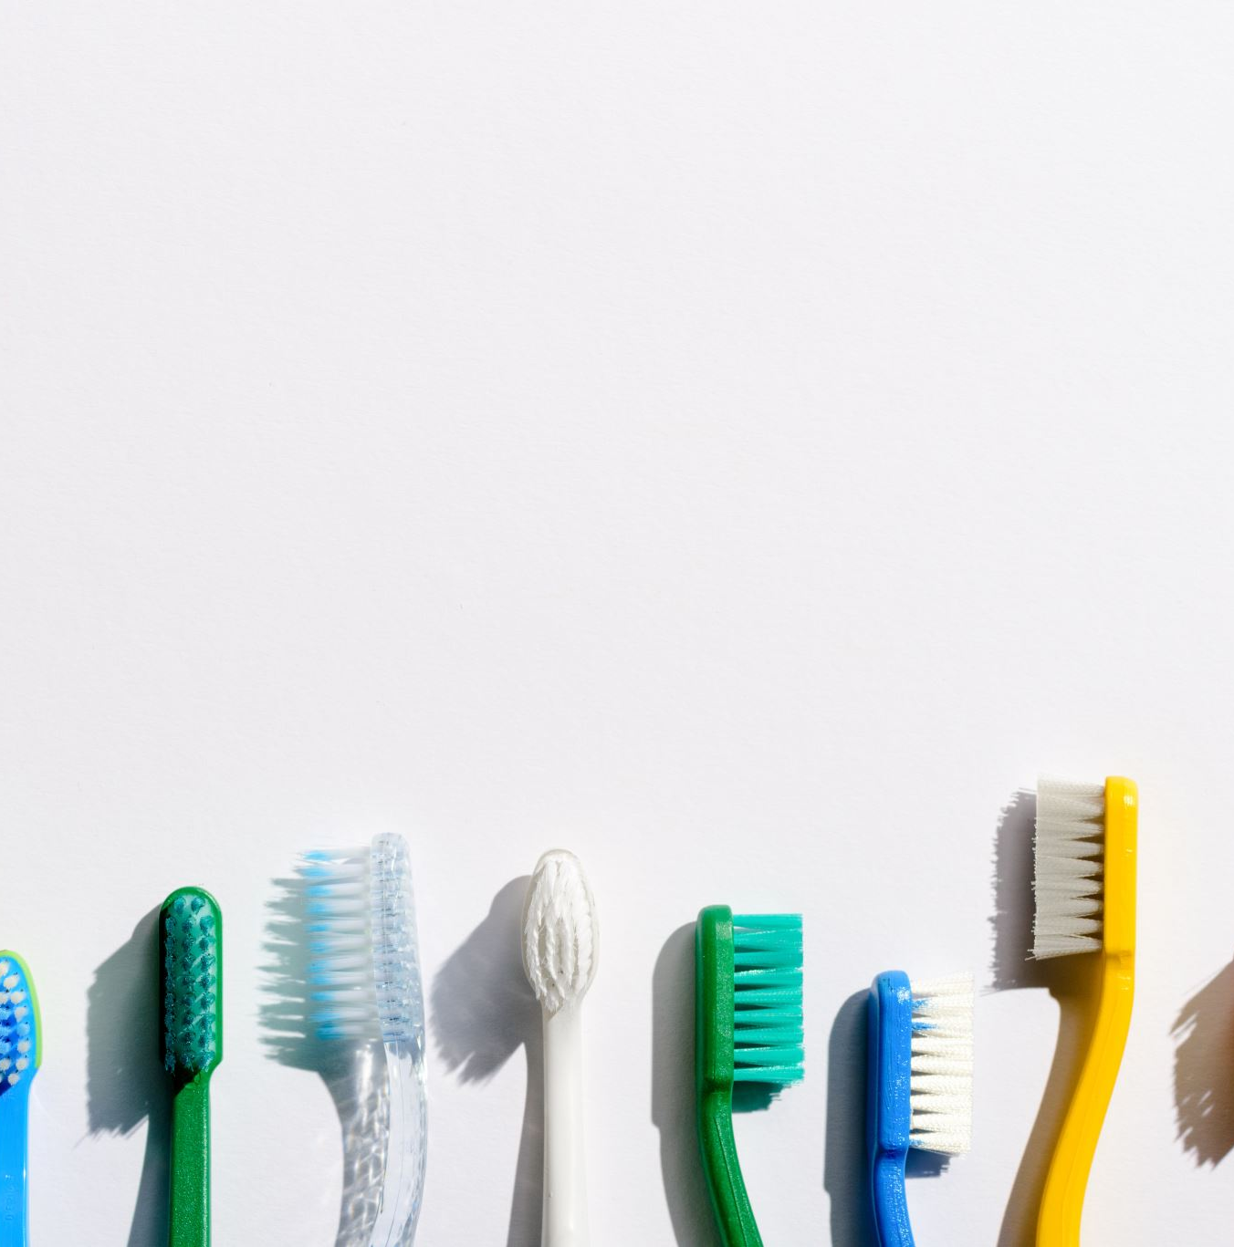
Chief complaint
Patient wanted a cleaning and to know the condition of her dental health.

Slide 4
Initial visit
Reviewed medical history
Clinical assessments
Dental charting
Periodontal charting
Case type and periodontal status
Radiographs taken
Scaling started

Slide 5
Health history
ASA II
Patient had Lyme disease in September of 2020 and was treated
Since 2012 at age 18, patient was diagnosed with hypertension. Patient informs us of history of hypertension from both sides of the family
She takes Labetalol 100mg 2x/daily for hypertension
Blood pressure readings at visits:
Initial visit 1st BP:136/92
Final visit 1st BP:153/102, 2nd BP: 148/100, 3rd BP:135/103
Patient was cleared for treatment by the supervising dentist.

Slide 6
Explanation of condition (hypertension)
A common condition in which the long-term force of the blood against your artery walls is high enough that it may eventually cause health problems, such as heart disease, lead to stroke and kidney disease.
Blood pressure is determined both by the amount of blood your heart pumps and the amount of resistance to blood flow in your arteries. The more blood your heart pumps and the narrower your arteries, the higher your blood pressure.
https://www.mayoclinic.org/diseases-conditions/high-blood-pressure/symptoms-causes/syc-20373410

Slide 7
How to manage condition
Often check blood pressure
Patient should make it a priority to eat healthy
Be as stress free as possible
Taking medication as prescribed
https://www.mayoclinic.org/diseases-conditions/high-blood-pressure/diagnosis-treatment/drc-20373417

Slide 8
Dental consideration
Blood pressure should be taken at every visit
Must understand antihypertensive medications may cause oral/dentofacial adverse effects
Although vasoconstrictors in local anesthetics are rarely contraindicated, the potential for cardiovascular stimulation (e.g., increased heart rate, increased blood pressure) following inadvertent intravascular injection may cause dental practitioners to reduce or avoid vasoconstrictor-containing formulations in individuals with cardiovascular compromise
https://www.ada.org/en/member-center/oral-health-topics/hypertension

Slide 9
Dental history
Patient did not receive cleaning in 3-4 years
Patient brushes 2x/day with soft manual toothbrush with Colgate toothpaste
Periodically flosses
Uses Listerine 1x/day

Slide 10
Clinical findings
Extra-oral findings: Periodically popping of tmj with no pain.
Intra-oral Findings: Mandibular bilateral tori, mild change of pigmentation on anterior tongue.
Oral pathology: 3x3 round raised papule with pink center and white circular boarder
Patient was made aware and given a referral
Hard tissue:
Class of occlusion- III bilaterally
Overbite- 40%
Overjet- 3 mm
Attrition: #6-11 & #22-27
Gingival statement: Generalized pink gingiva, interdental papilla fits snugly around the tooth, with localized inflammation on mandibular anteriors with localized recession on anteriors.

Slide 11
Dental charting
Patient had occlusal composites: #2-5, #12-21, #28-32
Missing teeth: #1

Slide 12
Patient case type
Plaque induced gingivitis with light deposits

Slide 13
Radiographic findings
Horizontal bitewings taken
No bone loss, cavities or calculus found

Slide 14
Treatment plan
Teach modified Bass toothbrushing technique fist visit and flossing second visit
Take horizontal bitewing
Engine polish on last visit
Administer 5% fluoride varnish and give post op instruction

Slide 15
1st visit
All assessments done
Bitewing radiographs taken
Modified Bass method taught as OHI
1st quadrant scaled
Referral given for papule

Slide 16
2nd visit
Due to high blood pressure patient had to take blood pressure throughout the appointment.
Supervising dentist cleared for visit.
Patient did not follow up with referral given last visit
Flossing was taught as OHI
Full mouth scaled
Selective engine polishing was preformed.
5% Fluoride varnish administered with post op instructions
Recare was set for 6 months.

Slide 17
Final reflection
Patient enjoyed being shown each procedure to learn about her oral health.
Blood pressure should be monitored very carefully.
Patient showed that she improved her brushing technique with plaque score.
With high blood pressure at such a young age consider nutritional counseling.

