Slide 1
a step-by-step guide to submitting your OER syllabus to Academic Works
Prof. Monica Berger NYCCT Library May 29, 2019

Slide 2
Get ready to submit
find your syllabus or course outline related to your OER

Slide 3
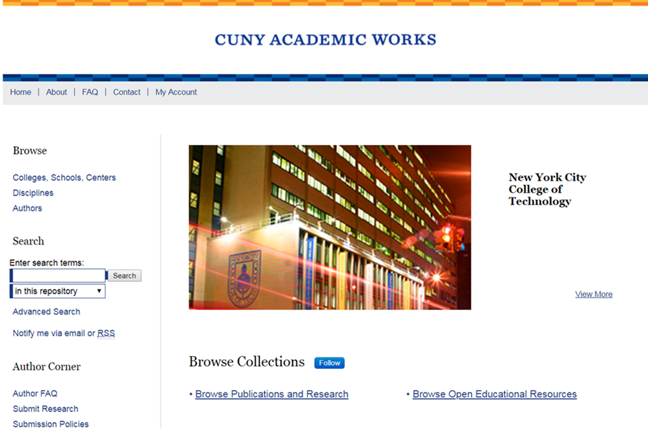
Step 1 Go to CUNY Academic Works https://academicworks.cuny.edu/

Slide 4
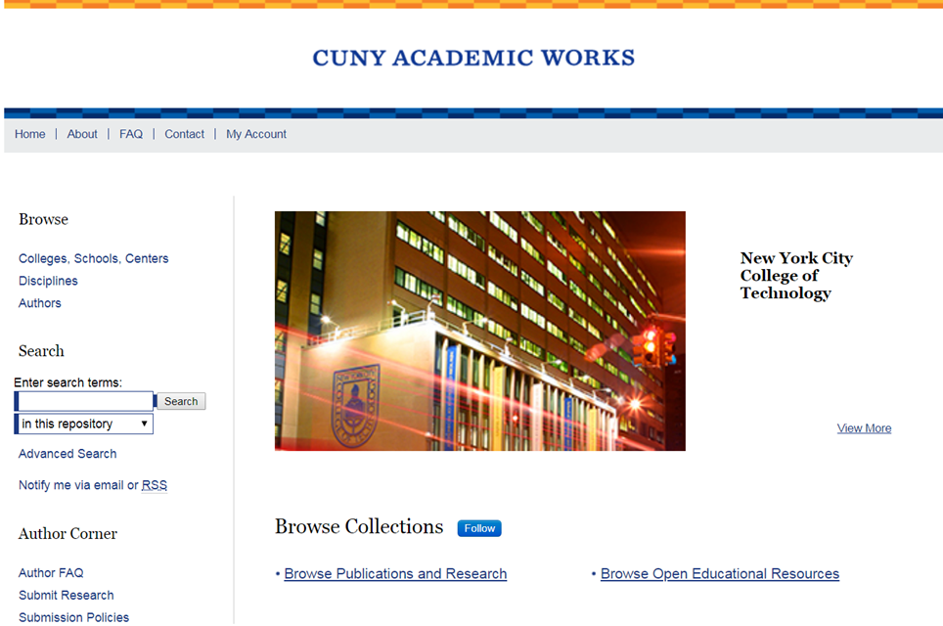
Step 2 Under AUTHOR CORNER, select SUBMIT RESEARCH

Slide 5
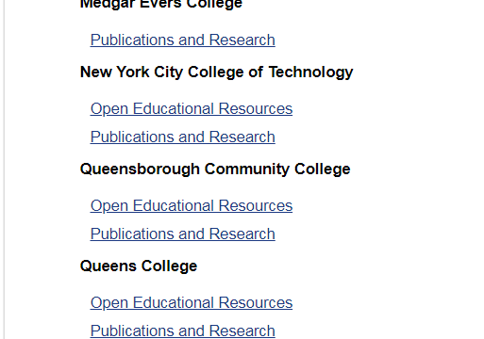
Step 3 Browse to NYCCT and select OER

Slide 6
Step 4 login (or create new account)

Slide 7
Step 5 fill out the form: title. Be explicit and descriptive= MAT 2675 Calculus III, Spring 2019, OER Syllabus

Slide 8
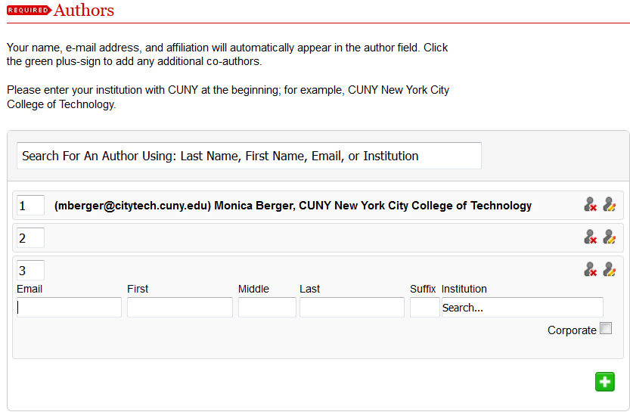
Step 6 fill out the form: authors. If you have a co-author, asking their permission to add to Academic Works is a courtesy but not a requirement. Click the green button to add an author

Slide 9
Step 7 affiliations at CUNY. Click on NYCCT to expand and then select your department to the right hand box

Slide 10
Step 8 document type. Select from the dropdown menu and pick syllabus

Slide 11
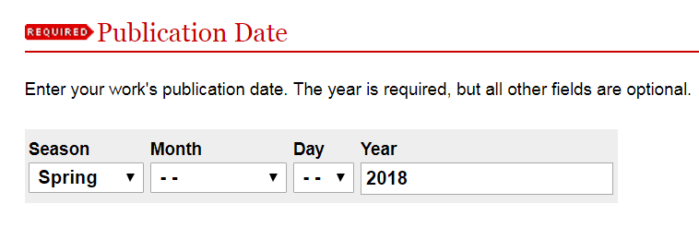
Step 9 publication date: pick the semester (season) and year of your OER fellowship

Slide 12
Step 10 embargo period: ignore

Slide 13
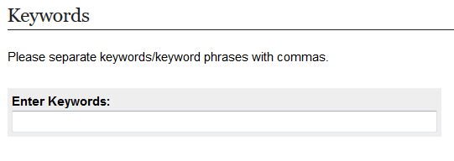
Step 11 keywords: OPTIONAL

Slide 14
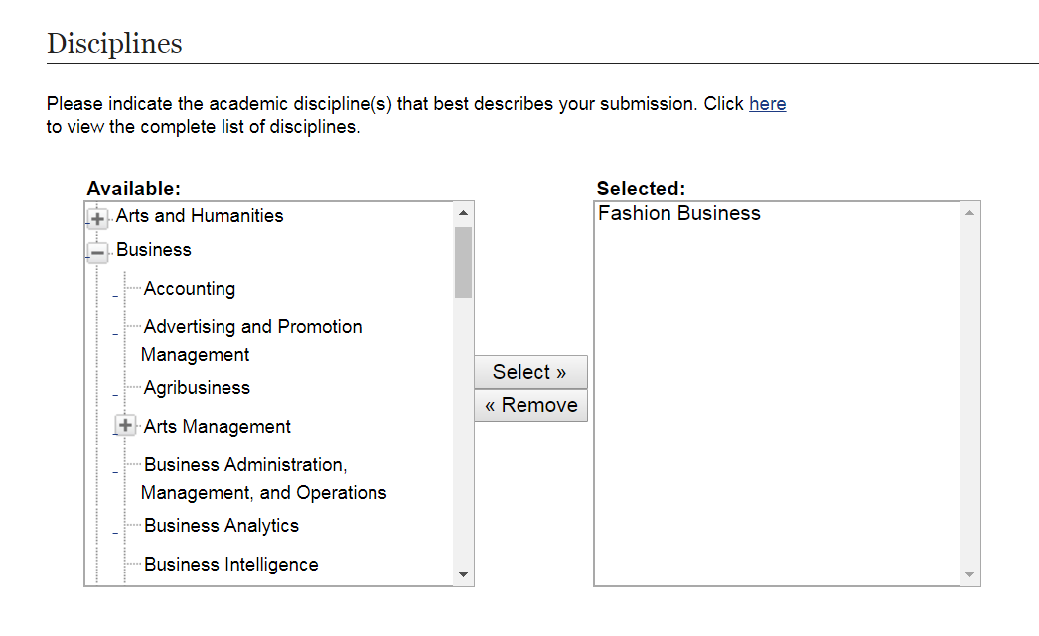
Step 12 disciplines. Add the discipline that maps to the OER

Slide 15
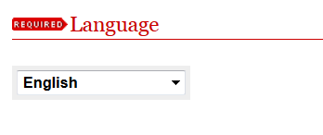
Step 13 language. Select from the dropdown menu

Slide 16
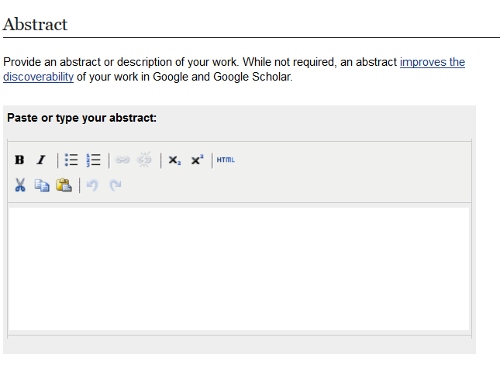
Step 14 abstract. Ignore

Slide 17
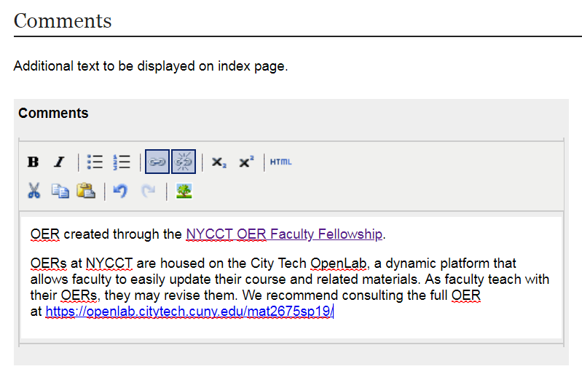
Step 15 comments: please consider adding this boilerplate text including the link to the actual OER

Slide 18
Step 16 Creative Commons license. Select CC BY NC SA (Creative Commons Attribution-Noncommerical-Share Alike 4.0)

Slide 19
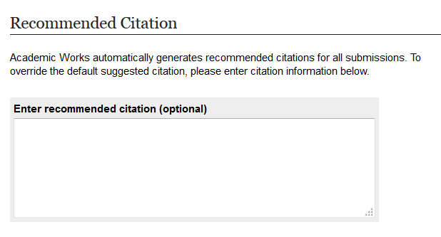
Step 17 citation. Ignore

Slide 20
Step 18 upload the file

Slide 21
Step 19 additional files: upload supplemental material including handouts (OPTIONAL)

Slide 22
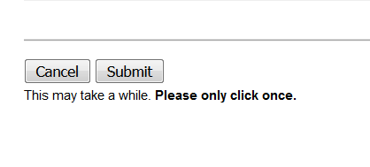
Step 20 SUBMIT. Now your submission will go to an administrator for approval. If no changes are needed, it will go live after a brief delay

Slide 23
That’s it. Hurrah!
Need help? Call Monica Berger at 260-5488 or mberger@citytech.cuny.edu
we can also work in person at your desk or mine

