Slide 1
Make use of these resources:
Accessible Syllabus Template
Accessible Syllabus Checklist
Notes:
Accessible Syllabus template: https://docs.google.com/document/d/1yGcYAHxCGLNPKU3y5Y8fn2qsC66Wgs8csJGvidT8ipc/edit?ts=5e73b350#
Accessible Syllabus checklist: https://docs.google.com/document/d/1ypOoxDGDK5zGmXtP2BfZ4wwf1-beYNFacYPHLUZZe4E/edit

Slide 2
Formatting Linked Materials
Great example:
Read: Lorde, Audre. “The Master’s Tools Will Never Dismantle the Master’s House.” Sister Outsider. Trumansburg: The Crossing Press, 1984. Accessed at Black Thought and Culture via City Tech Library.
Do:
Provide a bit of context on the source and where it’s from
Avoid:
Exposed URLs - they make it tough to scan materials and are bad for anyone using a screen reader

Slide 3
Attributing and sourcing Creative Commons licensed content
“Sex and Gender.” Introduction to Sociology 2e. Rice University. Accessed at OER Commons (licensed under CC BY 4.0).

Slide 4
Best Practices for building out your course outline
Example on next slide...

Slide 5
Unit 1: Theme {Heading 2}
1-2 sentence context about theme and topics covered.
Assignments {Heading 3}
Read:
Listen:
Due for next session:

Slide 6
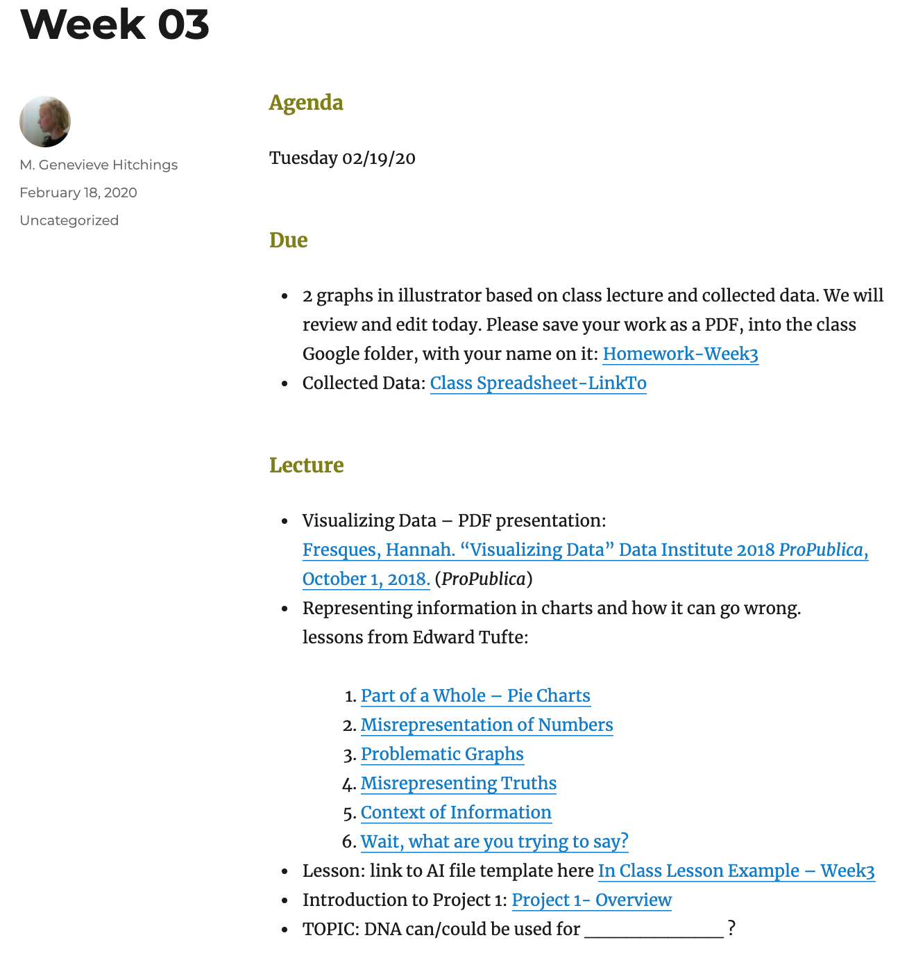
Example from Prof. Hitching’s Information Design OER Site

Slide 7
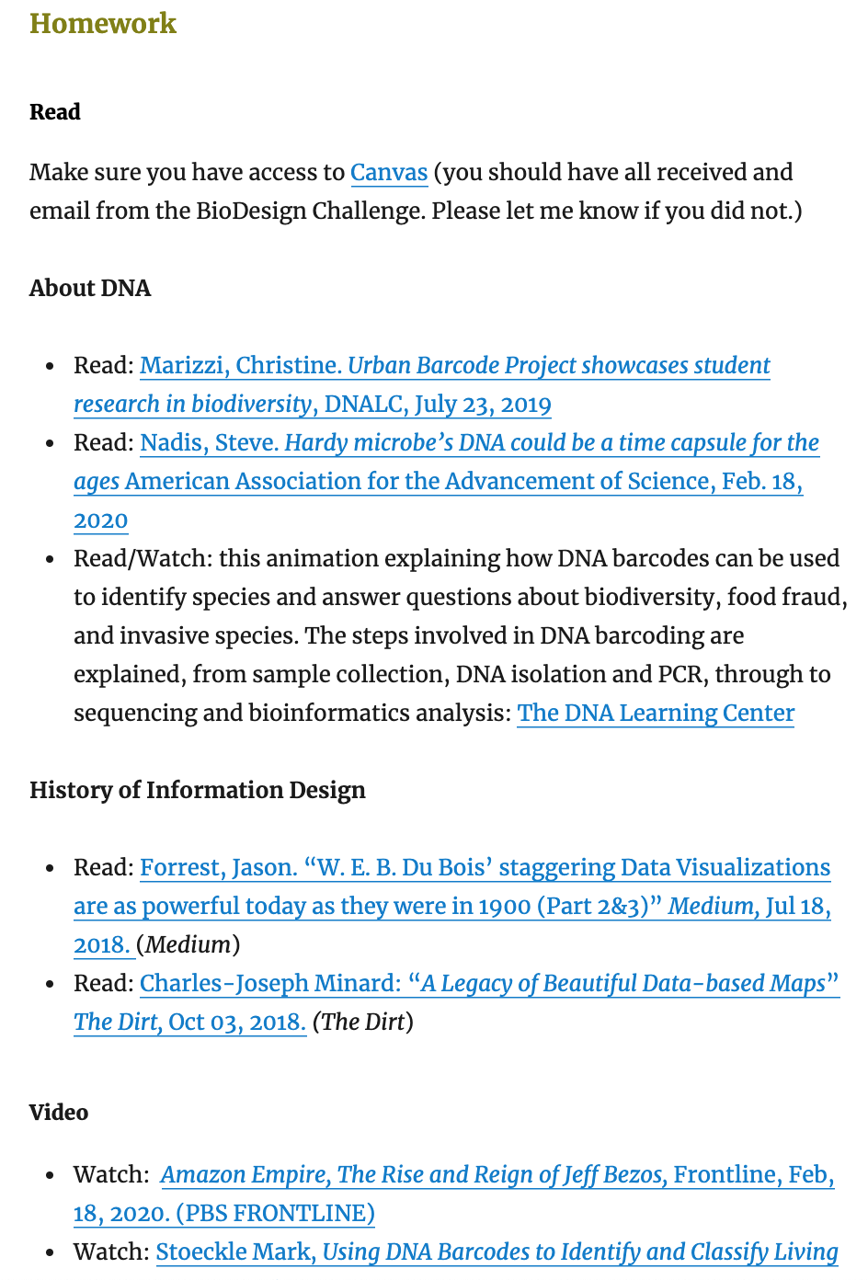
From Prof. Hitching’s Information Design OER Site

Slide 8
Example Syllabus w/ course outline
Template adapted from Prof. Munroe’s Business of Fashion course
Notes:
Her OpenLab site, in case we want to screenshare it: https://openlab.citytech.cuny.edu/munroebuf4700/course-materials/syllabus/
On her site she includes additional syllabus components, including details on assignments, netiquette, etc.

