Slide 1
Timothy Hogan (Photographer)
Omar Chowdhury

Slide 2
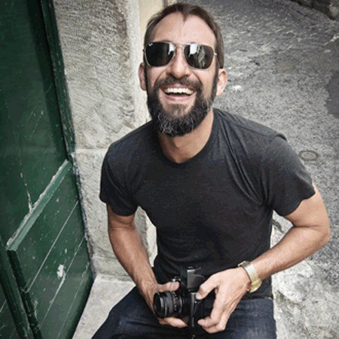
Why I select Timothy Hogan?
  He is known as one of the best photographer in California. Timothy Hogan Shoots bests pictures “for an array of international brands and advertising agencies in the technology, fragrance and design industries”(Hogan). He was a maker and an inventor since he was a child. Even if I don’t want to be a photographer in the future, he made me feel like this is one of my best hobbies and something I am interested in.

Slide 3
Introductory Paragraph
Timothy Hogan is a famous photographer who spent 12 years in New York City before he moved to Los Angeles in 2011. He is currently developing his skills as a furniture and product designer to compliment his photography skills. Timothy Hogan is one of two Hasselblad Ambassadors in the United States. He was awarded in Communication Arts Photography Annual for his Graphics Photo Annual. After completing his education, he opened his first studio in 2000 on 29th street, New York.

Slide 4
Research
Timothy Hogan uses light and colors in new, interesting ways to highlight products in his work. The way that Hogan’s photos are described by clients are dramatic and impactful on society for advertising. He has worked on projects with big companies such as Budweiser and Tommy Bahama. He is specialized in almost all forms of photography. He became experienced with traditional photography and then took up digital style. In 2012, he founded and directed FINproject.com, a website that shows where people job is to build great products.

Slide 5
Research (Continued)
He is an inspiration to any photographer in the world. Timothy Hogan is somebody who made his dreams come true and able to managed to be the best in what he does as a photographer. Timothy Hogan has a team that has years of experience in the sections of marketing and images. When he is not working, one of his favorite activity is surfing. For any photographers, achieving balance in life is very important.

Slide 6
Conclusion
One lesson that I feel like I have learned from Timothy Hogan is that no matter how hard life is, it’s always important to be the best at what you do. If a person is not the best at what they do, they will never be success. The more a person practice, the more experience they will have at anything. As a photographer, when a person takes a picture, they expect the picture to look like as if it has a great quality. It would be the best to take a picture like during the day and then the photographer can do some editing on their own.

Slide 7

Graphics of Timothy Hogan
In my opinion about this graphic, I like the fact that it has a darker
Background but shows a better view of the glass and it shows some
Good colors of the fruits in the glass.

Slide 8

Graphics of Timothy Hogan (Continued)
I like the colors in the photo because it matches with the color of the bottle.
When looking at an image like this, it gets a lot of people’s attention when
they first see it.

Slide 9
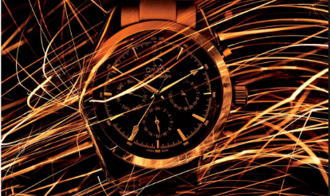
Graphics of Timothy Hogan (Continued)
I like the watch because of how it looks like and especially gold. The watch looks like
something professional a person would wear at a job interview. It is good to use editing
in images like this.

Slide 10
References/Bibliography
http://www.timothy-hogan.com/about
https://www.pinterest.com/pin/460774605594974052/
http://frostsnow.com/timothy-hogan
https://www.buynsellstockphotos.com/blog/timothy-hogan-biography
http://bijog.com/biography/timothy-hogan
http://www.finproject.com/en/
http://www.hasselblad.com/inspiration/hasselblad-ambassadors/our-ambassadors/timothy-hogan
https://www.pinterest.com/pin/167125836146667581/

