Slide 1
“Healthy Choice, Healthy Teeth!”
Nutritional effects on caries in children and prevention methods
Presented by:
Semah Altam, Kehinde Bello
Olga Bondaresco, Jose Torija Gutierrez

Slide 2
Healthy teeth and unhealthy teeth
Healthy foods make your happy teeth
Bad foods make your teeth unhappy
Unhappy teeth have caries ( tooth decay)
caries are the most common disease in children the main of cause tooth loss.

Slide 3
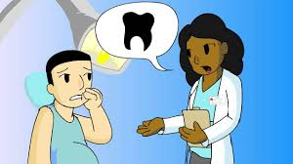
Untreated caries
Leads to pain & infection
Problems with eating, speaking, playing, and learning.
Tooth loss, hospitalization,
Children with poor oral health are often absent from school.
Poor performance and poor grades.

Slide 4
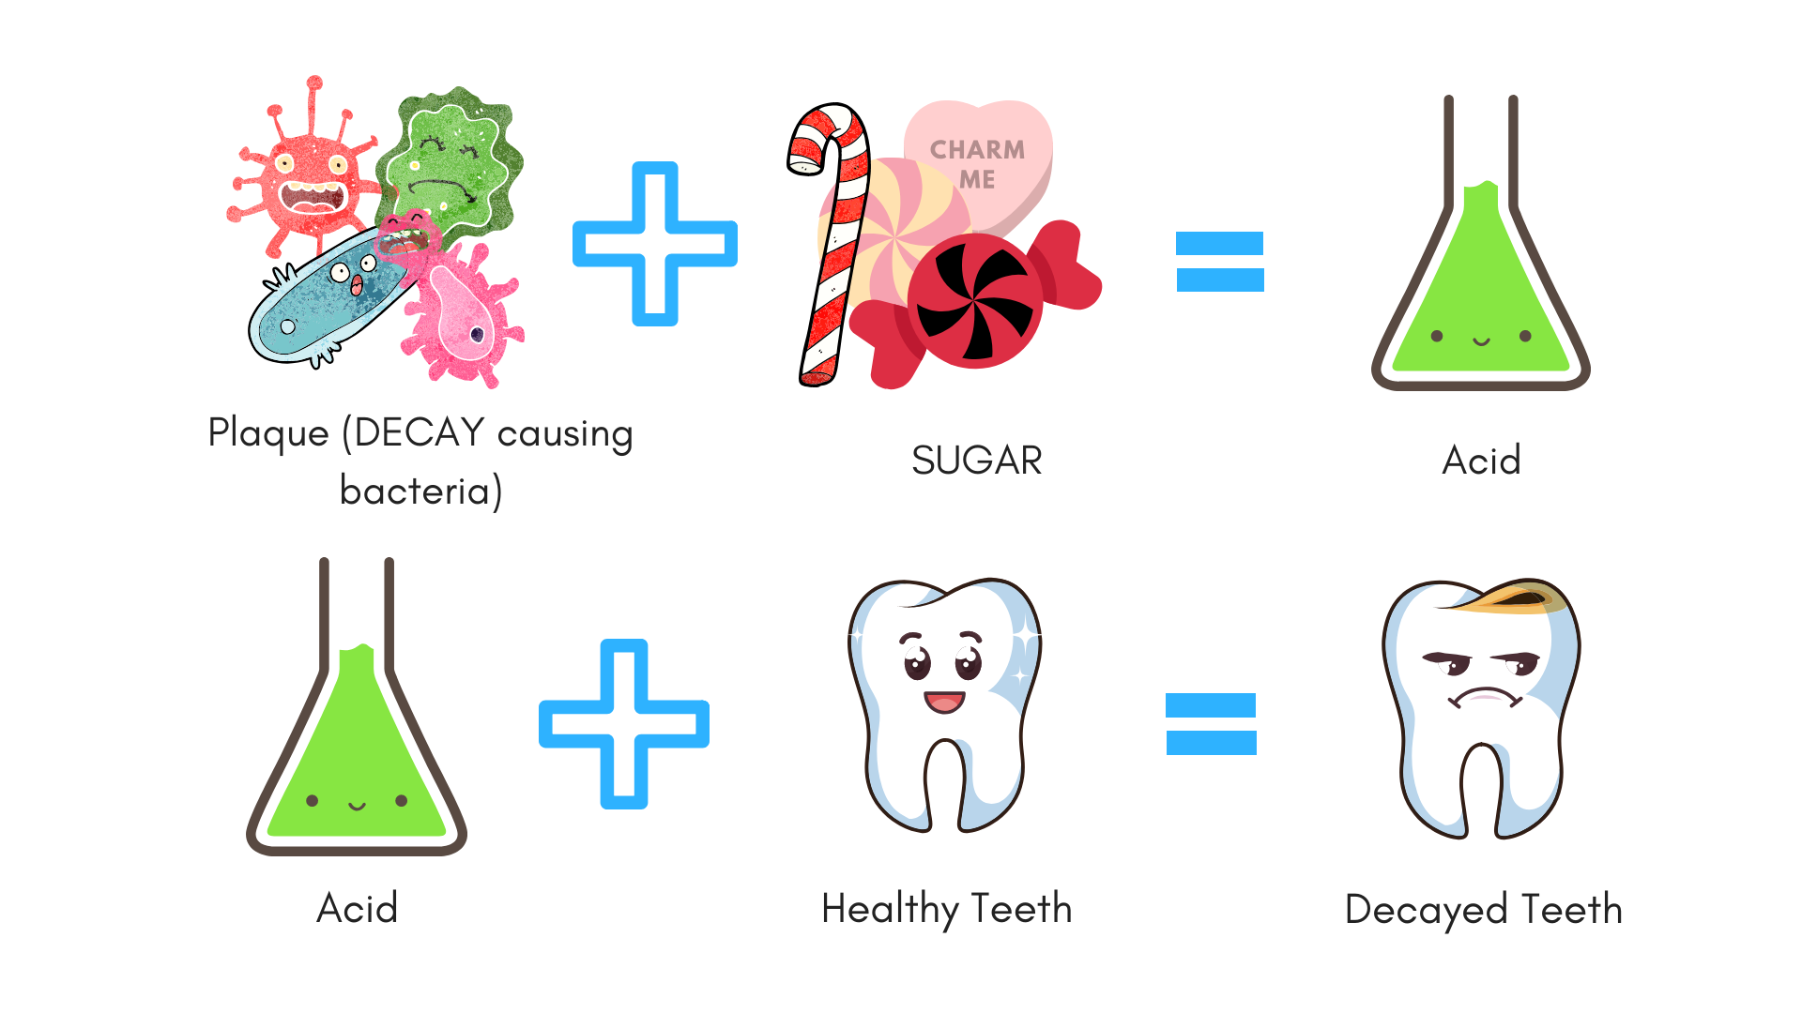
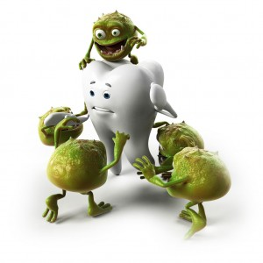
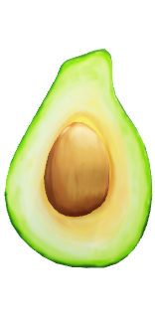
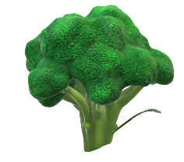
How do you get caries?
Unhealthy foods
and
Improper oral hygiene
Healthy foods contain good Vitamins and Minerals which prevent caries to destroy the teeth and keep your smile healthy!

Slide 5
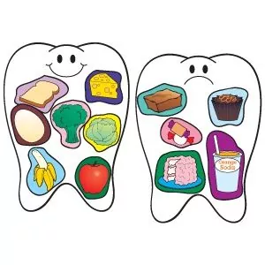
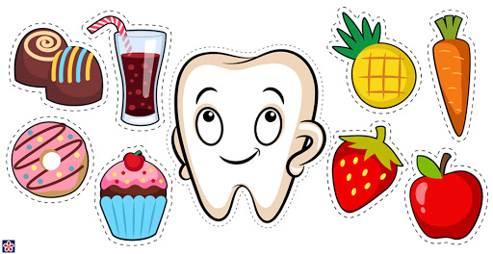
Healthy VS Unhealthy foods!
HEALTHY:
Apples
Celery and Carrots
Broccoli and Green Leafy Vegetables
Nuts and Seeds
Milk, Cheese, and Yogurt
Eggs
UNHEALTHY:
Cakes and Biscuits
Soft drinks
Sweets and Chocolate
Sauces and Syrups
Jams
Sugary Cereals and Cereal bars

Slide 6
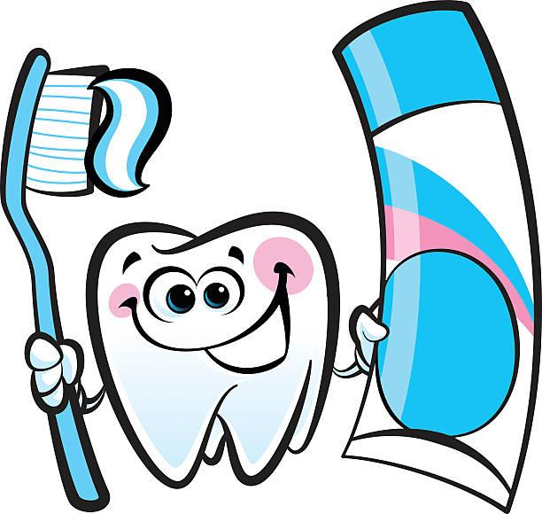
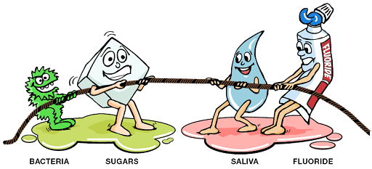
What we need to know?
Identify healthy foods and harmful sugary foods.
How to brush the teeth and for how long.
Visit the dentist for a checkup.
Child’s typical dental care routine.

Slide 7
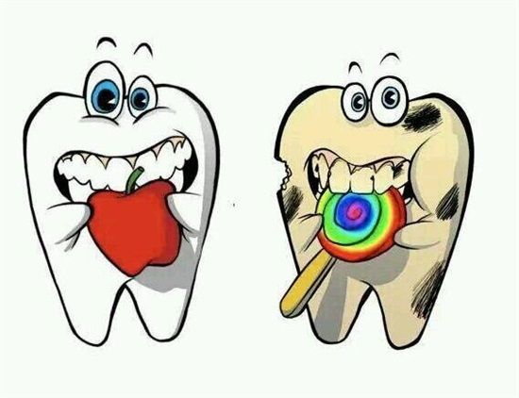
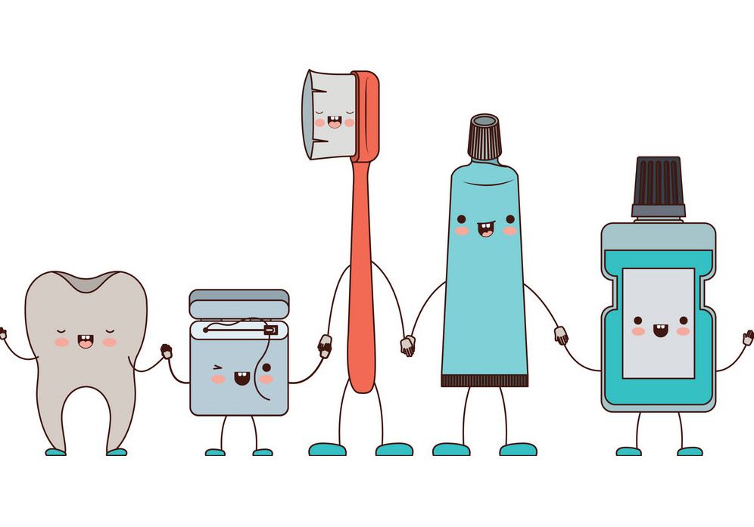
Our Goal!
Improvement in the number of children that can correctly label out the healthy and unhealthy foods.
To effect on families' eating habits.
Improvement in home oral care: regular flossing and brushing.
Educate the children on the importance of making regular visits to the dentist.

Slide 8
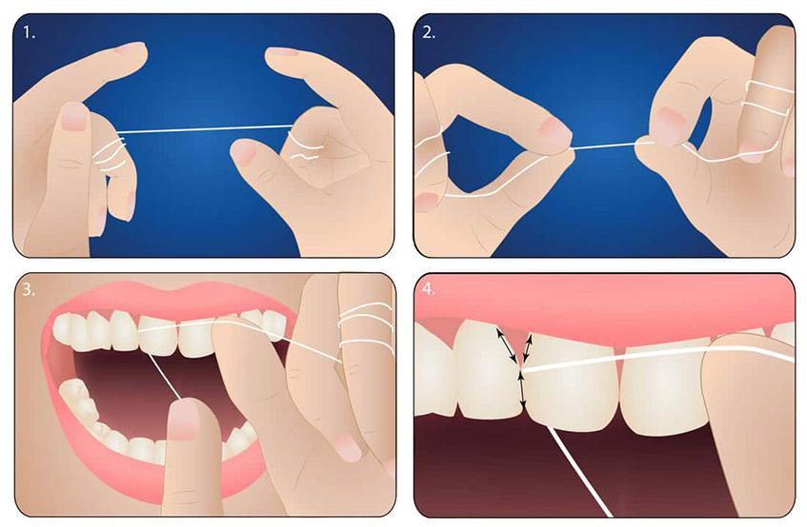
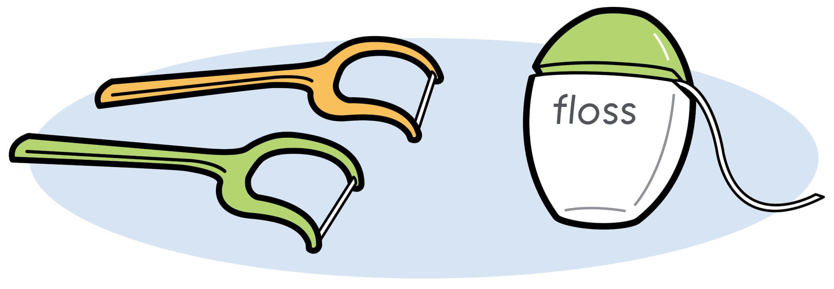
How to Floss?
Twirl floss around a finger from both hands.
Hold the floss tightly and place between teeth.
Make a “C” shape around the tooth and slide it up and down.
Having a hard time? You can also use handled floss!

Slide 9
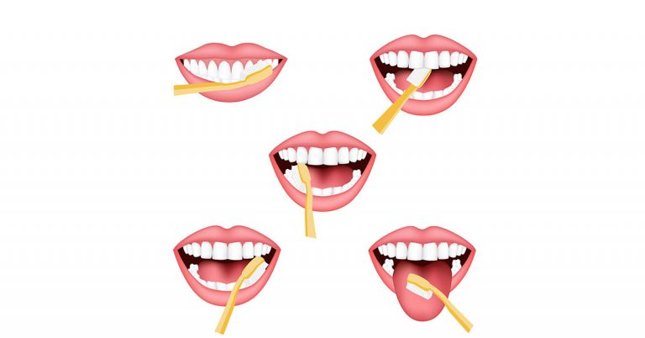
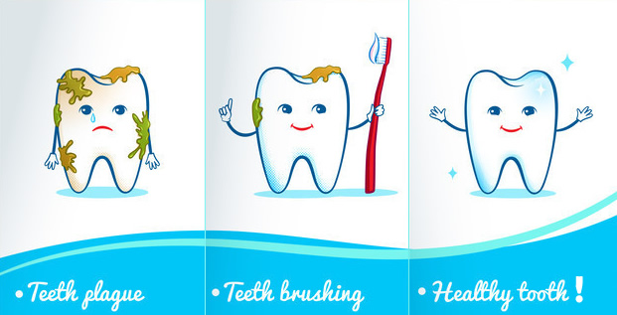
How to brush?
Divide the mouth into 6 sections and take 20 seconds to brush each.
Start with outer surface of the lower jaw.
Then the inner and then the biting surfaces
Repeat with the upper jaw
Small circular movements near the gumline is most effective.
Lastly, don’t forget to gently brush the tongue

Slide 10
Let’s brush with Mickey!
https://www.youtube.com/watch?v=FA8O_Ff0CFk

Slide 11
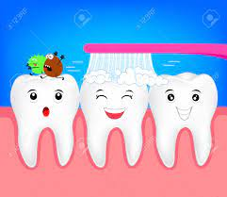
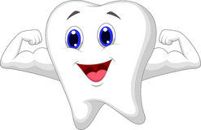
How to achieve our Goal?
When brushing twice a day and flossing once a day this keeps your teeth strong.
Visiting the dental office regularly is very important for early detection.
Also, maintaining a healthy diet.
These steps are essential for disease prevention.

Slide 12
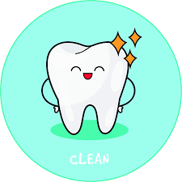
Steps to happier teeth
I will wake up everyday and brush my teeth.
I will eat my fruits and vegetables and less sugary foods.
I will floss once a day.
Lastly I will brush my teeth before I go to bed

