Slide 1
Syphilis
By Olga Bondaresco

Slide 2
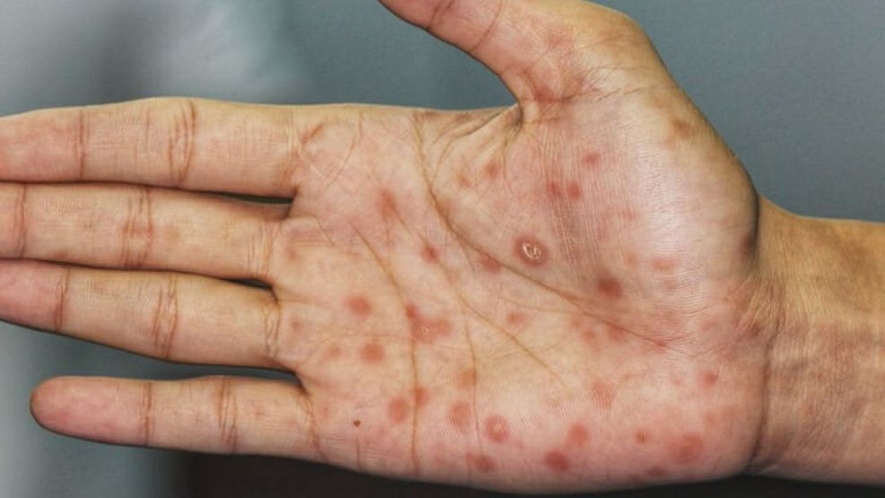
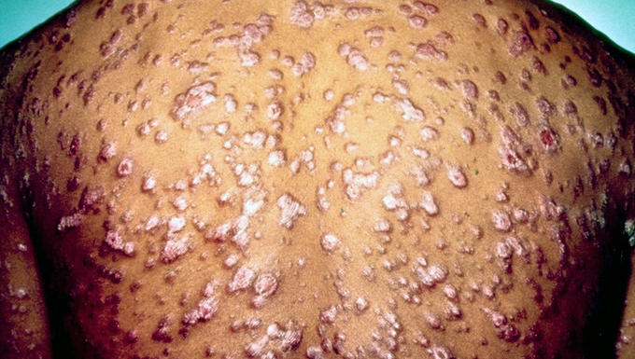
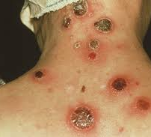
Syphilis
is a sexually transmitted disease which is passed from person to person through direct contact with a syphilitic sore. Sores of syphilis occur on the external genitals — vagina, anus, cervix, or in the rectum 3 weeks after contact. Syphilis sores are hardly recognized because of the absence of symptoms.

Slide 3
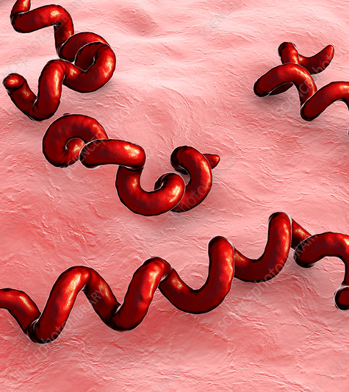
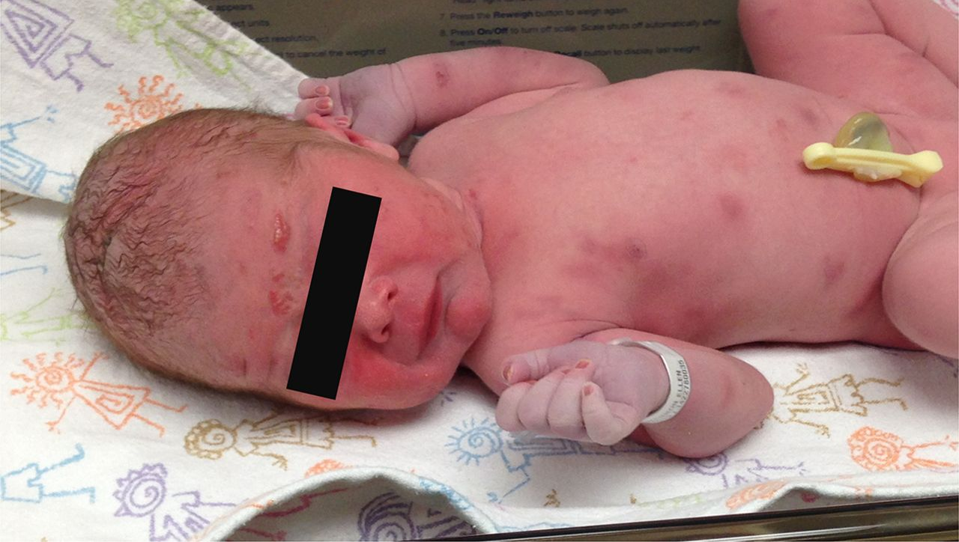
Treponema pallidum
is one of the infective teratogens which cross from the pregnant woman to the embryo by way of the placenta and cause syphilis.

Slide 4
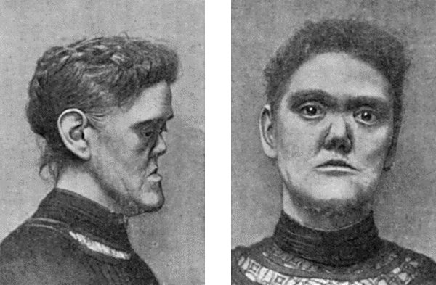
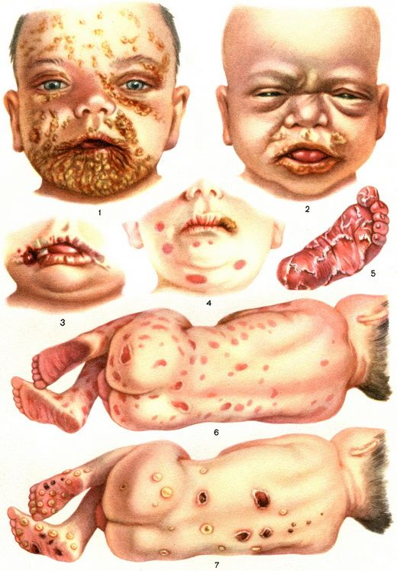
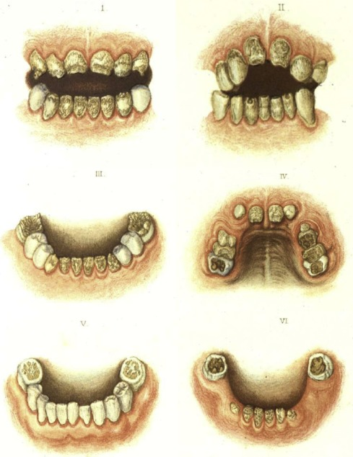
Treponema pallidum
affects the facial structures and teeth of the fetus. It often results in a diffuse maculopapular rash, atrophic glossitis, rhinitis, yellow discoloration of lips, high narrow palatal vault, and periostitis.

Slide 5
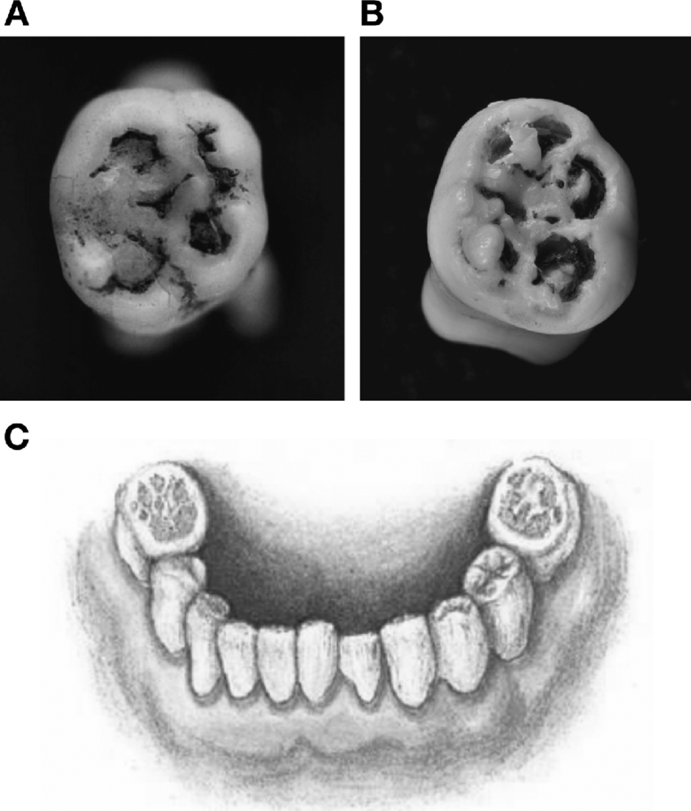
In case of late congenital syphilis, a newborn can have dental abnormalities that occur in teeth during the first year of life. The most common oral pathologies caused by syphilis are Hutchinson’s teeth and Mulberry molar.

Slide 6
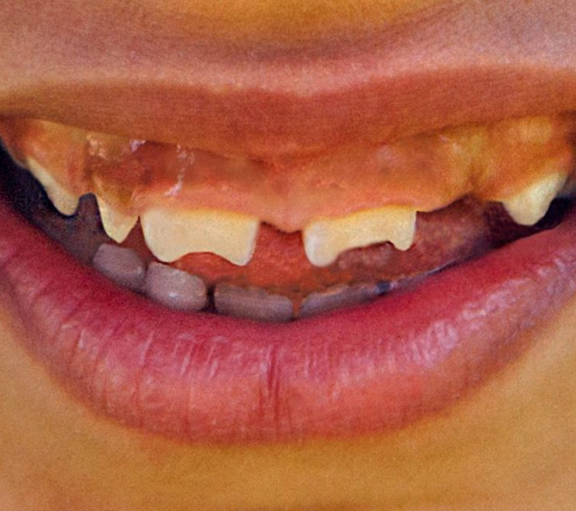
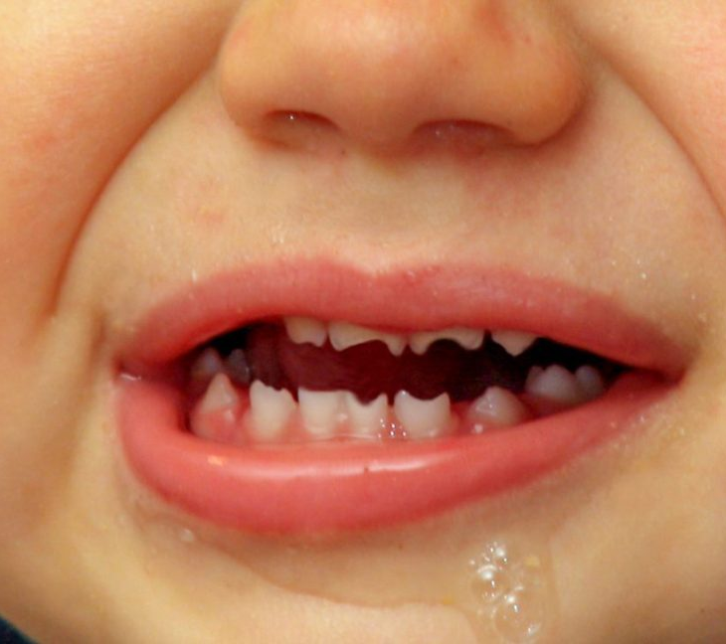
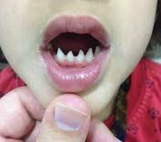
Hutchinson’s teeth
are abnormal peg-shaped and triangular-shaped incisors with wide space between them. The pathology may be unnoticed until the 5th year of a child’s life when permanent teeth appear.

Slide 7
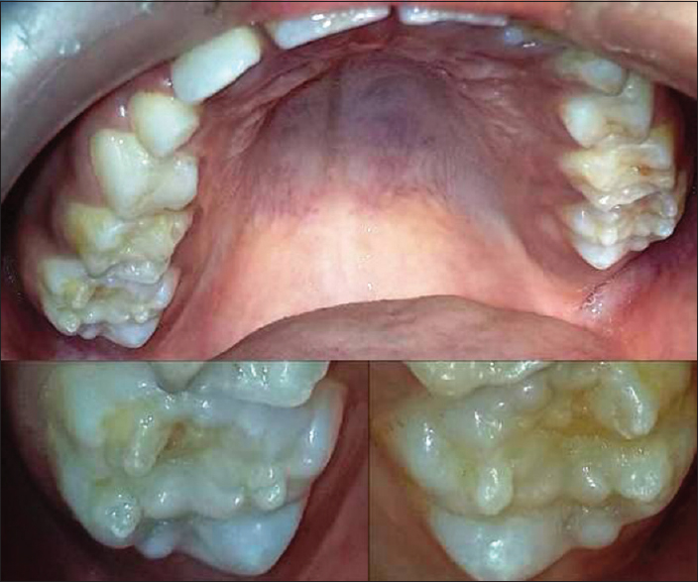
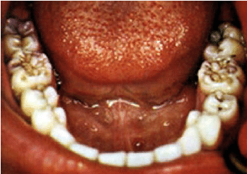
Mulberry molars
are characterized by many small cusps on the tooth’s surface. They are often called defective permanent molars with poorly-developed enamel.

Slide 8
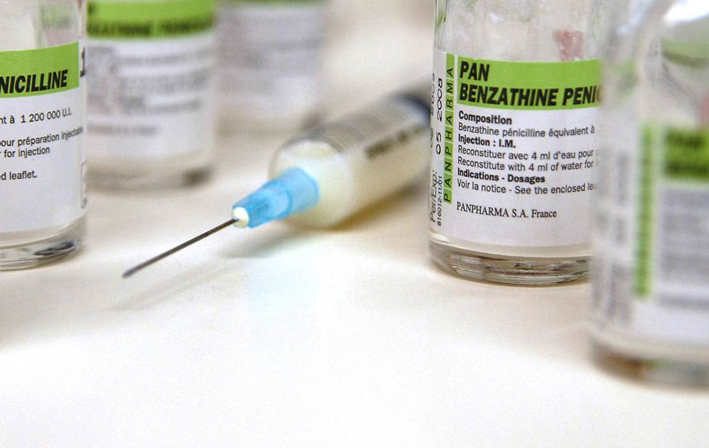
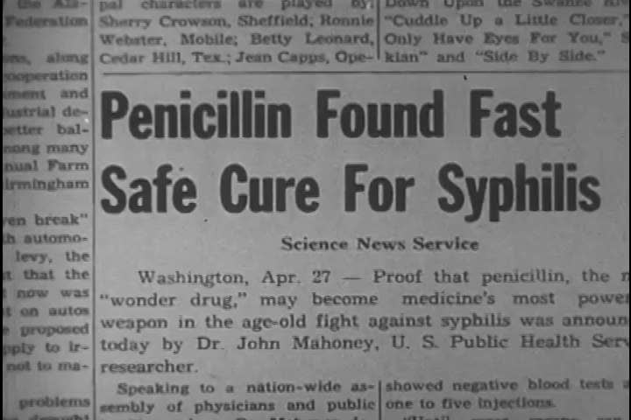
The most effective drug for treating syphilis is penicillin. However, systemic antibiotic therapy of the pregnant woman during the fetal period can result in tetracycline stain within primary teeth of a child.

Slide 9
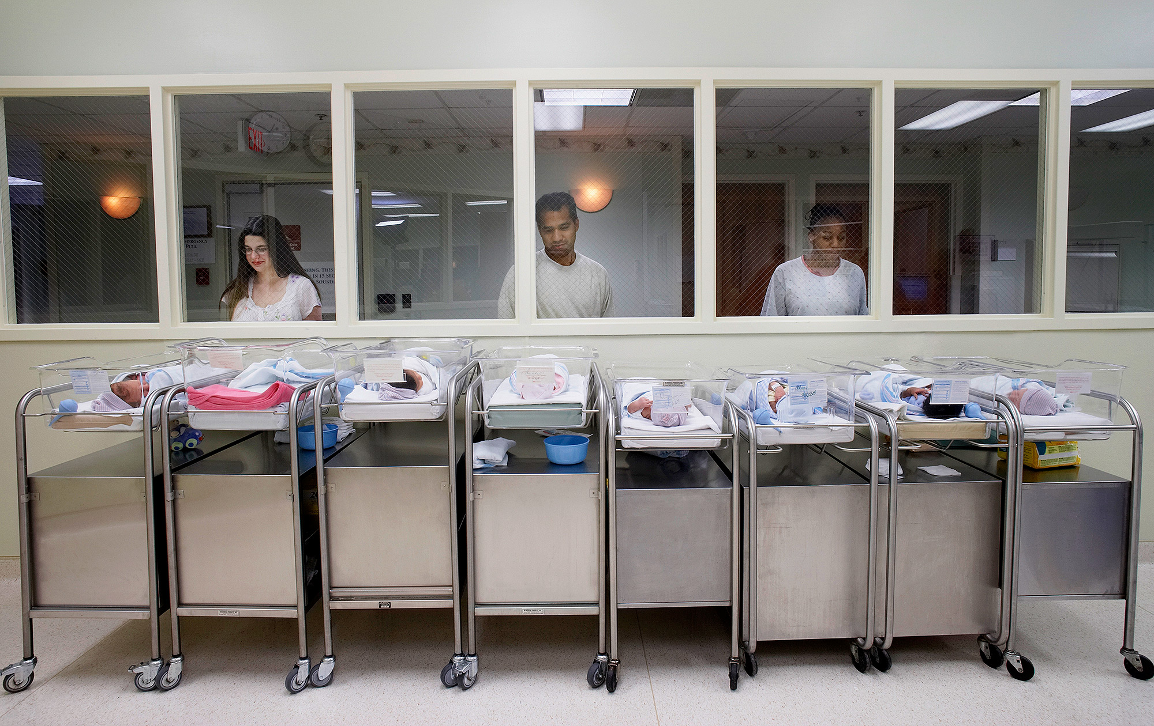
According to the World Health Organization, about 12 million people are infected each year. The researchers also show that congenital syphilis remains the main cause of perinatal mortality. An untreated infection may lead to severe pregnancy outcomes like prematurity, infant death, early fetal loss, and stillbirth. If not treated, syphilis also causes dental anomalies, including defects in the incisors and molars, as well as deafness, blindness, and possible paralysis.

Slide 10
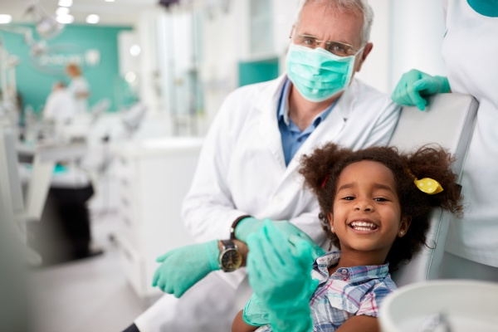
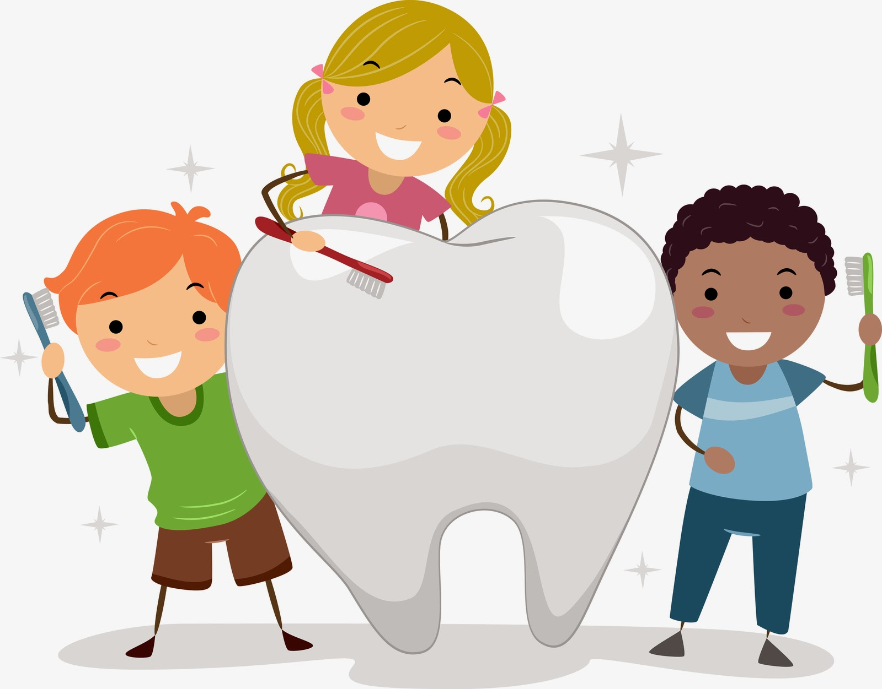
In case some oral pathology is present, regular dental hygiene care is the best option. As soon as the child’s teeth have erupted, there must be proper care. It includes brushing teeth twice a day with fluoride toothpaste, using a mouth rinse, flossing between teeth and visiting dentist on a regular basis.

Slide 11
THE end
Sources
1. De Santis M, De Luca C, Mappa I, Spagnuolo T, Licameli A, Straface G, Scambia G. Syphilis infection during pregnancy: fetal risks and clinical management. Infectious Diseases in Obstetrics and Gynecology. 2012; 12(5).
2. Fehrenbach M J, Popowics T. Illustrated Dental Embryology, Histology, and Anatomy. Maryland Heights: Elsevier; 2016.

