Slide 1
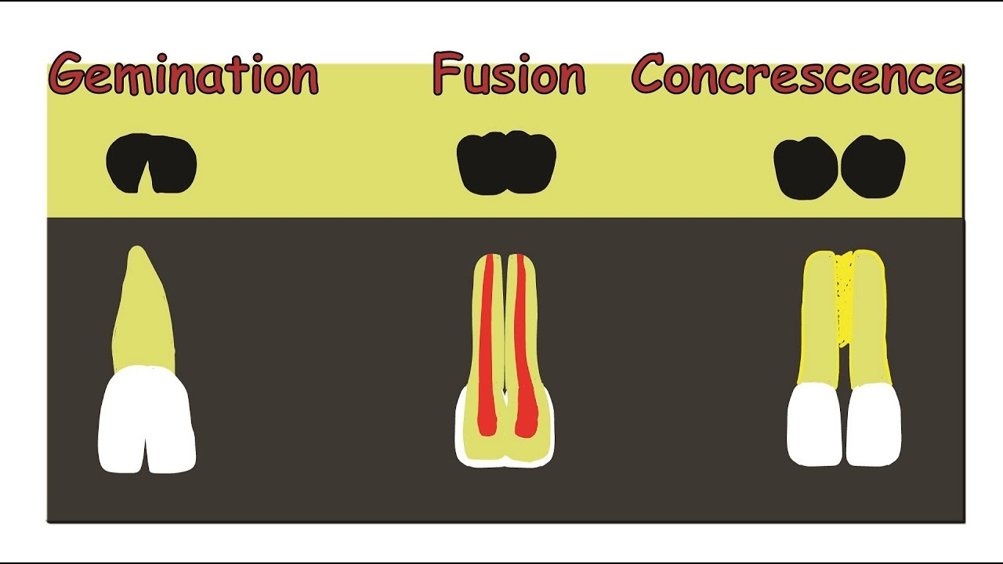
Gemination, Fusion and Concrescence
Johanne Aranda T.
Olga Bondaresco

Slide 2
Gemination
When a tooth germ attempts to divide and results in a bifid crown
Usually affects the primary teeth, but it can affect permanent anterior teeth.
It is considered one tooth with a single pulp chamber

Slide 3
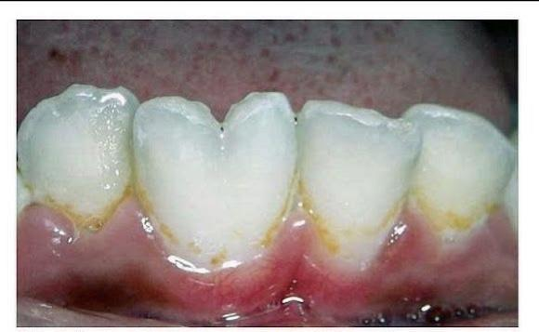
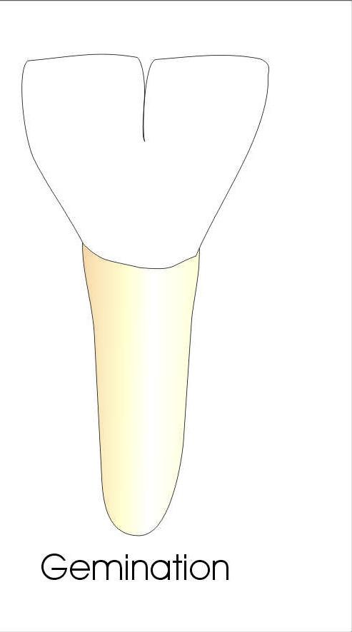
Gemination
This images shows how in a gemination tooth, the crowns share a root and pulp chamber. This is considered one tooth.
This is what a tooth gemination would look like in the oral cavity, you can clearly see a bifid crown.

Slide 4
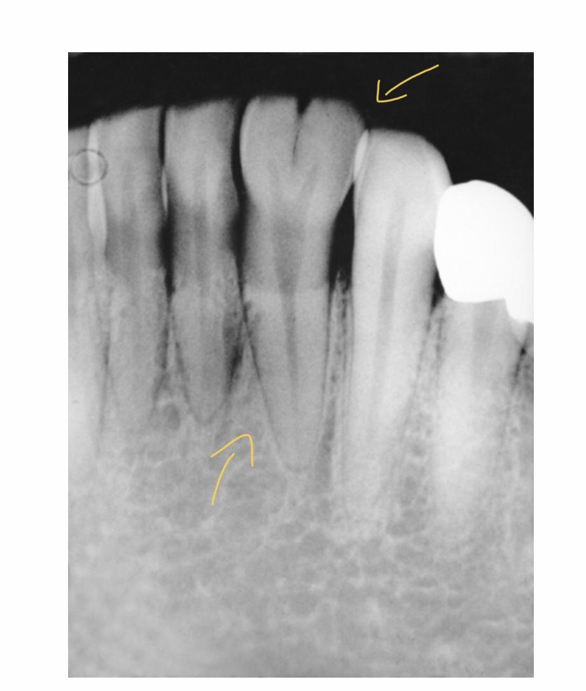
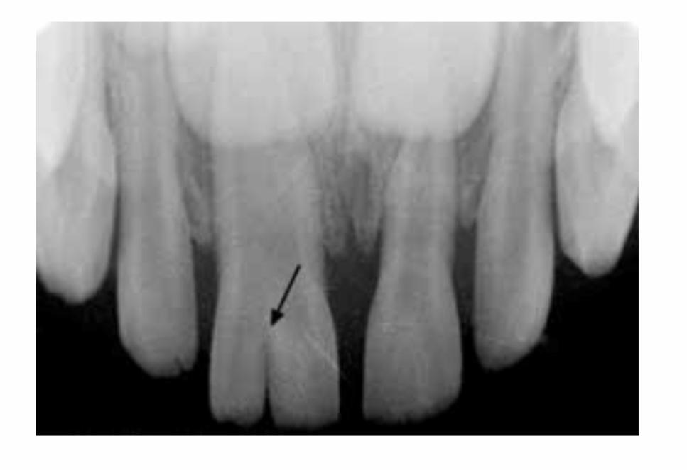
Gemination

Slide 5
Fusion
The union of two normally separated teeth to form an enlarged tooth
Tooth buds begin to develop separately and join in the final stage of tooth development
The fused teeth take up as much as two teeth space in the mouth
Teeth can have separated roots and canals or have a large bifid crown with one pulpal space

Slide 6
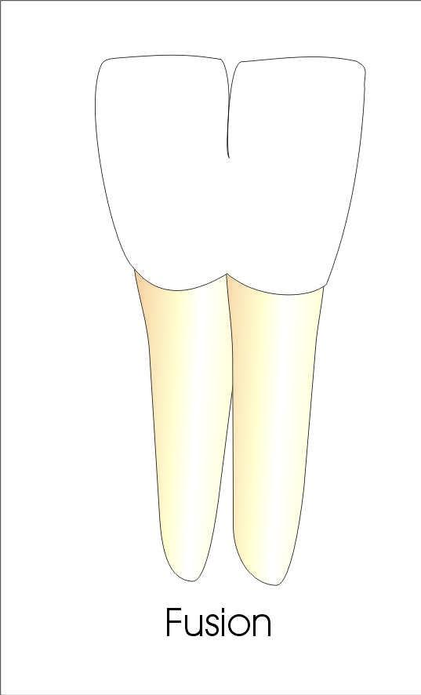
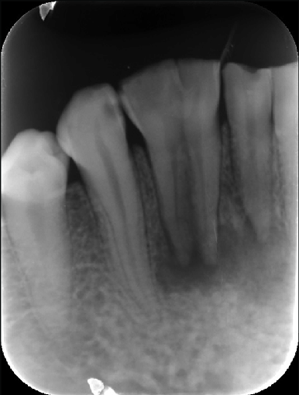
Fusion
These images show two teeth fused together but have separate roots and/or canals.

Slide 7
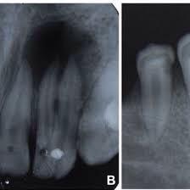
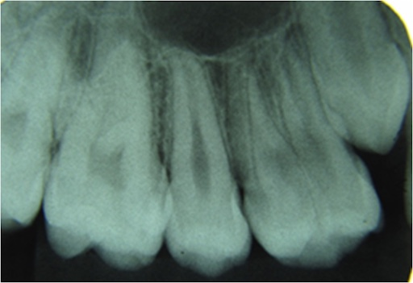
Fusion

Slide 8
Concrescence
Occurs in the embryonic stage of fetal development
Tooth cementum is joined with another tooth cementum.
The teeth are connected at the roots
Can go undetected if the teeth appear normal, will need dental radiographs to make a determination

Slide 9
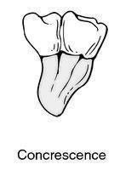
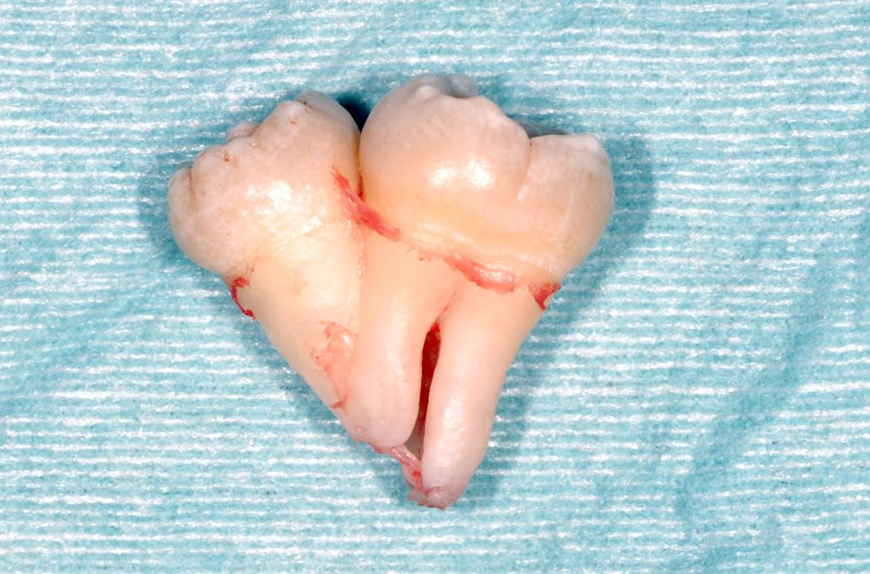
Concrescence
These images show how the molars being connected by their roots

Slide 10
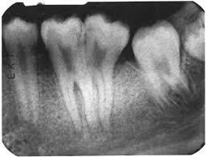
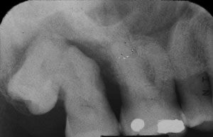
Concrescence

Slide 11
References:
Gemination:
https://www.longdom.org/articles/gemination-in-primary-teeth--a-report-of-two-clinical-cases.pdf https://pocketdentistry.com/7-acquired-and-developmental-disturbances-of-the-teeth-and-associated-oral-structures/ https://www.ncbi.nlm.nih.gov/pubmed/21685518
Fusion:
https://www.researchgate.net/publication/264196970_Tooth_fusion-_A_rare_dental_anomaly_Analysis_of_six_cases http://pubs.sciepub.com/oral/3/1/4/index.html https://www.researchgate.net/figure/Preoperative-radiograph-of-fused-mandibular-lateral-incisor-with-supernumerary-tooth_fig1_291528248
Concrescence:
https://www.colgate.com/en-us/oral-health/basics/mouth-and-teeth-anatomy/what-is-concrescence--
https://www.jendodon.com/article/S0099-2399(06)80075-0/pdf
https://am-medicine.com/developmental-anomalies-of-tooth/. https://www.nature.com/articles/sj.bdj.2013.438

