Slide 1
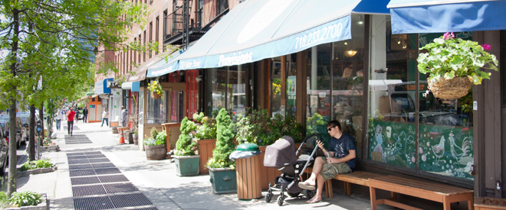
The Sounds of Fort Greene
By: Kyle Miller, Sanjida Uddin, and Pedro Salazar

Slide 2
Sounds of Technology from the past

Slide 3
Sounds of Technology from the present

Slide 4
Sounds of Music from the past

Slide 5
Sounds of Music from the present

Slide 6
Sounds of People from the past

Slide 7
Sounds of People from the present

Slide 8
Sounds of the Roads from the past

Slide 9
Sounds of today's Roads

Slide 10
Sounds of Transportation in the past

Slide 11
Sounds of Transportation today

Slide 12
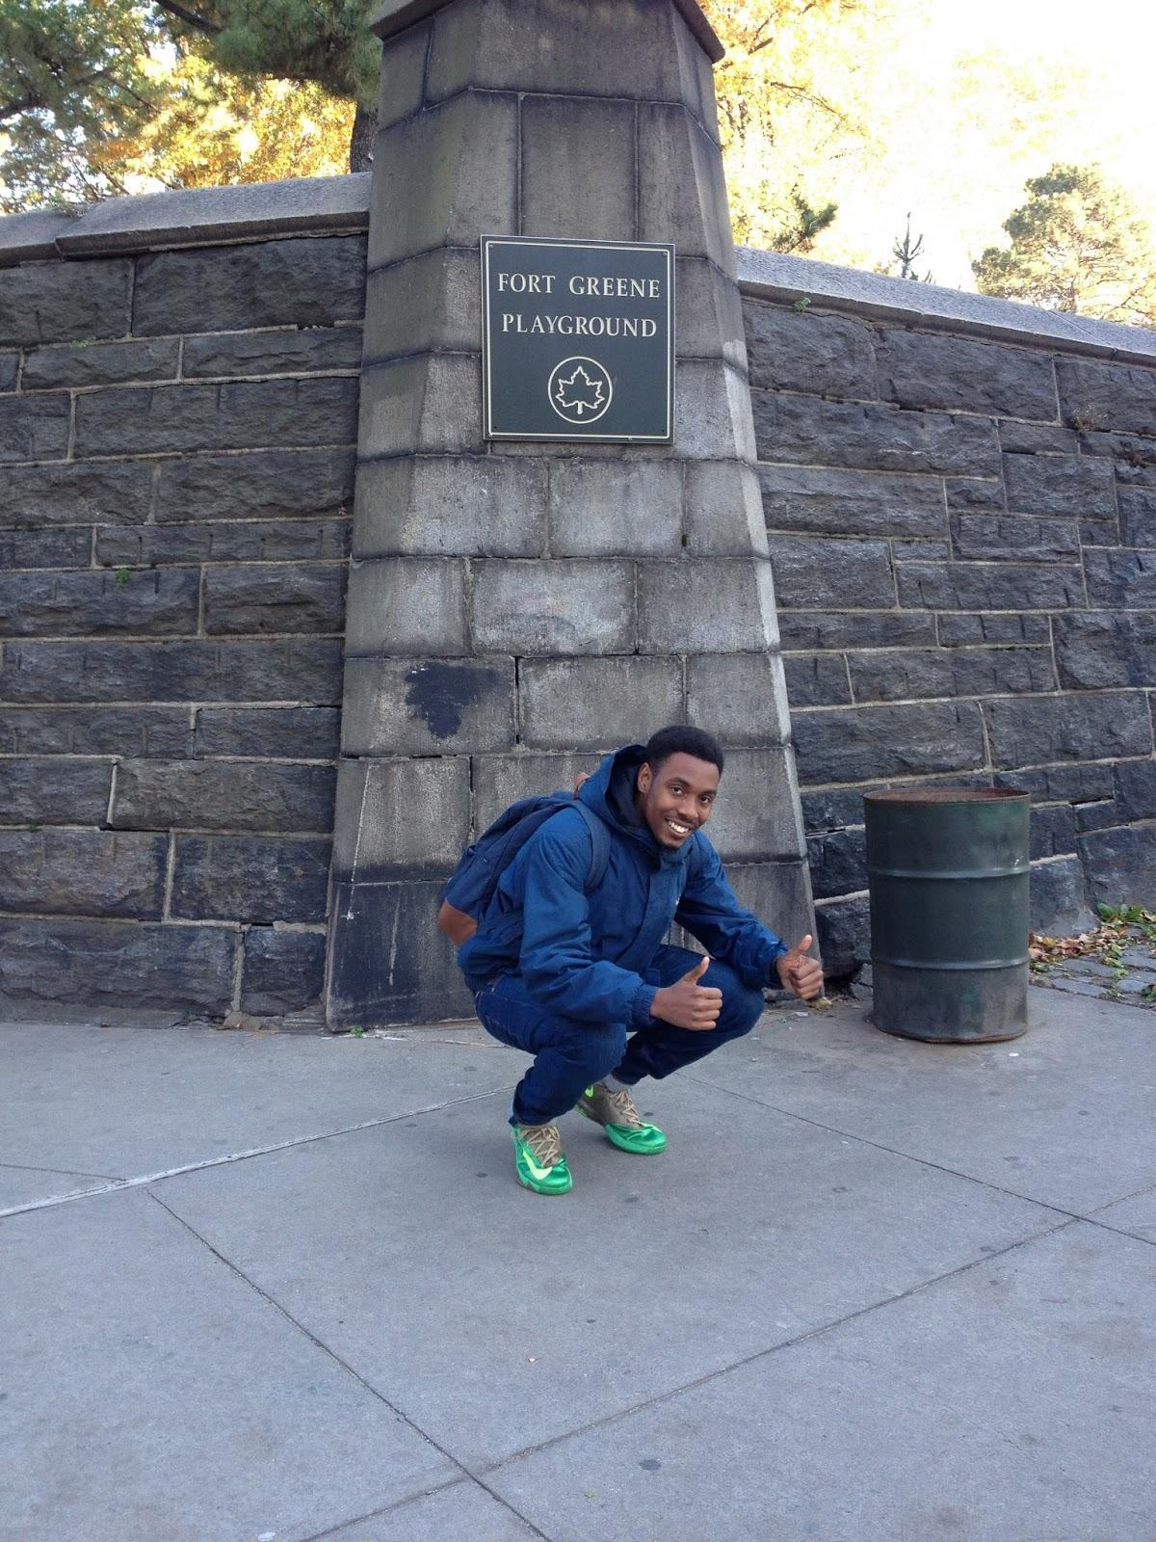
This is Kyle at Fort Greene Park
Thanks for viewing!

