Slide 1
My Internship Experience Fall 2019

Slide 2
The Professional Development Center
The company where I interned for the Fall 2019 semester was at the Professional Development Center (PDC) at New York City College of Technology located at 300 Jay St, Brooklyn, NY 11201 / Room L-114. The company is located inside of the school within the school’s Welcome Center.
The Professional Development Center’s main purpose is to help students take the necessary steps to achieve their career goals. The Professional Development Center collaborates and helps build relationships with other organizations to help provide job opportunities for current students and alumni looking for meaningful employment.

Slide 3
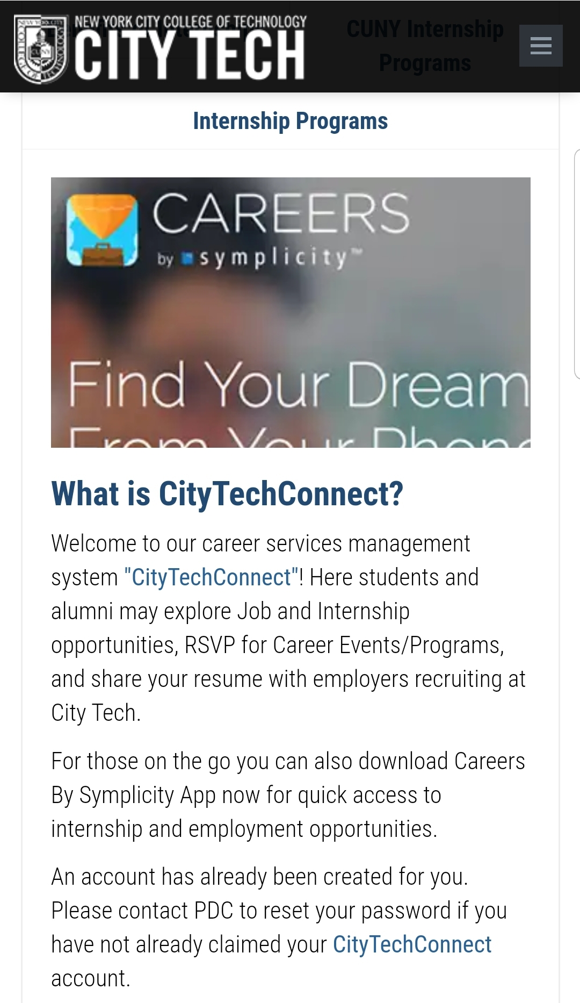
CityTech Connect
The staff at the Professional Development Center also help students gain access to CityTech Connect. CityTech Connect is a resource which helps students and alumni to find networking events, workshops, internships and job employment. Students and alumni can create a profile and then upload their resumes, cover letters, portfolio sites, etc. This is a great resource for all students and alumni.

Slide 4
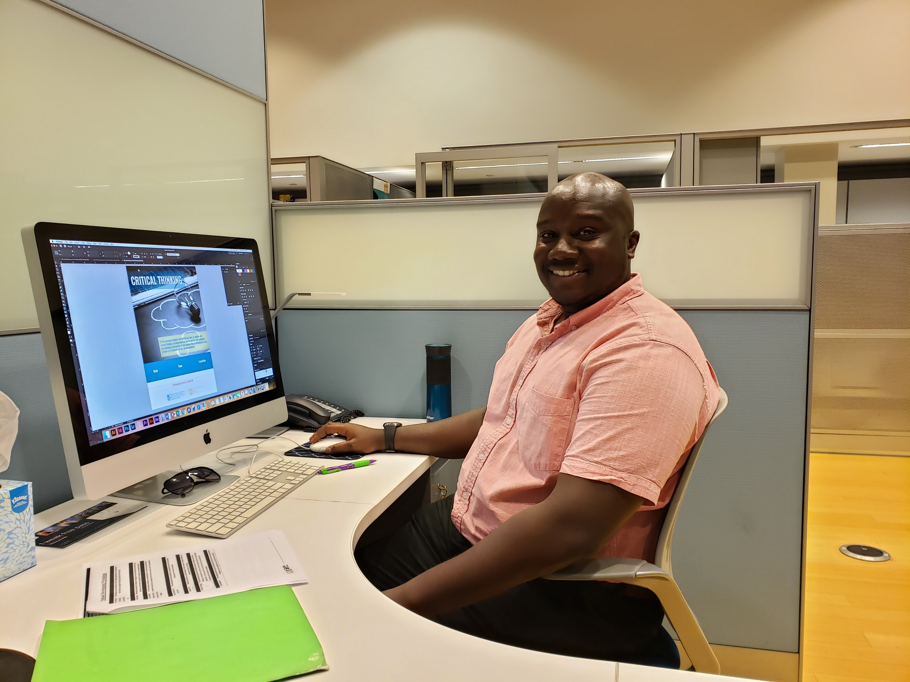
Graphic Design Intern
My role as a Graphic Design Intern in the Professional Development Center was to design and update current flyers for upcoming PDC Workshops and Internship Info Sessions. My supervisor’s name is Bradley Burford who is the Interim Director at PDC. He supervises the interns at the Professional Development Center.

Slide 5
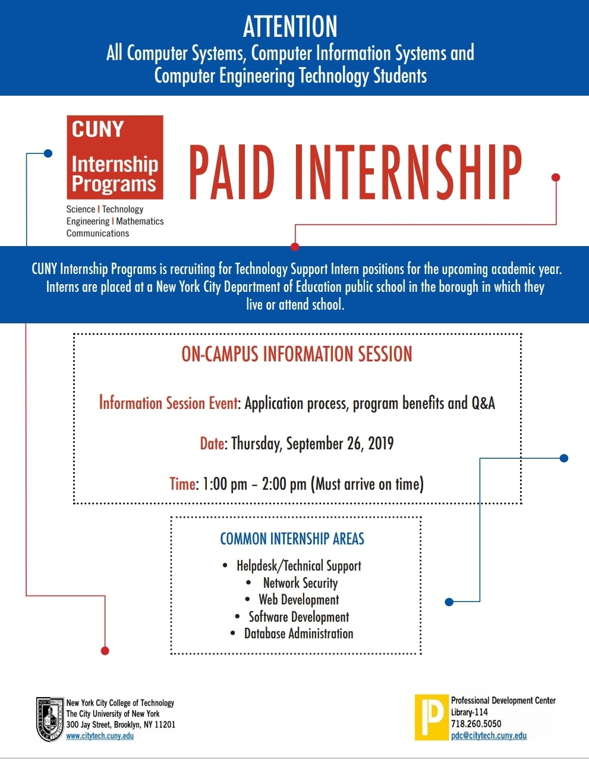
My First PDC Flyer
What do you think? Please provide feedback.

Slide 6
More PDC Flyers
Here is a link of more flyers I worked on.
https://openlab.citytech.cuny.edu/nmugaviri-eportfolio/entry-6/

Slide 7
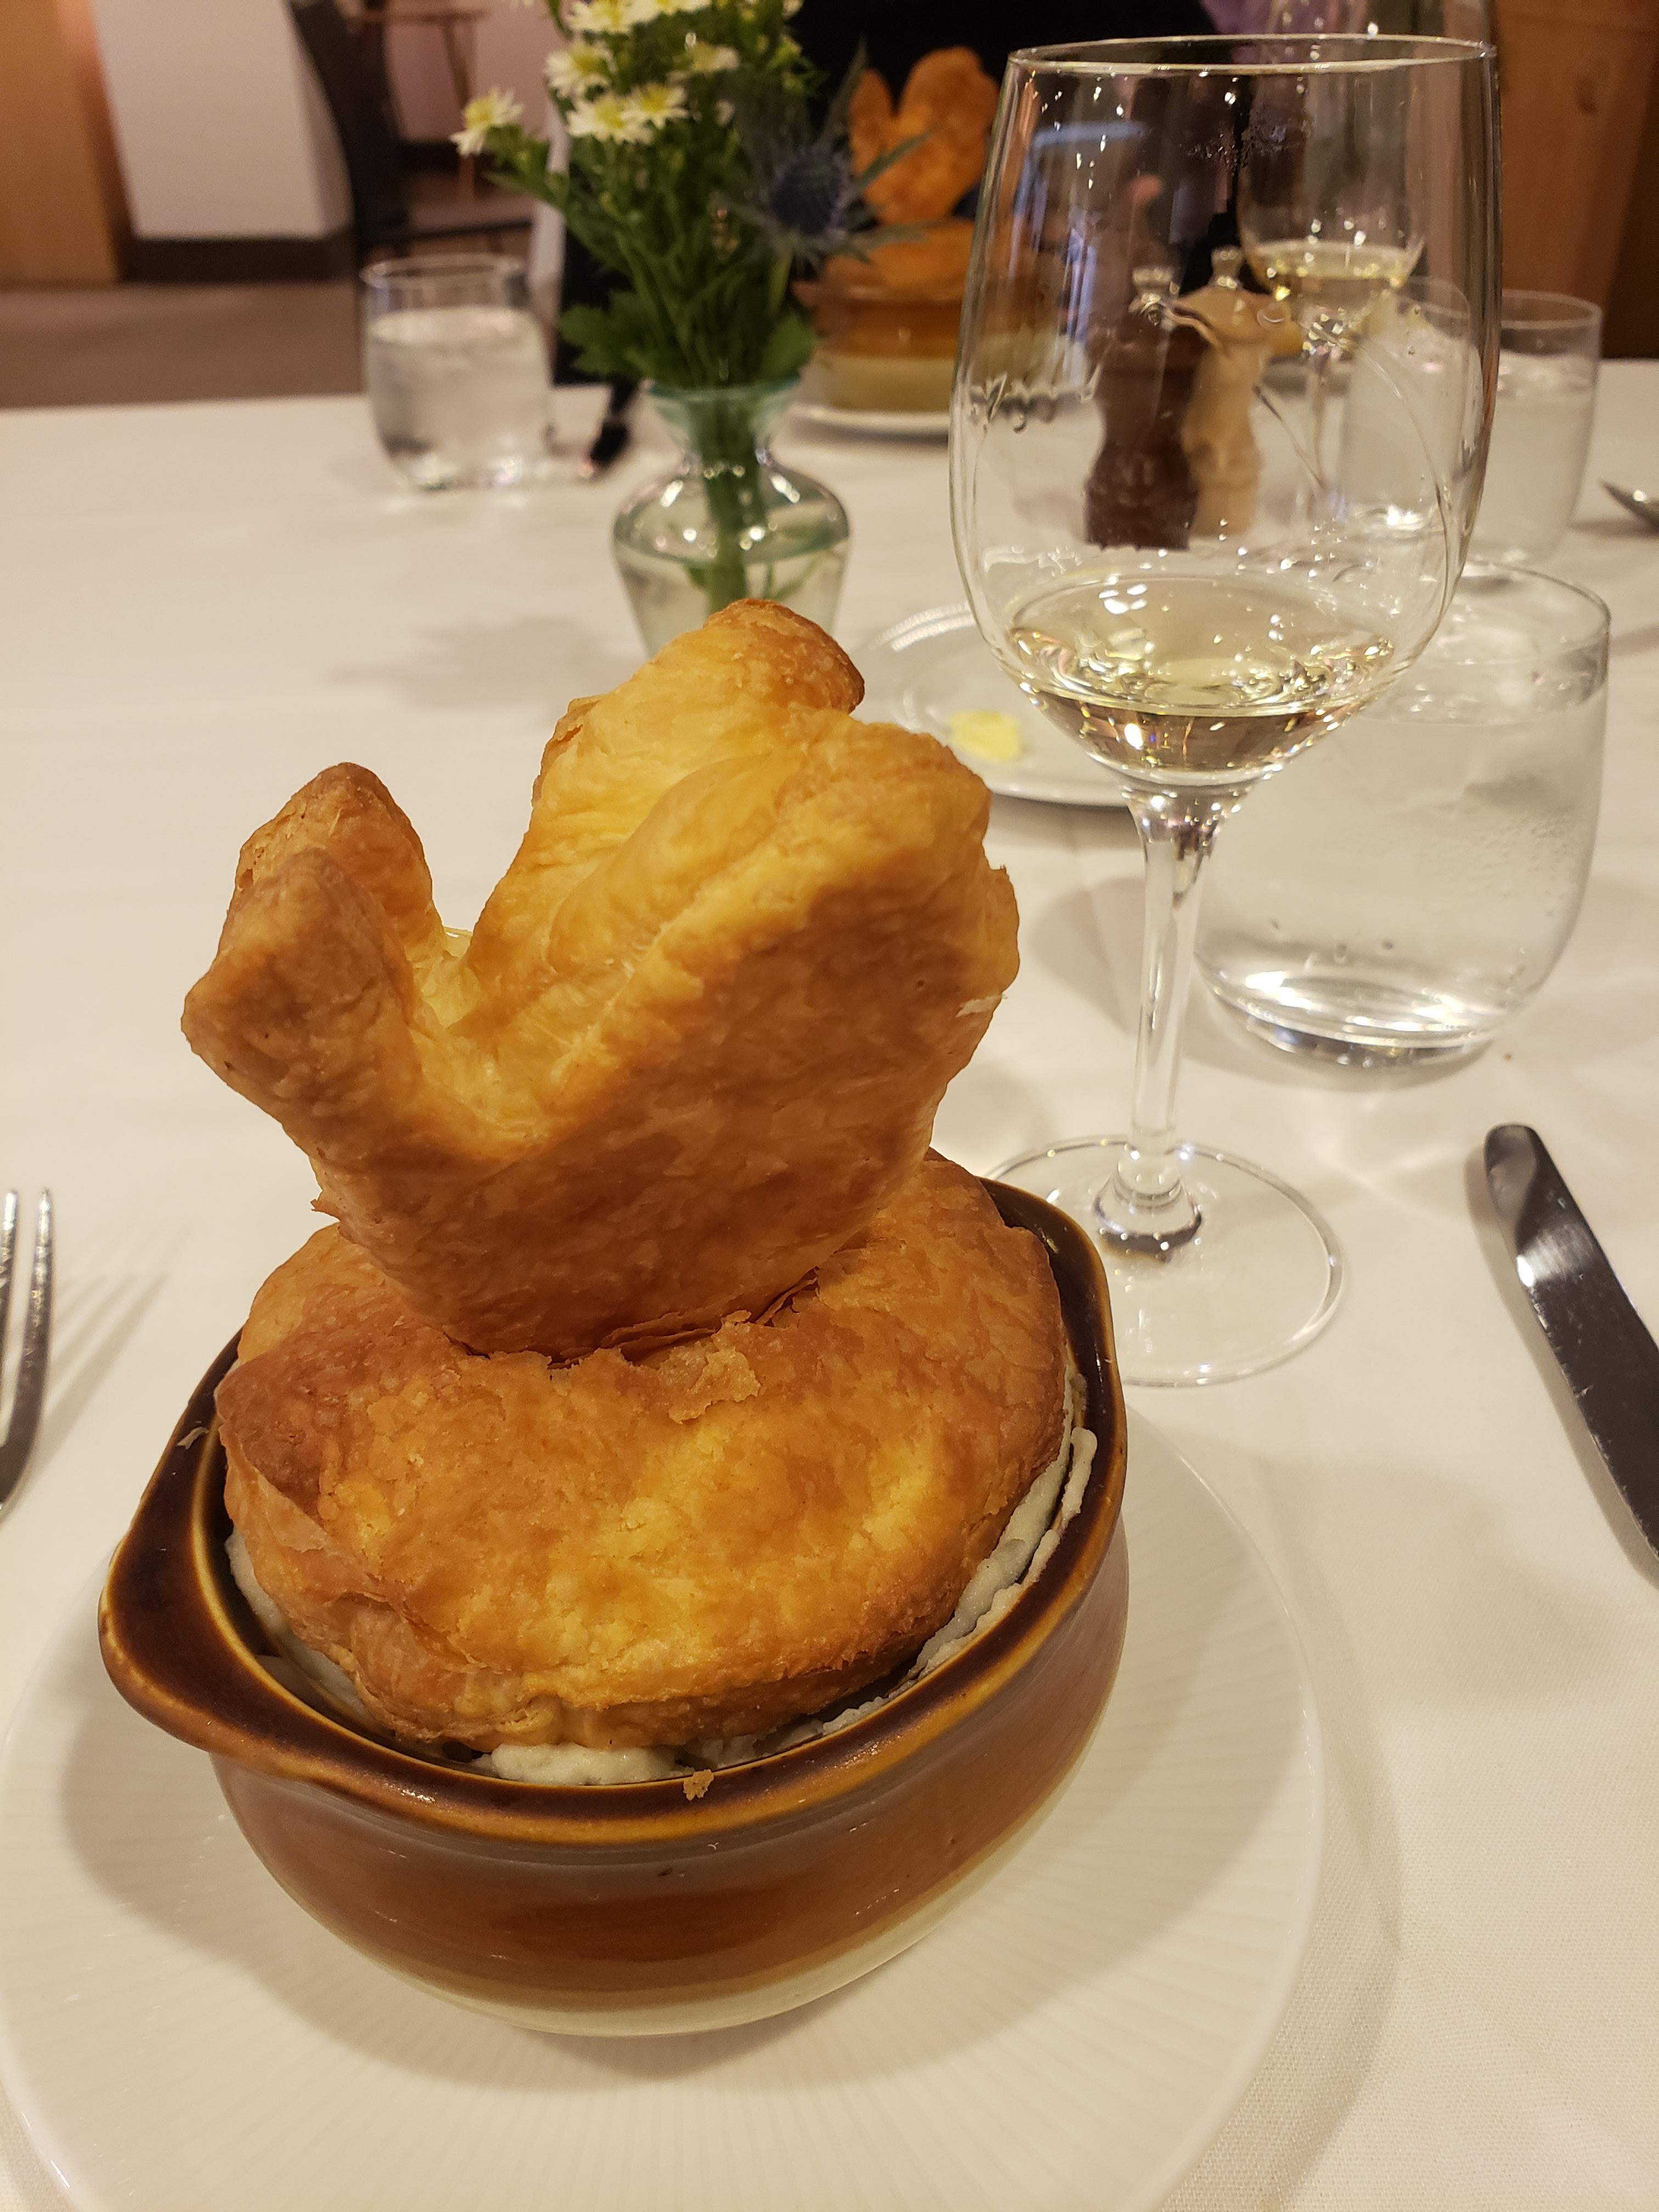
Dining Etiquette
I had the chance to attend two Dining Etiquette workshops during my internship and they were awesome experiences. Not only did you just learn about table manners, but you also get a three-course meal which was prepared by the Culinary staff and students. It is also a great way to network.

Slide 8
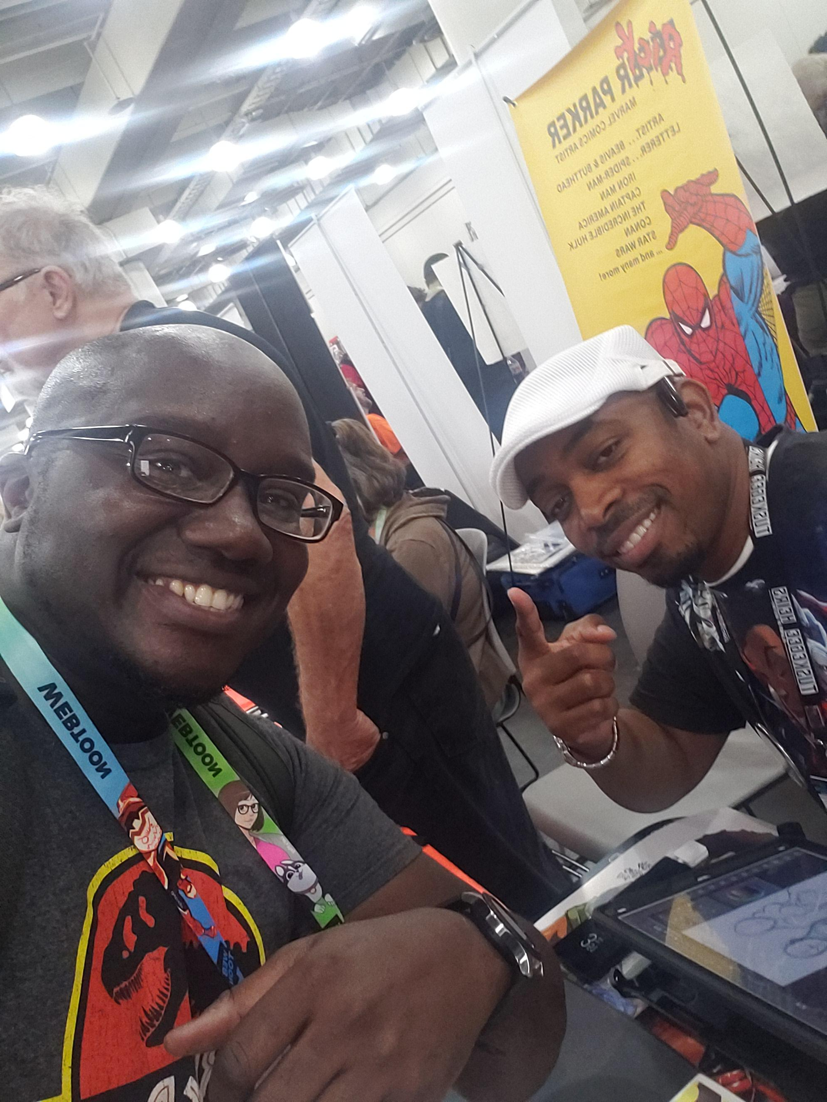
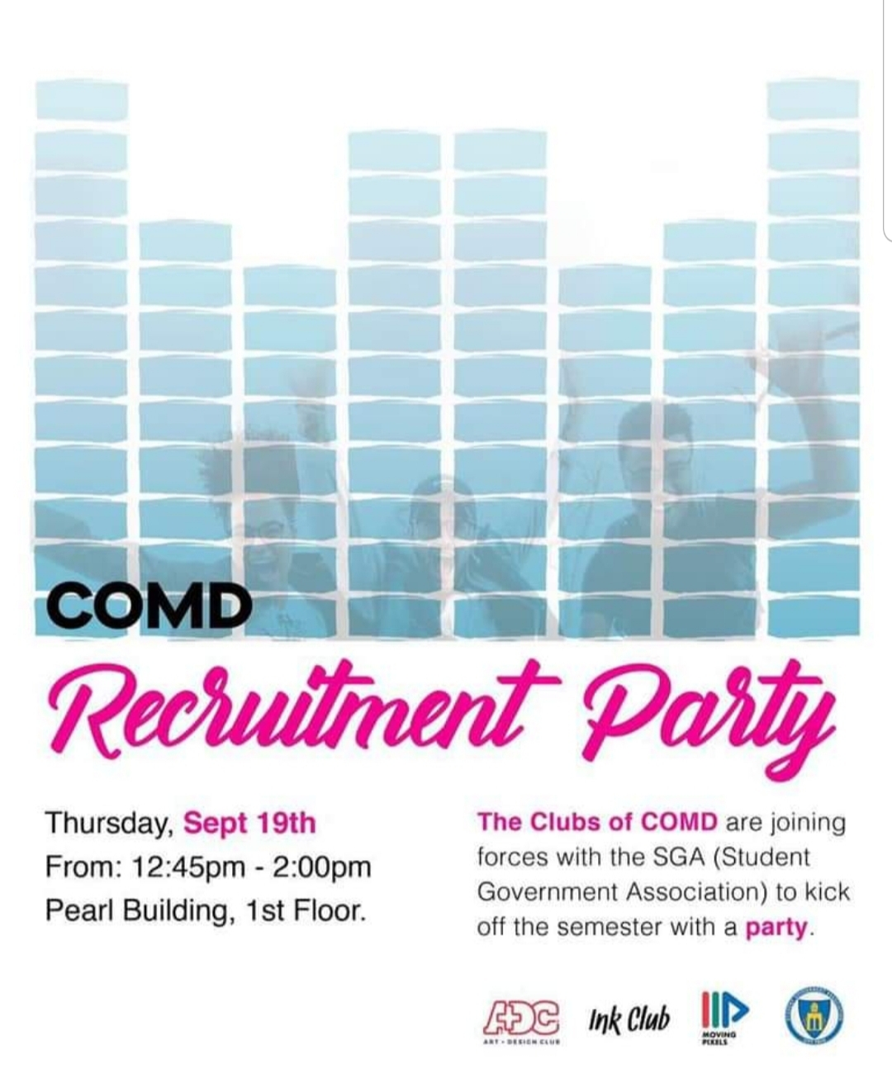
Networking
These are some of the events I attended during the Fall semester.

Slide 9
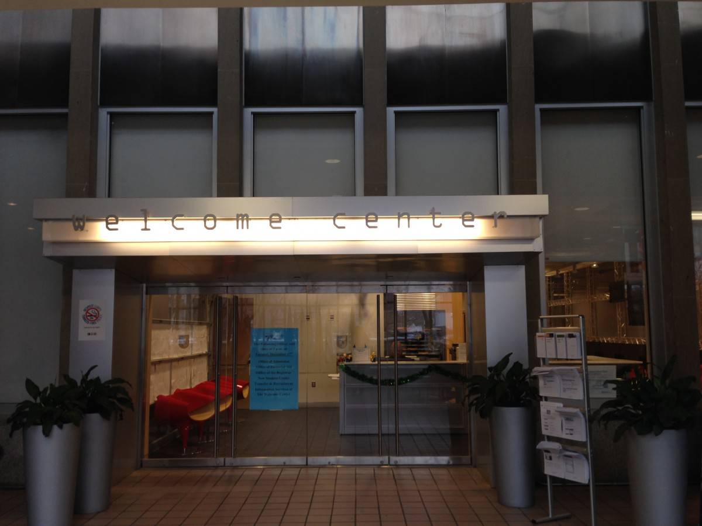
A Great Experience
I enjoyed my time interning at PDC and it was a pleasure working with the staff there. I felt very welcomed and that I was a part of the team. I will take what I learned from this experience and take it with me moving forward into my career.

Slide 10
The End

Slide 11
Any Questions?

