Slide 1
Mandibular Landmarks
By Natallia Mikhelis
DEN1218/D230

Slide 2
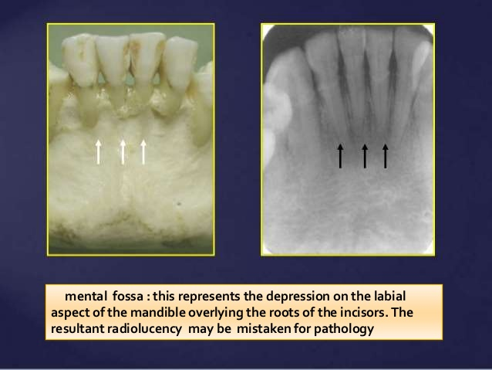

Slide 3
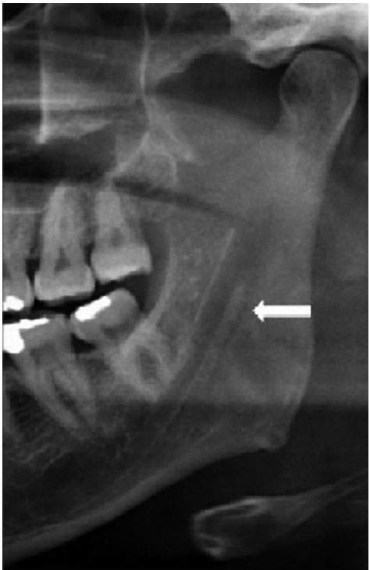
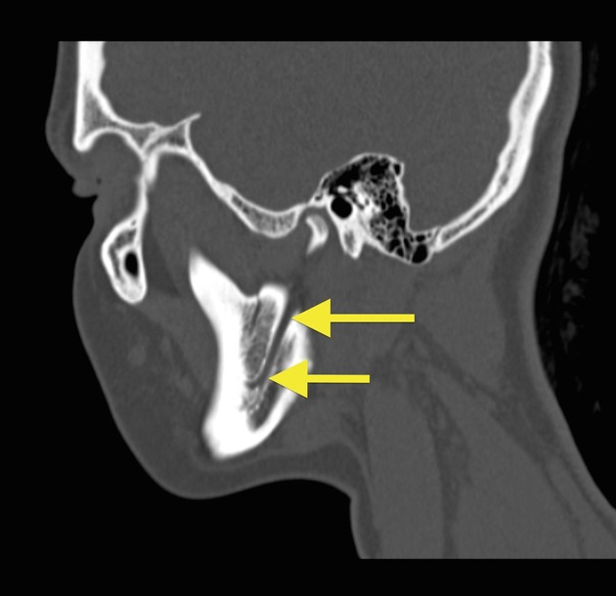
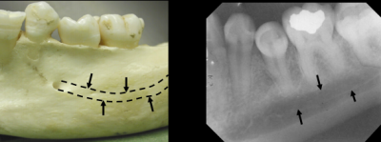
Walls of Mandibular Canal

Slide 4

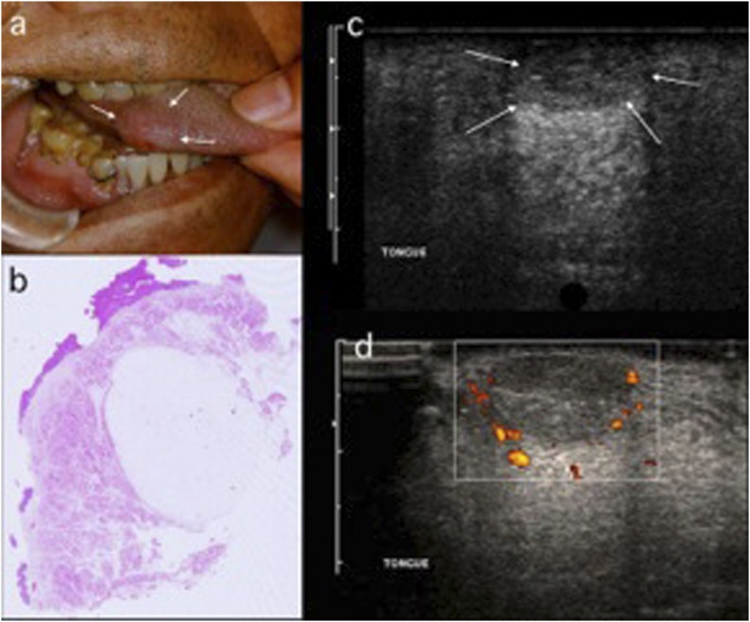
Soft Tissue Shadow of the Tongue

Slide 5
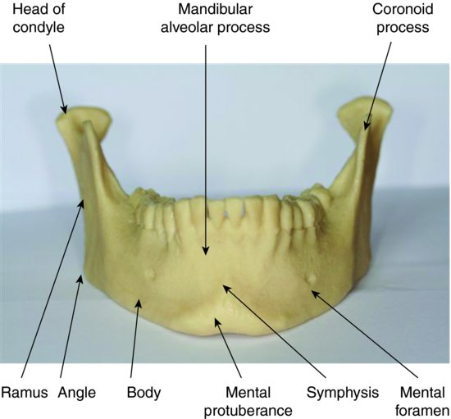
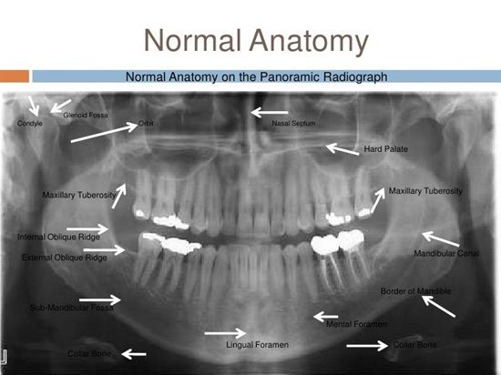

Slide 6
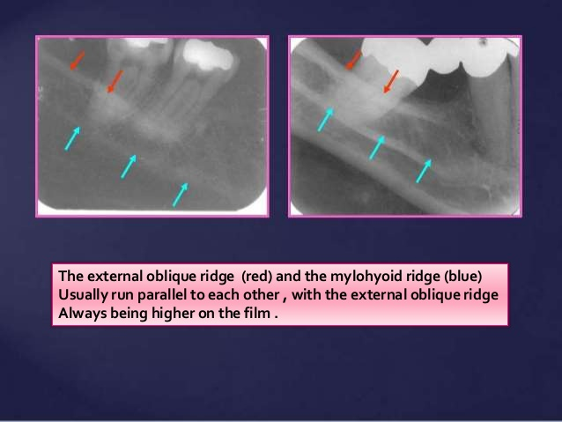
The External and Mylohyoid Ridges

Slide 7
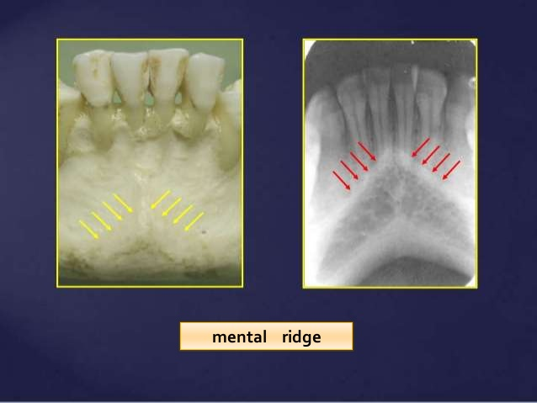
Mental Ridge

Slide 8
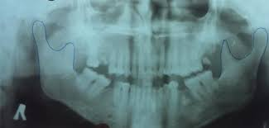
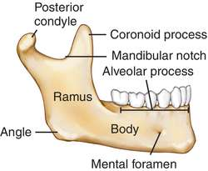
Condyle and Coronoid Process

Slide 9
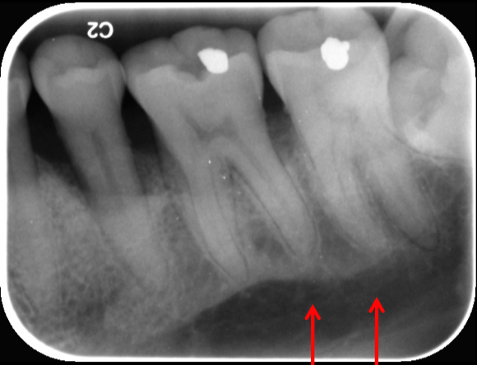
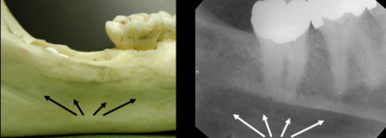
Submandibular fossa

Slide 10
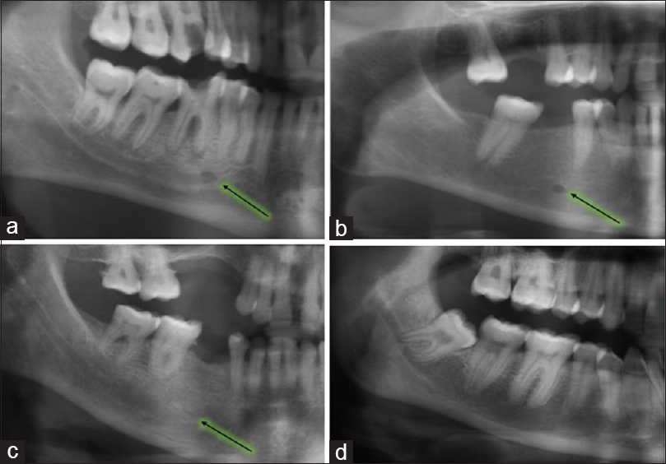
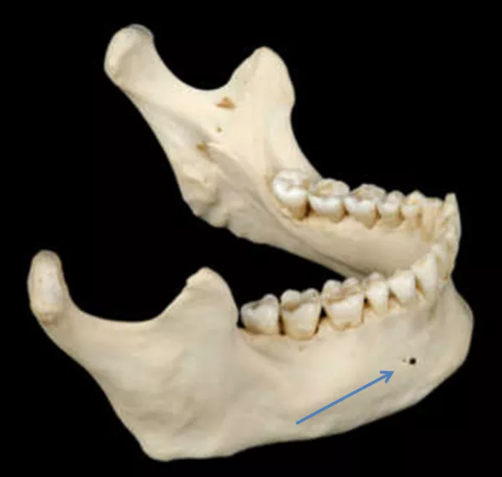
Various appearance of mental foramen

Slide 11
References
www.ncbi.nlm.nih.gov/pmc/articles
https://oralradiology.wordpress.com
www.google.com/search submandibular+salivary+gland+fossa+anatomy
www.google.com/searchq.mandibular+canal
http://www.jfsmonline.com
http://www.oraljournal.com

