Slide 1
Importance of oral hygiene in our life

Slide 2
Presented by:
Fuchs, Maxine
Mikhelis, Natallia
Roy, Prianka
Stern, Zoe
Yakimidi, Vlada
Zhalivtsiv, Nataliia

Slide 3
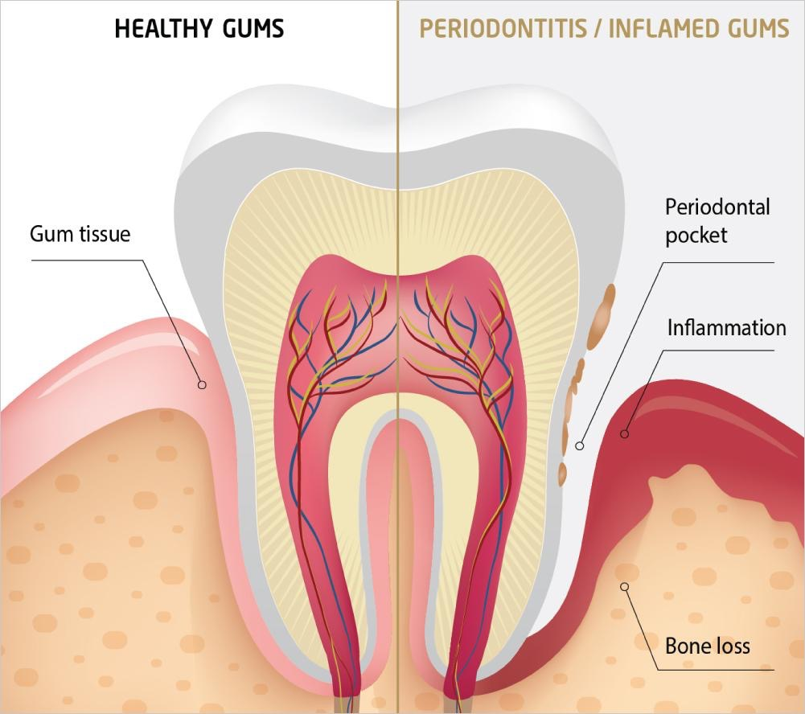
Importance of Oral Health
What is Dental Hygiene?
Dental hygiene, or oral health, is concerned with the teeth, gums and mouth. The goal is to prevent complications such as tooth decay (cavities) and gum disease and to maintain the overall health of your mouth.
Notes:
Image: https://us.periochip.com/for_patients/

Slide 4
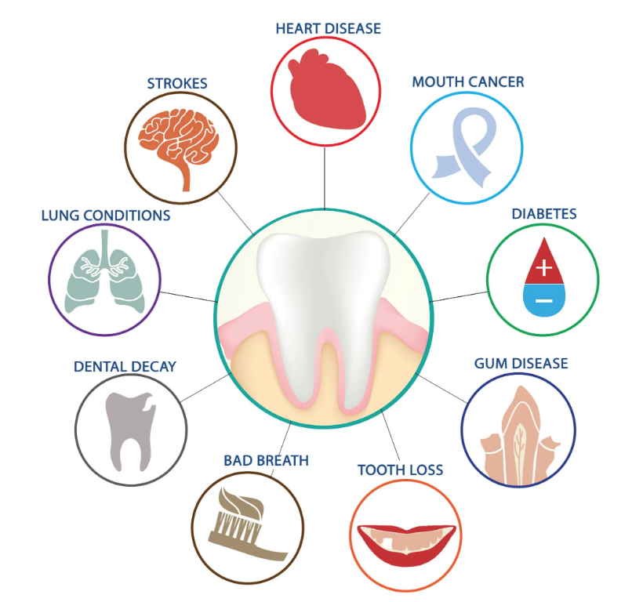
The Mouth Serves as a “Health Window”
to the Rest of the Body
Why is Dental Health important?
Oral conditions have an impact on overall health. Bacteria from the mouth can cause infection in other parts of the body when the immune system is compromised.
Systemic conditions and their treatment may also have an impact on oral health, such as reducing salivary flow or altering the balance of oral microorganisms

Slide 5
Gum Disease
Gingivitis refers to inflammation of the gums due to an excess of plaque on the teeth. Signs of gingivitis include red, swollen gums, or gums that bleed easily when you brush your teeth. This can be reversed with good oral home care and regular cleanings at the dentist.
Periodontitis is caused by untreated gingivitis that has advanced. The result has lasting damage to your teeth and the bones that support them and is the leading cause of tooth loss.

Slide 6
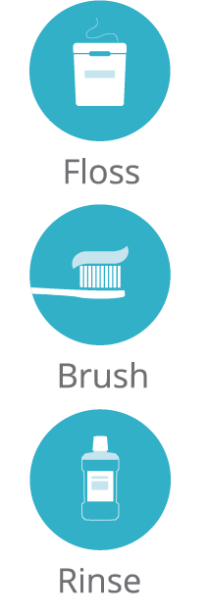
Oral Health Care
How can I protect my oral health ?
To protect your oral health, practice good oral hygiene daily.
Brush your teeth at least 2x’s a day with a soft-bristled brush using fluoride toothpaste.
Floss or use another interdental cleaner daily.
Use mouthwash to remove food particles left after brushing and flossing.
Eat a healthy balanced diet and limit between-meal snacking.
Replace your toothbrush every three months or sooner if bristles are splayed or worn.
Schedule regular dental checkups and
dental hygiene cleanings.

Slide 7
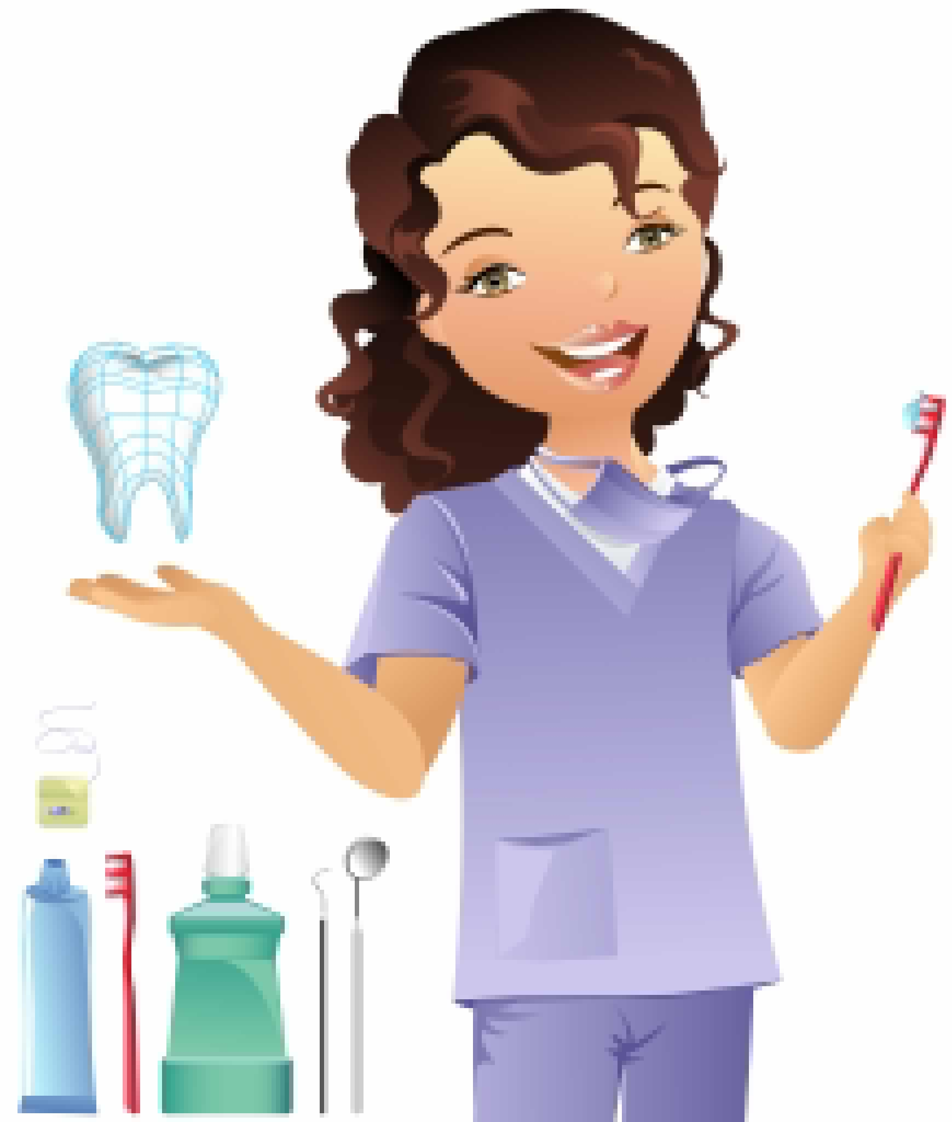
Dental Visits
Why is it important that I schedule regular visits to the dentist if I take good care of my teeth?
Many people believe that they need to see a dentist only if they are in pain or think something is wrong, but regular dental visits can contribute to a lifetime of good oral health.
Routine cleanings and examinations allows the dental hygienist to catch small issues before they evolve into serious problems. This is especially true if you have diabetes or some other underlying health issue that could potentially worsen if your oral health is poor.

Slide 8
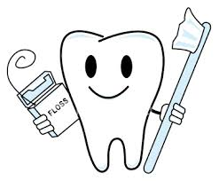
Oral Hygiene Instruction: Toothbrush
The Importance of Brushing includes:
Dental biofilm removal
Application of preventive agents
Halitosis control (Bad breath)
Oral cavity sanitation
A proper brushing technique is the first step in maintaining healthy teeth and gums. For proper control of dental biofilm and oral cavity sanitation, at least two brushings, minimum, are recommended per day, as well as appropriate interdental care. The longer the bacteria remain undisturbed in the mouth, the greater the pathogenic potential.
Notes:
https://clipartix.com/floss-clipart-image-56403/

Slide 9
Oral Hygiene Instruction: Floss
The Importance of Flossing includes:
Removing biofilm and food particles from interproximal surfaces
Prevents plaque build-up that can lead to gum disease and cavities in the areas that a toothbrush can’t reach
Allowing access of the proximal surfaces for
fluoride and other agents in toothpaste
Brushing alone may not prevent you from gum disease and
tooth loss. Cleaning between teeth a minimum of once a day
is essential to your oral and overall health. Patients should
talk to their dentist and dental hygienist about choosing the
right interdental cleaner for them.

Slide 10
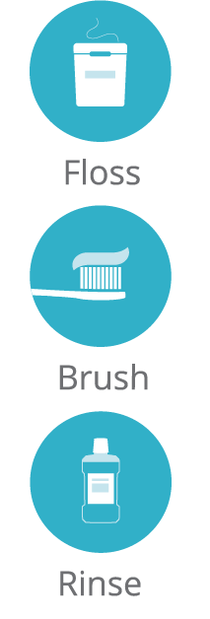
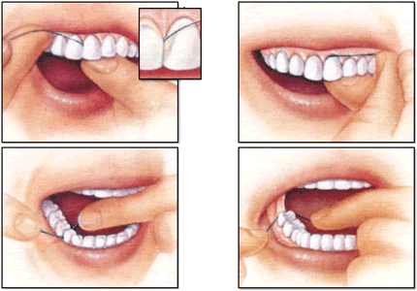
Notes:
https://www.dentalcare.com/en-us/patient-education/patient-materials/manual-brushing-and-flossing

Slide 11
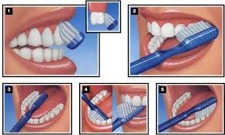
Notes:
https://www.dentalcare.com/en-us/patient-education/patient-materials/manual-brushing-and-flossing

Slide 12
Common Mistakes & How to Implement Positive Habits
Brushing for too long or not long enough
Brushing correctly involves spending two full minutes using a recommended brushing technique, which includes 30 seconds of brushing each quadrant of the mouth (upper right, lower right, upper left, lower left). Many power toothbrushes have built-in timers that signal lapsed time. This should be done twice daily.

Slide 13
Using a hard-bristle toothbrush A soft nylon brush is not only more effective in cleaning hard to reach areas, but less traumatic to the gum tissue in vigorous brushers. This helps in preventing sensitive gums, tooth abrasion, and gingival recession. Brushing too soon after eating Acids created by food can lower the pH level in the oral cavity, weakening the enamel of your teeth! Brushing can pose as a risk in abrasively wearing away that enamel if done too soon. You should allow time for the saliva in your mouth to properly return the pH level in your mouth back to normal before brushing - about 1 hour!

Slide 14
Common Mistakes & How to Implement Positive Habits
Not cleaning tongue.
Total mouth cleanliness involves the tongue too!
Using incorrect brushing technique
One should speak to their dentist and dental hygienist about choosing the right prevention and brushing technique that meets their own personal needs. Manual or powered toothbrushes may be ideally effective for different patients. Overall, prevention should include ensuring the complete coverage of each tooth surface.

Slide 15
Without variations for special conditions, the widely accepted effective method (Bass Method) involves brushing toward the gums (up for maxillary and down for mandibular), turning the brush head at approximately a 45-degree angle in short, light strokes against the gum line.
Keeping the same toothbrush
It is important to change your toothbrush every 3 months!

Slide 16
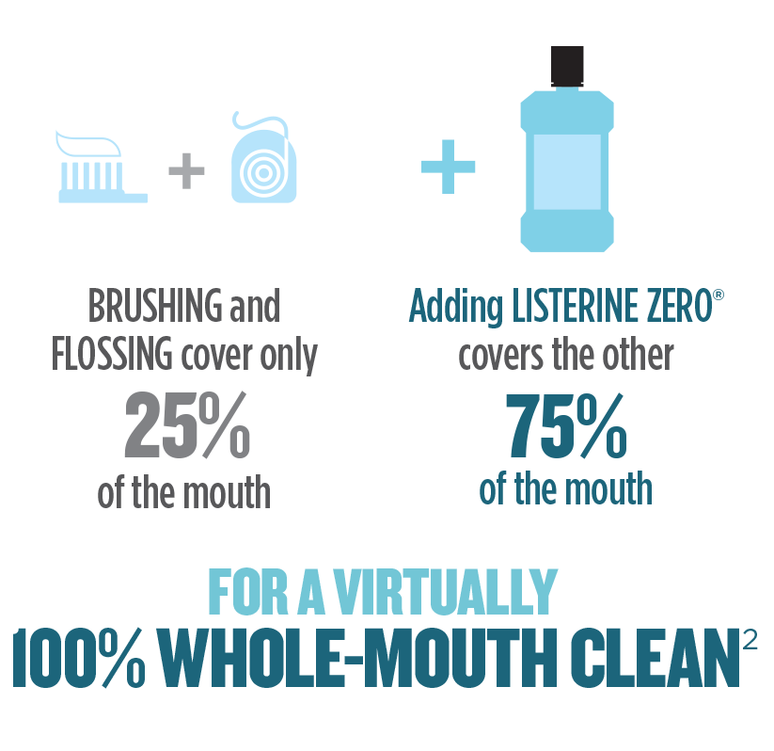
Rinse
Rinse with an ADA-accepted antimicrobial mouthwash to reduce plaque and gingivitis
And also a fluoride mouthwash to prevent tooth decay

Slide 17
Rinse 2x/day for 30 seconds with 20 ml(4 teaspoons)– can penetrate deep into plaque biofilm to kill the bacteria in virtually 100% of the mouth

Slide 18
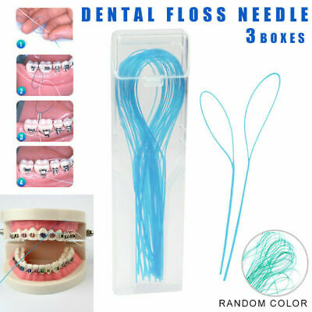
Dental floss threaders for orthodontic braces
Flossing with braces can be tedious, but you won't regret it. First of all, if you don't floss you will develop the gum disease gingivitis, which makes your gums sensitive, red and swollen, resulting in a “gummy” smile. Plus, your teeth will move a lot faster with healthy gums.

Slide 19
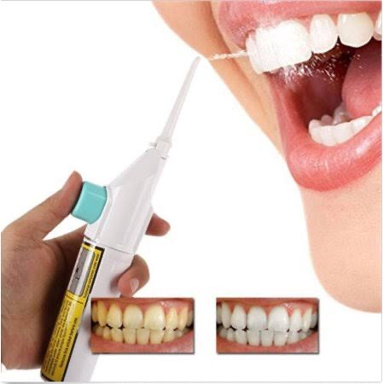
Waterpik for gums
Gingivitis is caused by the accumulation of plaque and bacteria lurking between and around your teeth resulting in red, swollen, and bleeding gums. ... You can treat gingivitis at home using a Waterpik® Water Flosser.
The researchers found that the group who used the waterpik had a 74.4 percent reduction in plaque as compared to a 57.7 percent reduction in the group who used the string floss.

Slide 20
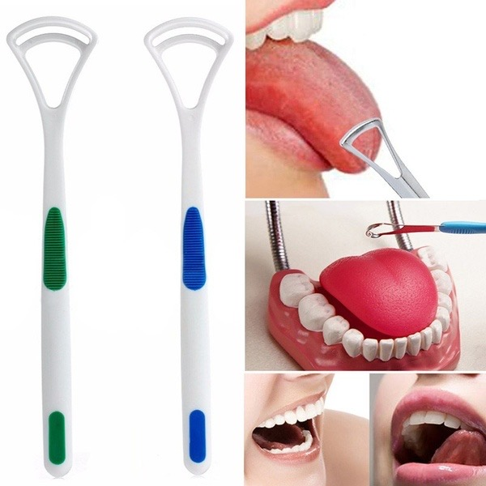
Tongue cleaner
Tongue scraping can do a better job at removing the plaque and bacteria off the tongue's surface

Slide 21
Vaping and Oral Health
E-cigarette use from 2017 to 2018 increased 78% among high school students and 48% among middle school students.
Using e-cigarettes, referred to as vaping, works by heating a liquid to generate an aerosol that the user inhales.
Ingredients:
Propylene;
glycol;
glycerin;
flavorings;
water;
nicotine;
THC;
Acetate E oil.

Slide 22
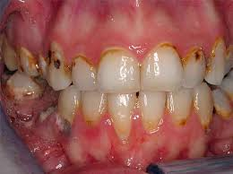
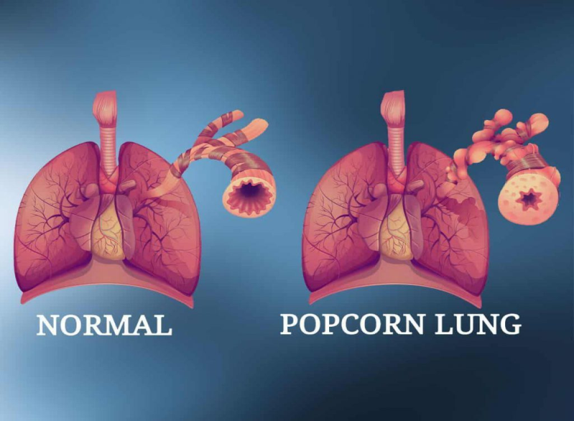
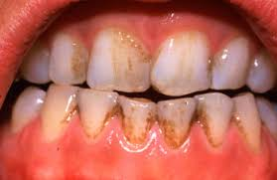
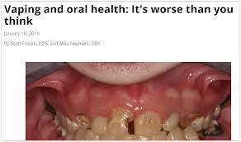
Vaping and Oral Health

Slide 23
Alcohol and Oral Health
Gum disease;
Tooth decay;
Mouth sores ;
Plaque/Stain;
Dryness;
Tooth damage.
(more likely for heavy drinkers, and alcohol abuse is the second most common risk factor for oral cancer).
If you're going to drink alcohol, here are some tips to help keep your mouth healthy:
Drink responsibly and in moderation.
Drink plenty of water.
Brush and floss daily. .
Visit your dentist.

Slide 24
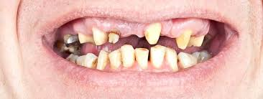
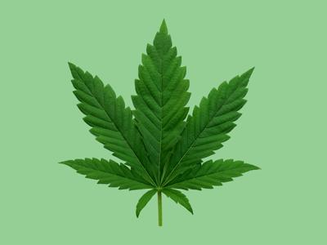
Oral Health of Drug Abusers
Tooth loss;
Tooth extractions;
Generalized tooth decay;
Salivary hypofunction;
Xerostomia;
Burning mouth;
Taste impairment;
Eating difficulties;
Mucosal infections;
Periodontal diseases.
Cannabis is the most abused drug in most countries of the world.1 An estimated 147 million people use cannabis globally, mainly for recreational purposes.
Cannabis smoking is associated with periodontal complications, xerostomia, and leukoplakia as well as increased risk of mouth and neck cancers.

Slide 25
Nutrition
Dental health is more important than most people realized. And nutrition plays a big role in this. We would like to provide a few suggestions that will protect your teeth from erosion, staining, caries.

Slide 26
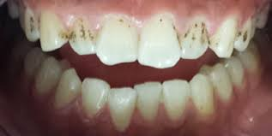
Suggestion #1
Coffee and black tea can cause staining of your teeth.
Do not brush your teeth right after coffee or any other acidic food or drink. Better drink water and if you need to brush you can brush 30 minutes after consumption, because this is the time needed for our pH to get back to normal.

Slide 27
Suggestion #2
Dental erosion is the loss of the surface of your teeth due to acids that you eat or drink. Stomach acids also can cause erosion. This acids has a big influence on our enamel leading tooth surface loss. Try to avoid acidic food in a big amounts and often, drink water after eating this type of food.

Slide 28
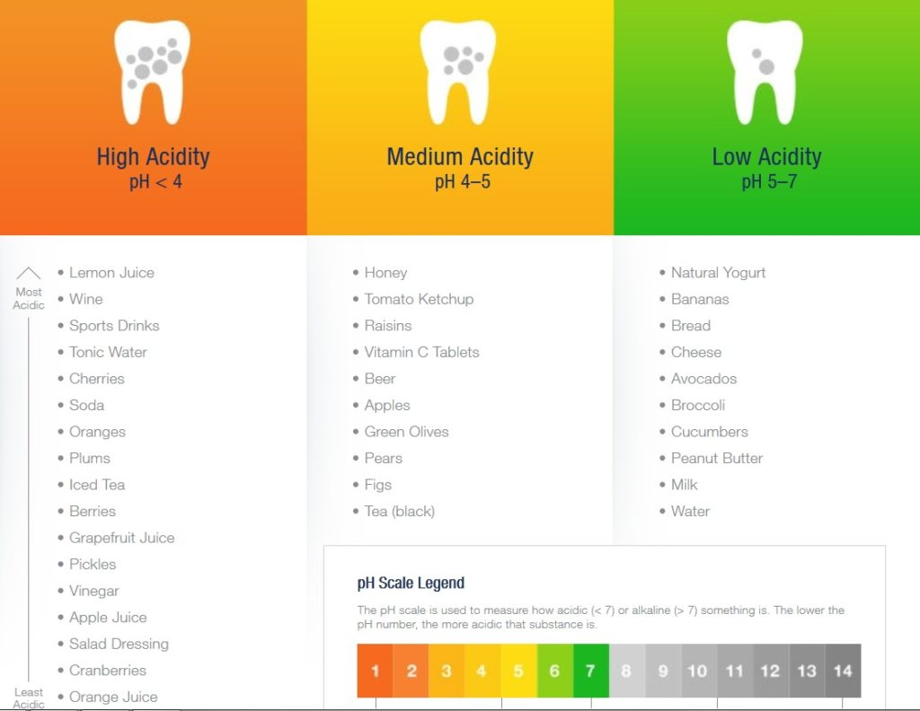
Print master

Slide 29
#3: Sweets can cause carries. Streptococcus mutans cause caries. This bacteria stick to our teeth metabolize and release a byproduct acid which softens our enamel and makes penetration of bacteria easier, that will cause decay.
#4: Felling asleep with milk bottle can cause early childhood caries.
If your child can’t fell asleep without bottle, give them water instead of milk.

Slide 30
References
https://www.healthline.com
https://www.perioimplantadvisory.com
https://www.cigna.com
https://www.ncbi.nlm.nih.gov

