Slide 1
Dilaceration and Accessory Roots
by Natallia Mikhelis

Slide 2
Definition
The term dilaceration was first used by Tomes in 1848 and is defined as a deviation or bend in the linear relationship of crown of a tooth to its root
Dilaceration is a developmental disturbance in shape of teeth. It refers to an angulation, or a sharp bend or curve, in the root or crown of a formed tooth

Slide 3
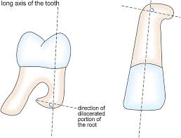
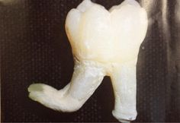
EXAMPLES

Slide 4
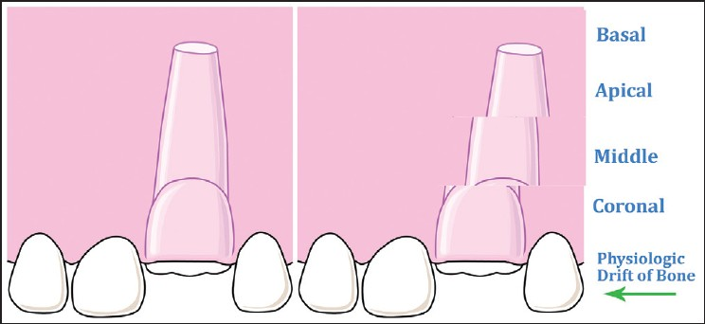
Causes of Roots Dilaceration
The proposed hypothesis describes tooth root dilaceration resulting from tooth root sheath displacement due to gradients of plasticity present within the alveolar bone. A possible etiology for the dilaceration of permanent tooth roots relative to bone remodeling gradients in alveolar bone.

Slide 5
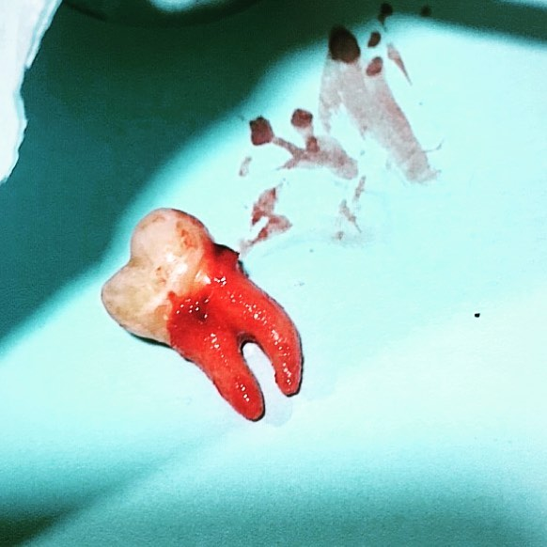
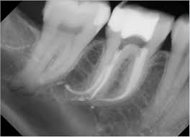
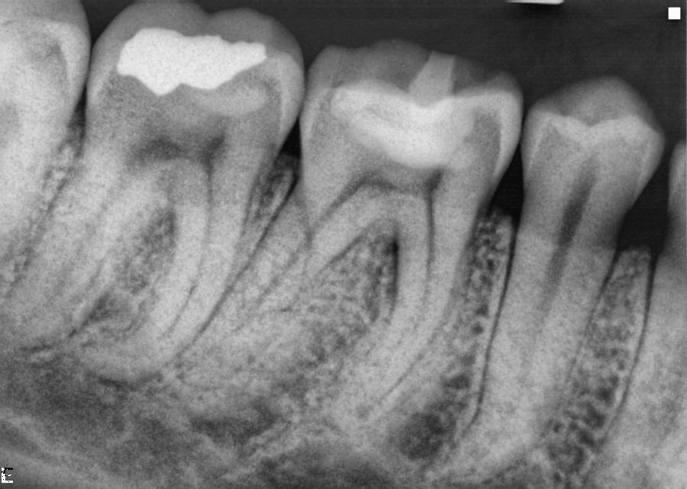
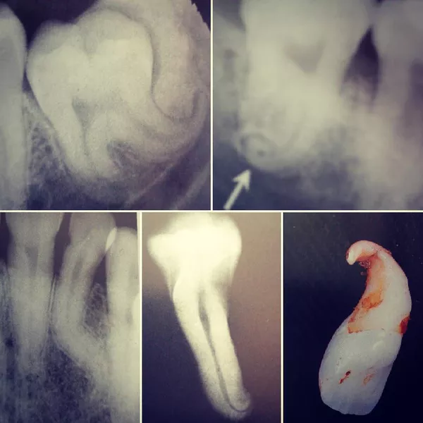
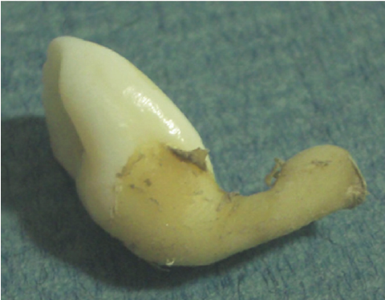

Slide 6
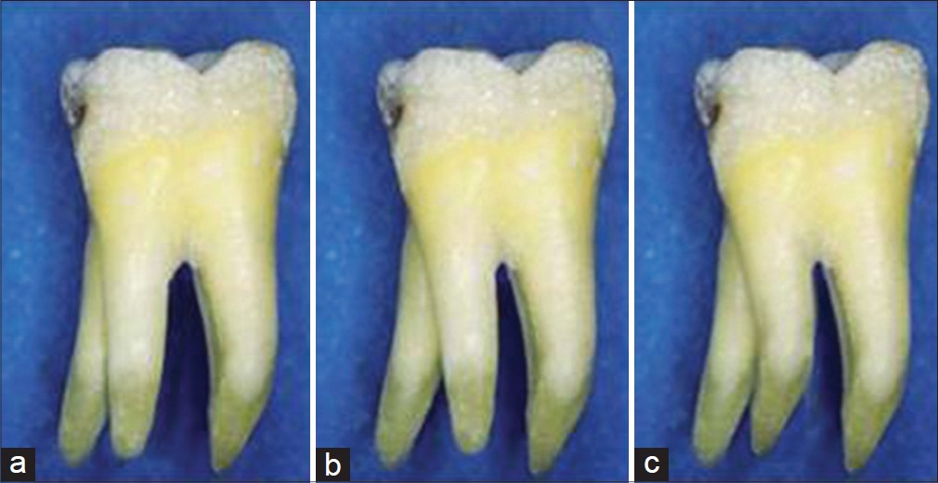
Accessory Roots
An anomalous additional tooth’s root.

Slide 7
Etiology
Accessory root formation usually occurs through
two ways:
either by splitting the Hertwig’s Epithelial
Root Sheath (HERS) to form two similar roots;
2. folding of the HERS to form an independent root
which may have various morphological features.
The etiology of this groove is not fully understood. It could represent an infolding of the enamel organ and HERS (Hertwig’s Epithelial Root Sheath) or an alteration of genetic mechanisms.

Slide 8
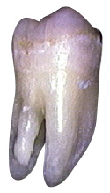
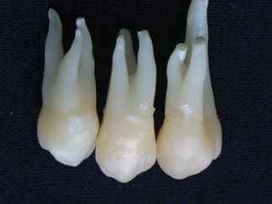
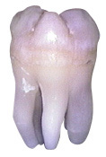
Examples
Highest Incidence of Extra Roots
Third molars

Slide 9
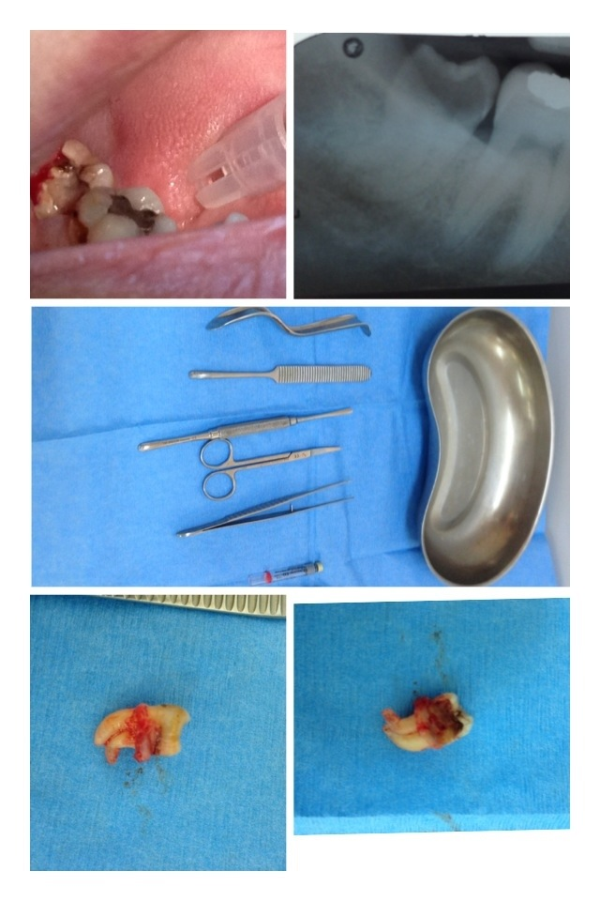
Clinical Consideration
Clinical recognition of dilaceration of the root and accessory roots of teeth is important
because it can lead to non eruption, longer retention of primary predecessor tooth or possible apical fenestration of the buccal or labial cortical plate.
Dilaceration causes a challenge for endodontic or orthodontic treatment as well as difficulty in extraction.
X-ray is required!!!

Slide 10
References
https://www.researchgate.net/publication/285204618_A_possible_etiology_for_the_dilaceration
file:///C:/Users/Natali/Pictures/a09v12n1%20(1).pdf
https://onlinelibrary.wiley.com/doi/pdf/10.1111/iej.1250
http://www.brainelike.com/dentanat_tour/Anomalies_Dental_Hard_Tissues/Anomalies_Dental_Hard_Tissues_print.html

Slide 11


