Slide 1
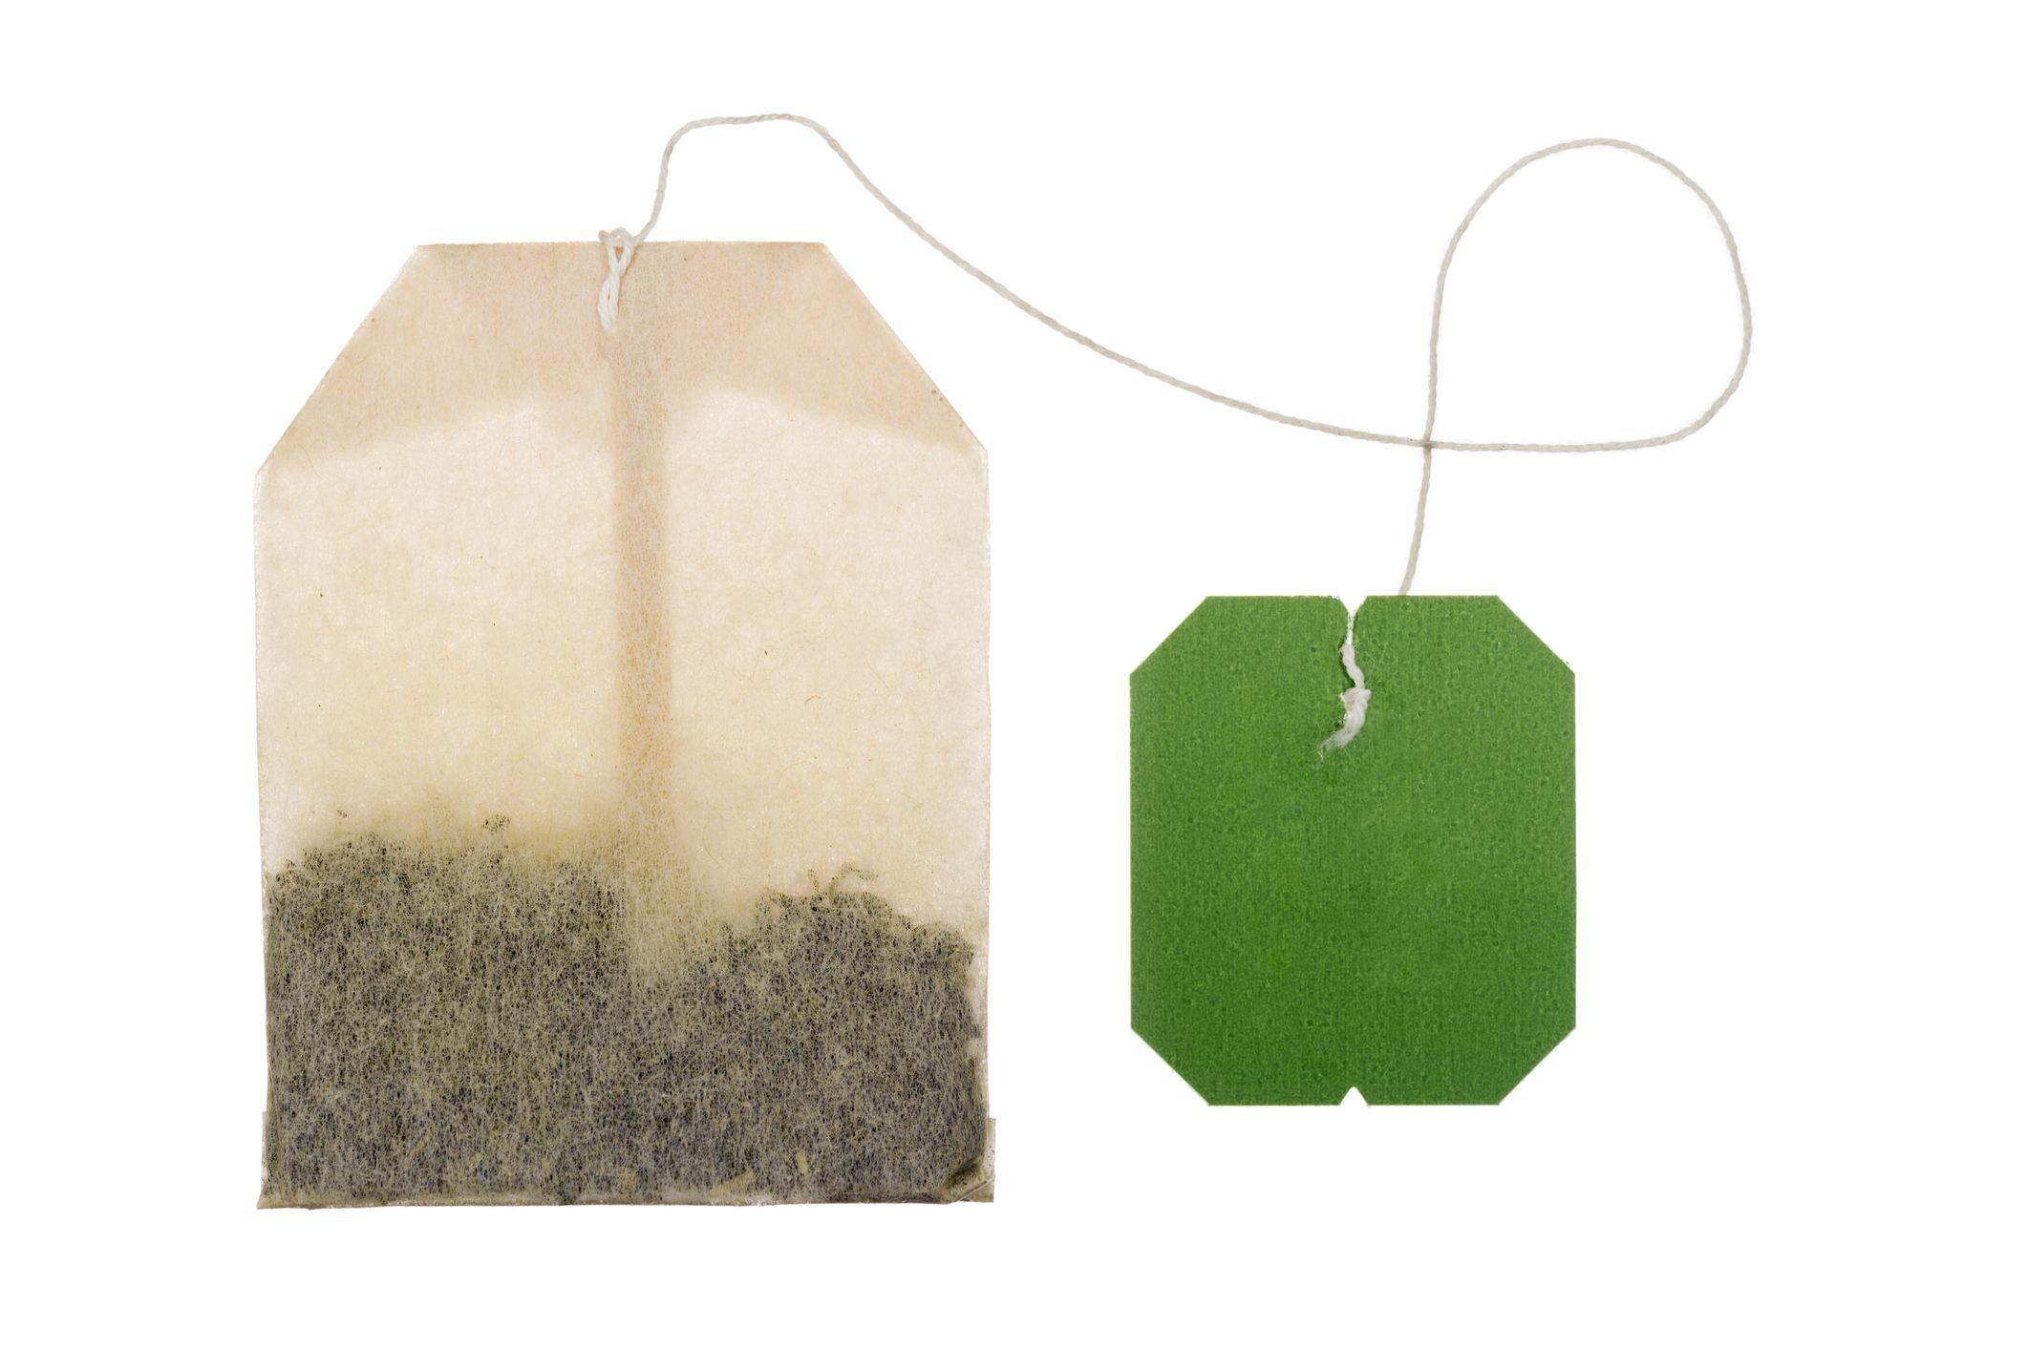
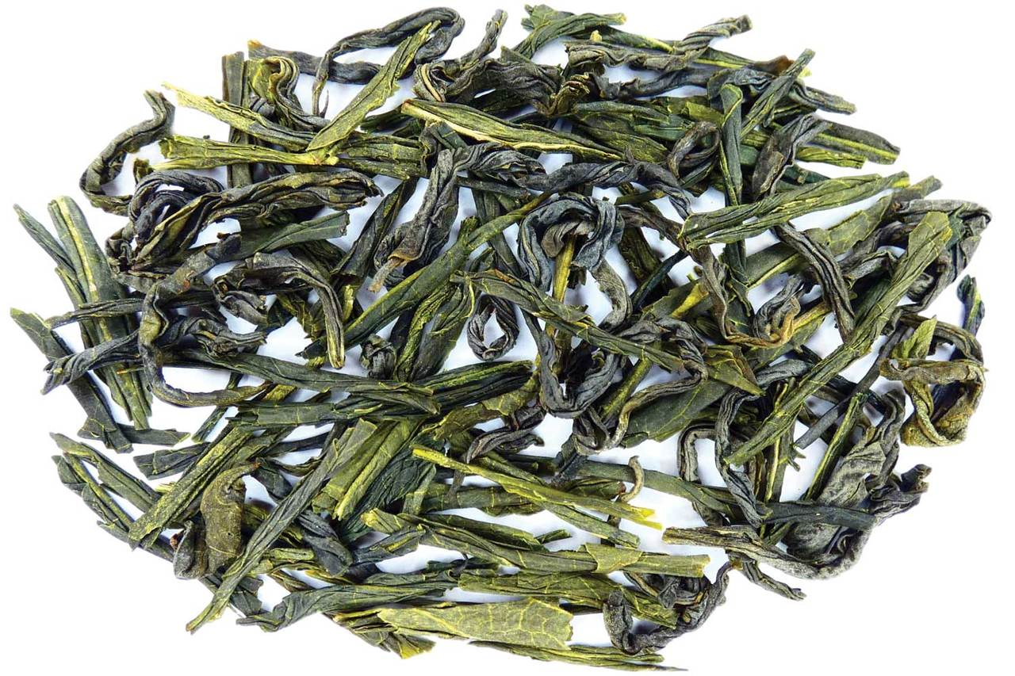
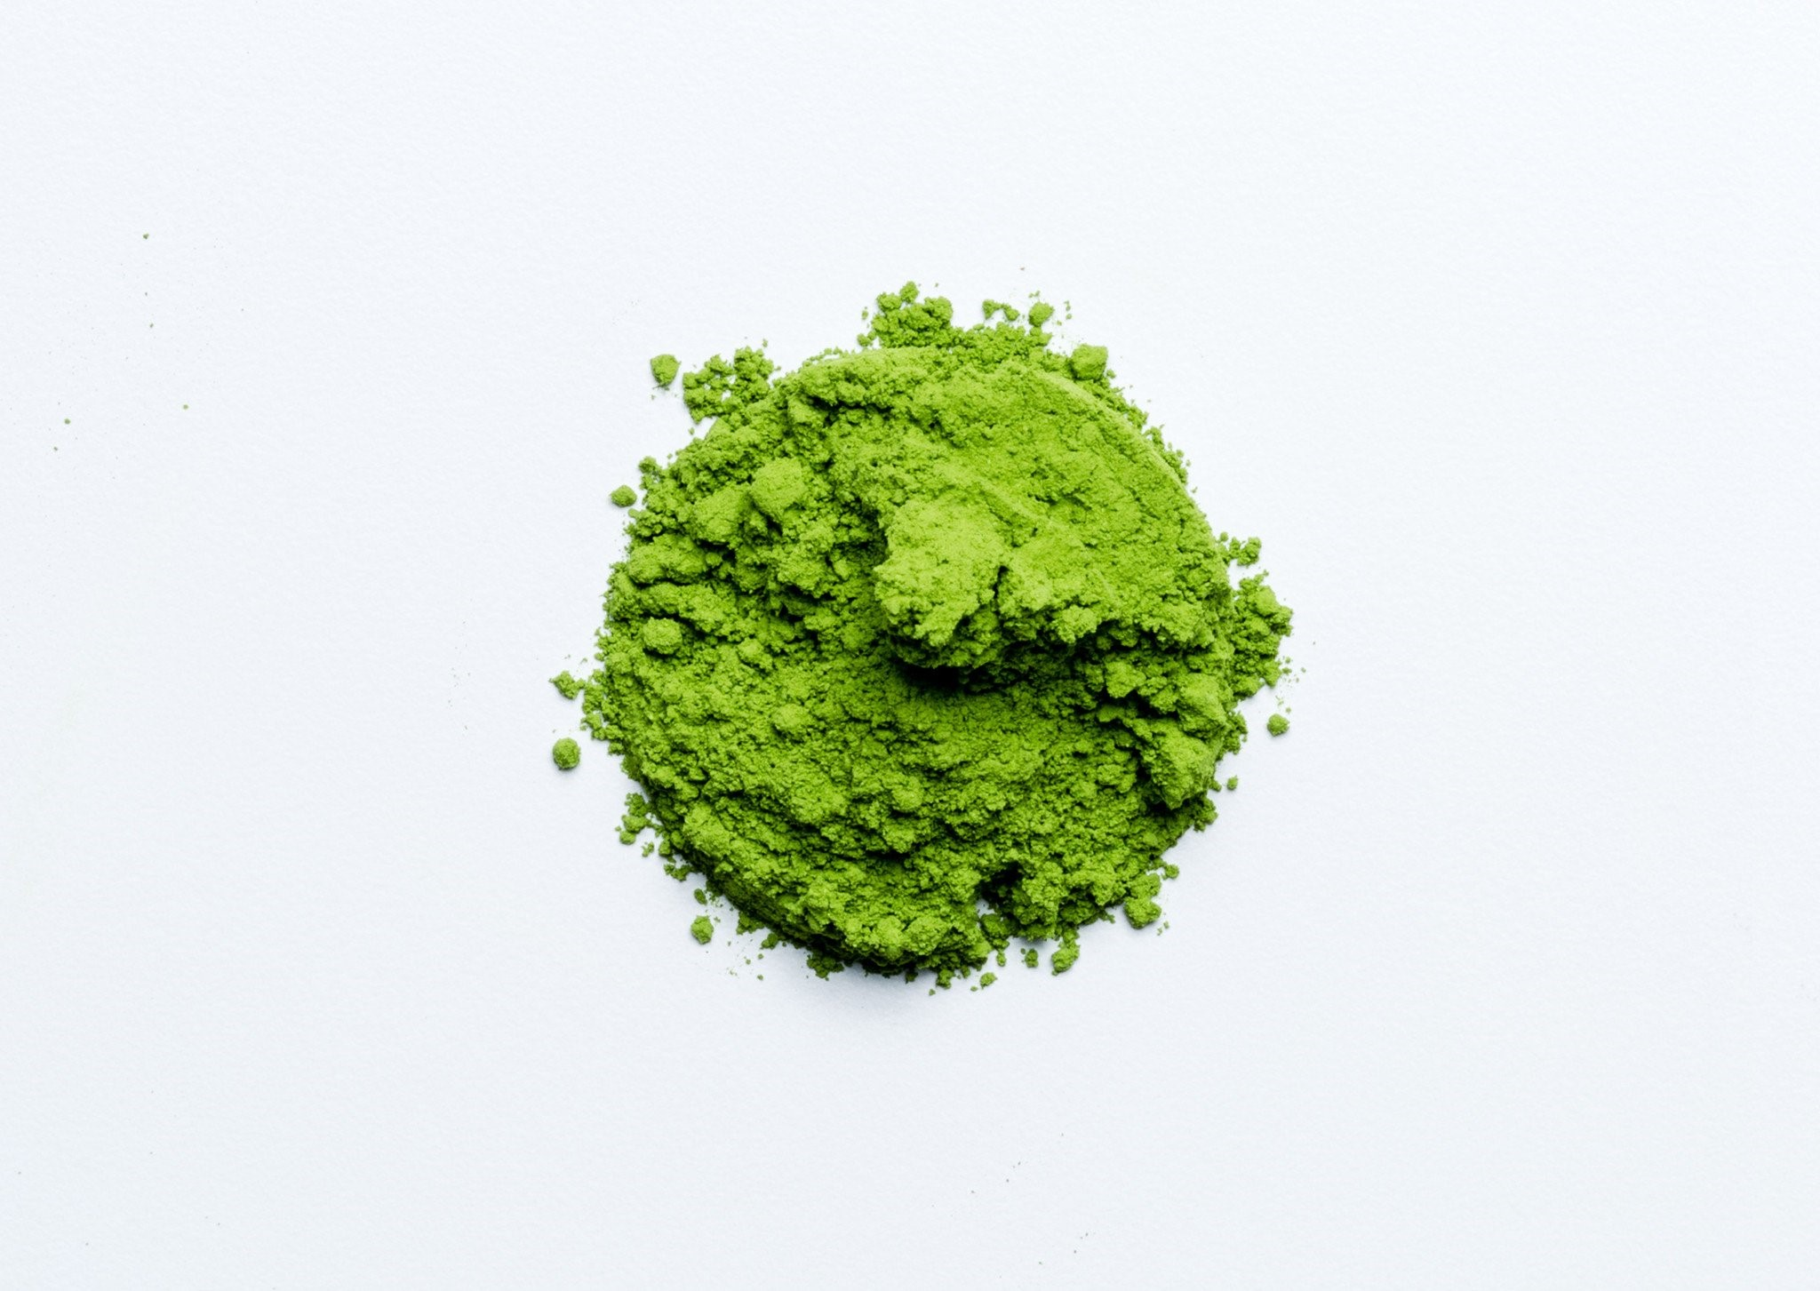
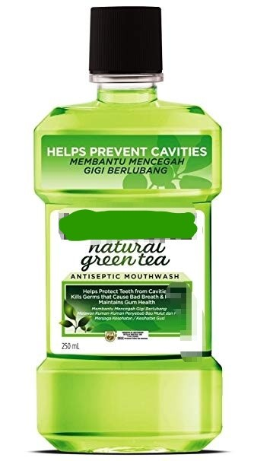
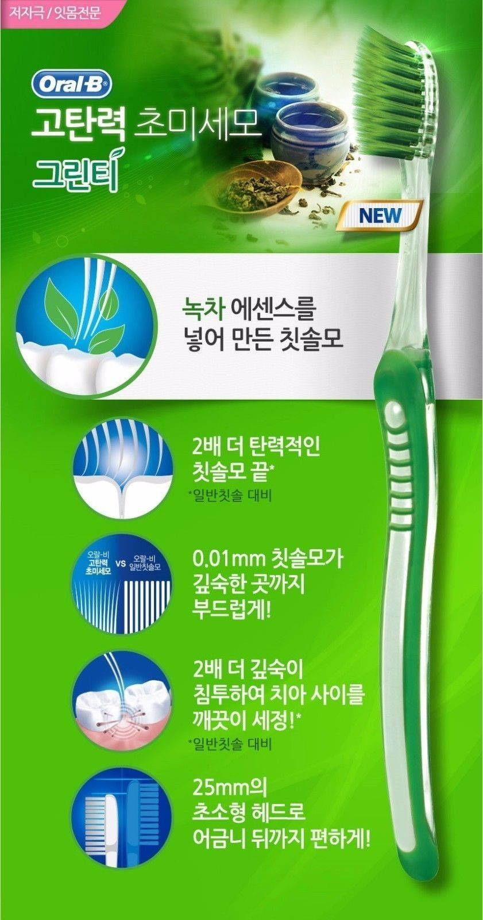
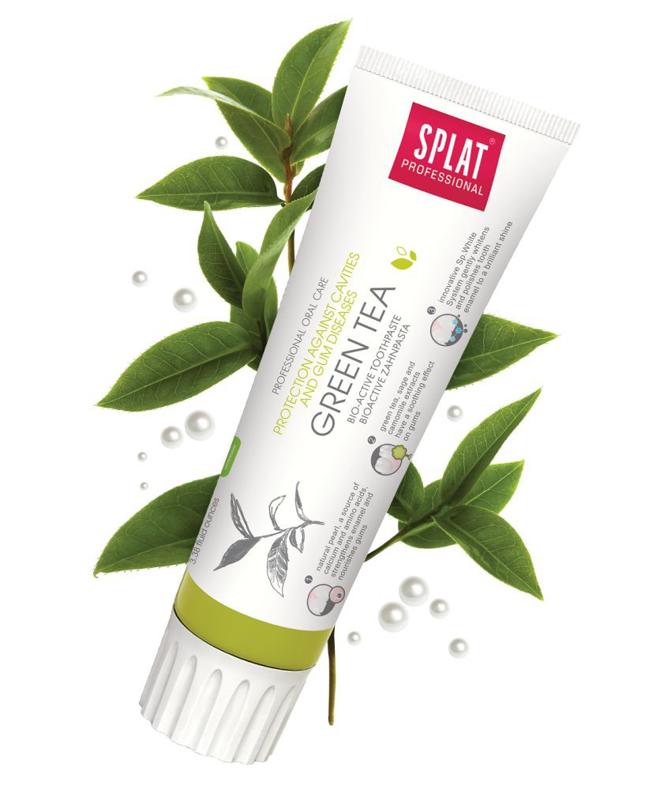
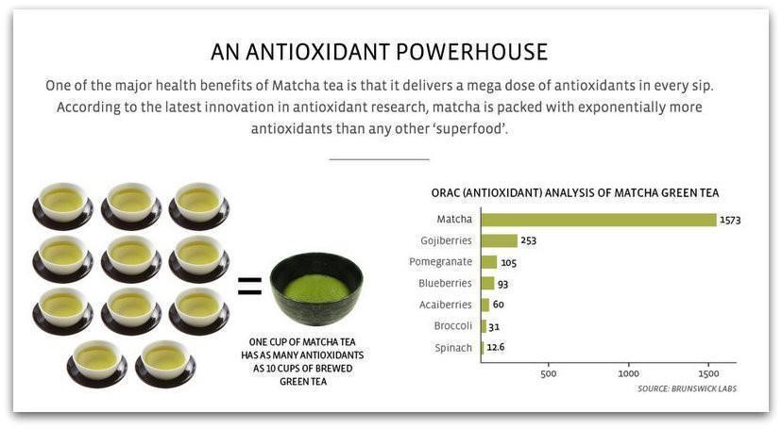
Green Tea and Its Effects on Oral Health
Zoe Stern, Nicky Joe Ly, Liling Zhang
New York City College of Technology
INTRODUCTION
ANTIMICROBIAL EFFECTS
What is Green Tea?
- Green tea was first discovered in China in 2737 BC. It serves as a beverage as well as medicine in many countries.
- Derived from the camellia sinensis plant, green tea is made by steeping cooked tea leaves in hot water. The health promoting effects of green tea, or its polyphenol catechin (antioxidant) content, represents 30% of its fresh leaf dry weight.
- Another type of green tea is called matcha, where the camellia sinensis leaves are consumed whole by grinding it down to a powder and mixing it into hot water.
Studies have shown that the direct effect of green tea catechins (antioxidants) lies with its ability to inhibit bacterial growth by binding to the bacterial cell membrane and inhibiting their enzyme activities.
This includes:
Streptococcus Mutans, Strep. Sobrinus, Lactobacilli - Associated with caries
Porphyromonas Gingivalis and Prevotella Intermedia (Halitosis and Periodontal disease)
Salmonella Typhi, Salmo. Typhimurium, Salmo. Enteritidis (Typhoid Fever)
Shigella Felxneri, Shigella Dysenteriae (Causes Diarrhea and upset stomach)
Vibrio Cholerae (Causes severe diarrhea)
Clostridium SPP ( Causes food-borne disease)
Pseudomonas SPP (Causes infections)
H. Pylori (Causes Ulcers in the stomach)
TYPES OF GREEN TEA
ROLE OF A DENTAL HYGIENIST
-
- To educate the patient about the importance of proper home care because drinking green tea alone is not enough to maintain optimal oral health.
- Encourage the patient to visit their dentist every 4-6 months as needed, for cleaning and checkups.
- Recommend to the patient about the many different varieties of green tea infused products that include:
Mouthwash
Toothpastes
Toothbrushes
Mints/lozenges/chewing gum
String floss
Green Tea Bag
Loose Green Tea Leaves
Matcha Green Tea
BENEFITS
Green tea contains powerful, polyphenol antioxidants that have been shown to:
Promote periodontal health by reducing inflammation
Preventing bone resorption (bone loss)
Limiting the growth of bacteria associated with periodontal diseases and dental caries.
Preventing oral oxidative stress, resulting from cigarette smoking, reducing dentin erosion and abrasion.
Green tea contains four types of catechins (antioxidants):
Epicatechin, epigallocatechin, epicatechin-3-gallate, and Epigallocatechin Gallate (EGCG; the most potent and powerful antioxidant found in green tea!) These antioxidants counteract free radicals in the oral cavity, as well as the body, in protecting cells and tissues from damage.
Epigallocatechin Gallate (EGCG) helps to reduce gingival inflammation and protect against oral diseases such as tooth decay, gingivitis, periodontitis and halitosis (bad breath).
European Market
South African and Middle Eastern Market
East Asian and South East Asian Market
South East Asian Market
DID YOU KNOW?
RESULTS
According to a study in Kyushu University of Japan, researchers linked an important correlation with green tea and oral health. Of the 940 participants that incorporated green tea into their daily diet, there was a decrease in periodontal pocket depth, clinical attachment loss of the gingival tissue and bleeding upon probing of the gingival tissue.
- The antioxidants in green tea reduces the inflammatory response to periodontal bacteria.
- In addition, in a randomized, double blinded, controlled clinical study, stain indexes showed significantly less tooth staining when using a respective green tea mouthwash twice a day for 28 days, as compared with a generic chlorhexidine mouthwash.
RISKS
REFERENCES
- Green tea contains blood thinning qualities, therefore it is important not to mix with drugs such as Aspirin, Apixaban (Eliquis), Dabigatran (Pradaxa), Edoxaban (Savaysa), Fondaparinux (Arixtra), Heparin and Warfarin (Coumadin and Jantoven).
- Patients that may be pregnant should not consume more than three cups a day because it can prevent the absorption of folic acid which is a vital nutrient, especially during the first trimester.
- If you consume more than 7-10 cups a day or drink green tea with your meals, it may prevent absorption of certain nutrients such as iron and thiamine (Vitamin B).
- Chacko, S. M., Thambi, P. T., Kuttan, R., & Nishigaki, I. (2010). Beneficial effects of green tea: a literature review. Chinese medicine, 5, 13. doi:10.1186/1749-8546-5-13
- Health Benefits of Matcha Tea. (n.d.). Retrieved March 28, 2019, from https://matchasource.com/health-benefits-of-matcha-tea
- Khurshid, Z., Zafar, M. S., Zohaib, S., Najeeb, S., & Naseem, M. (2016). Green Tea (Camellia Sinensis): Chemistry and Oral Health. The open dentistry journal, 10, 166–173. doi:10.2174/1874210601610010166
- Maiden, Z. (2017, August 11). The History of Green Tea. Retrieved March 28, 2019, from https://www.hackberrytea.com/blogs/tea-education/the-history-of-green-tea
- Maleki, A., Daraei, H., Mohammadi, E., Zandi, S., Teymouri, P., Mahvi, A., & Gharibi, F. (2016). Daily Fluoride Intake from Iranian Green Tea: Evaluation of Various Flavorings on Fluoride Release. Environmental Health Insights, 10(2016), 59-63.
- Radafshar, G., Ghotbizadeh, M., Saadat, F., & Mirfarhadi, N. (2017). Effects of green tea (Camellia sinensis) mouthwash containing 1% t annin on dental plaque and chronic gingivitis: A double‐blinded, randomized, controlled trial. Journal of Investigative and Clinical Dentistry, 8(1), N/a.
- Study Finds Benefits of Green Tea For Periodontal Health | Colgate Dental Health Articles. (n.d.). Retrieved April 2, 2019, from https://www.colgate.com/en-us/oral-health/conditions/gum-disease/ada-03-green-tea-may-be-good-for-periodontal-health
- Watkins, S. (2017, October). Is it safe to drink green tea during pregnancy? Retrieved April 2, 2019, from https://www.babycentre.co.uk/x568596/is-it-safe-to-drink-green-tea-during-pregnancy
Presented at the 95th Annual Session of the Greater New York Dental Meeting in 2019

