Slide 1
PUBLIC HEALTH
Sajma Feratovic
Navneet Kaur
Marie LaRocca
Besim Mashkulli
Iryna Yakymenko

Slide 2
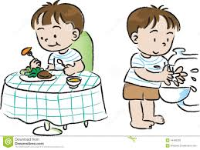
Wash your hands….
Before and after you eat

Slide 3
Wash your hands….
After using the bathroom

Slide 4
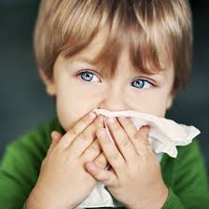
Wash your hands….
After you blow your nose

Slide 5
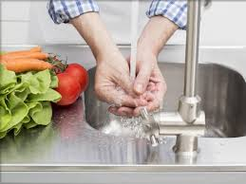
Wash your hands….
Before you cook

Slide 7
Cover your mouth when sneezing or coughing with a tissue or upper sleeve

Slide 8
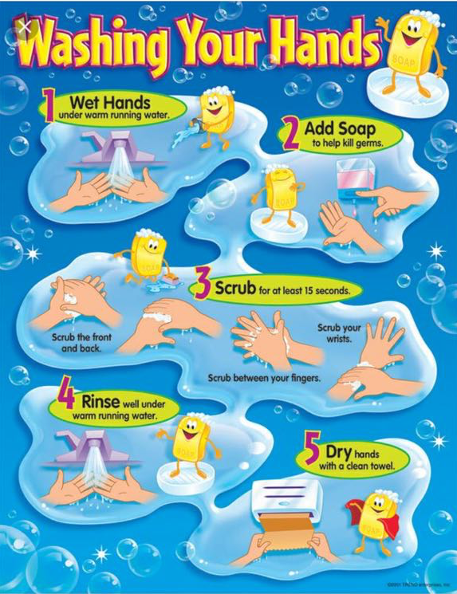

Slide 10
If you get sick, change your toothbrush when you feel better!

Slide 11
Change your toothbrush every 3 months

Slide 12
Brush your teeth 2 times a day, morning and night!

Slide 13
If your teeth touch, floss in between them

Slide 14
Go to the dentist every 6 months

Slide 15
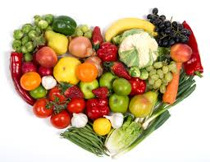
Choose fruits and veggies over candy!

