Slide 1
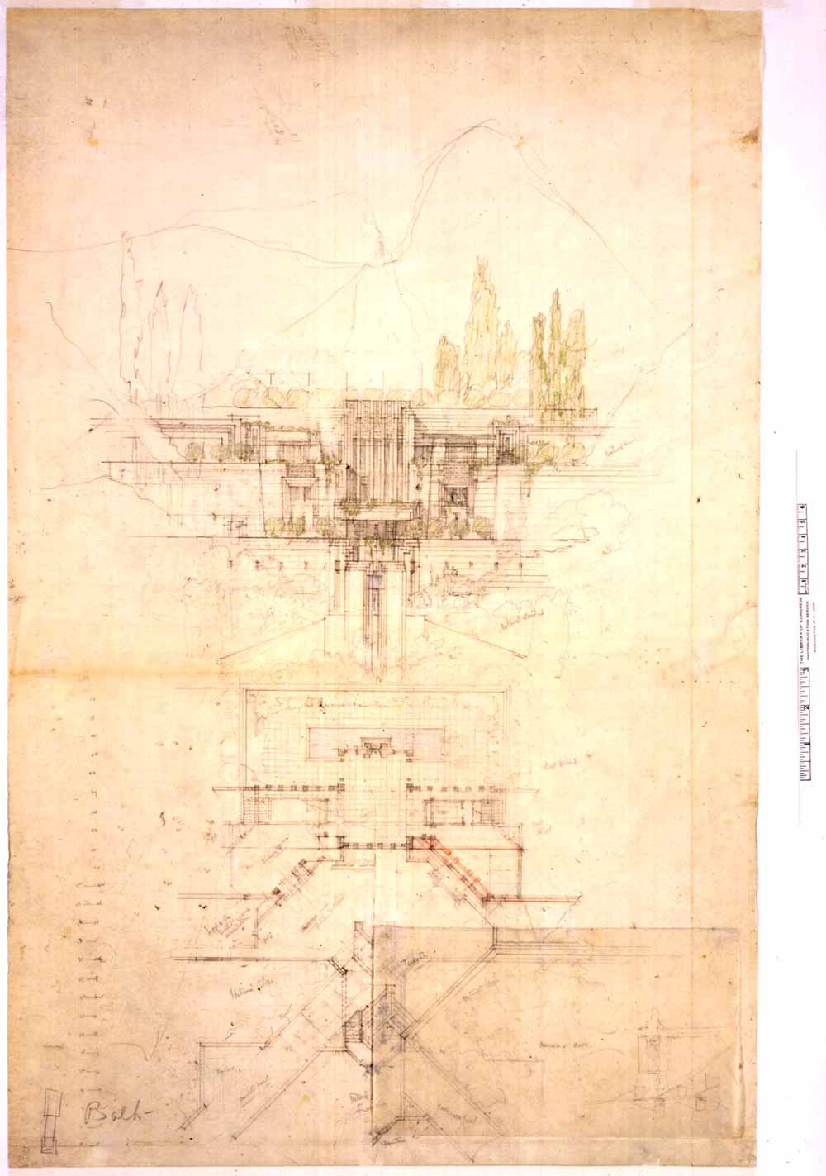
Working Drawings:
Exterior Elevations
CMCE 1110 Construction Drawings
Professor Anderson

Slide 2
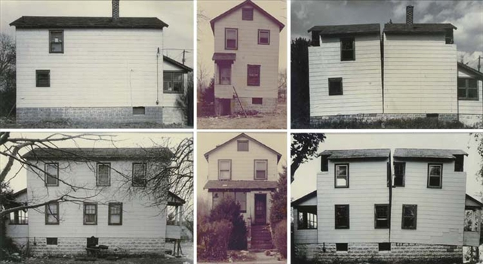
Gordon Matta Clark, Splitting
1974
Building Cuts Series

Slide 3
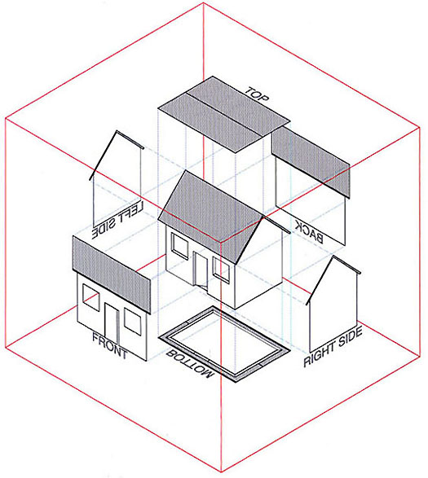
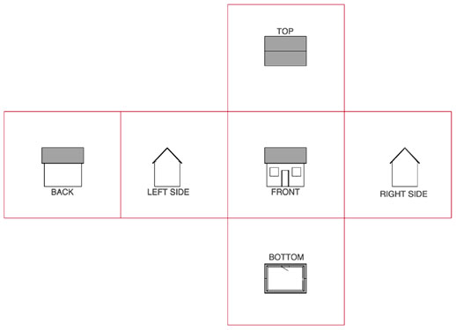
Principles of Orthographic Projection

Slide 4
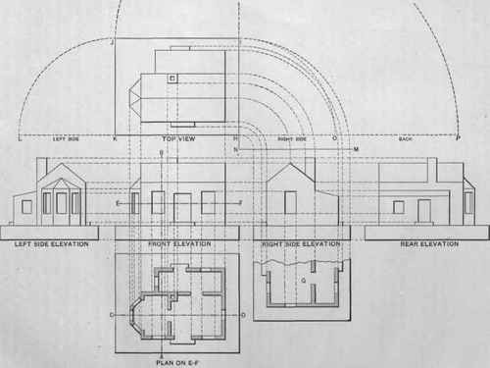
Principles of Orthographic Projection

Slide 5
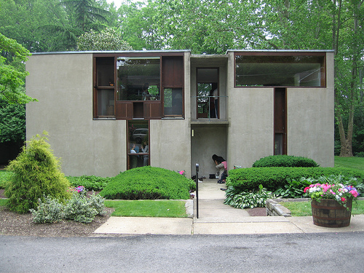
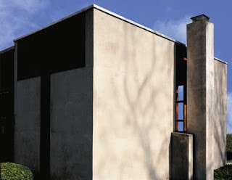
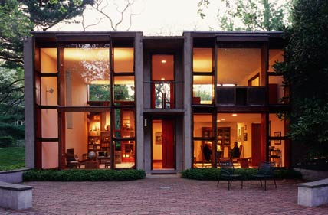
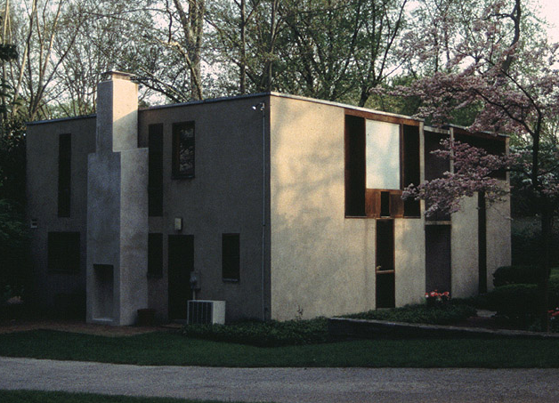
Escherick House
Louis Kahn, 1959-1961
204 Sunrise Lane, Philadelphia, PA
SECOND FLOOR PLAN
FIRST FLOOR PLAN

Slide 6
Autocad Techniques
Leaders
Notes
Hatch
Tools we have learned:
Line and X-Lines
Offset
Extend/Trim
Fillet
Copy/Paste
Ortho Mode and Polar Tracking
Object Snap
Layers and Color Styles
Line-types
Dimensioning
Paper Space vs Model Space
Viewports
Arc
Ellipse
Blocks

Slide 7
Leaders and Notes
Leader creates a line the connect annotation to a feature. It is used for adding notes to a drawing.
Resources: https://knowledge.autodesk.com/support/autocad/learn-explore/caas/CloudHelp/cloudhelp/2016/ENU/AutoCAD-Core/files/GUID-BC466DEE-ACD8-419A-B017-AB3065336AD7-htm.html

Slide 8
Multileader
Editor
Multileader Style Manager allows you to create and modify styles used to create multileader objects.
Access: Down arrow in Leaders window.
1
Resources: https://knowledge.autodesk.com/support/autocad-civil-3d/learn-explore/caas/documentation/CIV3D/2012/ENU/filesACR/WS1a9193826455f5ff104d7f510f19418261-62b0-htm.html
2
4
6
3
5
Set scale factor based on scale of final drawing
BY LAYER
7
Set to 1/8”

Slide 9
Hatches
Hatches are used to fill an enclosed area or selected object with a pattern. Use hatches in section views to indicate specific materials. Also used to add patterns or shading to elevations or plans.
Access: Click hatch button in Home tab or type “h”.
Resources: https://knowledge.autodesk.com/support/autocad/learn-explore/caas/CloudHelp/cloudhelp/2015/ENU/AutoCAD-Core/files/GUID-27C104F2-B687-4025-B50B-A58E37329832-htm.html
1
2

Slide 10
Edit Hatches
Hatch Creation tab pops up when the hatch command is active or when a hatch is selected. Here you can edit hatch patterns, scales, angles, origin and definition.
Access: Click Option down arrow in Hatch Creation tab or type “he”.
OR
1

Slide 11
Orthographic Projection: Process
1
SECOND FLOOR
2
Copy first and second floor plans.
Rotate plans accordingly, per required view.
Align plans (stack vertically – make sure outer walls align).
Set elevation markers in area below plans.
1
FIRST FLOOR
3
2
3
4
4
4

Slide 12
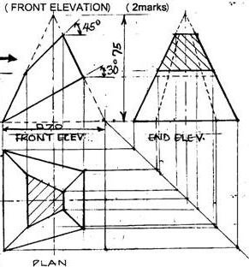
Orthographic Projection: Process
5. Vertical Lines: Use X-Lines to project features from first floor plan to elevation.
5
EXAMPLE

Slide 13
Orthographic Projection: Process
6. (REPEAT 5) Vertical Lines: Use X-Lines to project features from second floor plan to elevation.
6
EXAMPLE

Slide 14
2
Orthographic Projection: Process
1
SECOND FLOOR
2
REPEAT steps 1 – 6 for next elevation.
Copy first and second floor plans.
Rotate plans accordingly, per required view.
Align plans (stack vertically – make sure outer walls align).
Set elevation markers in area below plans.
1
FIRST FLOOR
3
3
4
4
4

Slide 15
Orthographic Projection: Process
8
8
8
8. Horizontal Lines: Create X-Lines to project building regulating lines (floor heights, dimensions) from one elevation to the next.
EXAMPLE

Slide 16
Orthographic Projection: Process
9. Horizontal Lines: Create X-Lines to project features from one elevation to the next. Use known dimensions to construct remainder of elevation. Assign line wieghts/layers as applicable.
9
10. Annotation: elevation markers, notes, dimensions.

Slide 17
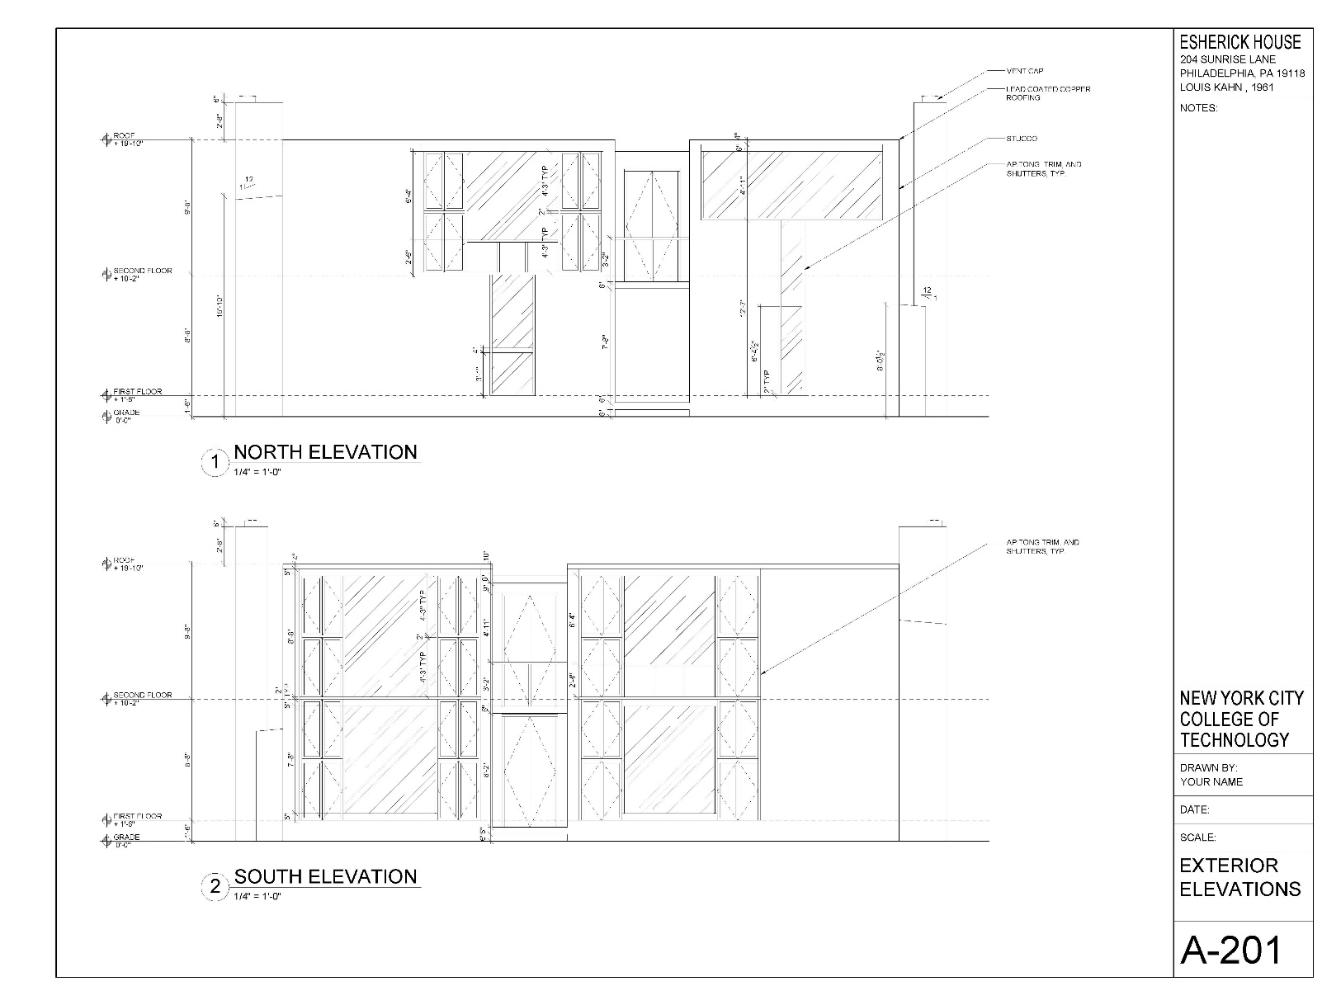
Complete Layout: Titleblock and Viewport

Slide 18
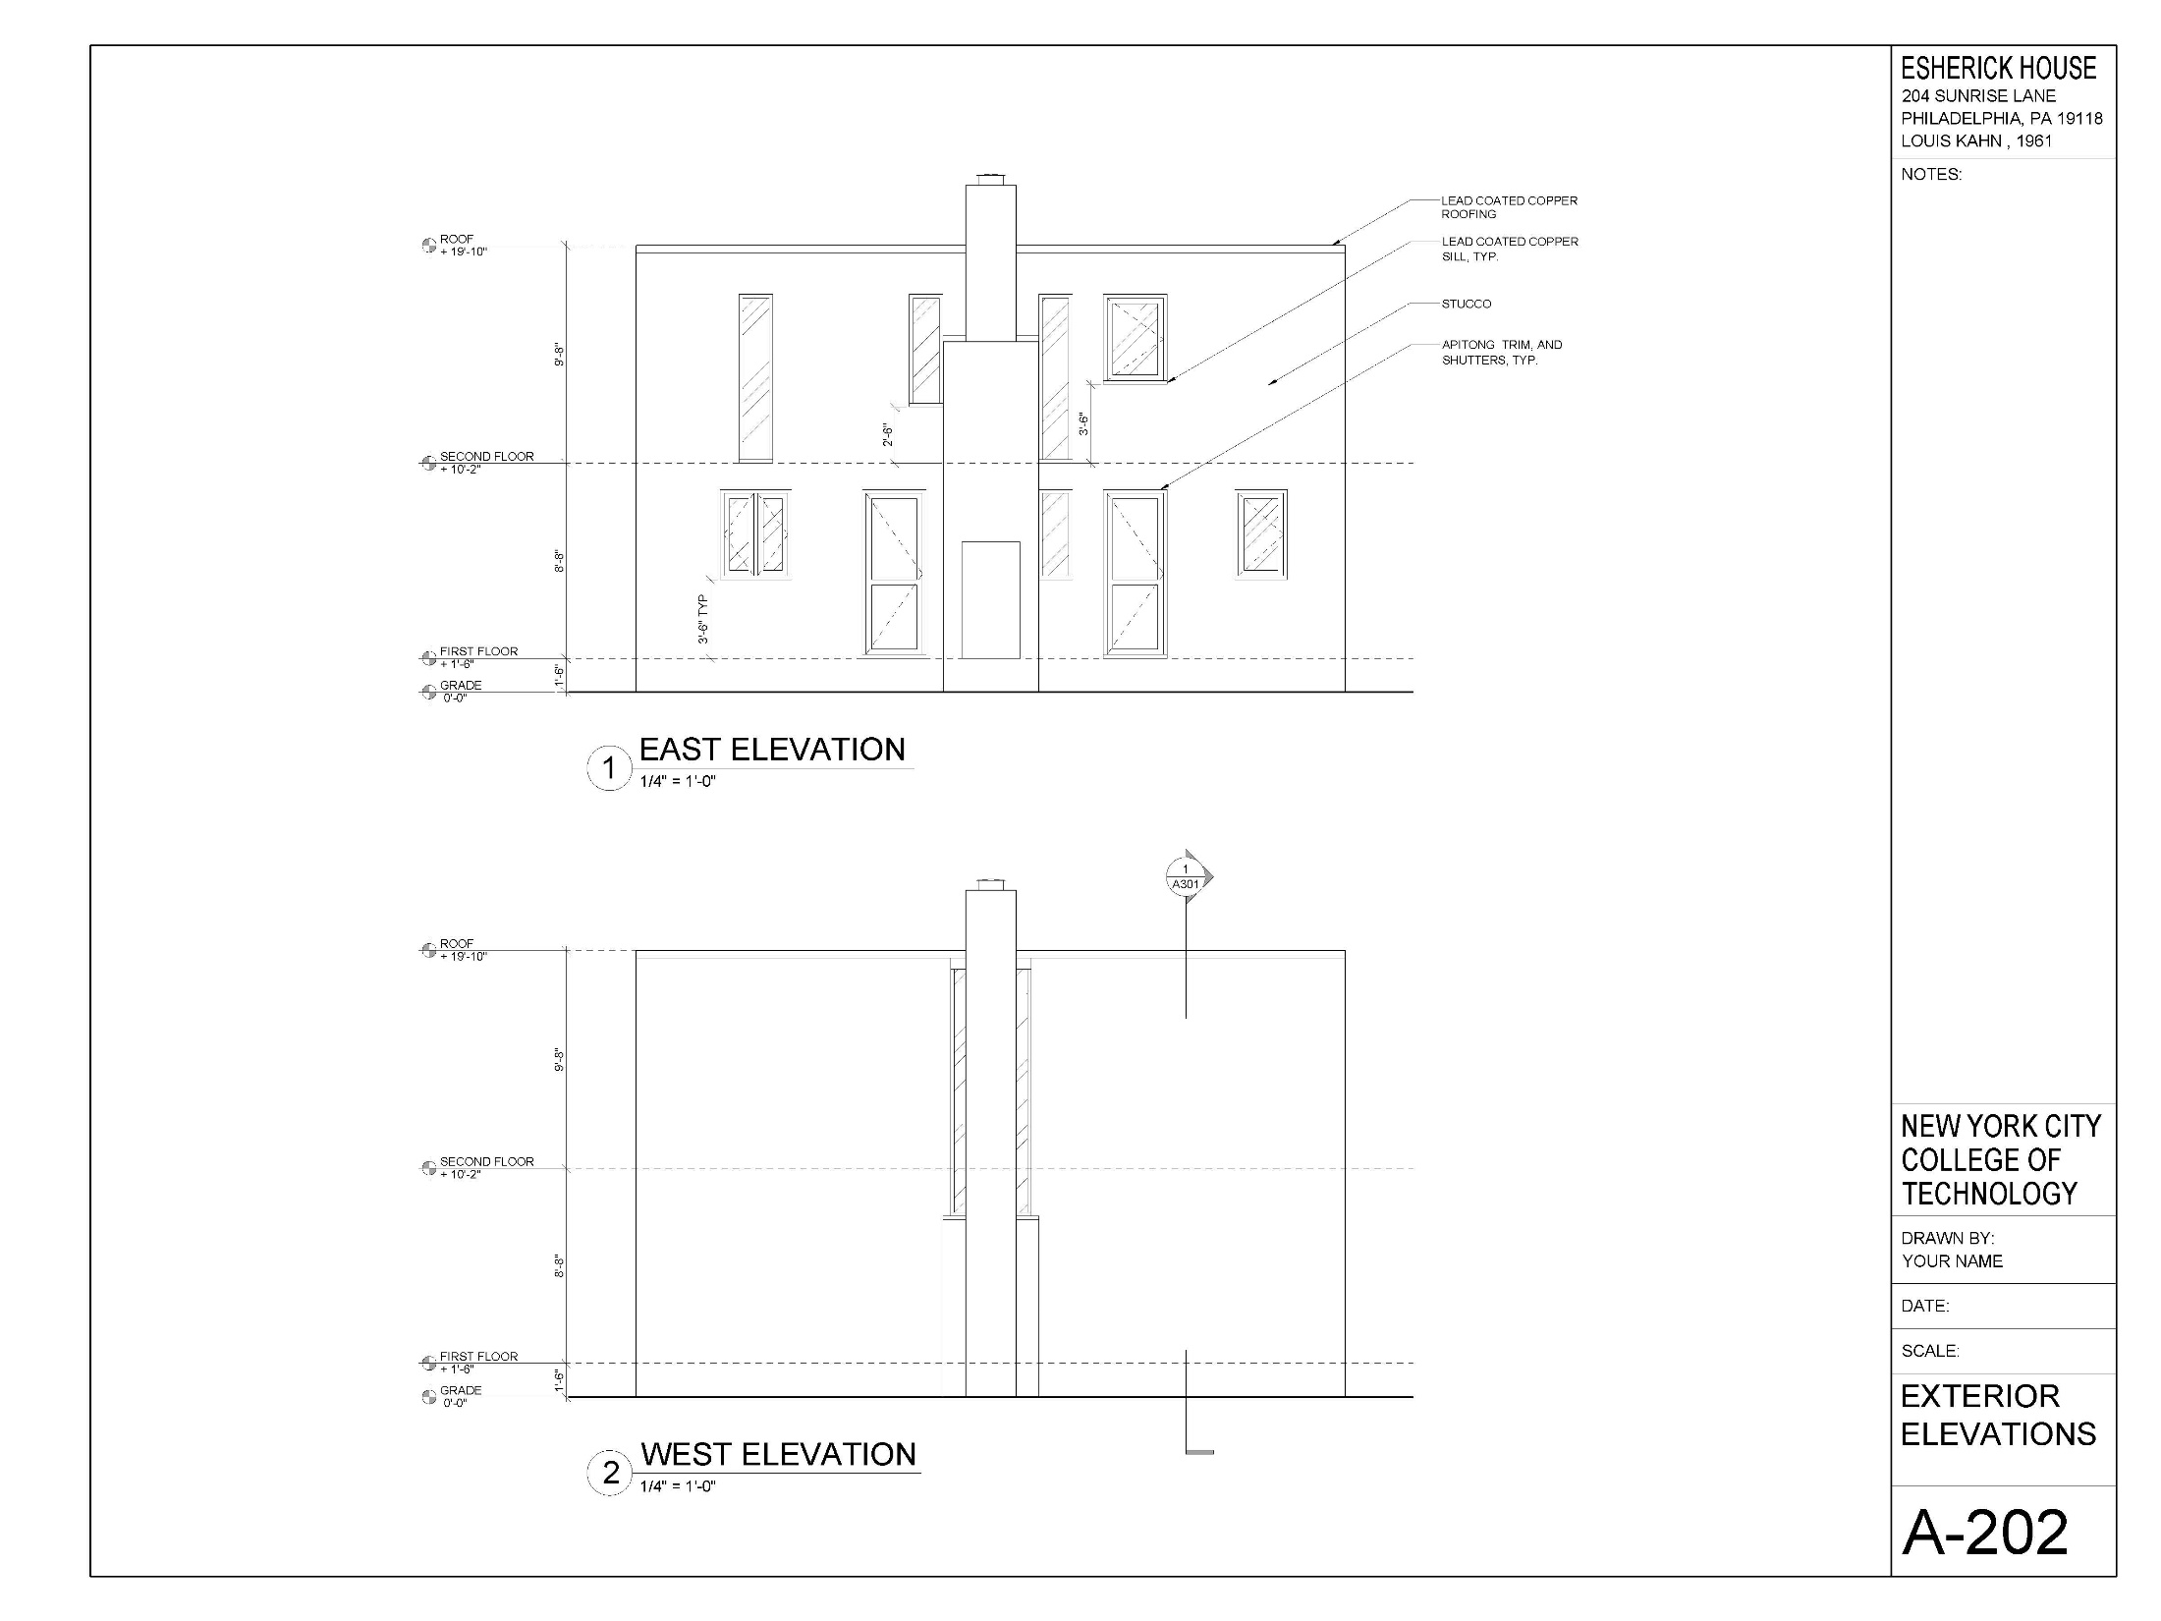
Extra Credit!!!

Slide 19
Assignment Specifications:
Create a Dropbox folder “A-004”
Upload your progress drawing at the end of this class to your Dropbox folder. Name files: Last Name First Name – Assignment Title.
Upload final submission *BEFORE THE START OF THE NEXT CLASS*
Submit 8.5”x11” plot of each drawing *AT THE START OF THE NEXT CLASS*

