Slide 1
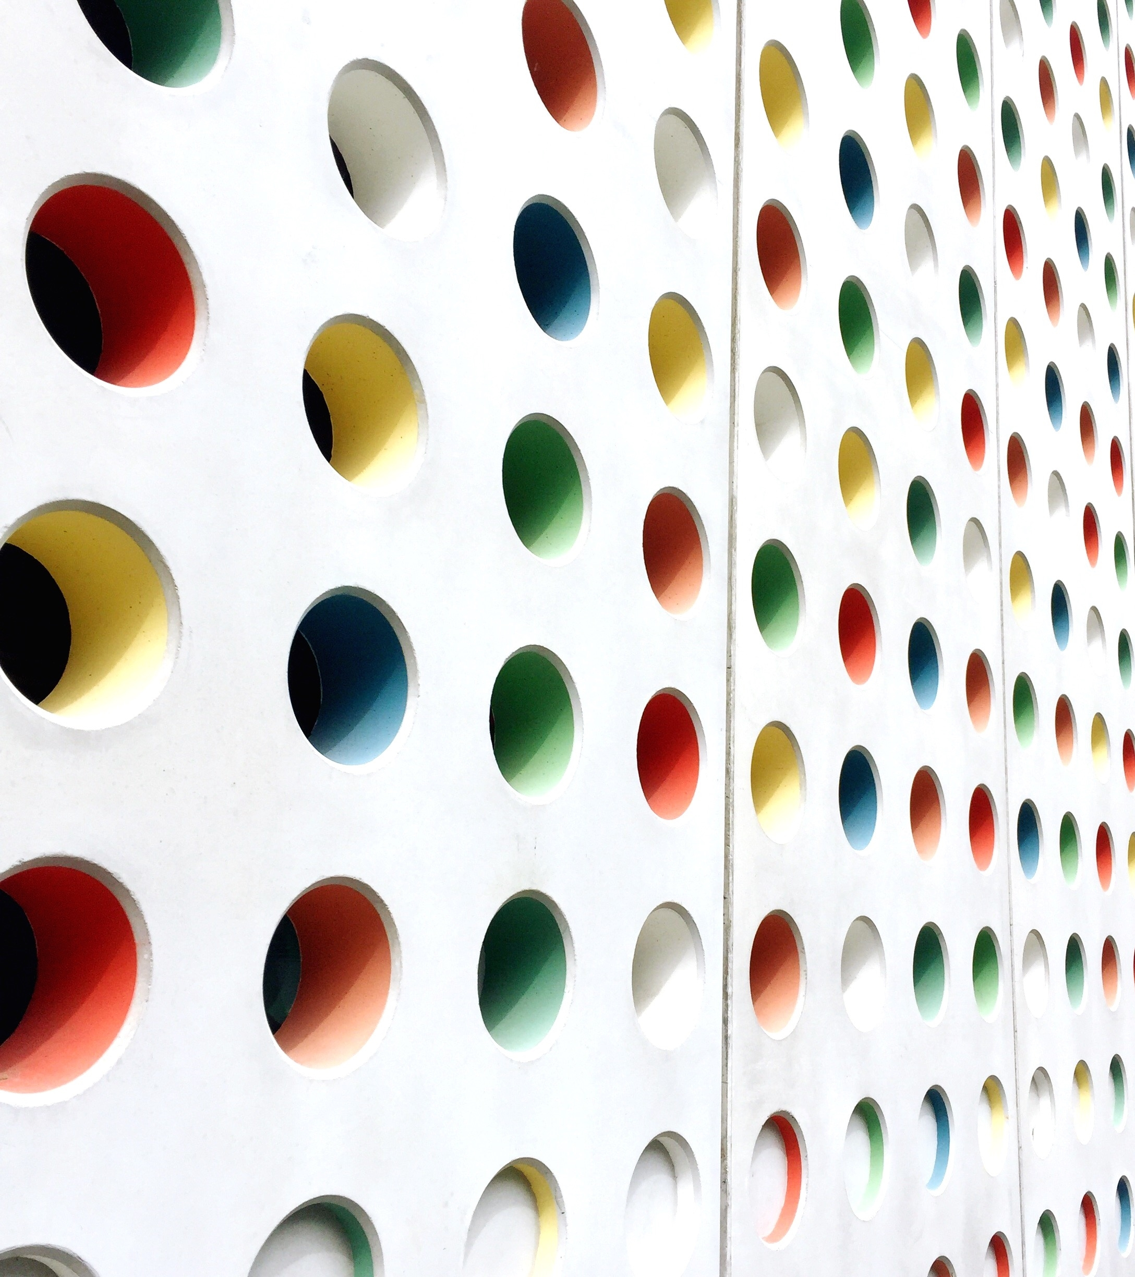
Shaping Young Minds; A Nutritional and Motivational Approach
U. HAMRAYEVA
Y. LORENZO
C. VALENTIN
F. ETIENNE
N. CARELA
A. UTEVOVA

Slide 2
Introduction
Healthy eating habits contribute to overall health and good oral health
The effects of proper eating socialization: setting an example as a parent and a teacher
Incorporating healthy eating habits into in a social circle with peer classmates
The community program: reading food labels and proper home care and be involved in the food cultivation process.
Today we will implement our community program to a certain extend. However, due to various circumstances we will be unable to have access to a community garden.
Notes:
Hello 4th graders of P.S. 177, my name is Christina!
My classmates and I are here today to discuss with you all the importance of eating healthy and talk about how certain foods can have a negative impact on the health of our teeth and body alike.
Nutrition is the study of food and how it works in your body! In your foods, there are so many things, called nutrients! What are nutrients, you may ask? Well, nutrients are vitamins, fats and proteins. It important to eat our fruits and vegetables because they help us grow big and strong and keep us healthy!
We are going to ask you some questions and we want you all to answer them as truthfully as you can, just know we are not here to judge you but to educate you!
Were also going to take a field trip to a local garden and were going to teach you see the process of growing your own fruits a veggies, how read food lables and we will also teach you how to properly brush your teeth!
We get it, we all love candy, but do you know what candy will do to your teeth if you don’t brush?
Well, were going to tell you all about that very soon!

Slide 3
Introduction
Target population: 4th grade students between the ages of 9 & 10
Location: Public School 177 located in Bensonhurst, Brooklyn
Assessment: a verbal questionnaire
Clinical consideration: mixed dentition

Slide 4
Nutrition and Eating Habits Questionnaire
How often do you consume sugary drinks and candies?
How often do you consume healthy foods like fruits and vegetables?
Do you know how to read nutritional labels? And how do we know if a food is healthy or not based on this label?
Do you know what happens to our body when we eat “junk food”?
Do you prefer to eat the school’s lunch, or do they pack their own?
How many times a day do you brush your teeth? How often do you floss?
Do you know what happens to our teeth when we don’t brush or floss?
Notes:
Hello , my name is Yessenia
and today I’m going to ask you some questions, these questions are just to better understand what may or may not know and how we can help you with nutrition and maintain a clean and healthy smile.
Below is a series of questions just choose the answer that best represents you
https://docs.google.com/forms/d/e/1FAIpQLSeNOtA3FuT9-WCxPTGXWLCdtujiKUfawG0XQjkM8IstnHeZsQ/viewform
Then go over answers

Slide 5
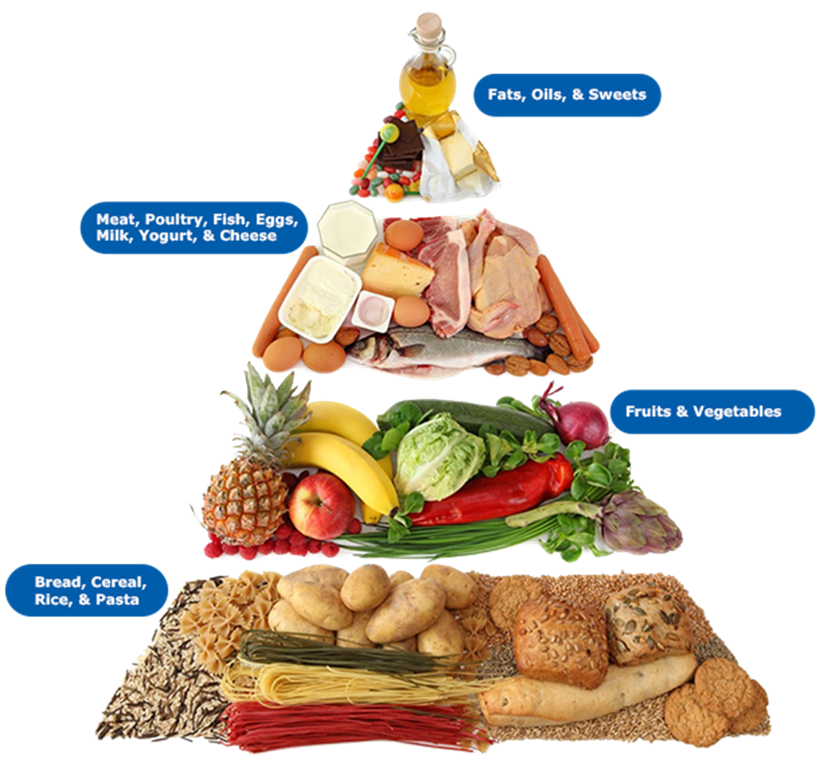
Food Pyramid
“Food pyramid” with four layers, each layer focusing on one of the nutrients.
Explain what carbohydrates, fats, protein
Now let’s try to match the food on the picture with four major nutrients
Benefits of eating vitamins and the causal relationship between carbohydrates and caries lesions.
Notes:
Hi Im Anara and today I’m going to discuss the food pyramid with you. As you can see on the picture,
The food pyramid consist of 4 levels and the levels are in a specific order
Starting with the very bottom: the grains, cereal, breads and pastas. This is at the bottom because grains, especially WHOLE grains should be a good portion of what you eat in a day. About 5-6 servings a day.
Next, we have fruits and veggies; these guys are your friends!!! And you want to have at least 2 servings of fruits and 5 servings of veggies in a day
Next we have meats, fish, and dairy, t
And lastly we have fat, oils and sweets, as you can see it’s a very small portion on the pyramid and do we know why that is ? Its because we don’t really need much of it in our daily diets; a little goes a long way!
I have a game for us to play
https://www.healthyeating.org/products-and-activities/games-activities/myplate
https://www.educaplay.com/learning-resources/4307484-food_pyramid.html

Slide 6
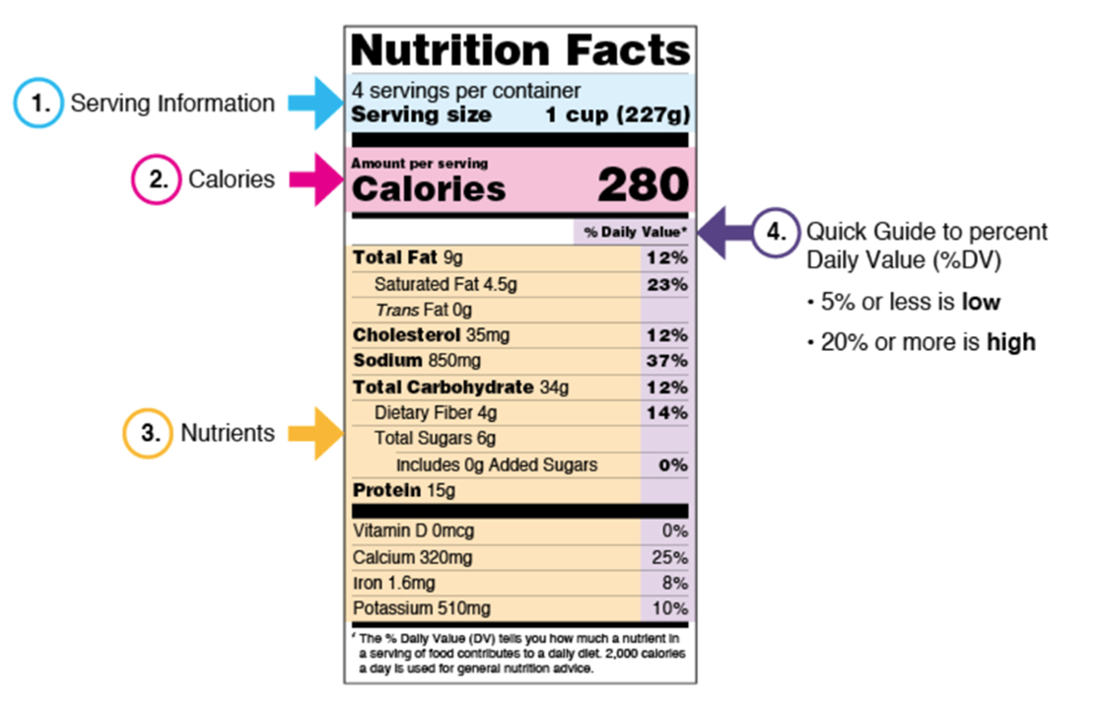
Reading Labels
Serving size: what people typically eat
2,000 calories a day; eating too many calories is linked to obesity.
Nutrients to get less of: Saturated Fat, Sodium, and Added Sugars; added during processing
Nutrients to get more of: Dietary Fiber, Vitamin D, Calcium, Iron, and Potassium.
Notes:
Hey there Im…
I going to be teaching you how to read food labels,
Food labels tell us what is in the food we are about to eat, and it can be overwhelming looking at it but im going to break it down so you can understand what food labels are actually telling us.
Lets start with Serving size: A serving size is a specific amount of food and its usually measured in cups or ounces
A serving size is based on a 2,000-calorie diet, but eating too many calories in a day can lead to an unhealthy lifestyle.
When reading food labels make sure you stay away from words like STARURATED FATS, SODUIM, AND ADDED SUGAR.
Look For words like FIBER, IRON, POTASSIUM, CALCIUM, VITAMINS

Slide 7
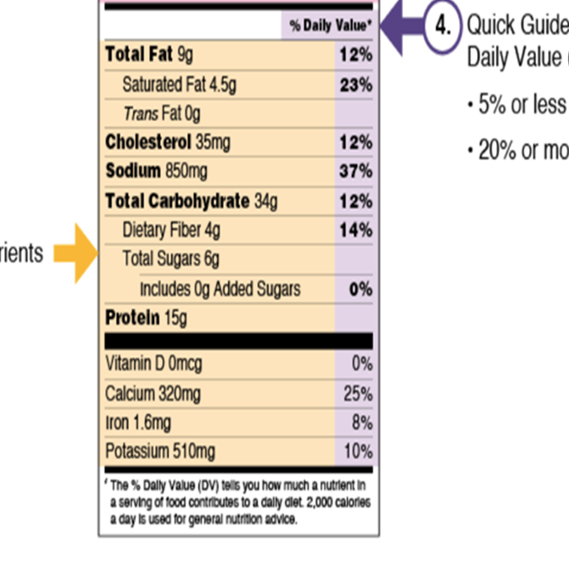
Reading Labels
The Percent Daily Value
5% DV or less of a nutrient per serving is considered low
20% DV or more of a nutrient per serving is considered high
Choose foods that are:
Higher in %DV for Dietary Fiber, Vitamin D, Calcium, Iron, and Potassium
Lower in %DV for Saturated Fat, Sodium, and Added Sugars
Notes:
This is not kid friendly not really sure how to break this down

Slide 8
Trip to Local Community Garden
Goal: Getting the children directly involved in the food growing process.
Coordinate weekly trips with the entire class to a local community garden and take part in activities such as watering the plants and removing weeds.
Notes:
We want to get you kiddos involved in the process of growing your own foods, so we will be taking a trip to a local garden, upon parental permission.
How many of you, have grown your own fruit or veggie? Do you know whats the first step? What is needed?
We will have a horticulturist ( someone who studies and grow’s plants, fruits, vegetables) talk us through the steps of growing fruits and veggies.
We will also bring some pots into the classroom so you can watch it grow and tend to it everyday.

Slide 9
Trip to Local Community Garden
A plot at garden was reserved
Parental permission obtained
Every Friday, the class will travel to the garden to tend to the plants.
On the second to last Friday before summer break, the produce will be harvested.
The produce will be used to make salads which would be served with the school lunch on the final day of school.
https://www.onegreenplanet.org/environment/how-growing-your-own-food-can-benefit-the-planet/

Slide 10
Eating Socialization
Each week, We will choose 5 children and ask you to Bring a fruit or vegetable to school.
Be ready to tell us about your fruit, including what food group it belongs to.
We will then combine everything into a salad and share it for snack time.

Slide 11
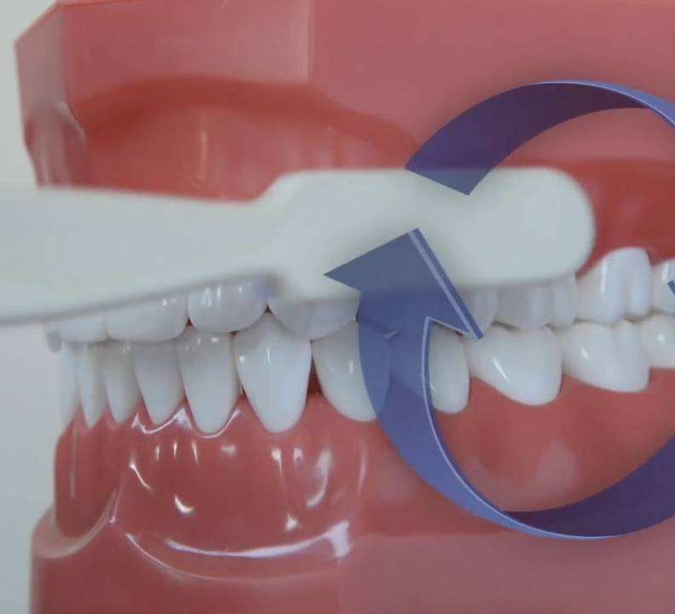
Brushing Demo
Fone’s/Circular Brushing Method:
Place the brush over 2-3 teeth at a time, then brush 4-5 times with gentle, circular motions
Video: (until 1:50)
https://www.youtube.com/watch?v=hDZXSMU2lAk
Notes:
Fones method

Slide 12
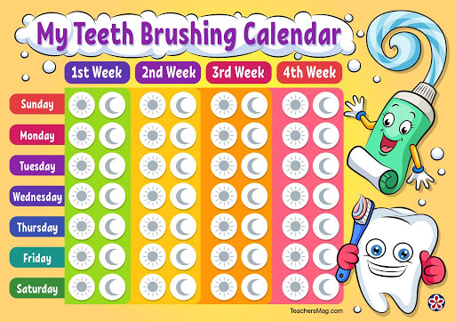

Slide 13
Any Questions?

