Slide 1
Mandibular Anatomy
Natalee Carela
&
Michael Cheung
DEN1218-E612

Slide 2
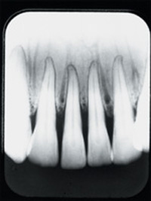
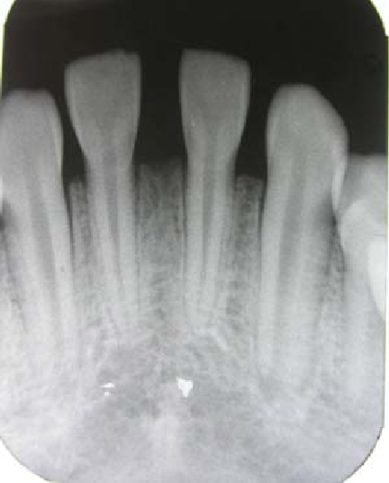
Anatomical Landmarks of the Mandible
Central Incisors
Lateral Incisors

Slide 3
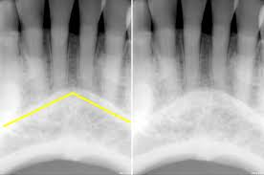
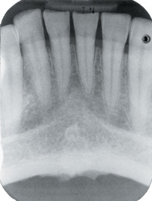
Anatomical Landmarks of the Mandible
Mental Ridges
Inferior border of mandible

Slide 4
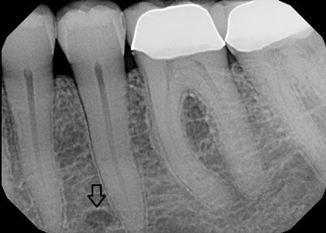
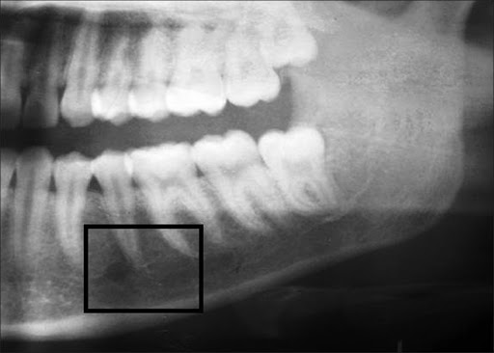
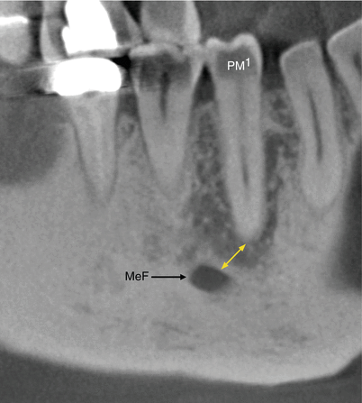
Anatomical Landmarks of the Mandible
Mental Foramen
Mental Foramen

Slide 5
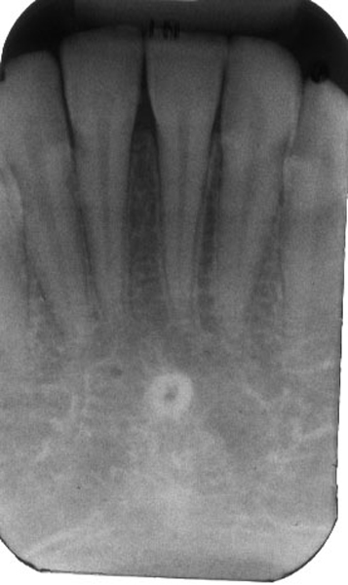
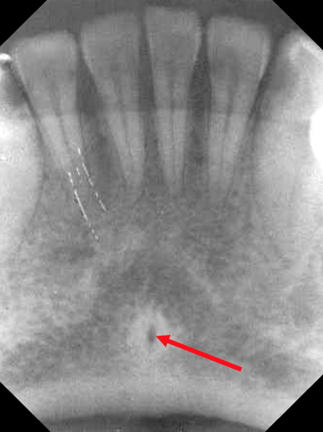
Anatomical Landmarks of the Mandible
Lingual Foramen
Genial Tubercles

Slide 6
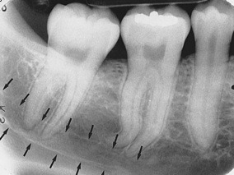
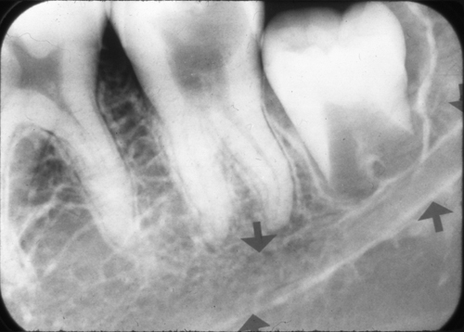
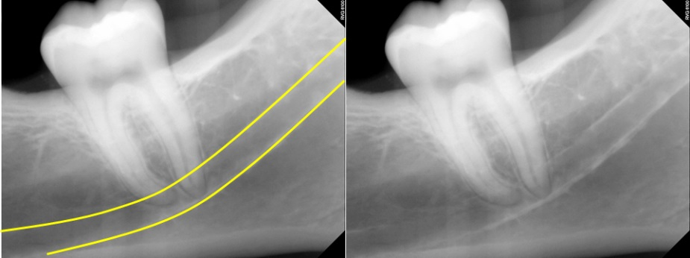
Anatomical Landmarks of the Mandible
Walls of mandibular canal
Mandibular canal
Walls of mandibular canal

Slide 7
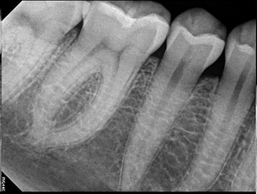
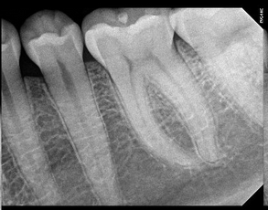
Anatomical Landmarks of the Mandible
Submandibular Gland Fossa

Slide 8
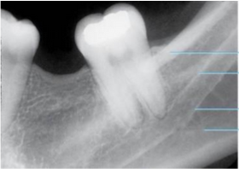
Anatomical Landmarks of the Mandible
External Oblique Ridge
Internal Oblique Ridge

Slide 9
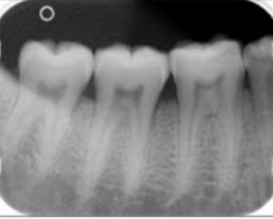
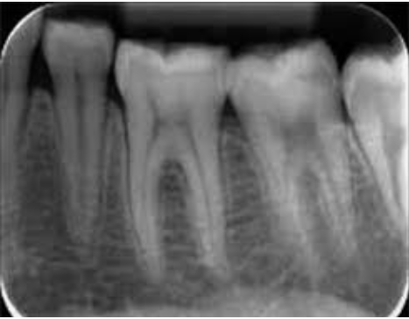
Anatomical Landmarks of the Mandible
2-rooted mandibular molars

Slide 10
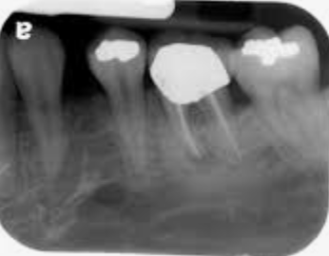
Anatomical Landmarks of the Mandible
Left premolar mental foramen

Slide 11
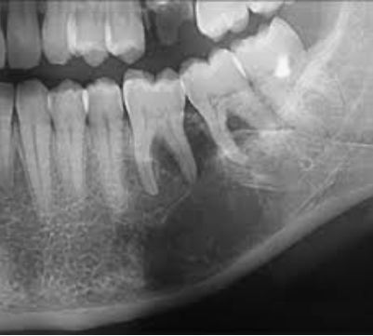
Anatomical Landmarks of the Mandible
External oblique ridge
Internal oblique ridge
Submandibular gland fossa
2-rooted mandibular molars

Slide 12
THE END THANK YOU!
Natalee Carela
&
Michael Cheung
DEN1218-E612

