Slide 1
Enamel pearl
Natalee Carela
WNH’20
January 2020

Slide 2
What is an Enamel pearl?
Enamel pearls appear as a small, spherical projection on root surfaces
Mainly occurs on permanent dentition but it can also affect primary dentition
Most commonly found at the Cementoenamel Junction and the furcation area of molars
Will appear radiopaque on radiographs

Slide 3
Etiology
Enamel Pearls are caused when ameloblasts migrate to the root’s surface and causes enamel to be abnormally formed over the cemental root surface
This abnormality occurs during the appositional stage of odontogenesis

Slide 4
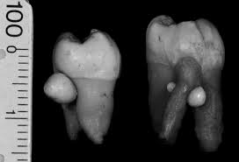
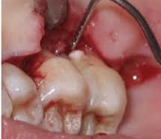
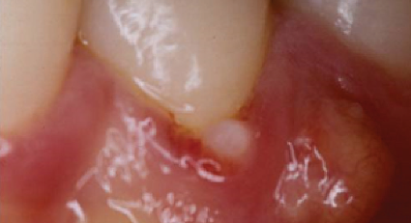
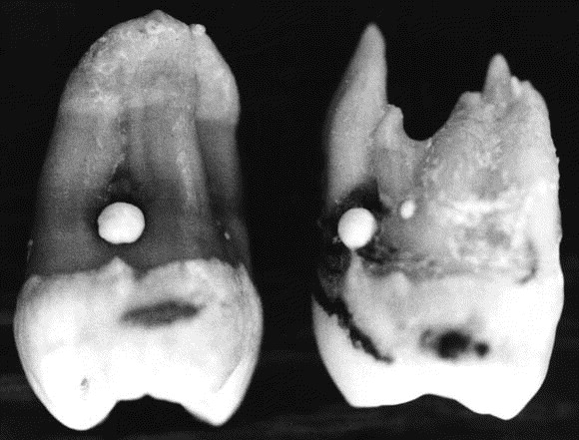
Enamel pearl

Slide 5
EFFECTS Of abnormality
Enamel Pearls can enhance plaque and biofilm retention
This bacterial accumulation can eventually lead to inflammation, gum disease, periodontal pockets and bone loss

Slide 6
Dental HYGIENE CARE
Radiographs must be carefully analyzed to be able to identify and diagnose enamel pearls before the development of periodontal disease
These pearls can be confused with calculus when exploring BUT it will not dislodge when scaling.
Attempting to forcefully remove it may result in a broken instrument tip instead.

Slide 7
Fluorosis
Natalee Carela
Jan.2020

Slide 8
DEFINITION AND ETIOLOGY
Fluorosis is a developmental disturbance marked by increased porosity of the enamel (hypomineralization)
It may appear as white or dark brown specks /streaks and rough pitted enamel
Damage to the enamel is permanent and there is various stages of severity, diagnosed using the “Dean’s Index”
It is caused by the ingestion of high levels of fluoride during enamel development
Some examples: Drinking fluoridated water, using fluoride tablets and ingesting fluoride toothpaste

Slide 9
Stages of Fluorosis
MODERATE
SEVERE
MILD

Slide 10
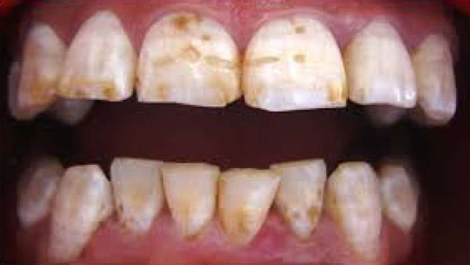
Role of Dental hygienists
Educate the patient about Fluorosis and its possible causes
Some treatment options available for Fluorosis include removing the stains through tooth whitening , veneers and bonding

