Slide 1
Stop And Frisk
By: Nicolas Franco

Slide 2
What laws are violated when STOP and FRISK is done?
The Fourth Amendment to the U.S. Constitution is searches and secures. Meaning that if one isn’t issued a warrant and has probable cause is not allowed to so anything.
It also breaches issues in the fourteenth Amendment. Which is called the Reconstruction Amendment. This stating that everyone has equal rights of having protection of the law.

Slide 3
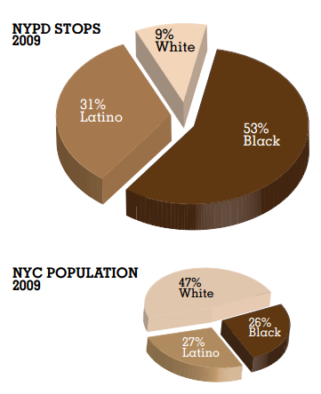
Statistic on STOPS an FRISK?

Slide 4
YOU TUBE VIDEO
http://www.youtube.com/watch?v=7rWtDMPaRD8

Slide 5
What can you do if you are stop?
Think carefully about your mannerisms when speaking. For example no profanity or a misconduct in tone. Other things to consider would be sudden movements, negative body language, and keeping your emotions intact. Do not get into an argument with the police it will not end in your favor. Anything you say or do can be used against you. Keep your hands where the police can see them. Do not run. Do not touch any police officer. Do not resist arrest even if you believe you are innocent. Do not complain on the scene by telling the police they are wrong or that you are going to file a complaint. Do not make any statements regarding your incidence. Ask for a lawyer immediately upon your arrest. Remember the officers badge & patrol car numbers. Write down everything you remember as soon as it happens. Try to find witnesses that are willing to give their names &contact information. If you are injured, take photographs of the injuries as soon as possible, but make sure you seek medical attention first.

