Slide 1
Ethical Issues and Dilemmas regarding life support
Natasha Dundas & Ingrid Fortune

Slide 2
INTRODUCTION
Ethical dilemmas arise in situations where
the ethically correct course of action is
unclear, such as when one is not certain
about which ethical principle to apply or
when multiple ethical principles are in
conflict.

Slide 3
Ethical dilemma
Self-Determination Act of 1990
The purpose of the Patient Self-Determination Act is to inform
patients of their rights regarding decisions toward their own medical care, and ensure
that their rights are communicated by the health care provider.
Advance Directives
Living Will
Power of Attorney

Slide 4
Case Manager’s responsibility
Addressing ethical dilemmas such as withdrawal of life support.
Patient advocacy
Assist family members in their decision

Slide 5
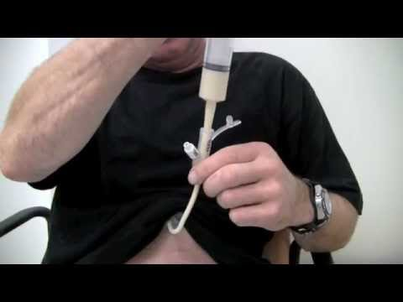
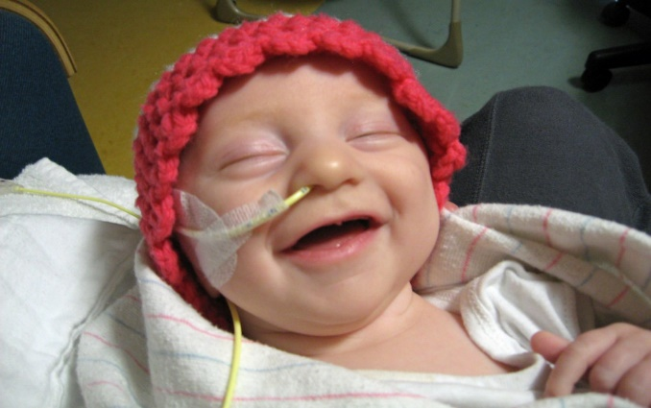
Types of Life support
Mechanical Ventilator
Mechanical ventilation is delivered through tubes inserted through the nose or mouth into the trachea.
Nutrition and Hydration
Treatments provided to patients who are unconscious or cannot swallow.

Slide 6
Jewish culture
Within the Jewish faith, they believe that each person’s life is sacred and should be sustained at all costs. It is strongly suggested that when
dealing with terminal illness, life support, organ donation, and the potential for resuscitation, that the advice of a rabbi, skilled in Jewish medical ethics is sought and that matters are then discussed with the patient and family as early as possible.
A clinical case, a 12 old boy, named Brody was hospitalized at Children’s National Medical Center in Washington, D.C. He was diagnosed with terminal brain cancer and put on life support.

Slide 7
Chinese culture
The moral perspective is inﬂuenced primarily by Confucianism but also by Taoism and Buddhism
Topic of death is a taboo
Maintenance of hope is important
Prefer family-centered decision making
Withholding information from the patient is normal

Slide 8
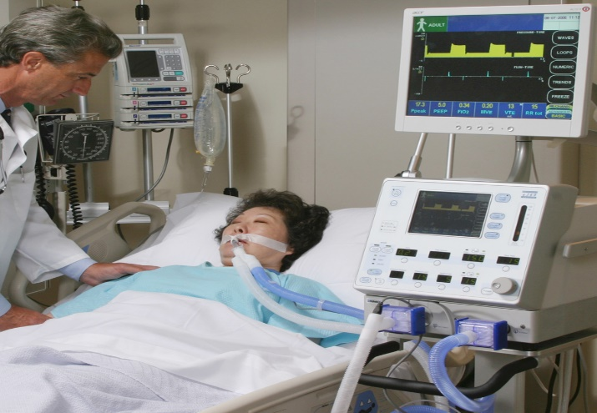
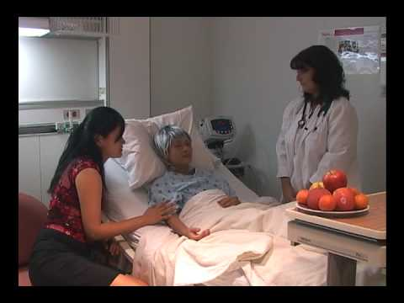
CHINESE CULTURE
Case managers need to have excellent communication skills
Case manager’s will now be more aware that the family makes the decision regarding patient’s care. Case manager needs to involve family in EACH step of the process.
Case managers cannot be afraid of discussing treatment options for fear of a dispute.

Slide 9
ETHICAL DILEMMA
Mrs. Lee is a 49-year-old Chinese woman who was admitted with a diagnosis of right-sided pneumonia which later revealed to be bronchial squamous cell carcinoma with lymph node and adrenal gland metastases. She was treated with IV antibiotics and radiation therapy. During her 2 week stay Mrs. Lee’s children and husband were with her constantly. Mrs. Lee’s son took primary responsibility for the decisions because Mrs. Lee and her husband could not speak English. He made it clear that he did not wish to discuss his mother's diagnosis with her and that he did not want the physicians to speak to his mother through interpreters. He requested that the physicians tell his mother that she has developed an aggressive form of the flu which is expected to clear up in a few months. Mrs. Lee later developed stage 4 cancer that spreaded throughout her body. Knowing her poor prognosis, her physician tried numerous times to discuss a "do-not-resuscitate" (DNR) order. Mrs. Lee son did not allow such a discussion and became agitated whenever the subject was raised and said that he wanted all possible care options for his mother. Mrs. Lee was later put on a mechanical ventilator in which the doctor advised against.

Slide 10
References
Abramowitz, J. (2014, September 11). Can You Ever Pull The Plug? Life Support And Jewish Law. Retrieved from http://jewinthecity.com/2014/09/can-you-ever-pull-the-plug-life-support-jewish-law/
Kelley K., The Patient Self-Determination Act. A matter of life and death, Physician Assist. 1995 Mar;19(3):49, 53-6, 59-60
Krishna, L. (2011). The position of the family of palliative care patients within the decsion-making process at the end of life in singapore. International Journal of Bioethics, 27 (3), 185-192.
Li, L. B. (2013). Clinical review: Ethics and end-of-life care for critically ill patients in China. Critical Care, 17(6), 244.
Manalo, M. (2013, March 10). End-of-life decisions about withholding or withdrawing therapy: medical, ethical, and religio-cultural considerations. Palliative Care, 7, 1-5.
MJL Staff, End of Life Issues: A Jewish Perspective. (n.d.) Retrieved from http://www.myjewishlearning.com/article/end-of-life-issues-a-jewish-perspective/
Powell, S.K., & Tahan, H.A. (2009). Case Management: A Guide for Education and Practice, New York: Lippincott: Williams and Wilkins.

