Slide 1
Smoking Cessation
Presented by:
Asfiya Afsar
Nadia Barak
Catriona Hagley

Slide 2
What is smoking cessation?

Slide 3
It is the Process of Discontinuing Tobacco Smoking.

Slide 4
How expensive is smoking?

Slide 5
$ 22 million spent a day on cigarettes.
Smoking costs the nation at least $193 billion in healthcare costs.

Slide 6
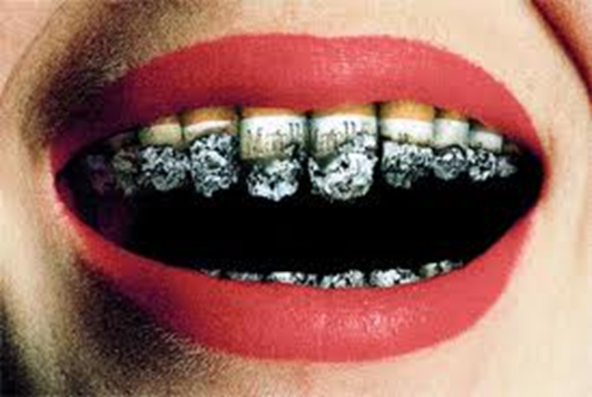
Don’t let your oral health go up in smoke!
Approximately, 43.8 million American Adults (20.6 %) are smokers.
19.5% of high school students and 5.2% of middle school students are smoking.
5 million deaths per year worldwide due to smoking tobacco (440,000 deaths in the U.S.)
On average, a smoker dies 10 years earlier than a non-smoker.

Slide 7
Smoking can affect the ones around you!
49,000 people die from second-hand smoke

Slide 8
Even your pets!

Slide 9
Think Smoking Affects Only You?
A pregnant woman who smokes…
Can have serious complications such as still birth, premature delivery, & low birth weight.
Toxins from smoking gets into your bloodstream, your baby's only source of oxygen and nutrients.
Children whose mothers smoked during pregnancy are especially vulnerable to asthma, and have triple the risk of sudden infant death syndrome (SIDS).
In a U.S. Centers for Disease Control and Prevention (CDC) study published in February 2011, babies whose mother smoked in the first trimester of pregnancy have a 20 to 70 percent higher risk of congenital heart defects at birth than for babies whose mothers did not smoke.

Slide 10
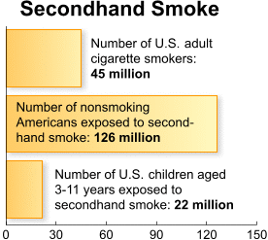
Think smoking affects only you?
Children exposed to second hand smoke are more likely to get…
Secondhand smoke exposure is responsible for:
•An estimated 150,000–300,000 new cases of bronchitis and pneumonia annually.
•Approximately 7,500–15,000 hospitalizations annually in the United States.

Slide 11
AS DENTAL HYGIENISTS, WHAT ARE SOME OF THE ORAL MANIFESTATIONS WE CAN EXPECT TO SEE IN A SMOKER?

Slide 12
Effects of Smoking on the Oral Cavity
Oral Cancer
Leukoplakia
Periodontal Disease
Dental Caries
Black Hairy Tongue
Halitosis
Delays wound healing.
Oral candidiasis-depresses immune system , making smokers more susceptible to infection.
Nicotinic stomatitis (smoker’s palate)-palate turns white with red dots located with small raised bumps.

Slide 13
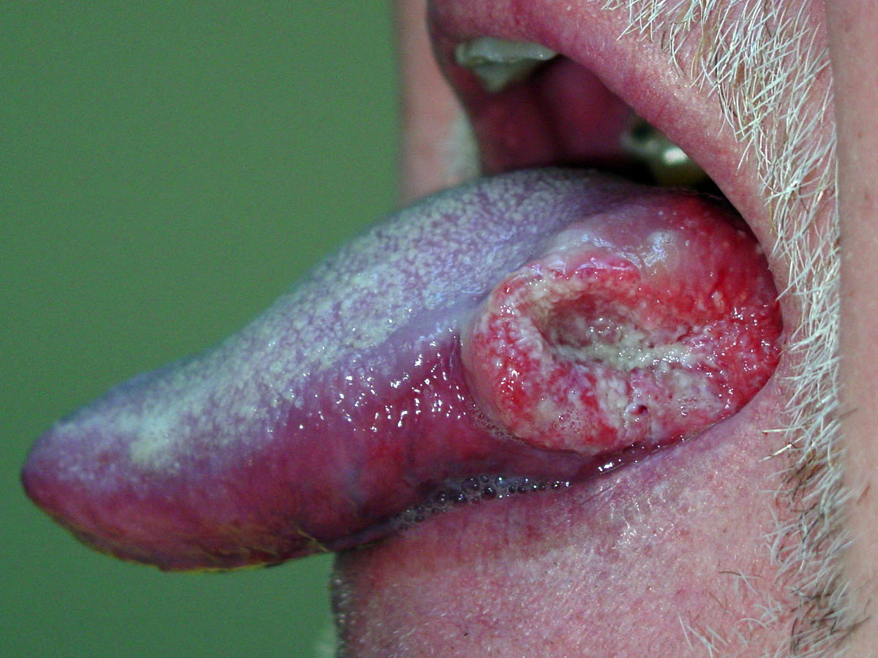
Oral Cancer

Slide 14
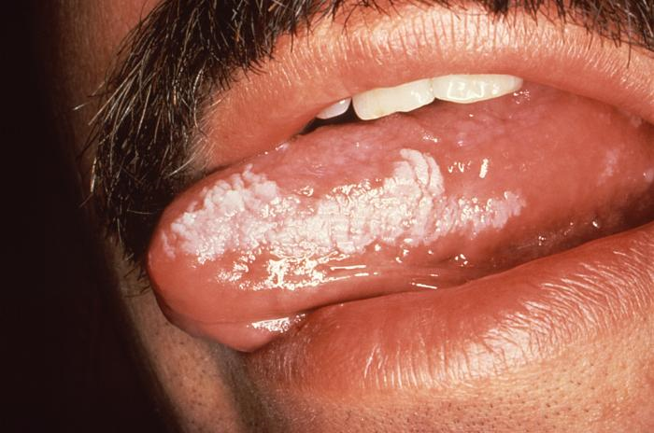
Leukoplakia

Slide 15
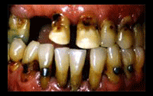
Periodontal Disease and Caries

Slide 16
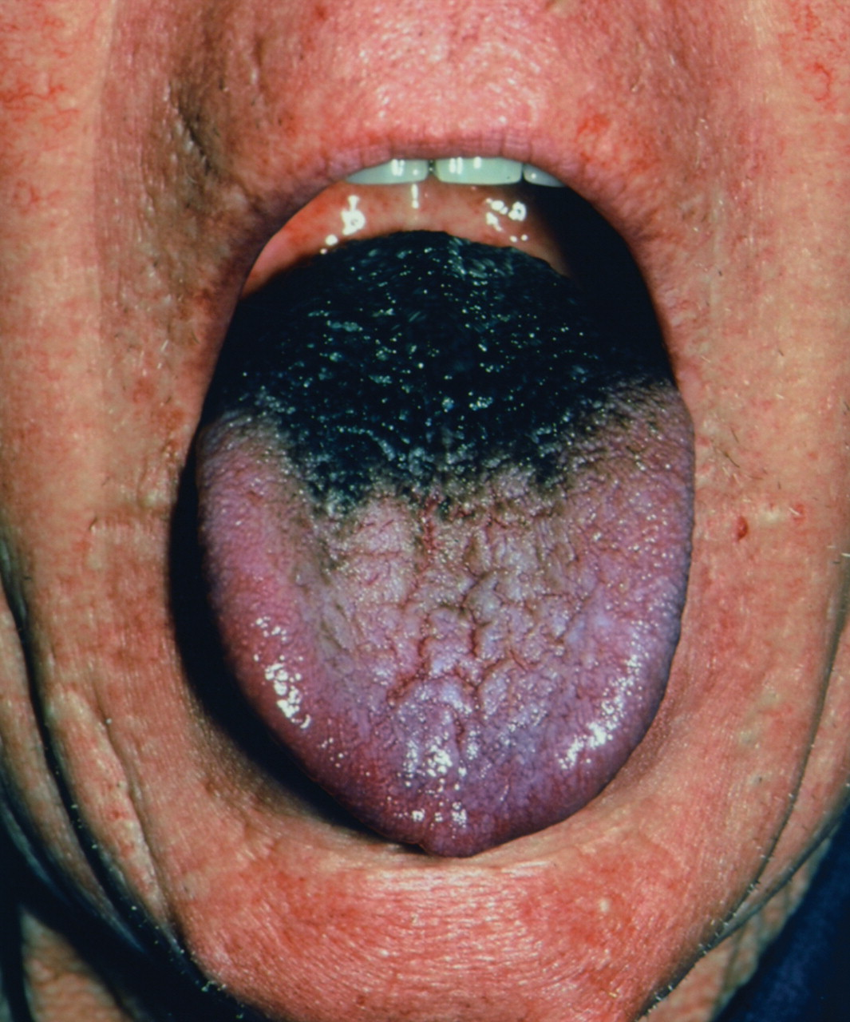
BLACK HAIRY TONGUE

Slide 17
Halitosis

Slide 18
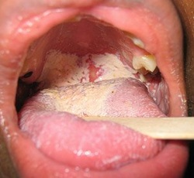
Oral Candidiasis

Slide 19
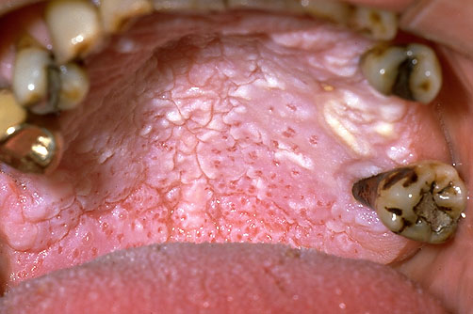
Nicotinic Stomatitis

Slide 20
Oral Cancer
Tobacco Use accounts for 90% of Oral Cancer.
Tongue 20%
Gingiva 18%
Floor of the mouth 12%
Lip 11%
Salivary gland 8%

Slide 21
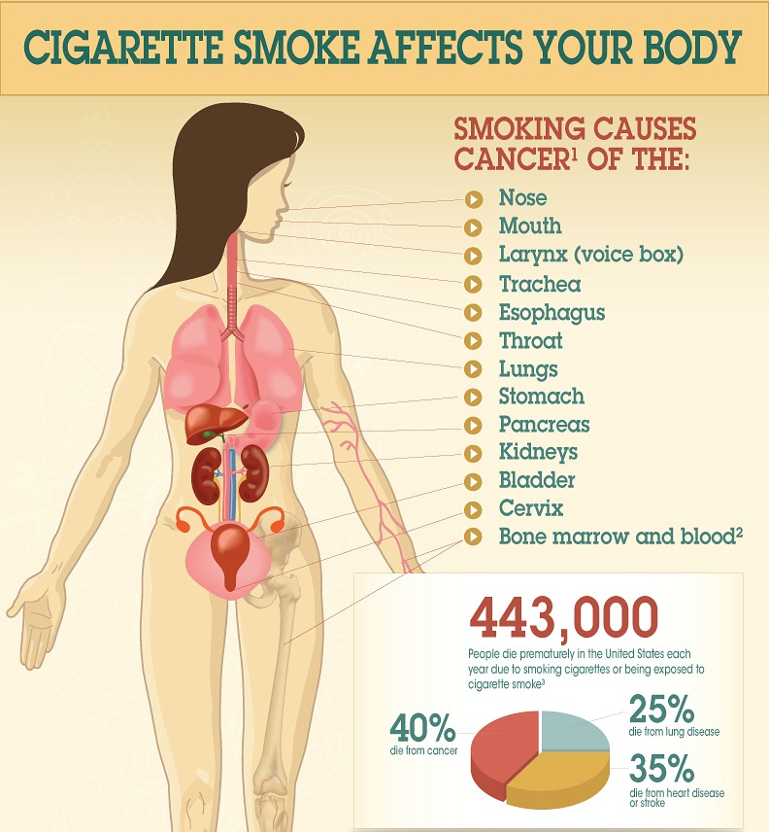
How Does Smoking Affect You?
40% Die from Cancer
25% Die from Lung Disease
35% Die from Heart Disease

Slide 22
THAT’S NOT ALL…

Slide 23
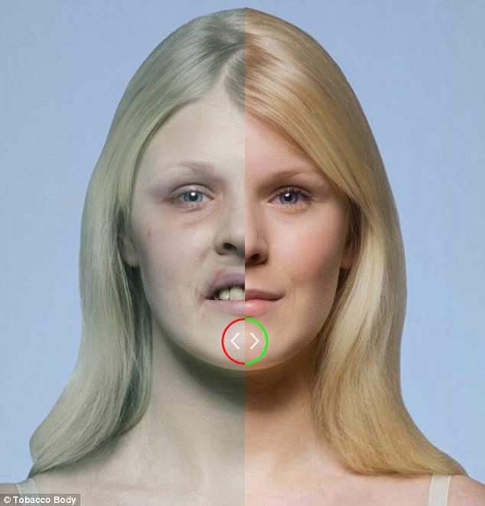
Smoking can affect your appearance !

Slide 24
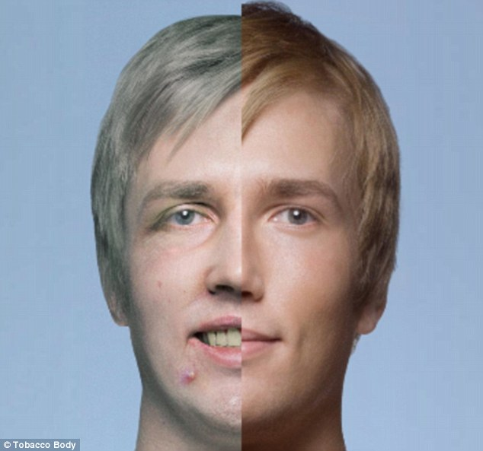
Smoking can affect your appearance

Slide 25
There Is A Way Out!

Slide 26
HELP
Nicotine Gum and Patches
Non Nicotine Prescription Medication
Therapy & Support Groups
1-866-NYQUITS
1-800-QUITNOW
1-800-LUNGUSA

Slide 27
Non nicotine Drugs used for smoking cessation
Zyban- Bupropion (Wellbutrin)
Dosage:
Take 150 mg/day for the first 3 days followed by an increased dose of 300 mgs/day.
Maximum dose of Zyban is 300 mg/day given as 150 mg, twice daily.
Treatment should be initiated while the patient is still smoking setting a target date for smoking cessation within the first two weeks of Zyban treatment.
Zyban therapy should be continued for 7 to 12 weeks, depending on the effect of the therapy.
If patient has not reduced smoking by the 7th week of Zyban therapy, it
is unlikely that they will quit, and Zyban therapy should be discontinued.
Adverse Effects: Xerostomia, Insomnia, Nausea, Tremors.
Drug Interactions: Vasoconstrictors

Slide 28
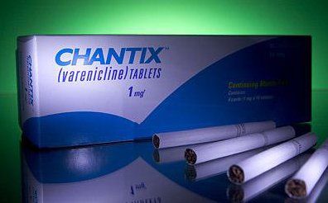
Non nicotine Drugs used for smoking cessation
Chantix -(Varenicline)
Dosage:
Day 1 to 3- 0.5- or 1- mg tablet once daily.
Day 4 to 7- 0.5 mg twice daily
Day 8- 1 mg twice daily until the end of treatment.
Chantix should be started 1 week before an established smoking stop date.
Chantix should be taken after eating with a full glass of water to reduce upset stomach.
It is recommended that this medication be taken for 12 weeks.
If smoking cessation is achieved, Chantix should be continued for another 12 weeks to maintain abstinence. If smoking cessation has not occurred after the first 12 weeks of therapy, Chantix should be stopped.
Adverse effects: Nausea, Insomnia and Headache.
Warning: The FDA on July 1, 2009 added a "black-box" warning for healthcare providers to use caution prescribing Chantix for patients with Pre-existing Psychiatric Conditions, and Significant Renal Impairment.

Slide 29
Remember the 5 D’s!
DELAY
DEEP BREATHS

Slide 30
TRUE OR FALSE? WHEN YOU STOP SMOKING, YOUR BODY BEGINS TO REPAIR ITSELF IMMEDIATELY.

Slide 31
It’s never too late to stop!
When You Stop Smoking, Your Body Begins To Repair Itself Immediately
Within 20 minutes:
Your heart rate calms down
Within 8 hours:
There is more oxygen in your blood
Mucus begins to clear out of your lungs making breathing easier
Within 48 hours:
Things smell and taste better
Within 3 months:
Your blood circulation improves
Your body is better able to fight infections.
Within 9 months:
You have less sinus congestion, wheezing, and shortness of breath.
After 1 year:
Your risk of dying of a heart attack is cut in half.
After 5 years:
You have much less of a chance of having a stroke.
After 10 years:
Your risk of lung cancer is cut in half.

Slide 32
Role of the dental hygienist
The 5 A’s:
Ask
Assess
Advise
Assist
Arrange

Slide 33
Role of the dental hygienist
ASK AND ASSESS
Medical and Dental History forms should include questions regarding tobacco use.
Be sure to ask your patient:
Do you smoke?
How long and how often?
Are you interested in quitting?
Have you ever tried to quit?
Label the patient’s chart with a sticker:
This indicates that the patient is a smoker and the hygienist should reinforce
smoking cessation at each visit.

Slide 34
Role of the dental hygienist
ADVISE
Over time, the harmful effects of smoking will only increase. Be sure to tell your patient to:
“Stop Smoking As Soon As You Can!”
Explain the adverse effects of smoking to your patient.

Slide 35
Role of the dental hygienist
ASSIST
Inform and discuss the various types of smoking cessation aids such as…
Nicotine Gum
Nicotine Patches
Non-Nicotine Prescription Medications
Therapy & Support Groups

Slide 36
Role of the dental hygienist
ARRANGE
Provide the patient with information about local smoking cessation services.

Slide 37
ROLE OF THE DENTAL HYGIENIST
BE A ROLE MODEL!!
As Ambassadors of Oral Health it is Important to be Smoke-Free!
Note to Dental Professionals:
-Compliment/Encourage those patients who do not smoke, or have quit smoking.
-Check up on patients’ progress by staying updated on their smoking history (whether they
quit, tried to quit, relapsed, decreased or increased smoking).

Slide 38
