Slide 1
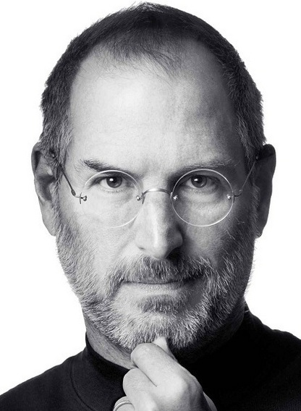
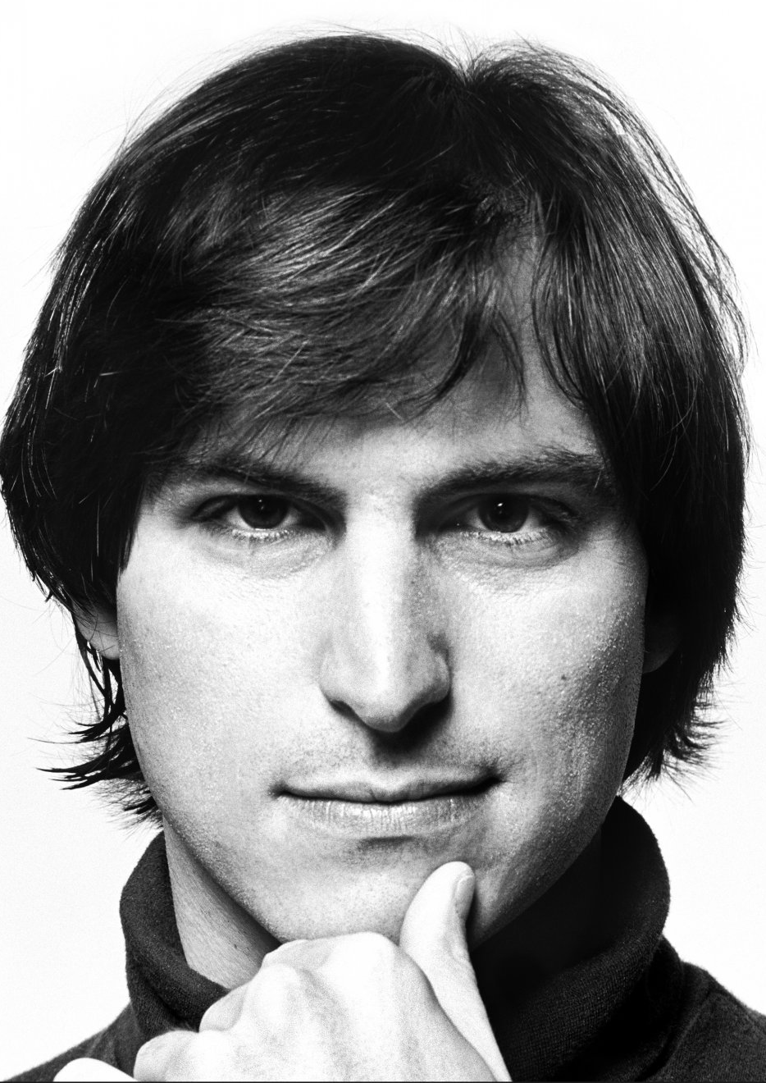
Steve Jobs
The Legacy
Nathalie Severino

Slide 2
Steve Jobs
A man whose perseverance and belief in himself and his vision brought him to be one of the most famous and fascinating people in our modern world.
His technological prowess revolutionized the world in personal computing, music, even animated movies.
For these reasons, he is an important figure in Art and Design and Graphic Arts.

Slide 3
Early Life
Born on February 24, 1955 in San Francisco, California.
He was put up for adoption by his parents Joanne Schieble and Abdulfattah Jandali without a name.
His adoptive parents, Clara and Paul Jobs, named him Steven Paul Jobs.

Slide 4
Schooling
Jobs had always been a trickster in his childhood.
He also received above average scores in school and was offered to skip to high school early on. His parents declined.
In high school he met his future partner, Steve Wozniak; a college student whom Jobs shared interests and views with.

Slide 5
College Life
Jobs attended a college in Portland, Oregon but dropped out shortly after.
Jobs decided to instead, visit creative classes for a year in a half.

Slide 6
Early Work
Jobs started out working as a video game designer for Atari.
Jobs and Wozniak started their business, Apple, in Job’s garage.
Their first creation was the Apple I, which was a personal computer.
It was, however, the Apple II that really sold and gained popularity.

Slide 7
Other Work
After many flowed device ideas Jobs renounced his position as co-CEO of Apple.
Jobs then created a company called NeXT, Inc. which was unsuccessful.
Jobs then decided to invest $50 million to what is now known as Pixar.
When Pixar gained popularity Jobs went back to his position in Apple.

Slide 8
Apple
Jobs went on to create the iMac which greatly elevated Apple’s popularity.
Apple went on to produce a profit of $1.58 billion.
In 2007, Apple had record breaking stock amounts of $199.99 per share.

Slide 9
Family
Jobs had his first daughter at age 23 with girlfriend, Chrisann Brennan, but he denied paternity of her until age 7.
He met his wife, Laurene Powell, at Stanford Business School.
Jobs and his wife had three children.

Slide 10
Illness
In 2003, Jobs learned that he had a tumor in his pancreas that could be removed with an operation.
He decided not to go through the surgery right away.
Jobs, being a very private man, never wanted to speak of his illness. It wasn’t until the next year that he decided to go through with surgery.

Slide 11
Death
Jobs died of Pancreatic Cancer
on October 5, 2011.
He was 56 years old.

Slide 12
Legacy
Steve Jobs was a game changer in the technological world and in everyone’s life. Everyone has, in some way, come across his devices and ideas.
He is important to ADGA because his designs and marketing strategies captivated us all into believing in his vision. The sleekness and ease of his devices is something that we now cannot be without.
Even after he is gone, Jobs’ ideas keep flowing. Soon we can experience anything from the iWatch, to the iTV, to even the iCar. The possibilities are endless and Steve Jobs paved the way for us to experience them.

Slide 14
References
Bio.com
Google images

