Slide 1
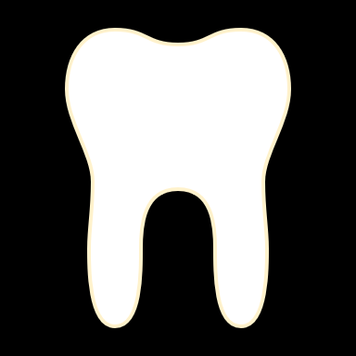
Enamel Structure Loss
Attrition, Abrasion, Erosion,
Abfraction
by Nashyra Zheng

Slide 2
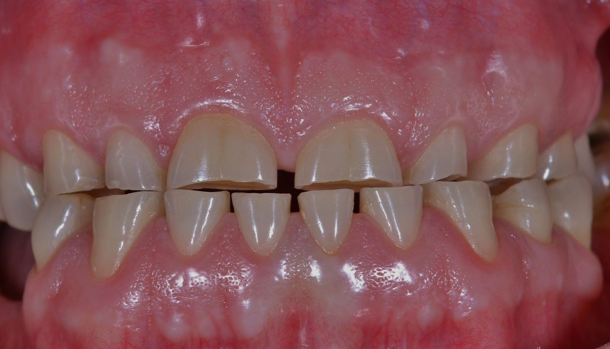
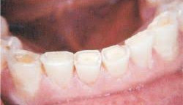
Attrition
Irreversible hard tissue loss caused by tooth-to-tooth contact during mastication, this can be naturally by aging or by parafunctional habits which results it to be more severe. Appearing more on the occlusal or incisal surfaces of teeth which are called wear facets.
Bruxism-griding of teeth, often causing audible noises.
Clenching
Protective layer of the teeth, the enamel, can be worn to the point that the inner dentin of the teeth is exposed, leading to tooth decay-causing an increase in dental sensitivity.

Slide 3
Attrition

Slide 4
Dental Team
Educating and bringing awareness to the patient that with dental attrition it causes irreversible damage to the enamel, but it is very common and occurs with age.
For the case of bruxism, the recommended treatment of a bite guard is given to be used when sleeping.
Treatments like composite dental filling placed to fill the wear facets for aesthetic purposes on the patient's smile is considered for a low-cost approach, but it is not a permanent solution.
Veneers would be a more permanent approach but a costly one to getting a perfect smile back.

Slide 5
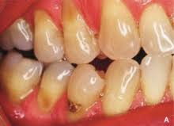
Abrasion
Enamel loss from excessive friction from a toothbrush. Abrasion is focused more on the mechanical action of improper tooth-brushing techniques. More specifically, the horizontal motion.
The friction of foreign items intraoral like mouth piercings, biting of pens and fingernails.
I’ll fitted dentures or retainers can contribute to abrasion
Even types of toothpaste used when brushing can contribute to the abrasion of the enamel. (e.g. whitening toothpaste)
Presents with a flat and wide wedge-shaped defect by the gum-line. Causing sensitivity to the tooth when touched by any hot or cold items.

Slide 6
Dental Team
The recommendation of a soft-bristle toothbrush with proper brushing techniques as well as a toothpaste that are rich in calcium or fluoride.
Asking your patient about any habits like biting pens to be avoided before any further damage.
If your patient wears dentures or retainers always check that they are fitted well, frequently.
As for procedures, fluoride treatment can be applied to strengthen your enamel and reduce sensitivity. If part of the enamel has been worn away slightly then dental filling can be a solution for the enamel lost.

Slide 7
Erosion
Irreversible loss of hard tissue by a chemical process -acid- not involving bacteria. The wearing off on the nonmasticatory surfaces of the teeth. Resulting in a broad concavity within the smooth surface enamel.
This can be by:
Consuming foods and liquids that are very acidic.
Medical condition like chronic acid reflux also known as gastroesophageal reflux disease (GERD)
The disruption of stomach acid coming the digestive system exposing the teeth derived from eating disorders like bulimia.
The decreased production of saliva (hyposalivation) known as xerostomia. There being a lack of saliva, saliva as a buffer won't be able to neutralize the acidity in the mouth.

Slide 8
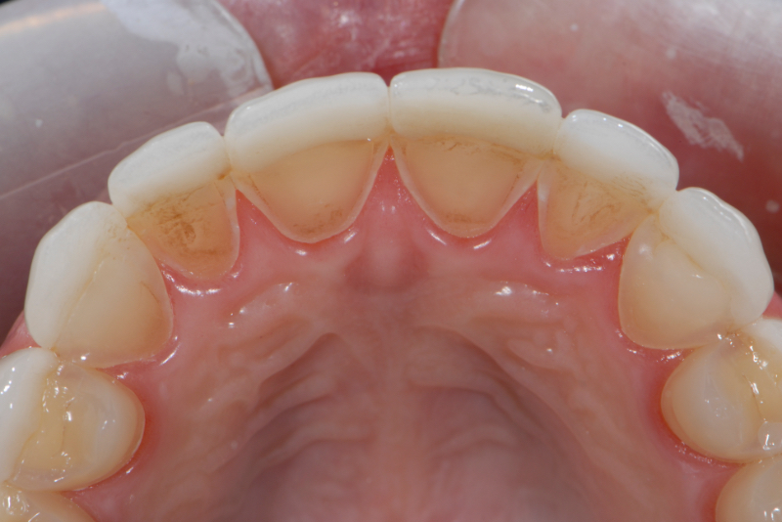
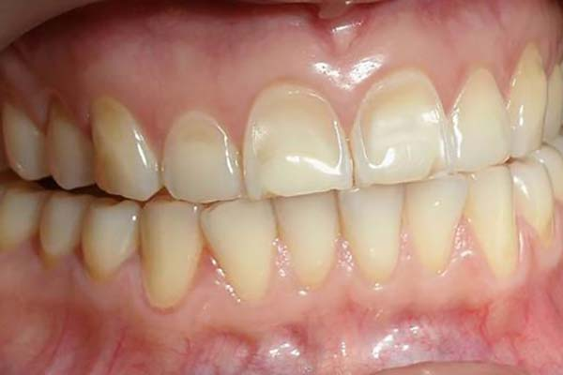
Erosion

Slide 9
Dental Team
Recommend patients to follow any consumed acidic foods or drinks with glass of water or even milk. This neutralizes the acidity in the mouth.
Encourage to not swish around but to use a straw for the consumption of any acidic drinks.
Since saliva is a buffer to neutralizing acidity in the mouth, chewing of sugarless gum can further stimulate saliva flow to protect from erosion.
Regular check-ups are highly recommended to prevent any further damage to the patient’s teeth. Procedures aren’t mandatory to be done unless the erosion of tooth surface is conflicting with the protection of the pulp which can lead to sensitivity.
Bonding on the tooth can repair minor worn-down, chipped or discoloration.
Crown or veneers would be recommended if the erosion has worsened.

Slide 10
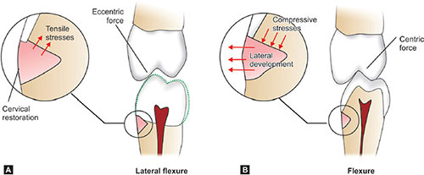
Abfraction
Abfraction is initiated by tooth’s mineral loss from acidic and abrasive factors that further worsen the lesion by flexural forces. Its unrelated to infections, caries, or bacteria.
Abfraction causes the tooth to flex because of uneven occlusal force which leads to one side of tooth to receive more force than the other leading to the enamel to displace itself, which exposes the tooth to further wear, caries and dentinal hypersensitivity.
This results in a V-shaped lesion.
It can occur or both the labial and lingual surfaces of the tooth on its cervical region (by the CEJ). Usually affecting one tooth.

Slide 11
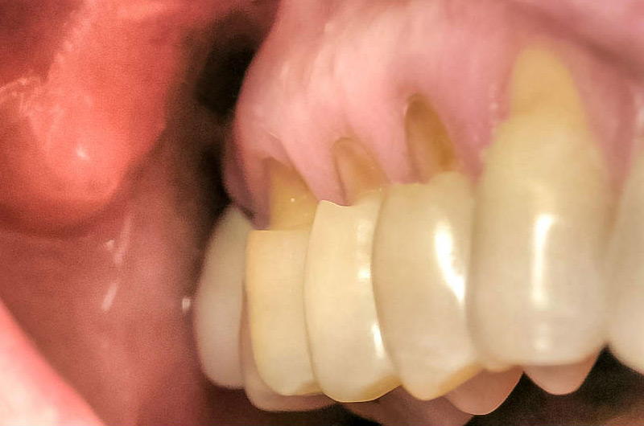
Abfraction

Slide 12
Dental Team
Treatments provided:
Bite guard can be given to reduce the occlusal force on the tooth involved, preventing further damage.
The lesion can be filled with composite or tooth-colored fillings if it becomes difficult to clean, decayed or if pulp is exposed. Leads to good aesthetic appearance and reduces sensitivity.
Orthodontic treatment to realign the patient's bite. This reduce future damage of teeth by getting rid of occlusal disharmony.

Slide 13
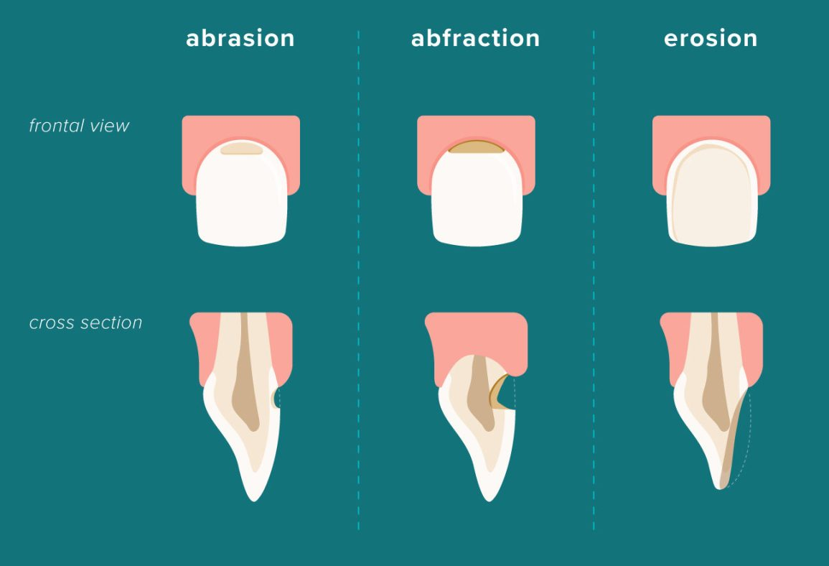

Slide 14
Works Cited
https://www.silversfamilydental.com/blog/2016/07/01/dental-attrition-vs-abrasion-what-172041
https://www.healthline.com/health/abfraction#causes
https://www.healthline.com/health/enamel-erosion#can-it-grow-back
https://ostrowon.usc.edu/2019/11/28/dental-erosion-attrition-abrasion-abfraction/
https://www.colgate.com/en-us/oral-health/brushing-and-flossing/causes-and-signs-of-dental-abrasion

