Slide 1
SWEATSHOPS
The good and the bad.

Slide 2
Table of contents
The film True Cost, Slide - 3.
Rana Plaza Slide - 4-7.
The after math of Rana Plaza Slide - 5.
Triangle Shirtwaist Fire slide - 9-12.
The after math of the Triangle Shirtwaist Fire slide – 13.
The Good slide – 14-15.
The Bad slide – 16-17.
Table 1. slide – 18.
Making a stand slide – 19.
Ethnical direction slide – 20.
References slide – 21.

Slide 3
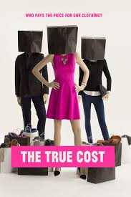
The true cost
I have been through a lot of things but have not come across something more emotional and learning that my peers and I are guilty of this crime is even more devastating.
We are all guilty of mass consumptions that is fueling the sweatshops component of the fashion industries here and overseas.
Watching films like The True Cost, have open my eyes to many issues we had taken for granted such as our simple past time call shopping.
https://truecostmovie.com/watch/the-true-cost
It is a global issue that impacts in regions not just the United States.
Its sad to say that the US has the biggest number of companies that fuel the sweatshops.

Slide 4
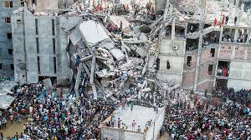
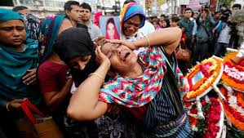
Rana plaza
DAYS AFTER
PRESENT DAY
FAMILY OF THE PEOPLE THAT DIED

Slide 5
RANA PLAZA
If you are like me you have not heard of events such as rana plaza until this film.
Just six years ago on 24 April 2013 a Savar eight- story commercial building in Rana Plaza collapse due to structural failure and bad working conditions.
The people of the Dhaka District, Bangladesh will never forget this devasting event.
The search for the dead ended on 13 May 2013 with a death total of 1,134. The search was only for a couple of weeks that goes to show you that 1,134 totals of death is not accurate.
Such events are example of the negligence’s of these industry leaders continuedly neglecting their responsibilities. Sweatshops are where all our fast fashion products are coming from with employee’s majority of women with no other means of income get up every morning to make a living.
We as American and other powerful nation need to examine these conditions and lend a helping hand. We are brain wash to consume these fast, trendy product because it will make use look and feel better about ourselves but not knowing the harm it is doing not only to the people in the manufactural countries but as a planet.

Slide 6
Rana plaza
Among the worst accidents in the fashion industry to ever be recorded the rana plaza was one of the most disasters that wake the world to conditions people are faced to worked in Bangladesh.
Bangladesh is one of the countries with the lowest wages of the world and these companies are taking advantage of it.
Millions of people mostly girls and women are force to work in a unsafe environments with high work-related accidents sometimes death because there are no better option.
All of the factories does not follow or meet standards required by building and construction guidelines.
As you can see Not following laws can result into deaths from the building collapsing or fire incidents. Laws are put in place to protect and ensure safety but because of the population of women working and the countries development level really allows these companies to take advantage of these poor working conditions.

Slide 7
Rana plaza
After the Rana Plaza disaster, a lot more accidents had occurred no less than 109.
Included were 35 textile factory incidents in which 491 workers were injured and 27 lost their lives.
Due to the lack of a well-functioning labor system inspections and of appropriate enforcement of the system, the decent work and life in dignity are still far from becoming possible for the majority of workers in the sweatshops industry and their families they work to support.
The hazardous working conditions and the high risk of exposure to employment injury in this division, should allowed adequate benefits to the employee to compensate for the injures they had.
This cause workers to the lose earnings because they would have to take off time to heal which causes them to suffer, even more.
For better work ethics companies need to force manufactures to ensure that their workers have access to the medical and associated care required by their condition.

Slide 8
After math
After the collapse a campaign was launched to provide adequate compensation to the families of the 1,134 people killed in the collapse and the 2,500 severely injured survivors.
It took over two years of negotiations activists chaining themselves to shops, global petitions and statements the Rana Plaza donors trust fund has finally met its target of $30m.
The campaign focused on securing compensation not just from brands that had been producing at Rana Plaza, such as Primark, but from any brand using Bangladesh to manufacture clothing.
Ben Vanpeperstraete, from the global trade union UNI and trade union federation Industrial, who worked on the organizing committee for the fund, describes the “unprecedented” step of bringing together all the stakeholders to discuss compensation. This was to avoid brands acting unilaterally and “coming up with their own calculations which risks that at the end there is not enough money in the bank account”.
The government is looking for money to help the families in need.

Slide 9
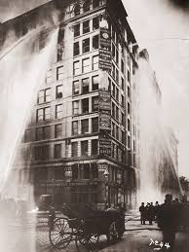
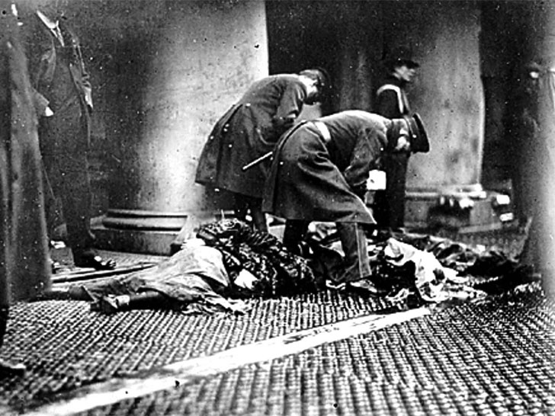
triangle shirtwaist fire

Slide 10
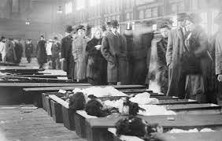
LOOKING FOR LOVE ONES

Slide 11
Triangle shirtwaist fire
On March 25, 1911, a fire began from a factory worker throwing his cigarette in the trash.
In minutes the Triangle Shirtwaist factory on the eighth floor in the heart of New York City’s garment district was up in flames.
It began in the cutting room and quickly spread throughout the factory. Due to Locked doors and inadequate fire exits trapped workers were trapped inside, trying fight for their life. the building’s sole fire escape collapsed.
There was only one elevator that day which soon break down cause some of the workers to jump to their death on top of the elevator .In all, 146 employees died, most of them young Jewish and Italian immigrant women, who either jumped to their deaths or perished in the flames.
It was a sight to see on a Saturday afternoon, workers were jumping out of window because the fire truck ladder was not built to reach that high.

Slide 12
Triangle shirt waist fire
This Triangle Shirtwaist Company factory is looked as a national symbol of business negligence and abuse.
Although hazardous working conditions in the garment industry had been the focus of numerous investigations, labor strikes, and public demonstrations throughout the late 19th century, it took the fire to shock the public resolve for workplace regulation and ongoing vigilance.
Labor organizer Rose Schneiderman said “This is not the first-time girls have been burned alive in the city. Every week I must learn of the untimely death of one of my sister workers. Every year thousands of us are maimed. The life of men and women is so cheap and property is so sacred. There are so many of us for one job its matters little if 143 us are burned to death.” Why something monumental has to happened to cause a change reaction.

Slide 13
After math
The triangle shirtwaist fire was the first sweatshop on American solid that grabbed America attention
A group of protectionist march with the support of NYC backing them in 1911.
With the protectionist movement comes the International Ladies Garment Workers Union. ILGWU
This movement lead to forceable laws that regulate the manufactures on how to operate including:
Working sprinkler system
Strong fire escape
No lock doors
Safe working hours
Increase in wages
Fire drills
Scheduled Building inspection
Unions or non union jobs with benefits

Slide 14
The good.
When it comes to sweatshop in third world continues it has more pros than cons
Creates jobs for monitories (women)
More independences and not a burden
Workers are able to support themselves and families
Girls are less likely to get pregnant at a early age or married off
Girls enrollment in schools have increased
Lessing the chance of getting involved with stone-crushing, street hustling, and prostitution.
Encourage more sustainable practice

Slide 15
The good.
Without sweatshops, clothing in the states would be more expensive
In 3rd world countries, sweatshops provide safer and more ethical alternatives to prostitution or crime, when sometimes those are the only three options to choose from
In 3rd world countries, sweatshops are safer alternatives to more dangerous jobs such as building construction, truck driving (Especially in India and Pakistan, where driving can very well get you killed), military service, etc.
The standards of living in Western countries is quite a comparatively higher than in parts of the world such as Ethiopia, South Sudan, parts of Pakistan, India, and China, etc., therefore we don't want to do those jobs; but in aforementioned parts of the world, it is very well possible that sweatshops may be a very good place to work in comparison to other job opportunities, and may even be a better place to be than the individual's homes (Such as in the case of a person who has plastic sheeting for walls)

Slide 16
The bad
Sweatshops are reported to have the longest working hours
Workers are being Paid cents an hour.
Sweatshops host of deadly diseases.
The bad conditions in sweatshops should not be an excuse for Western consumerism.
The wages are always so low to the point that families can goes days and in some cases even weeks without eating
Child labor
There is a lot exploitation of workers for corporate profitable gain.
Sweatshops take away jobs from countries such as the United States
Sweatshops increase dehumanization of people in 3rd world countries, in such a manner that some people would rather see someone else die than have to pay $5.00 more for a t-shirt.

Slide 17
The bad
Pollution
Birth defects
Low natural resource (water, food)
Months with out seeing family
Less job for other regions

Slide 18
Table 1. Average Hourly Wages of Apparel Workers

Slide 19
Making a stand
Many independent designers are refusing to use sweatshop like manufactures.
Alice Rolfe, runs ethical surface pattern company Rolfe & Wills, which is using organic cotton and responsibly sourced products in her company.
“I couldn’t run a company that takes advantage of other people just so I can do what I want to do with my life.” - Alice Rolfe

Slide 20
ETHNICAL DIRECTION
There are 35 Fair Trade & Ethical and counting Clothing Brands Betting Against Fast Fashion
Brands such as Everlane, Reformation, PACT, EILEEN FISHER, ABLE, THROUGHT CLOTHING, STELLA MCCARTHY and more
There were allegations against Stella McCartney stating that her designs for the Olympics were manufactured by exploiting Indonesian workforce
Which Encourage her and other companies around the world to think about a more sustainable future.

Slide 21
Reference:
Hoskins, T. (2015, June 10). After two years, the Rana Plaza fund finally reaches its $30m target. Retrieved from https://www.theguardian.com/sustainable-business/2015/jun/10/rana- plaza-fund-reaches-target-compensate-victims
Davies, A. (n.d.). Retrieved from http://contributoria.com/issue/2015-07/555c928d11d85eba370000be.html
Bowman, S. (2015, July 29). Sweatshops make poor people better off. Retrieved from https://www.adamsmith.org/blog/international/sweatshops-make-poor-people-better-off
Powell, B. (2017, March 20). Are Sweatshops Bad for Third World Workers? Retrieved from https://www.aier.org/research/are-sweatshops-bad-third-world-workers

