Slide 1
Computing in the Classroom and Best Practices to Improve Gender Diversity Equality a study by Lutfun Rahaman Conducted from February to March 2017 with math students at ASA College

Slide 2
KEY QUESTION IN CONDUCTING THIS STUDY According to research women are behind in technology courses. Was this true for my own students, and If so why?

Slide 3
The 21st century is the Technology Age. Please assist us in compiling data on the number of students who are choosing Computer related careers. Thank you. 1. What is your age? * 17 or younger * 18 -20 * 21 - 29 * 30 – 39 * Over 39 2. What is your current academic status in college? * 1st semester * 2nd semester * 3rd semester * Other (Please specify)
Survey Questions
February 2017

Slide 4
3. What is your major and minor? 4. What is the highest level of education you ever expect to complete? * Associate degree * Bachelor’s degree * Master’s degree * Professional degree e.g. Nursing; CPA * Other (Please specify)
Survey Questions

Slide 5
5. Rank your preference for the following fields, from most preferred to the least? 6. What gender do you identify as? * Male * Female * Other
Survey Questions
 | 1st | 2nd | 3rd | 4th
Health Disciplines
Business
Computer Technology
Criminal Justice

Slide 6
SURVEY RESULTS
122 ASA College Students, February 2017

Slide 7
Comparing Gender
Diversity in Computer
and Health Disciplines

Slide 8
Gender Diversity Over 4 Semesters
In a Computer Science Course at ASA College

Slide 9
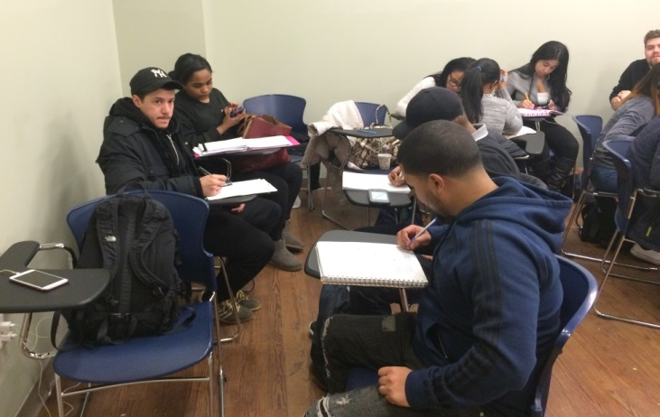
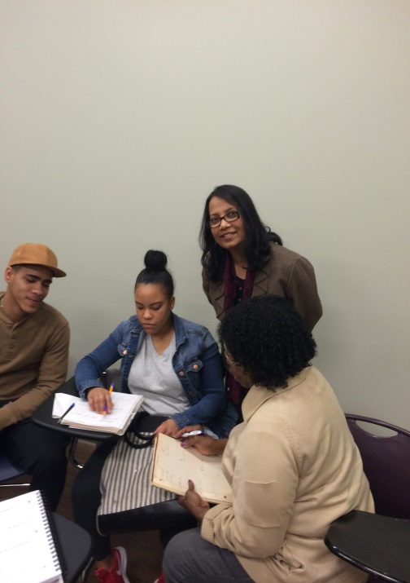
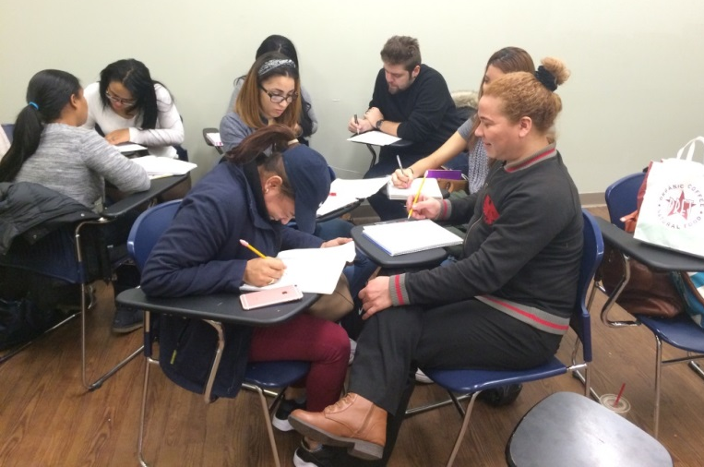
My Remedial Math Class at ASA College 02/2017

Slide 10
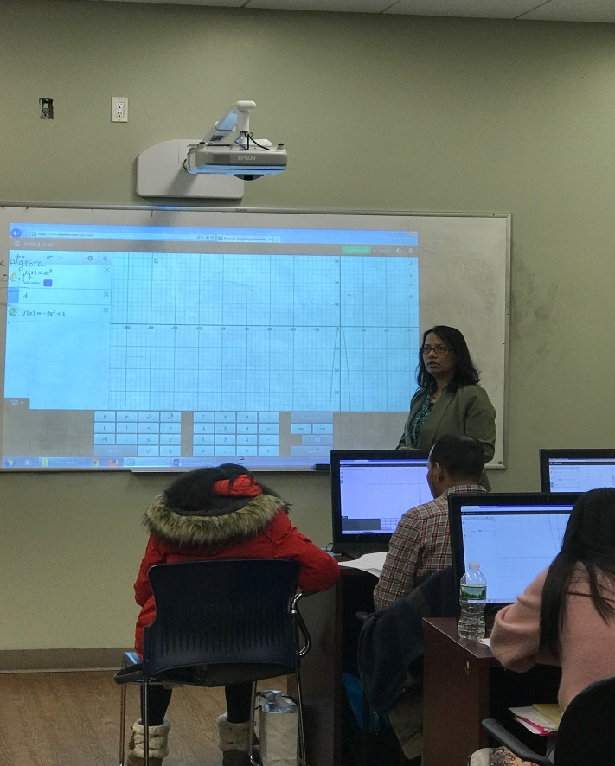
My College Algebra Class at ASA College 03/2017. Students working with Desmos a graphing calculator
https://www.desmos.com/

Slide 11
ASA COLLEGE MATH CLUB Mission Statement:
Create an energetic and sustainably active club that assists students in having fun and enjoyable experiences, using math games, digital materials http://digitalstorytelling.coe.uh.edu/example_stories.cfm?categoryid=6
Inspire women students to join the field of Math/Technology
Foster relationships between students, faculty and administration, student organizations, and the community through all its activities to encourage the involvement of women in technology

