Slide 1
Mind mapping
It’s not information overload.
It’s filter failure.
Clay Shirky
Power point presentation by Rita Nae, Adjunct, Mathematics Department NYCCT

Slide 2
Driving force behind the idea of implementing Mind Mapping in my classroom - common student complains:
Too much information;
Disconnect between the topics;
“around the time of midterm I don’t remember where did we even start..”

Slide 3
What is Mind Mapping?
Visual tool used to collect, organize and manage information in a hierarchical order.

Slide 4
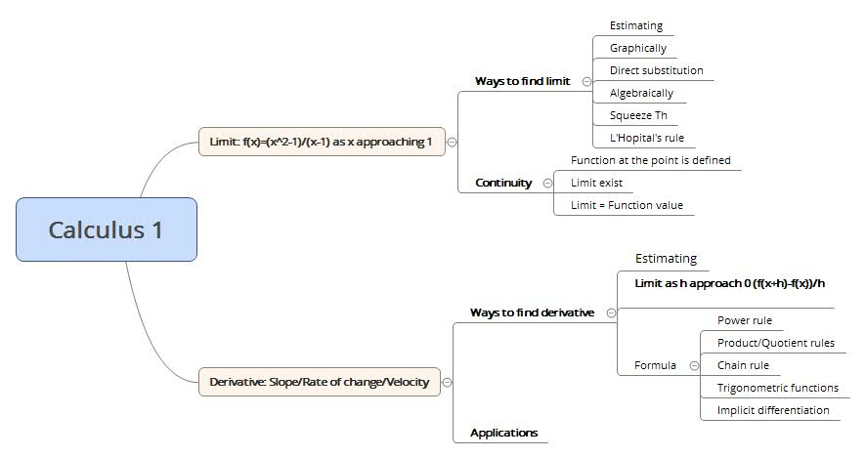
It represents information via spatial organization of concepts/topics, ideas, words, or other items linked to and arranged in a radial pattern around a central concept/topic. (Toni Krasnik, 2012) (1)

Slide 5
Key properties that I used for Mind mapping so far:
It should take less than 5 min to recreate entire map;
Map has to fit in one page;
Do it by hand versus software;
4 - 5 colors to represent major branches;
Redraw and update the map every other class.

Slide 6
Benefits of Mind Mapping:
Processing of unstructured information into systematic framework;
Less memorization, more analytic thinking;
Simple & easy to use;
Can be used for any other class or project;
Clarity.

Slide 7
Disadvantages:
Might not be preferred by auditory or kinesthetic learners;
It works the best when a creator of a map is also the user;
Maybe a limiting learning tool if a structure or framework is imposed to the student by the teacher.

Slide 8
Some research
Mind Mapping was selected as an effective strategy for encouraging creativity development in engineering students(Zampetakis et al, 2007) (2)
A study by Abi-El-Mona and Adb-El-Khalick (2008) (3) revealed that science students who used Mind Mapping achieved substantially higher gains in conceptual understanding and practical reasoning than students using conventional study techniques.
Mind Mapping has been shown to bring a renewed sense of enthusiasm to the classroom because it increases student confidence and sense of skill in mastering assigned materials (Mento et al, 1999) (4)
Concentration: Evidence includes improved concentration, staying on task for longer periods of time, improved questioning and answering during class discussions and improved independence. Cain (2001/2002) (5)

Slide 9
The illiterate of the 21st century will not be those who cannot read and write, but those who cannot learn, unlearn, and relearn.
– Alvin Toffle

Slide 10
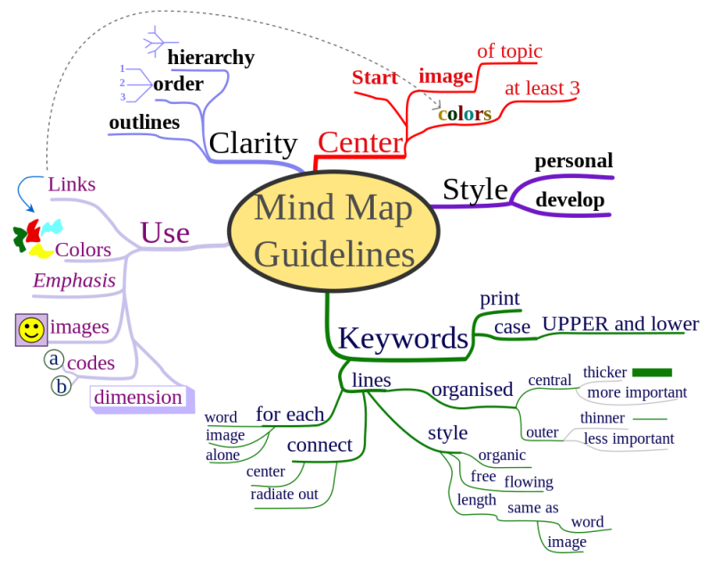
Mind Mapping tips
http://lifehacker.com/how-to-use-mind-maps-to-unleash-your-brains-creativity-1348869811

Slide 11
1. How to Study with Mind Maps: The Concise Learning Method for Students and Lifelong Learners (Expanded Edition) Kindle Edition, 2012. 2. Zampetakis, L. A., Tsironis, L. and Moustakis, V. (2007), ‘Creativity Development in Engineering Education: The Case of Mind Mapping’. Journal of Management Development, Vol. 26, No. 4, pp 370-380. 3. Abi-El-Mona, I. and Adb-El-Khalick, F. (2008), ‘The influence of Mind Mapping on eighth graders’ science achievement’. School Science and Mathematics. 4. Mento, A. J., Martinelli, P. and Jones R. M. (1999), ‘Mind Mapping in Executive Education: Applications and Outcomes’. The Journal of Management Development, Vol. 18, Issue 4. 5. Cain, M. E. (2001/2002), ‘Using Mind Maps to raise standards in literacy, improve confidence and encourage positive attitudes towards learning’. Study conducted at Newchurch Community Primary School, Warrington.
Resources:

