Slide 1
Presentation MSEIP workshop Spring 2017 Graphing Parabolas The three types of equation of parabola
Lucie Mingla

Slide 2
Some Information before the activity

Slide 3
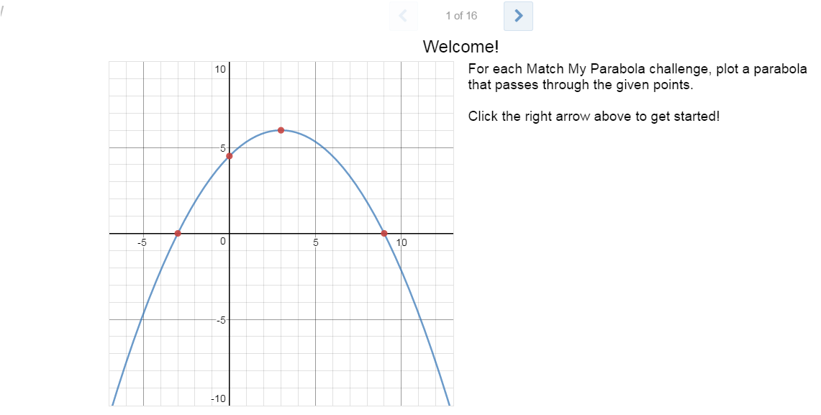
Activity Outline associated with solutions(my preparation)

Slide 4
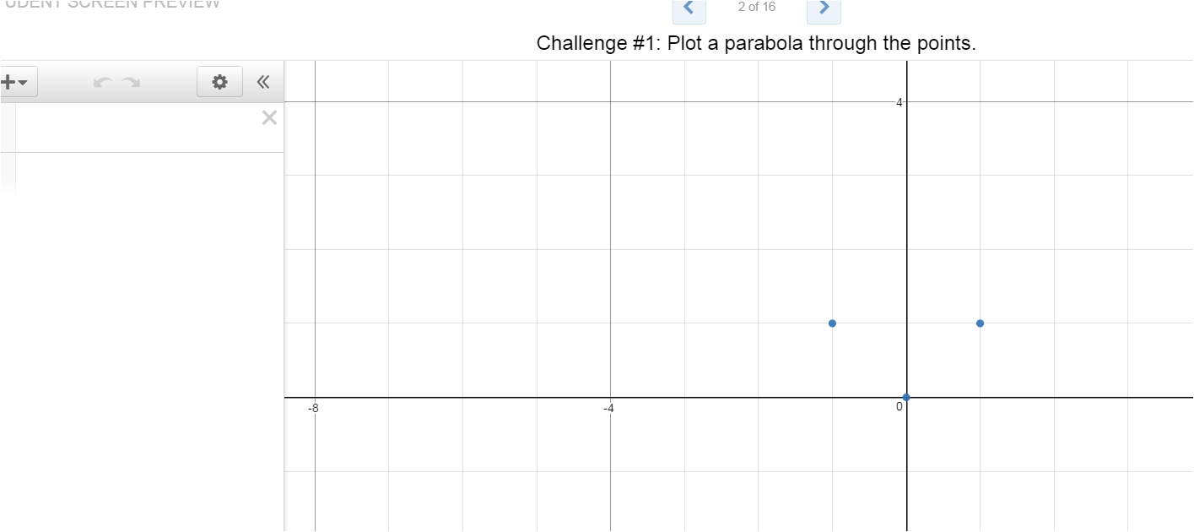

Slide 5
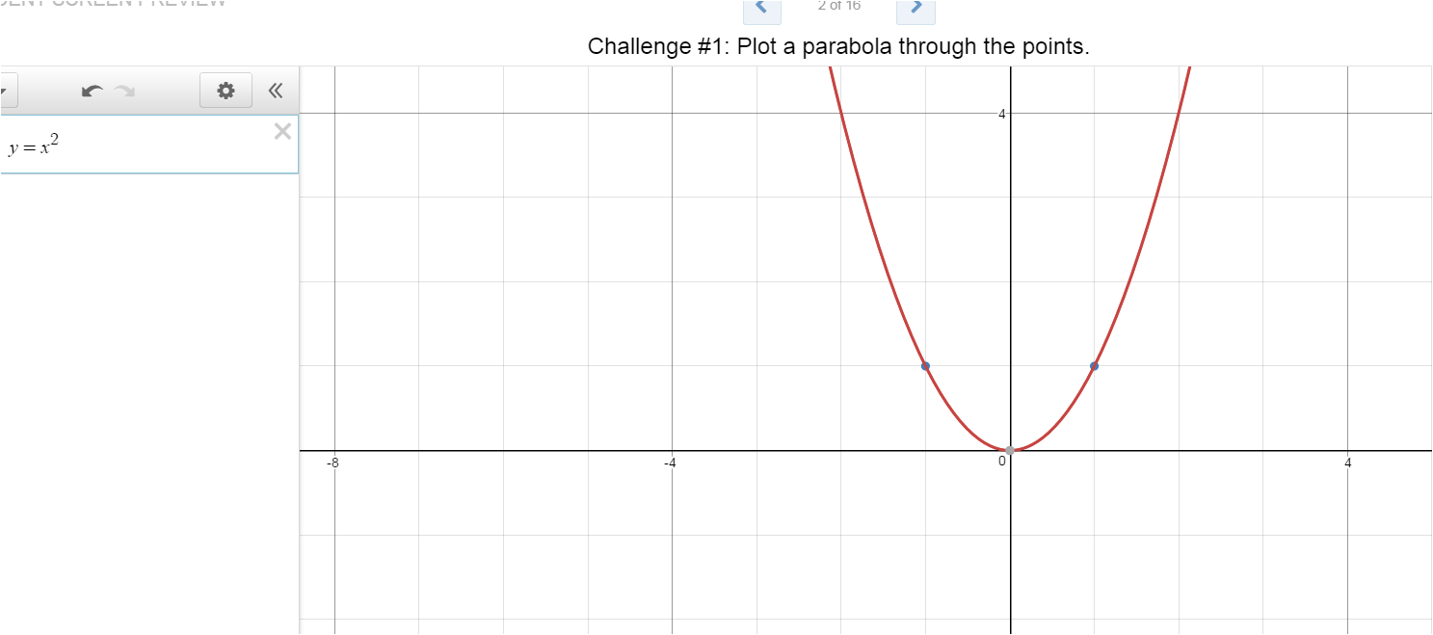

Slide 6
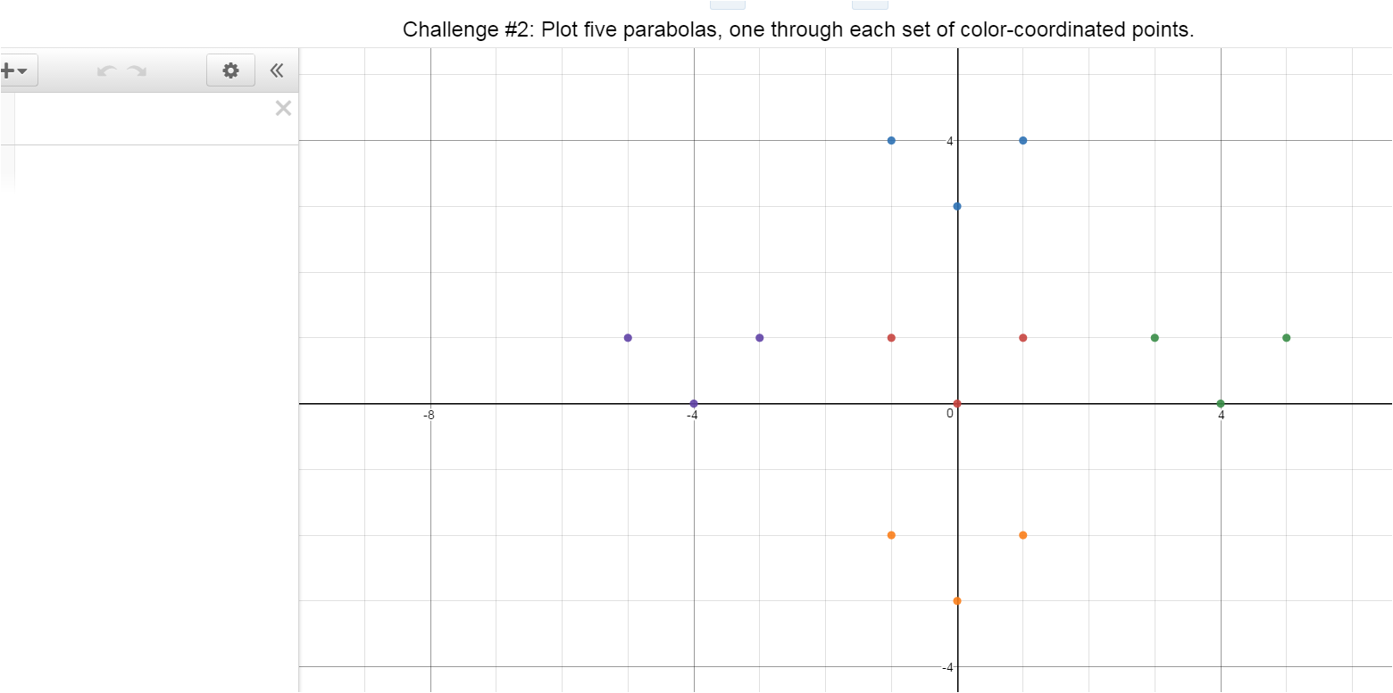

Slide 7
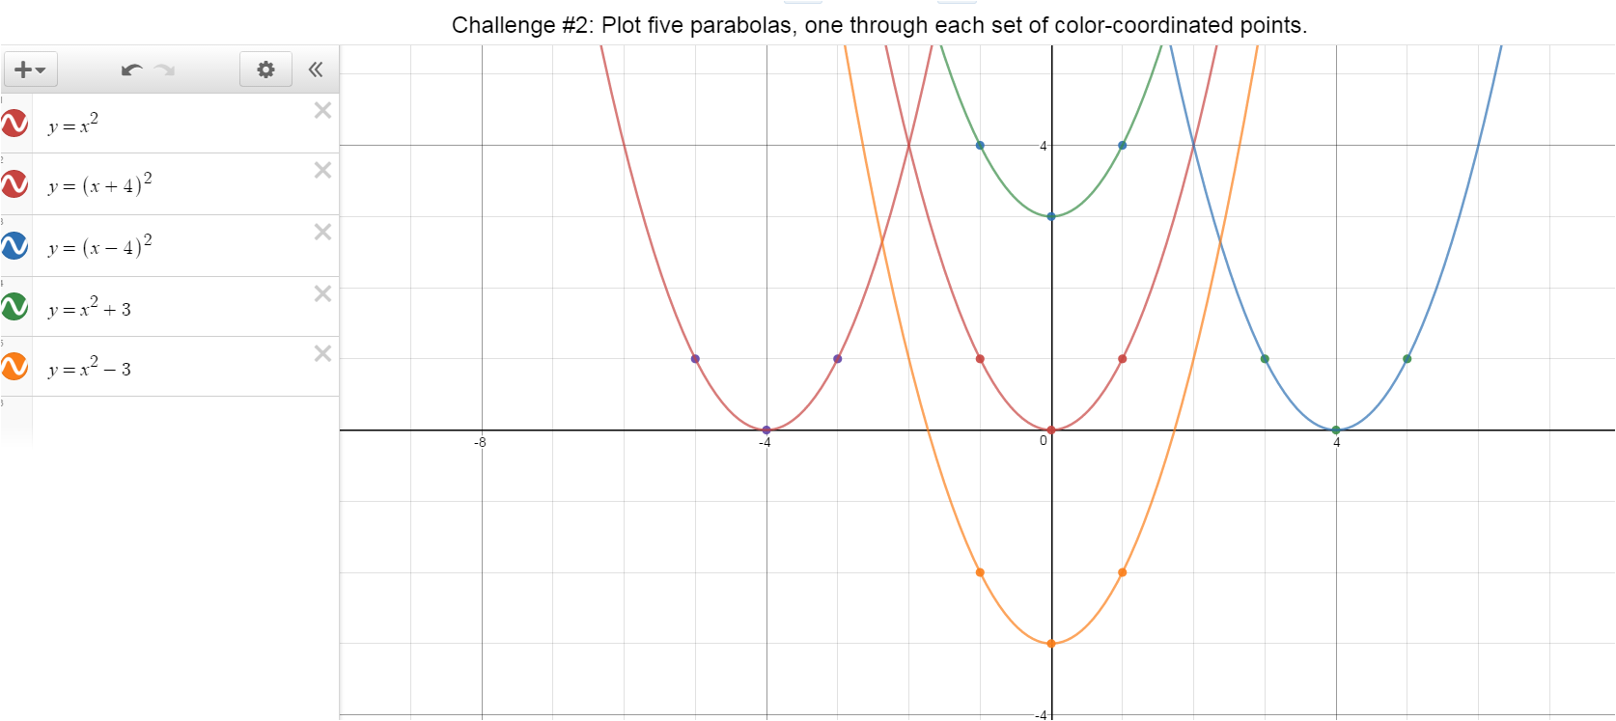

Slide 8
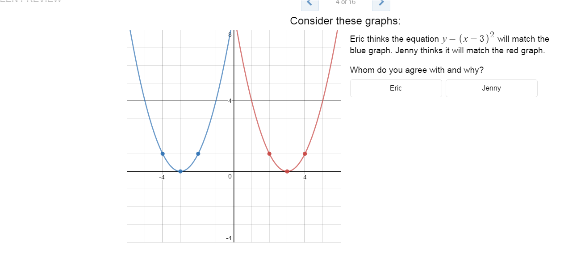

Slide 9
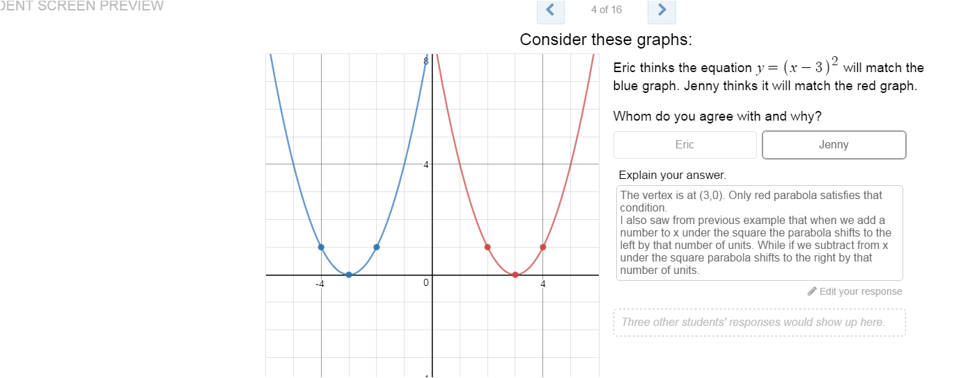

Slide 10
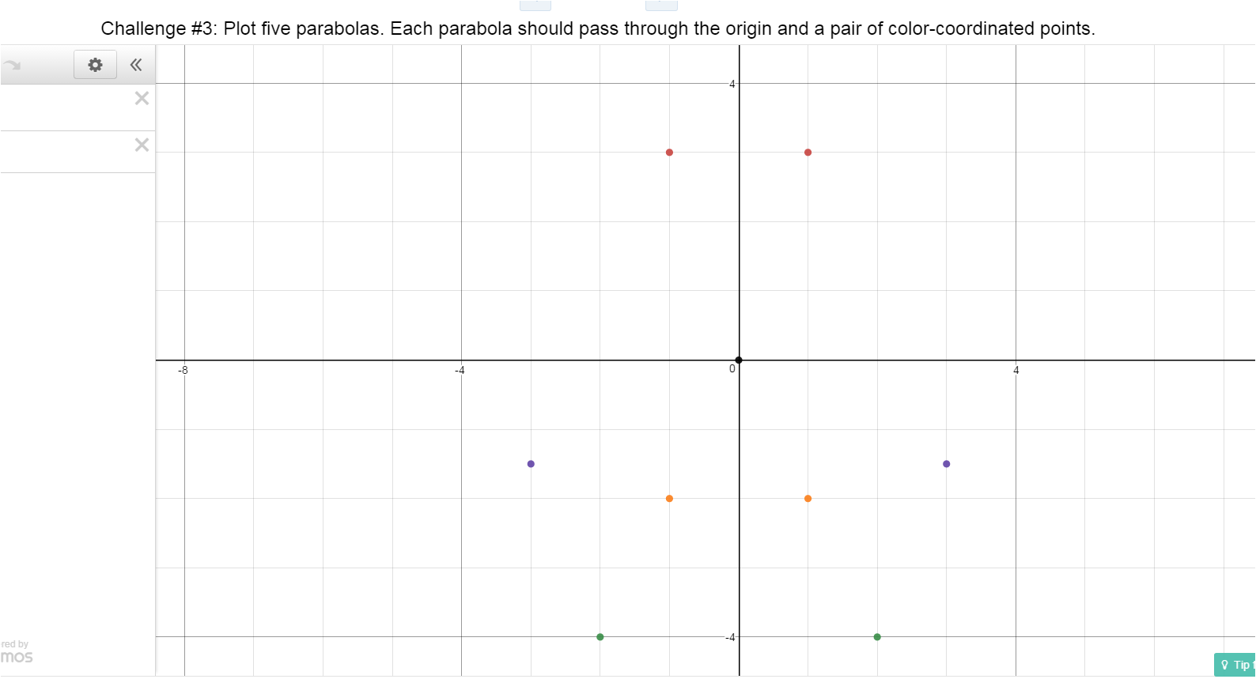

Slide 11
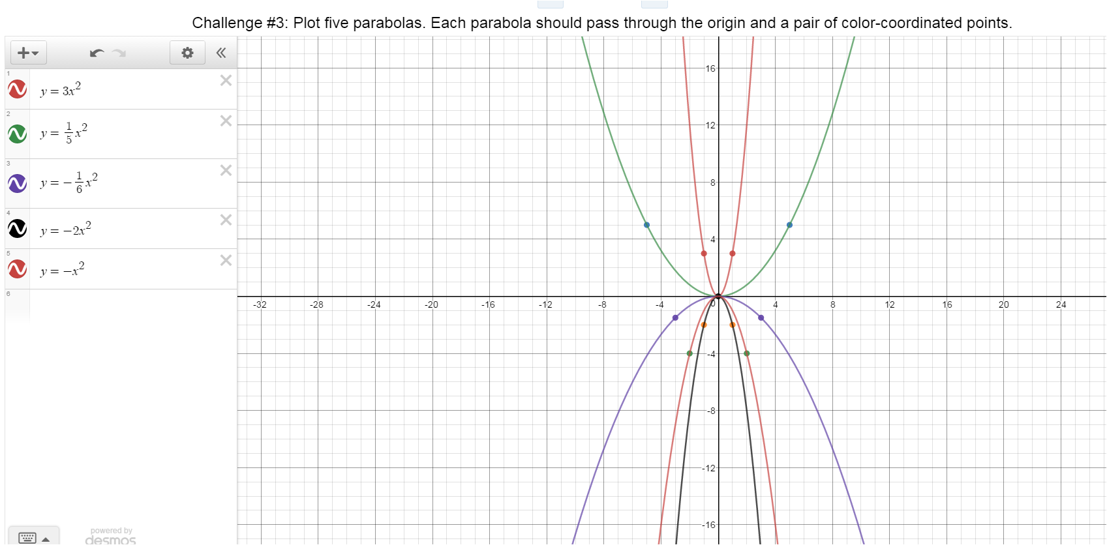

Slide 12
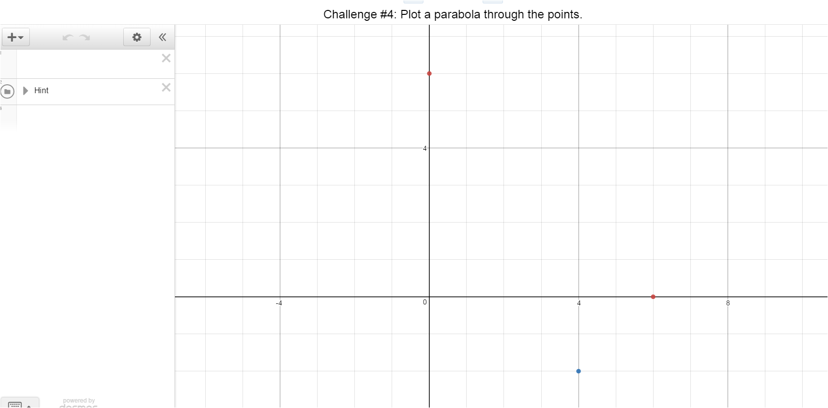

Slide 13
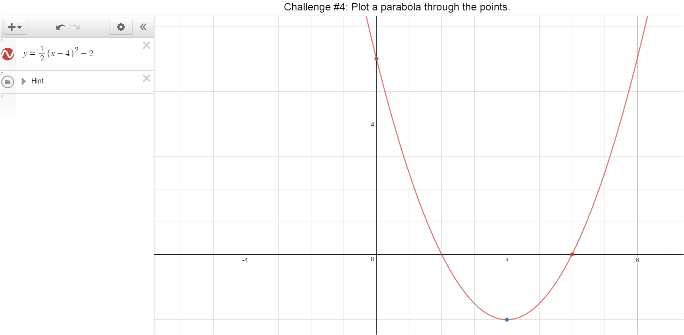

Slide 14
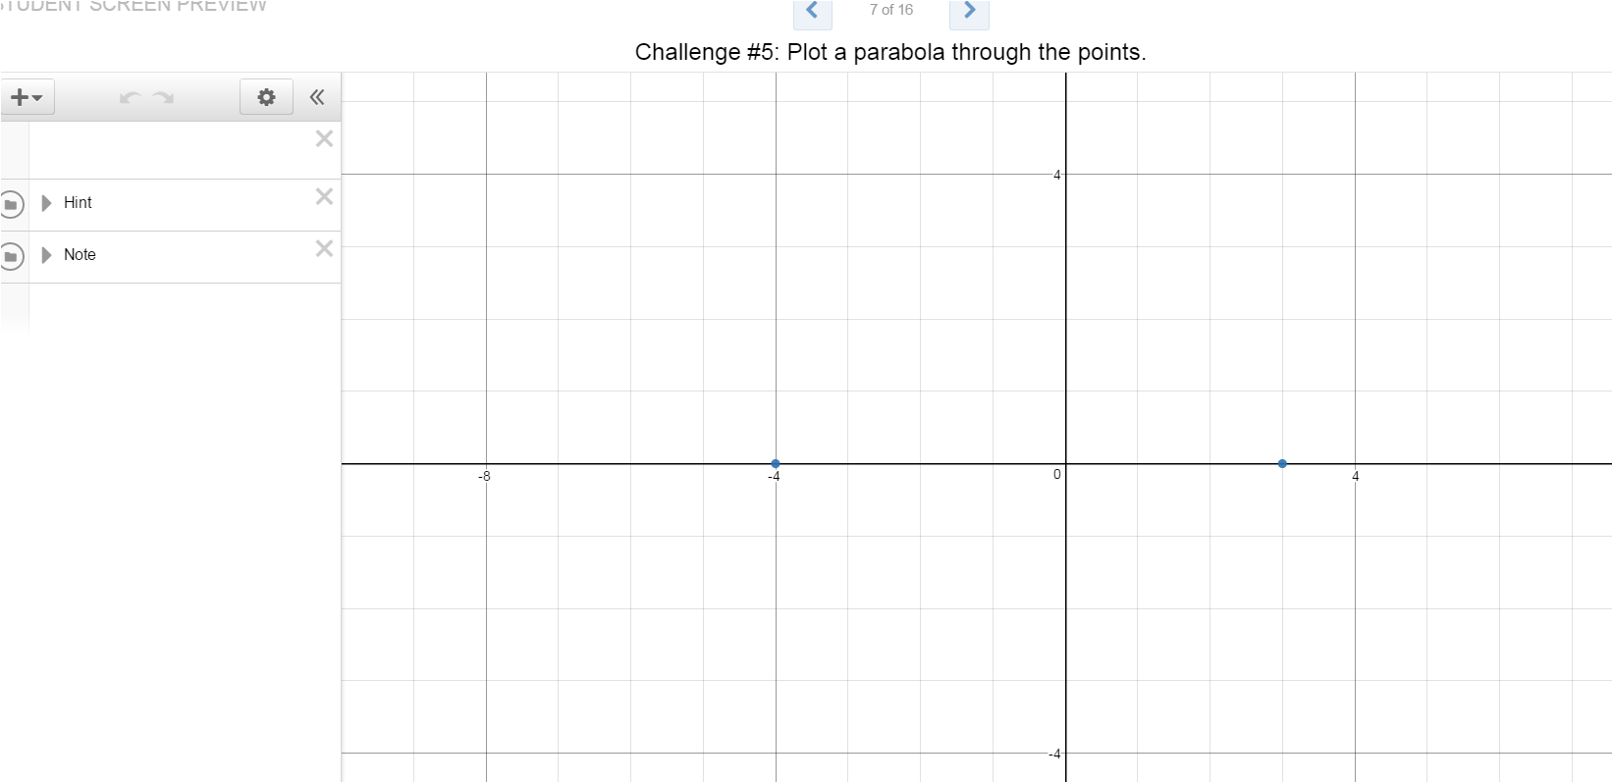

Slide 15
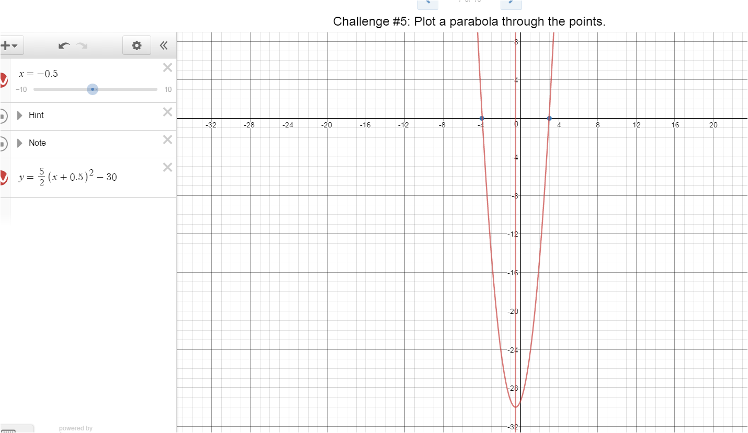

Slide 16
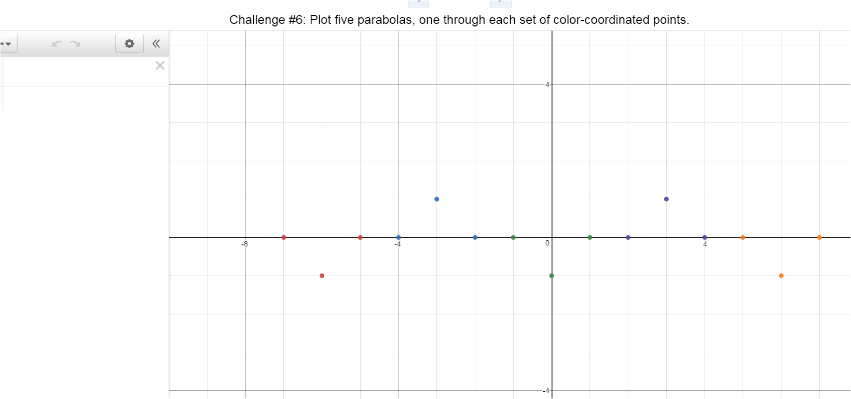

Slide 17
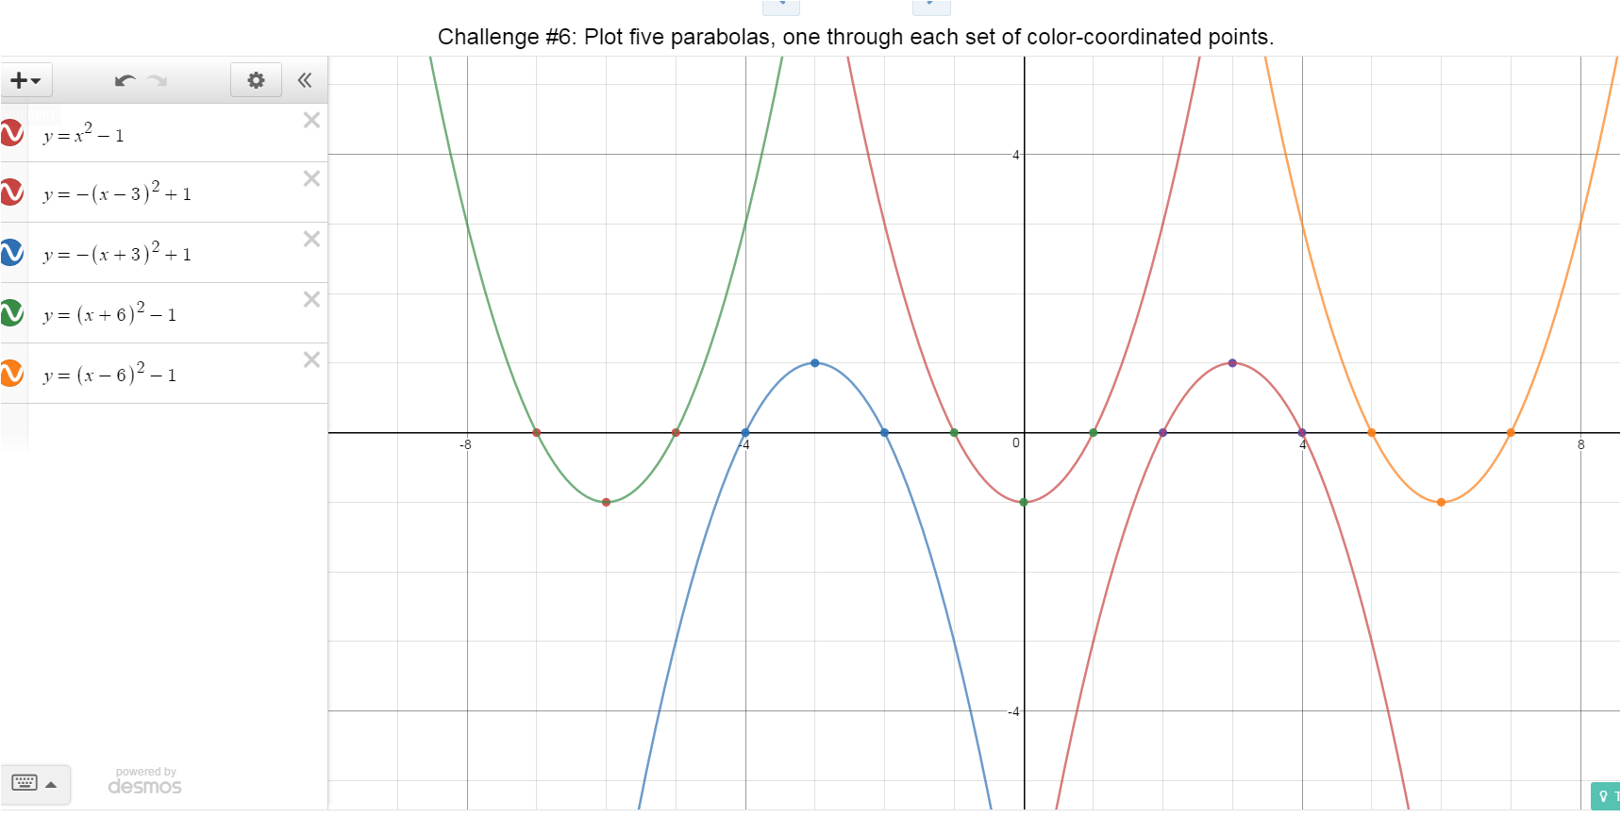

Slide 18
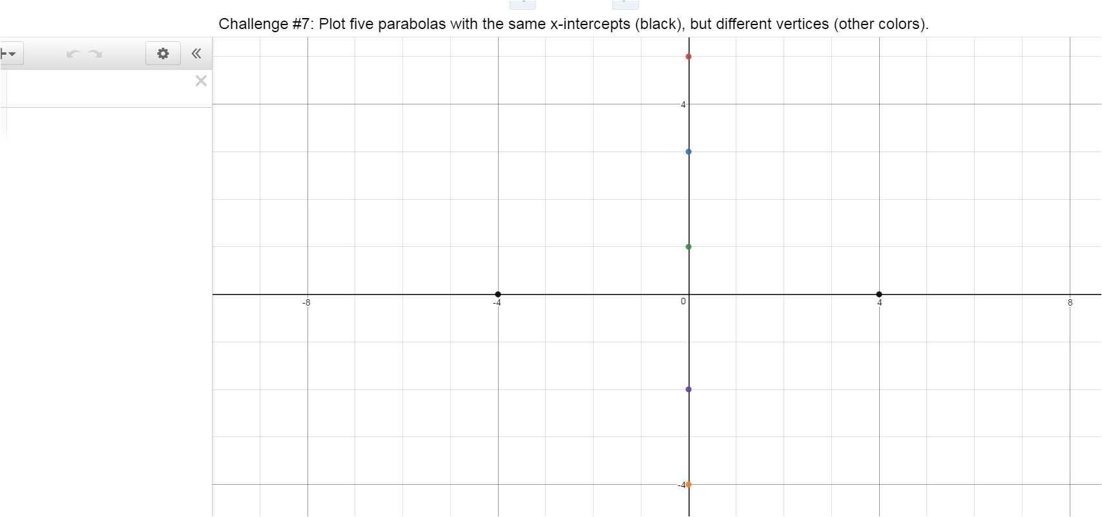

Slide 19
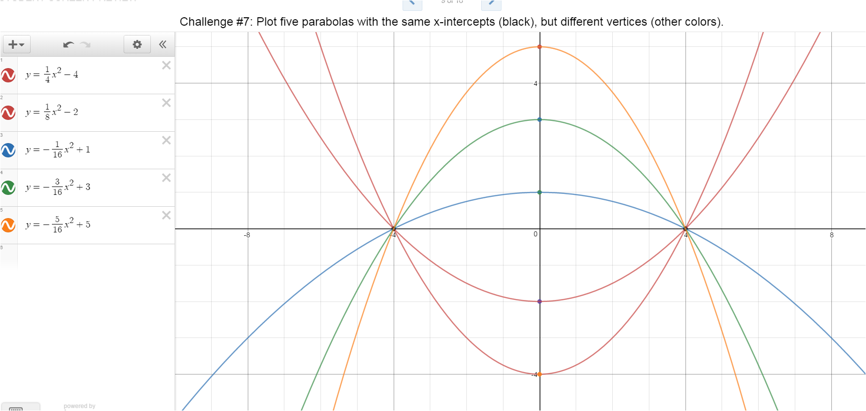

Slide 20
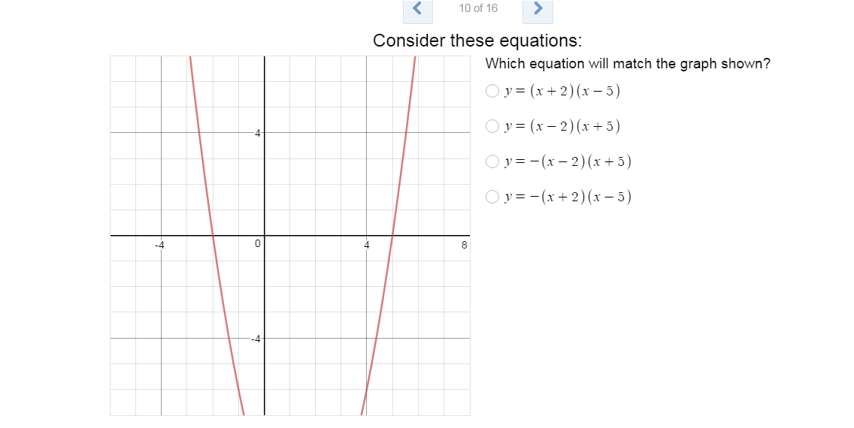

Slide 21
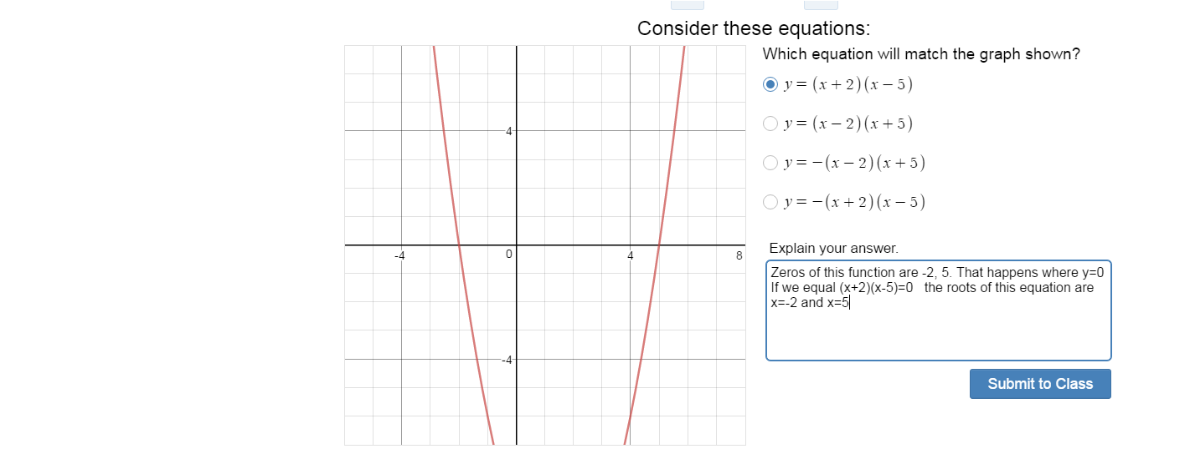

Slide 22
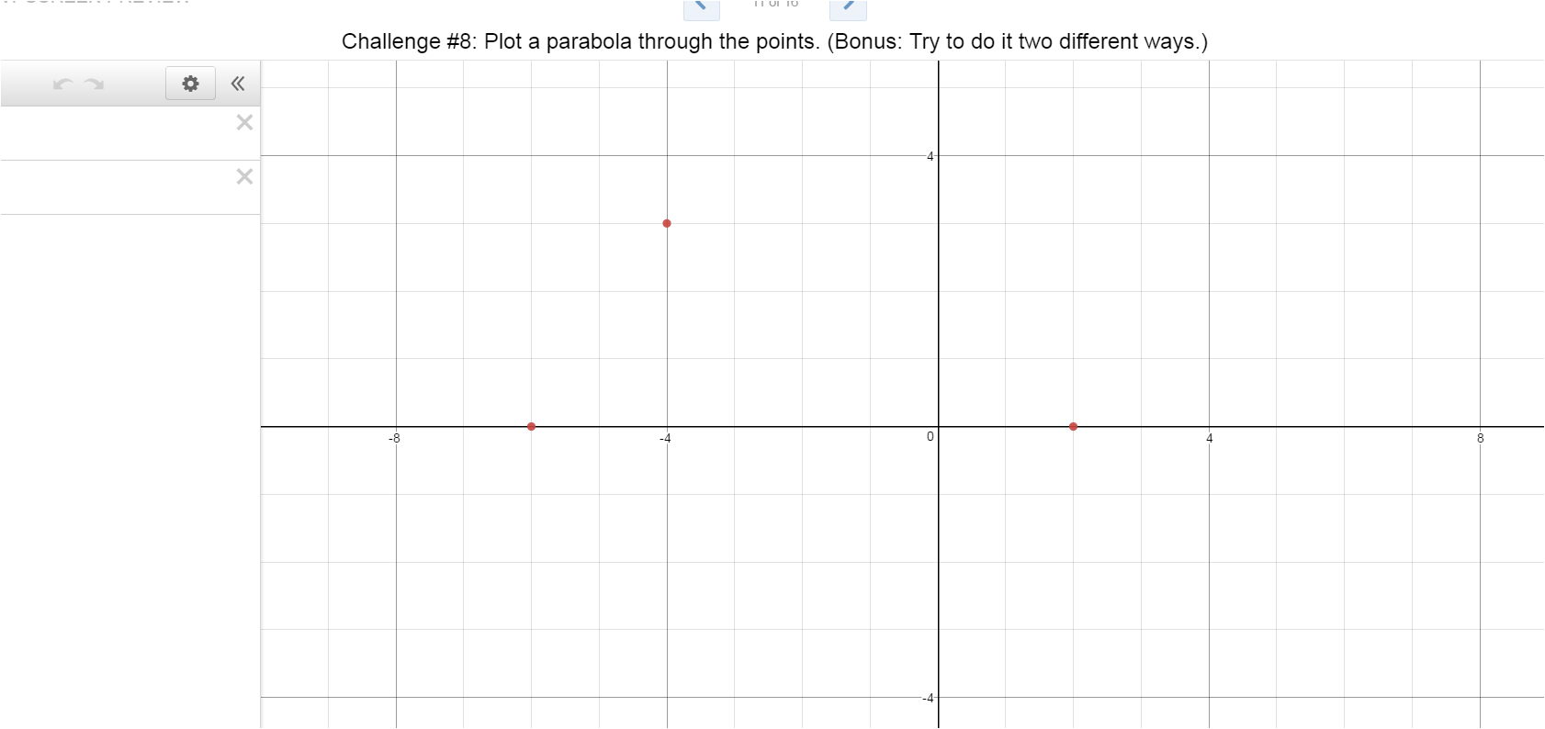

Slide 23
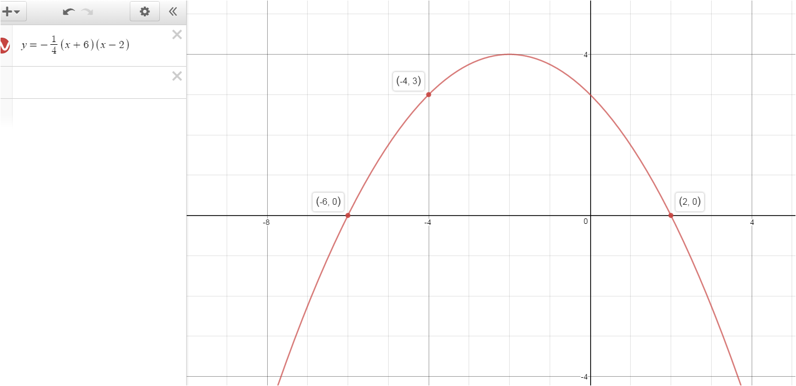

Slide 24
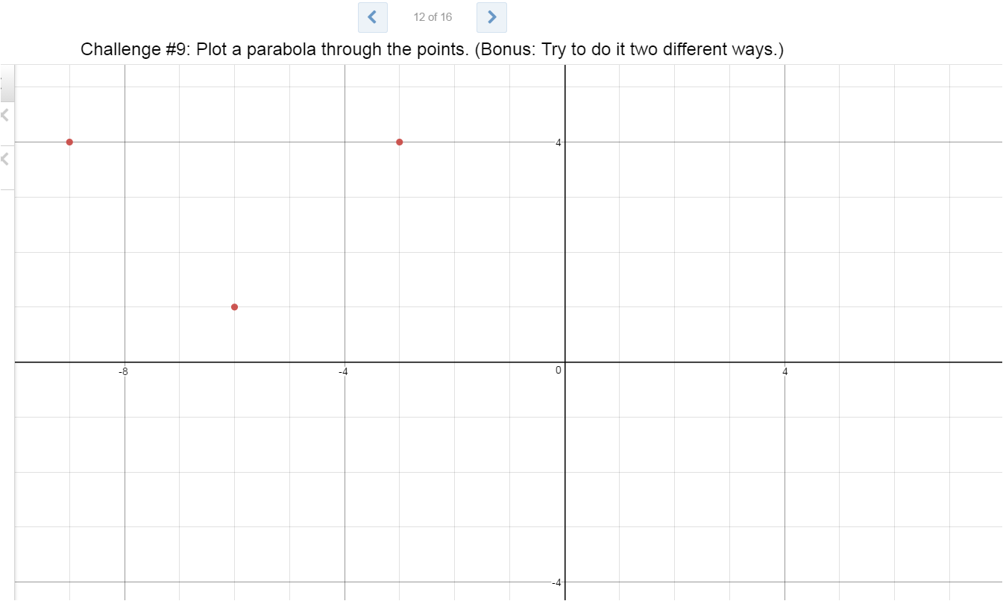

Slide 25
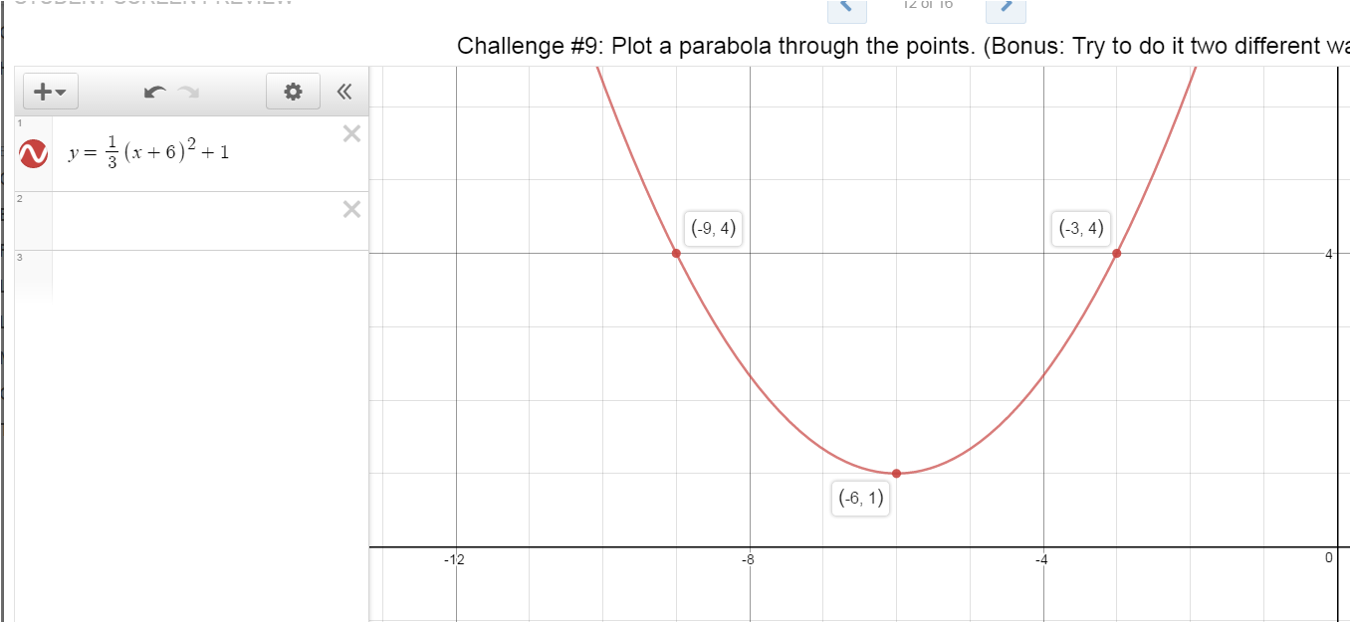

Slide 26
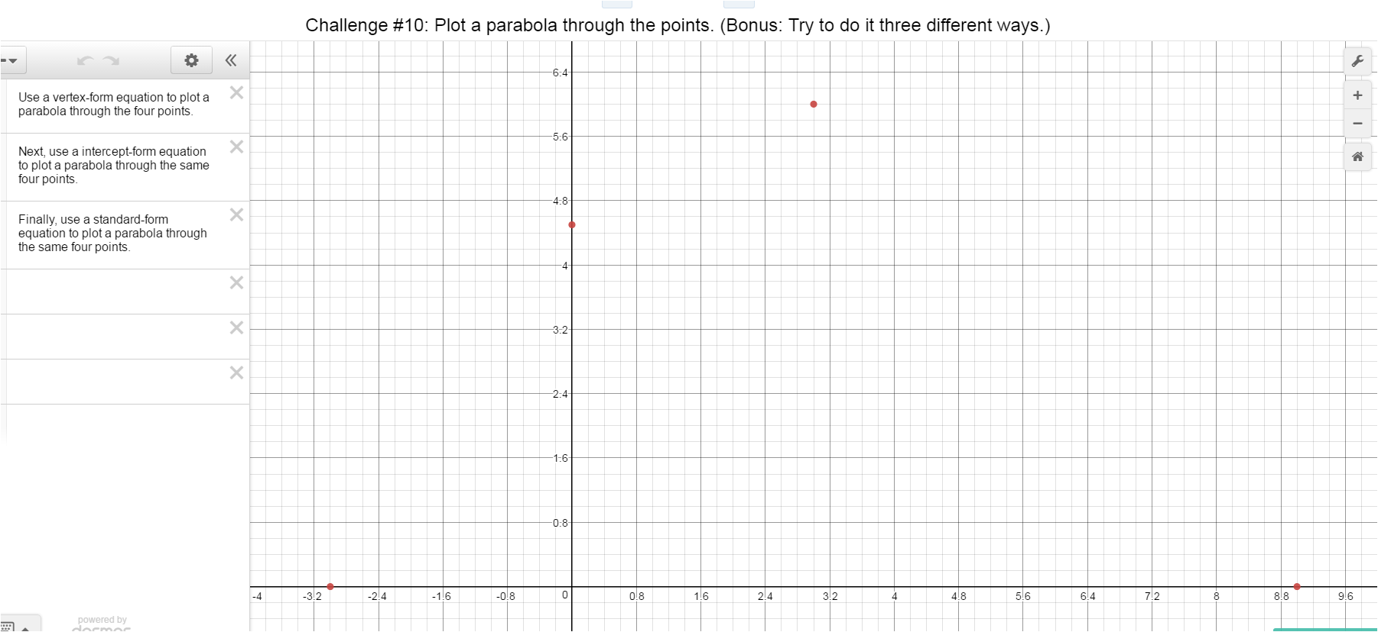

Slide 27
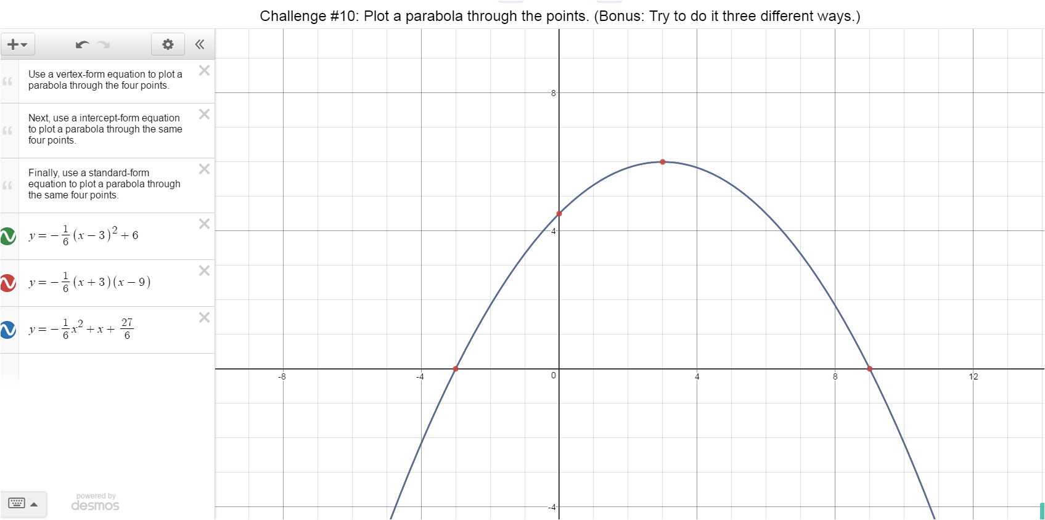

Slide 28
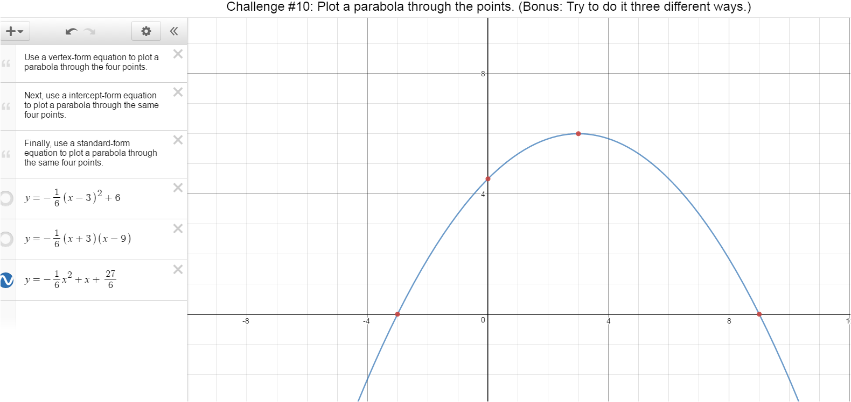

Slide 29
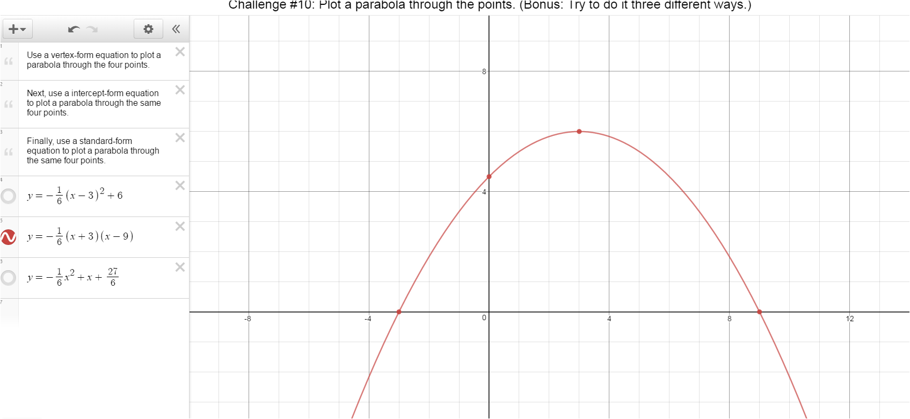

Slide 30
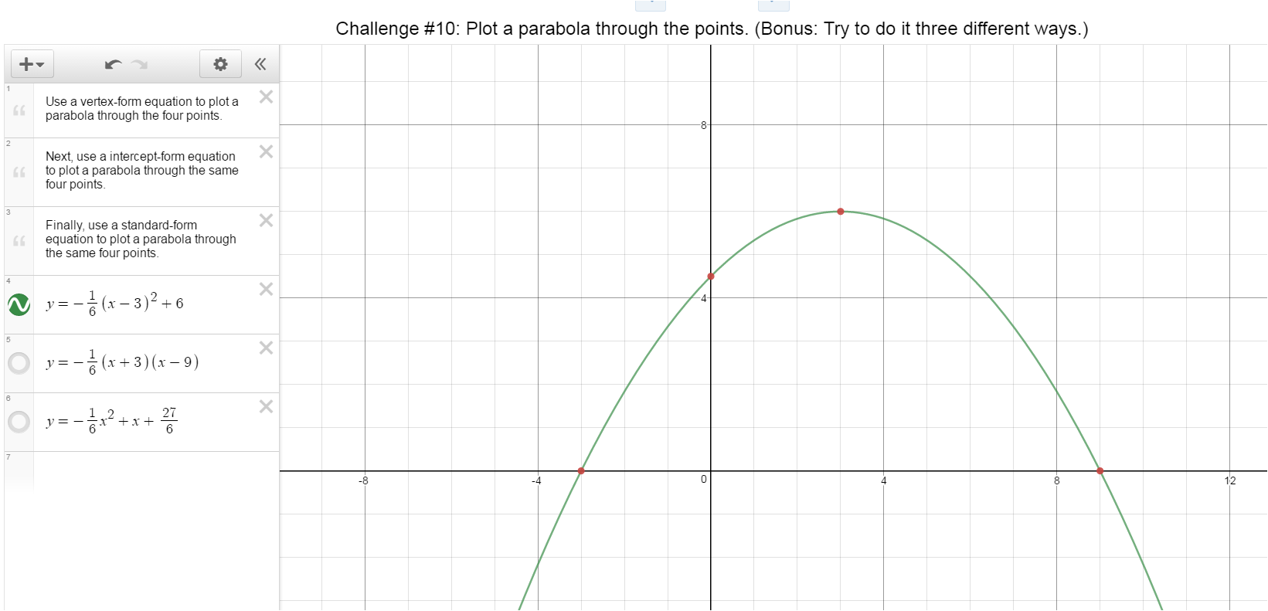

Slide 31
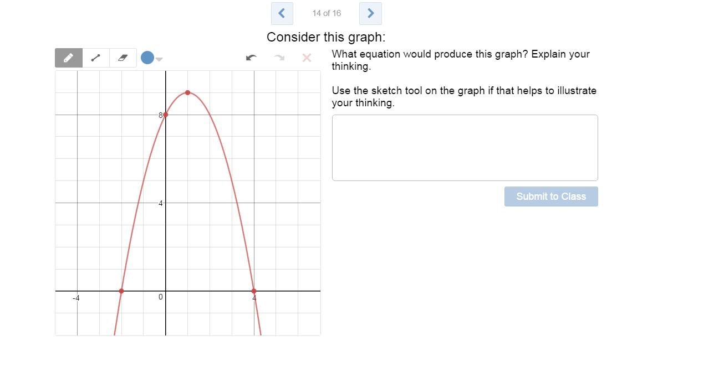

Slide 32
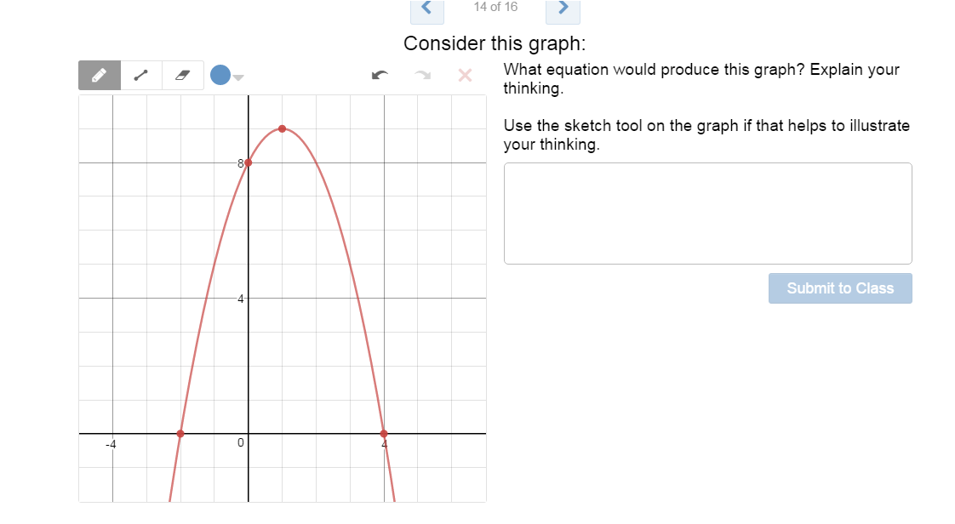

Slide 33
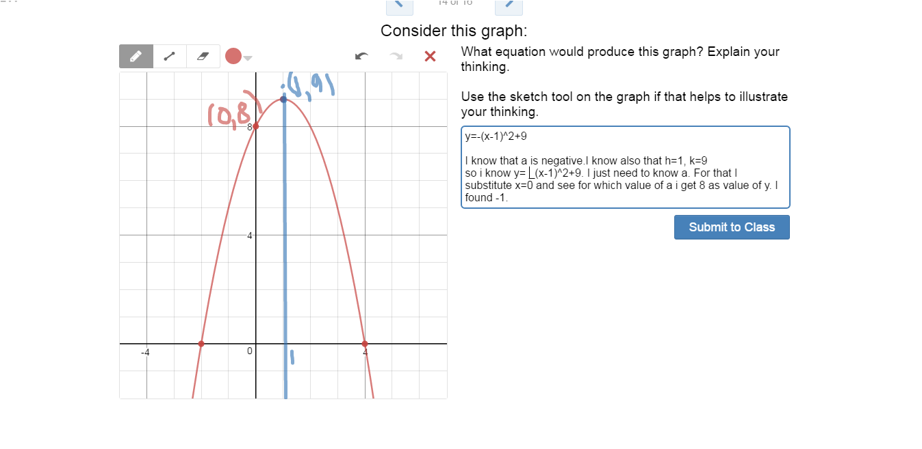

Slide 34
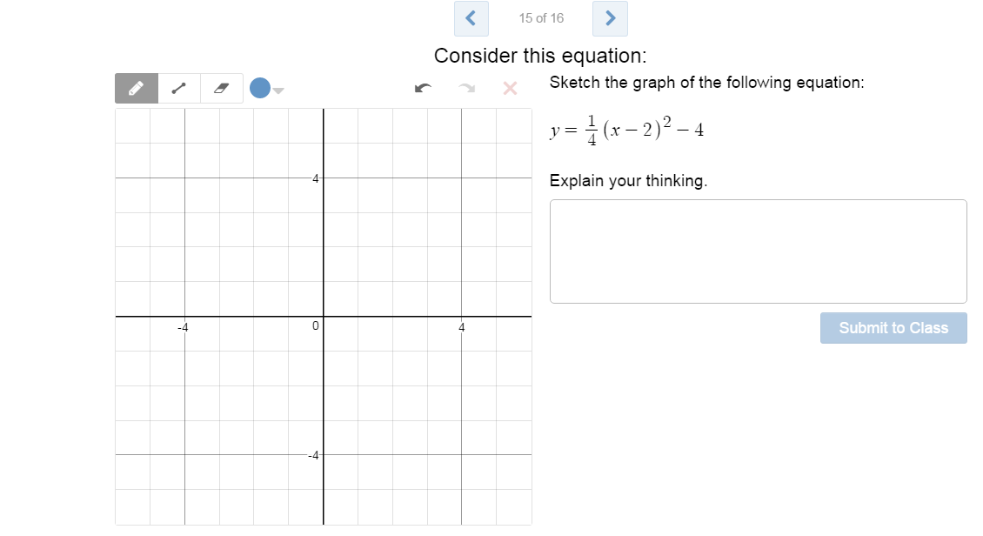

Slide 35
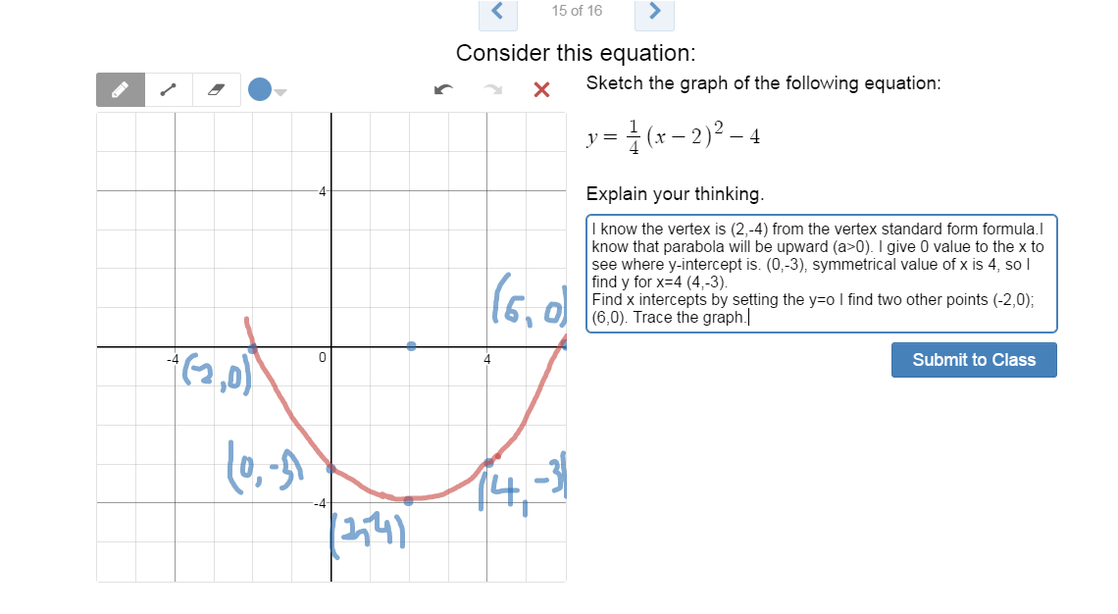

Slide 36
Match My Parabola Activity Results
Evaluating and giving feedback to students

Slide 38
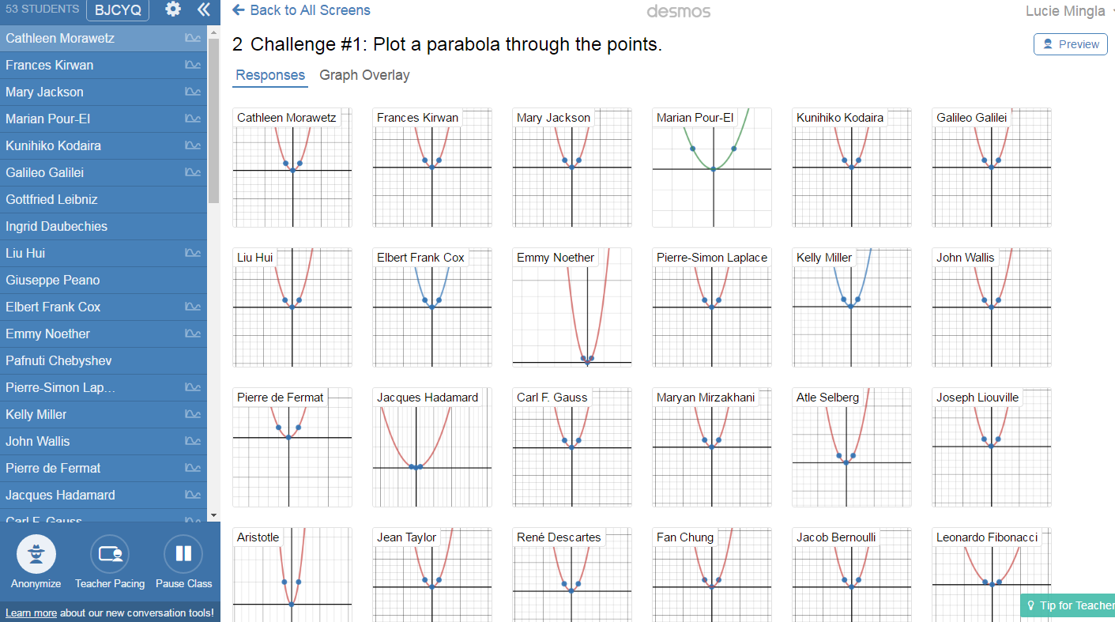

Slide 40
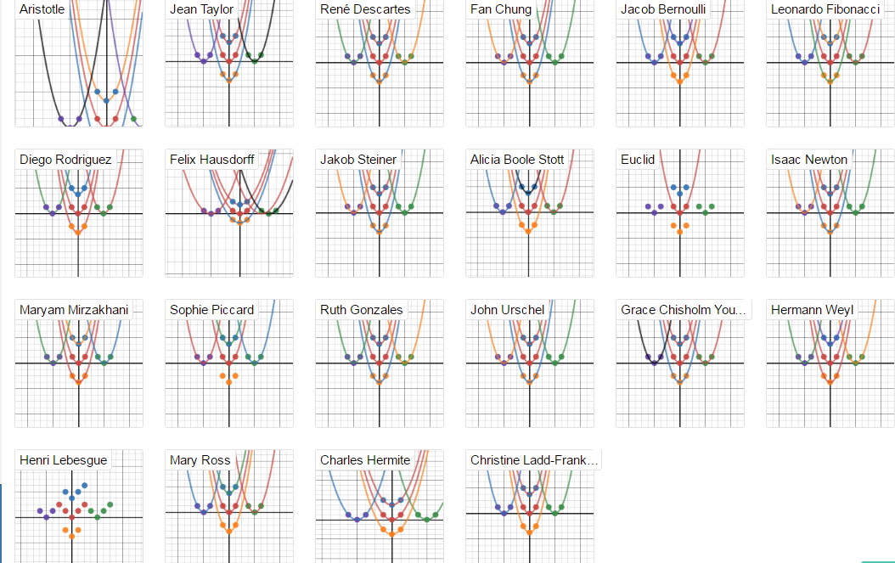

Slide 41
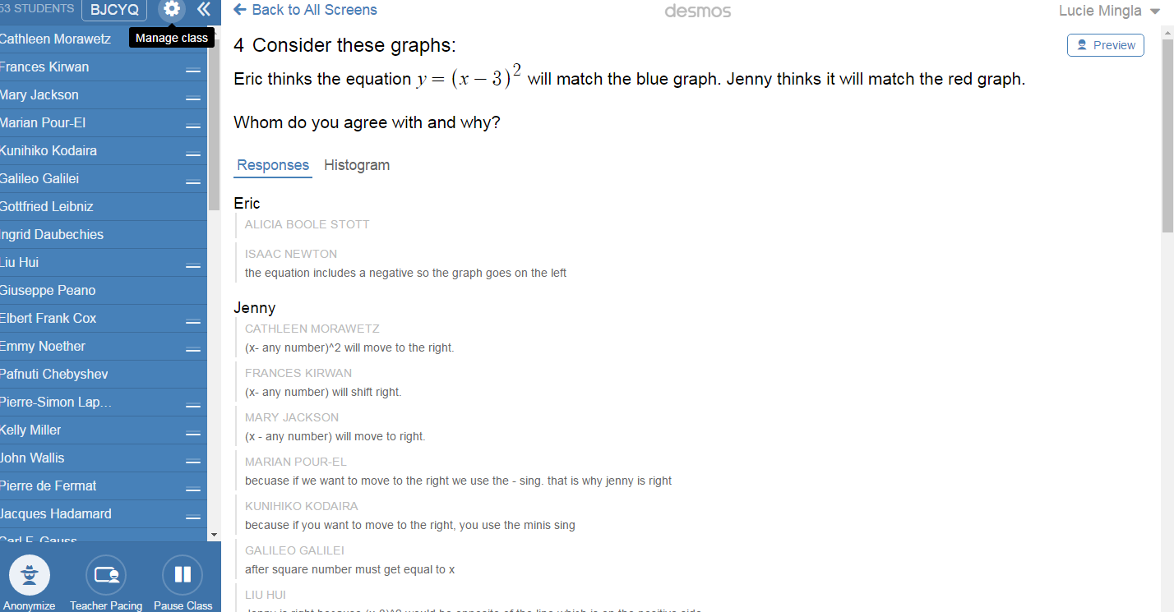

Slide 42
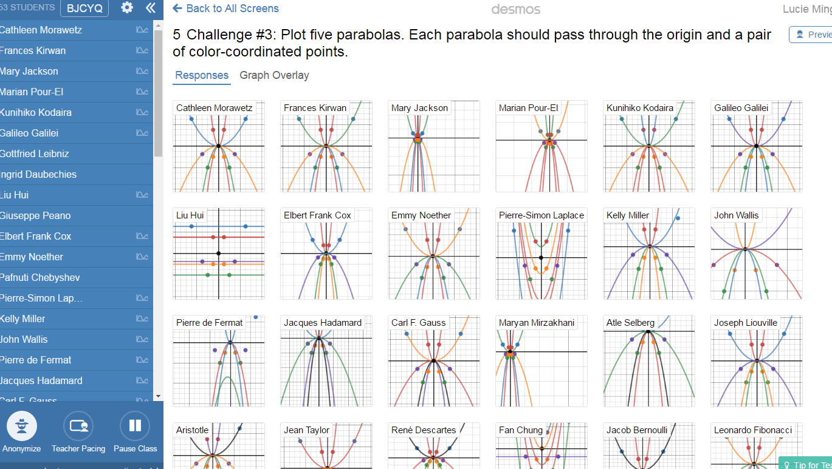

Slide 43
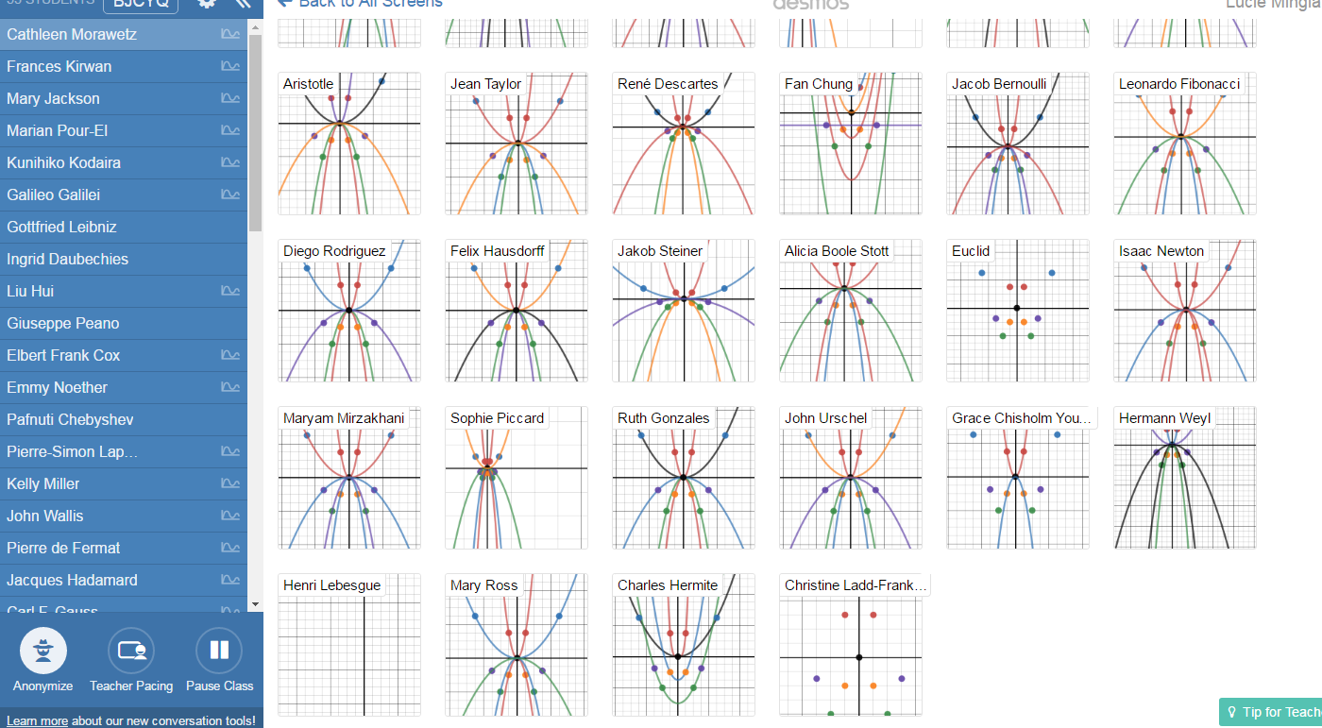

Slide 44
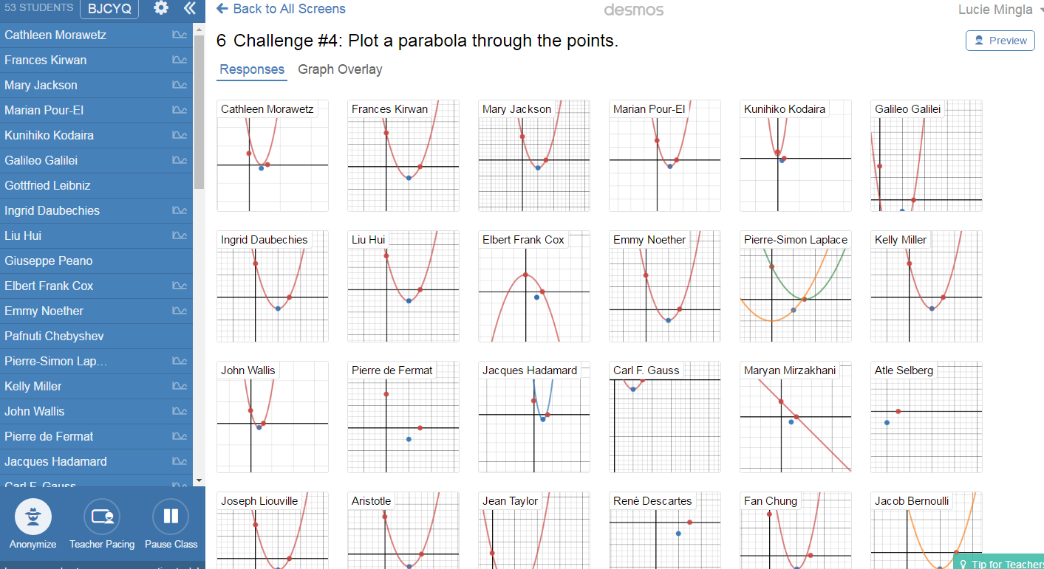

Slide 45
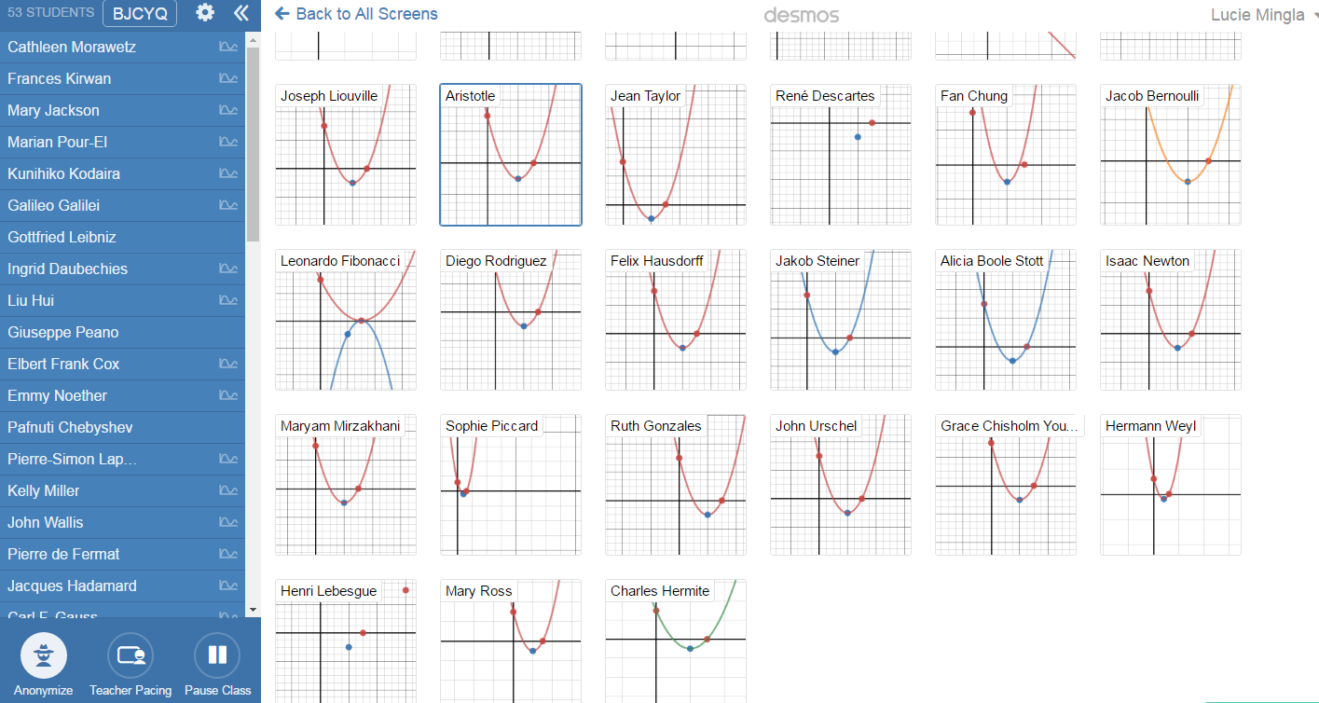

Slide 46
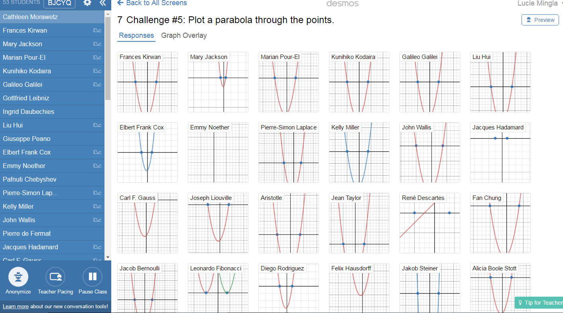

Slide 47
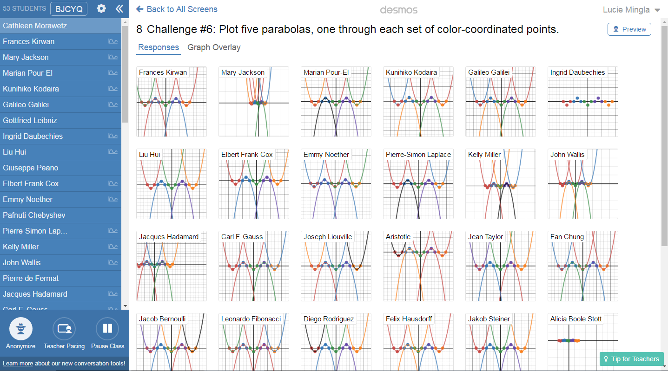

Slide 48
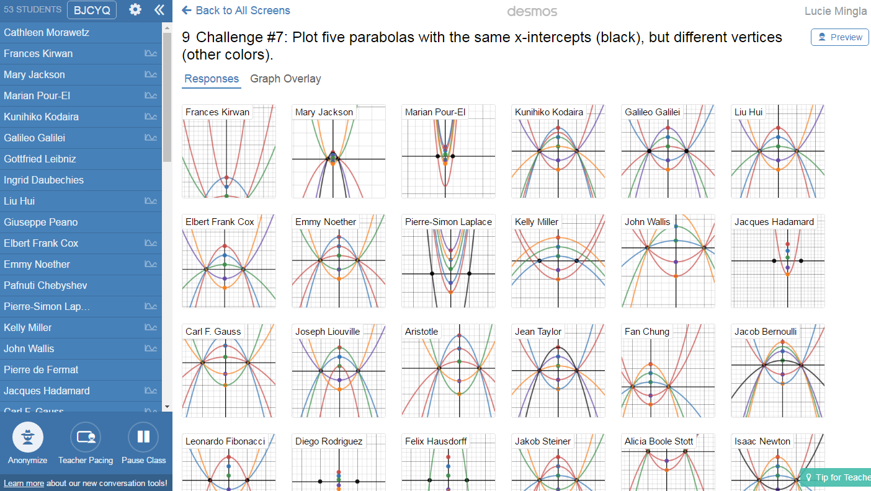

Slide 49
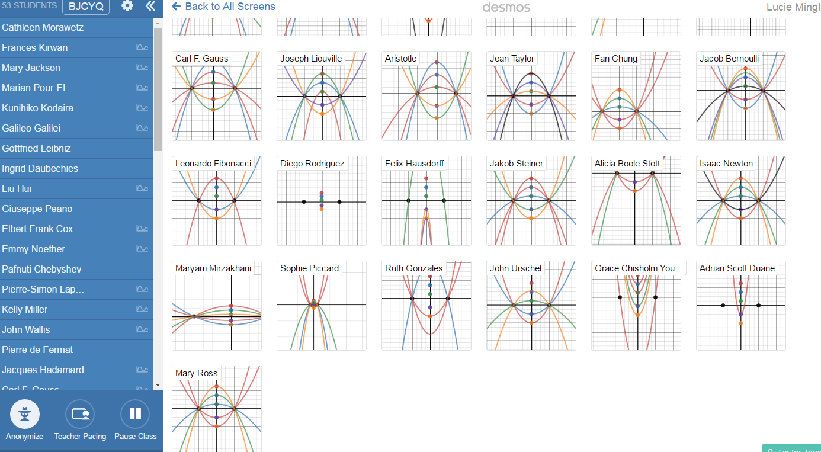

Slide 51
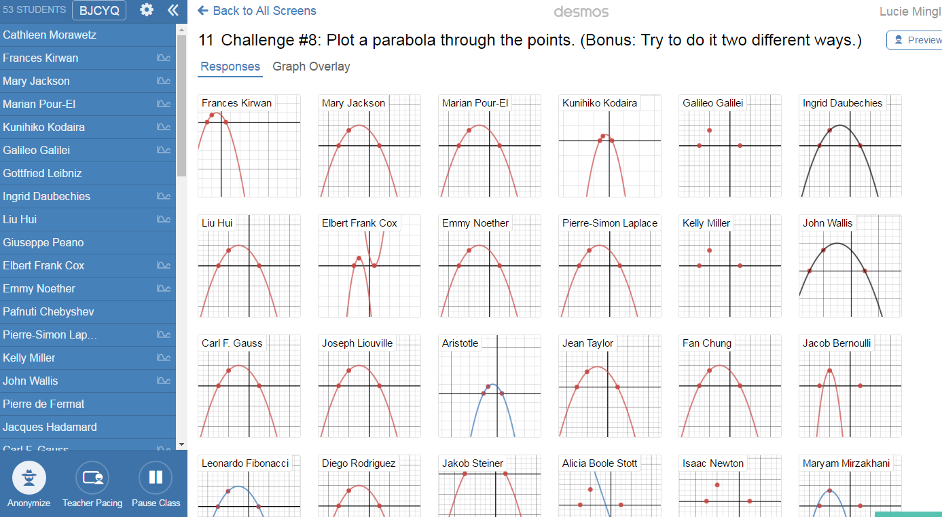

Slide 52
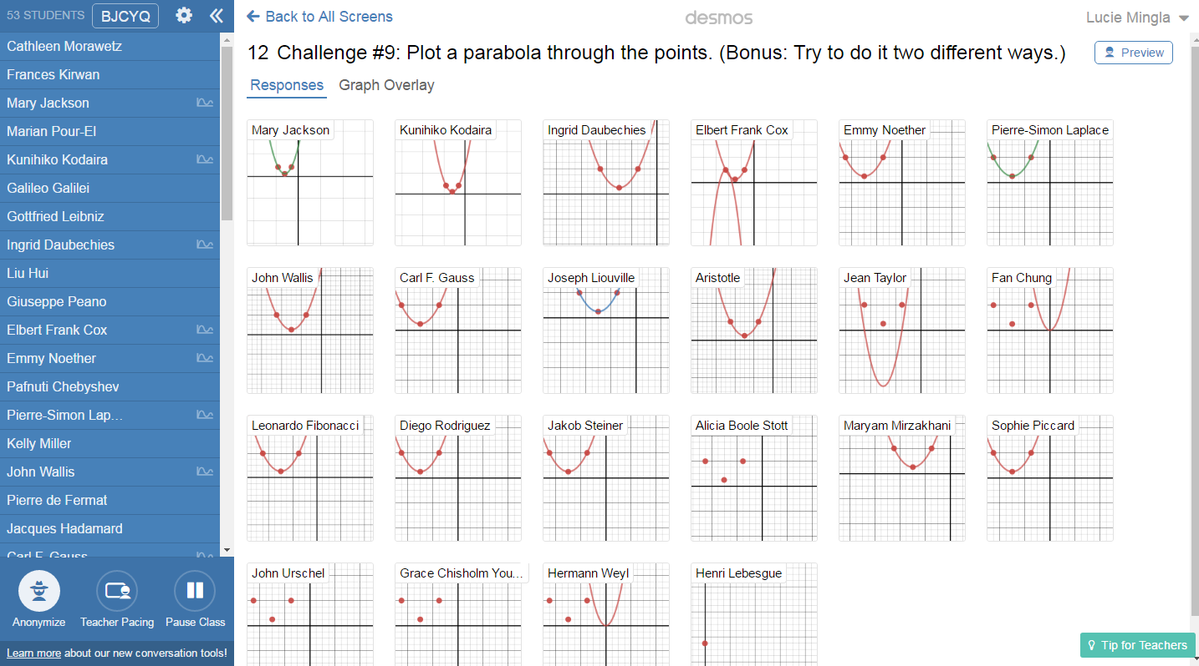

Slide 53
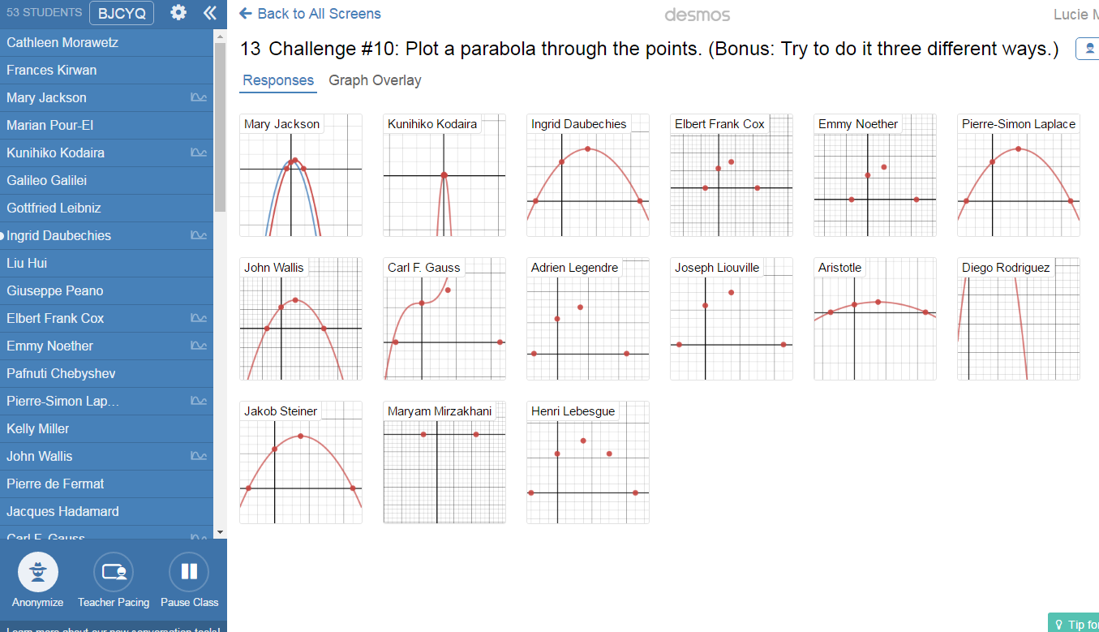

Slide 54
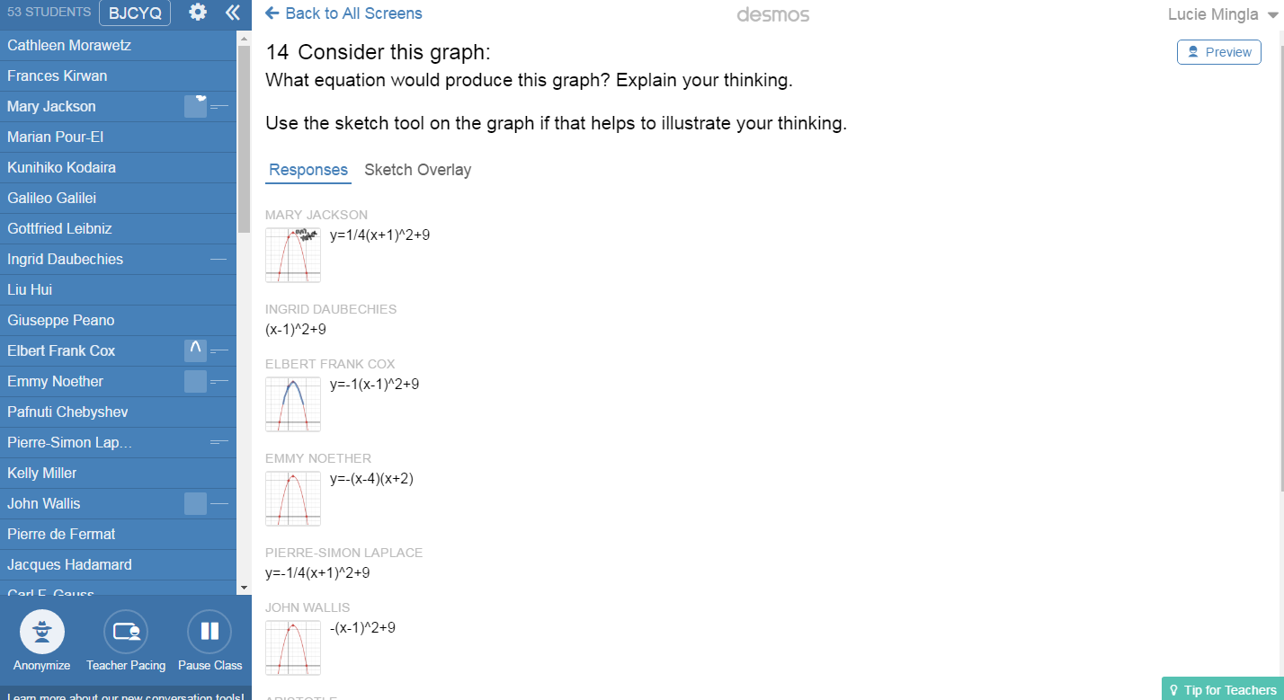

Slide 56
The benefits of these types of activities https://teacher.desmos.com/
The teacher follows up students work from the computer and give general feedback for the majority of the students on the screen and for individual students individually
Turn the names anonymous and discuss the question with the answer that needs clarification
Call the individual students to give specific feedback (differentiated instructions)
Connecting graphs with functions
A great task for visual learners. Looking at the zeros of the function, vertex coordinates etc
Transforming the general standard form of quadratics into vertex formula where the coordinates can be clearly seen.
Students can match the graph with the parabola given in different forms.
Standard form
Writing the equation in intercept form when the graph is given etc
Vertex form
Intercepts form
Immediate feedback for each students
Very good activity for connecting the graph with different types of quadratic functions.
Students can reveal, explore various forms of equation of parabola and the vertex coordinates, line of symmetry, concavity etc.

