Slide 1
Alexandre Barbier City University of New York New York City College of Technology
From Analog to Digital
Thinking through a transformational process
ABarbier@citytech.cuny.edu
ProfBarbier@gmail.com

Slide 2
Inception: It All starts as Analog
General observations
Instilling method in the thought process
Grammar: taboo or useful concept?
Summarizing what is to come: the Abstract
Seeing the Beginning and anticipating the End
Logic or Data design, from the plainspoken formulation
Caveats
Conclusion

Slide 3
General Observations
Many students begin their college curriculum without being equipped with proper communications skills
Computer Science, as all science, hinges on rigor and clarity
Correct grammar, let alone knowledge of grammar, is viewed as taboo, even elitist
A topic must first be expressed in clear analog format before being specified for a structured digital environment
Applying basic grammatical rules to verbal expression leads to clarity of concept and reduced ambiguity down the road

Slide 4
The student: willing but not Enabled
Give a colorful example
Transferable
Recognizable
Simple for the purpose
Explain it succinctly
Show the end goal
Develop it methodically
Suggest useful applications
Primary Key | Foreign Key
3 | 11
2 | 3
15 | 2
13 | 15
7 | 11
4 | 7
10 | 4
1 | 10
11 | 1

Slide 5
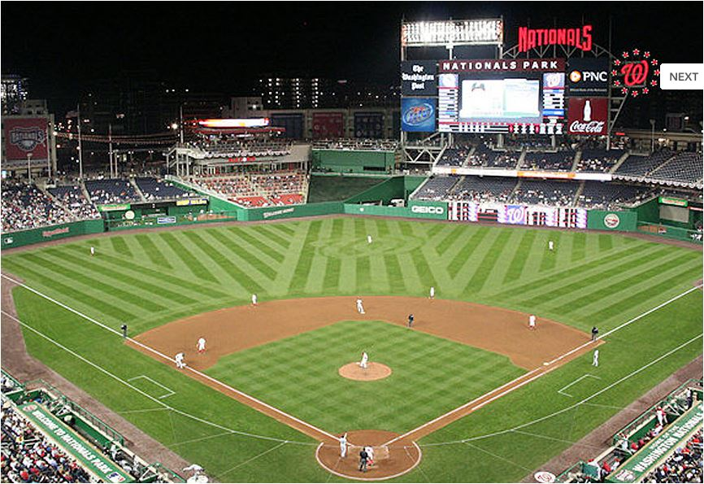
Start with a colorful example
Baseball
Hotdog
Apple pie
A game’s setup rules

Slide 6
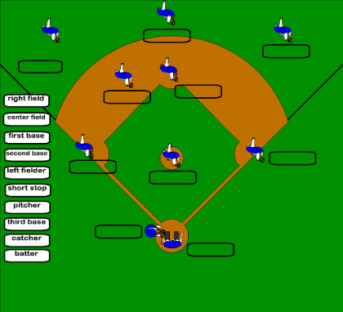
Start with a colorful example
Abstract
Outline a baseball lineup
Use formal grammar
Conceptual Design
Series of steps
Use formal grammar
Logical Design
Series of steps
Use structured logic & diagrams
Physical design
Series of steps
Use diagrams & pseudocode

Slide 7
Abstract: describe the starting lineup in baseball.
In baseball, the starting lineup is defined as:
“nine players follow each other at bat in a predictable sequence.”

Slide 8
Action Verb as Relationship
Independent ACTORS (NOUNS, Pronouns) as Entities
The rest of the abstract contains qualifiers to the action or attributes to the actors

Slide 9
“players follow each other”
Grammatical Analysis: look for NOUNS and PRONOUNS directly related to the ACTION VERB “FOLLOW” - WHO (noun “PLAYERS”) and WHOM (pronoun “EACH OTHER”) and mutually independent.
Thus we we can identify ENTITY (noun) and RELATIONSHIP (action verb) whose transactional diagram is the final goal of this exercise.
Use of grammatical analysis helps flow from the Abstract into the next phases of DESIGN:
Conceptual Design
Logical Design
Physical Design

Slide 10
Qualifiers and Attributes
The rest of the abstract either qualifies the ACTION or describes the ACTORS:
Nine
At bat
In a predictable sequence

Slide 11
Conceptual design
“nine players follow each other”
Elaborate on the Abstract’s central theme:
“nine players follow each other at bat, one offensive player at a time, in a predictable and unmovable sequence.”
The Conceptual Design should provide all the elements necessary to formulate the full Entity/Relationship diagram and is still expressed in plain language, as was the Abstract.

Slide 12
Additional considerations in the Conceptual Design
Descriptions relevant to the players provide additional attributes (player’s number, defensive field position, ERA, etc.)
Assertions relevant to the relationship can be made:
All the players need to know is the previous player’s number
The order applies to THIS GAME ONLY

Slide 13
Logical Design (step 1)
Player
follows
Question: do we need TWO entities?
Player

Slide 14
Logical Design (step 2)
Player
follows
Caveat
Answer: no, since all the items (players) have the same attributes
We are thereby defining a UNARY relationship
Always those. In this case:
The following is only good for one game, so it would be useful to create a more sophisticated design accommodating all games ever played, in good MLB fashion!

Slide 15
PhysicalDesign (step 1)
Concept of Primary and Foreign KEYS
Primary Key | Foreign Key
3 | 11
2 | 3
15 | 2
13 | 15
7 | 11
4 | 7
10 | 4
1 | 10
11 | 1
Player
follows

Slide 16
PhysicalDesign (step 2)
Concept of Primary and Foreign KEYS
Fill in all relevant attributes
Create Table
Primary Key | Foreign Key
3 | 11
2 | 3
15 | 2
13 | 15
7 | 11
4 | 7
10 | 4
1 | 10
11 | 1
Player ID (PK) | Last Name | First Name | Position | ERA | Follows ID (FK)
3 |  |  |  |  | 11
PlayerID
LastName
FirstName
Position
ERA
FollowsID

Slide 17
Car dealership Example
Abstract: At a car dealership, Customers PURCHASE Automobiles through Dealer Reps.

Slide 18
Ternary relationship
Here we clearly have three distinct nouns (Customer, Automobile, Dealer Rep) connected in a transaction suggested by the action verb (Purchase)
Purchase

Slide 19
Faster learning
CUSTOMER
Resulting tables
CustID
LastName
FirstName
Address
Phone
email
AUTOMOBILE
VIN
Brand
Model
DateSold
CustID_FK
RepID_FK
Customer
REP
We can now quickly figure out the Logical and Physical designs inherent to this transaction
RepID
RepLast
RepFirst
PctFee
Extension
RepEmail
Purchase
Caveat
Rep
Automobile
What if an automobile is sold into a co-ownership?

Slide 20
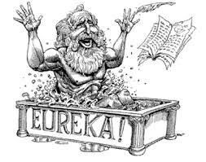
Conclusion
A clear understanding of the issue at hand can only come through clear and concise statements that follow known grammatical rules

