Slide 1
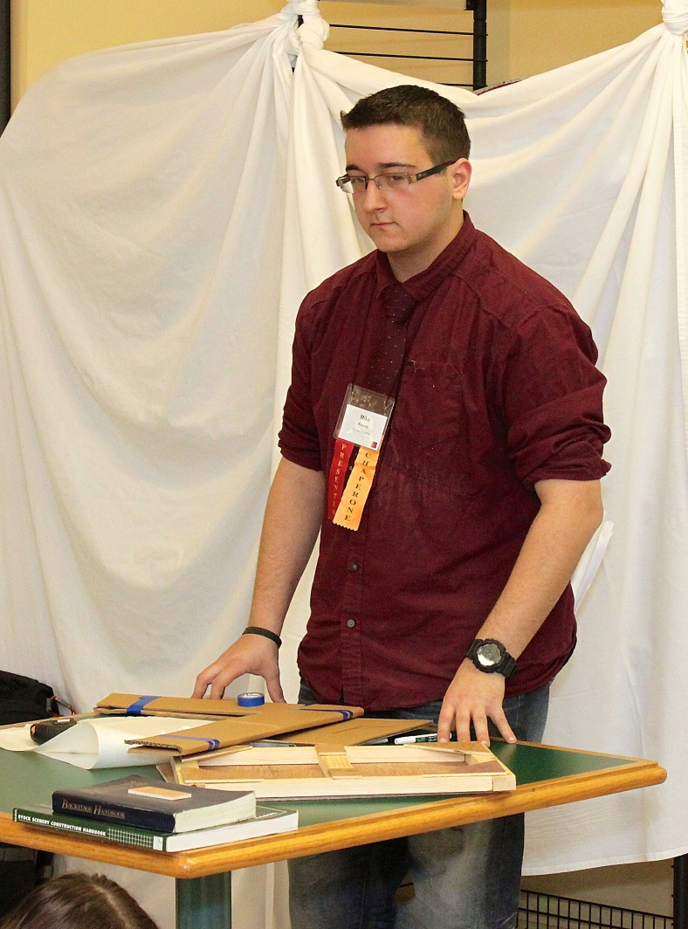
FLATTEN YOUR SETS, NOT YOUR WALLET
MICHAEL RINALDI SPRING 2014 CULMINATION At The New York City College of Technology

Slide 2
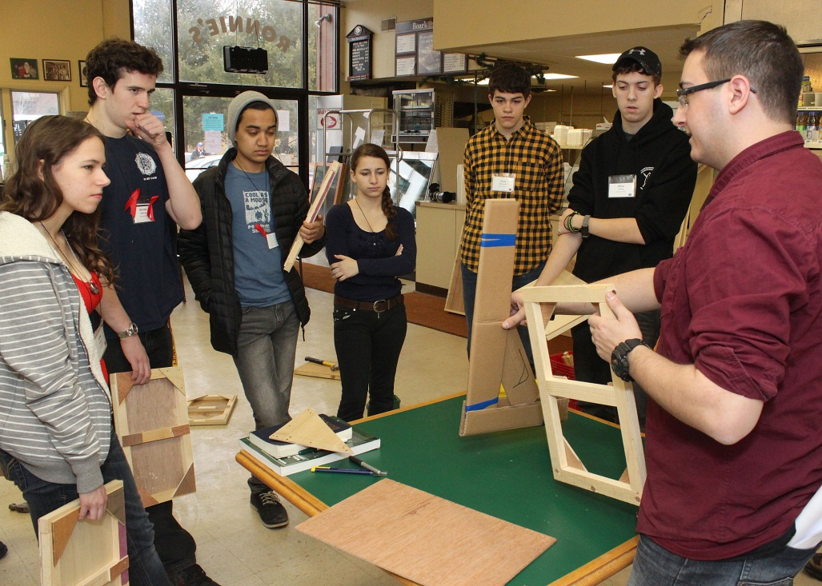
Introduction
I designed, built, and presented a seminar to high school students on building flat scenery at the 2014 NYSTEA student conference.
I managed a group of kids while teaching.
I challenged my ability to talk in front a group of people that I was unfamiliar with.

Slide 3
NYSTEA is the New York State Theatre Education Association.
NYSTEA holds an annual student conference with a collection of seminars that are presented by theatre professionals and teachers.
There were over 200 seminars and close to 750 students this year.

Slide 4
Lesson
Lesson Plan Worksheet NYSTEA 2014
Title: Flatten Your Sets, Not your Wallet Class Date:1/13/2014 Sunday 9:15 AM Students will demonstrate the ability to 1. Build a model theatrical style flat. 2. Articulate and define parts of a flat. 3. Demonstrate the build process, through two exercises.

Slide 5
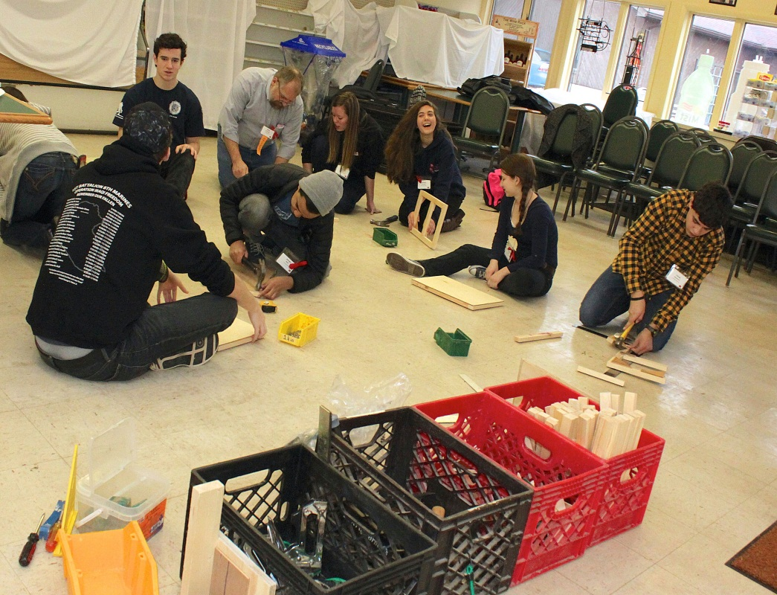
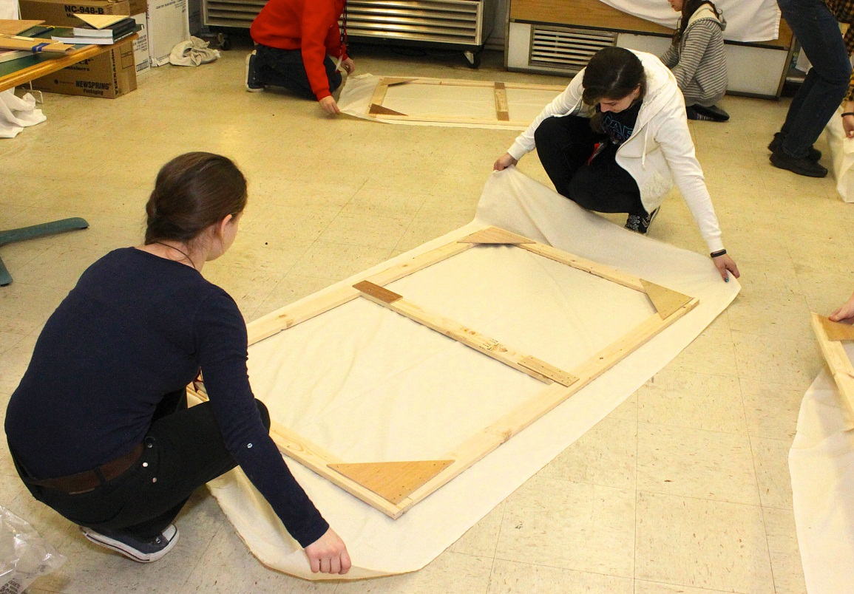
Objective
The students will: Bring new skills back to the classroom.

Slide 6
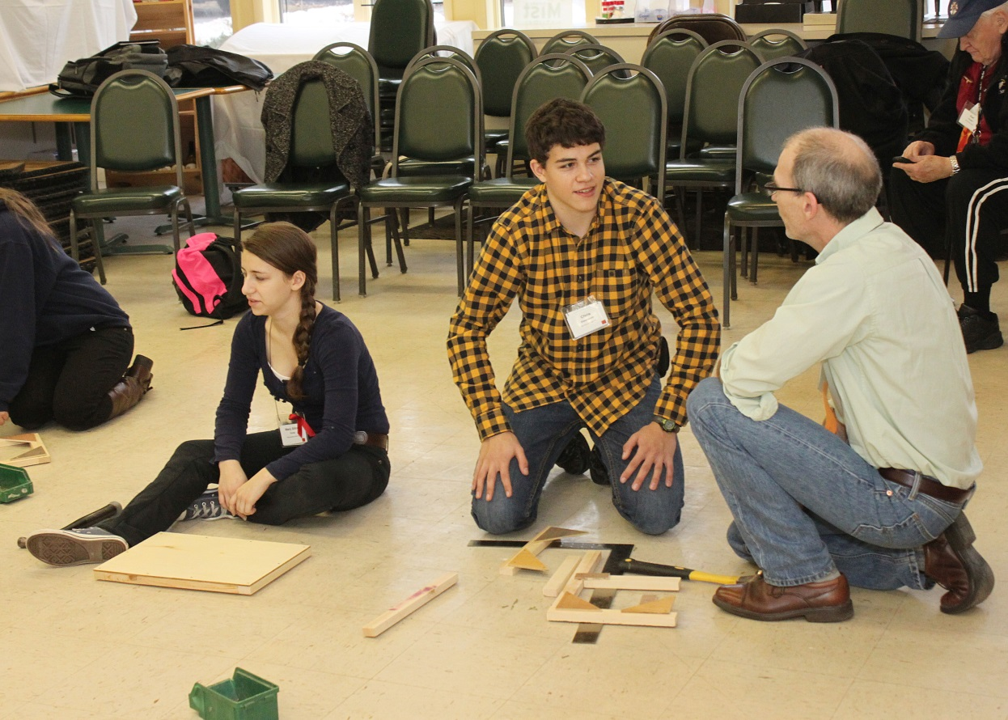
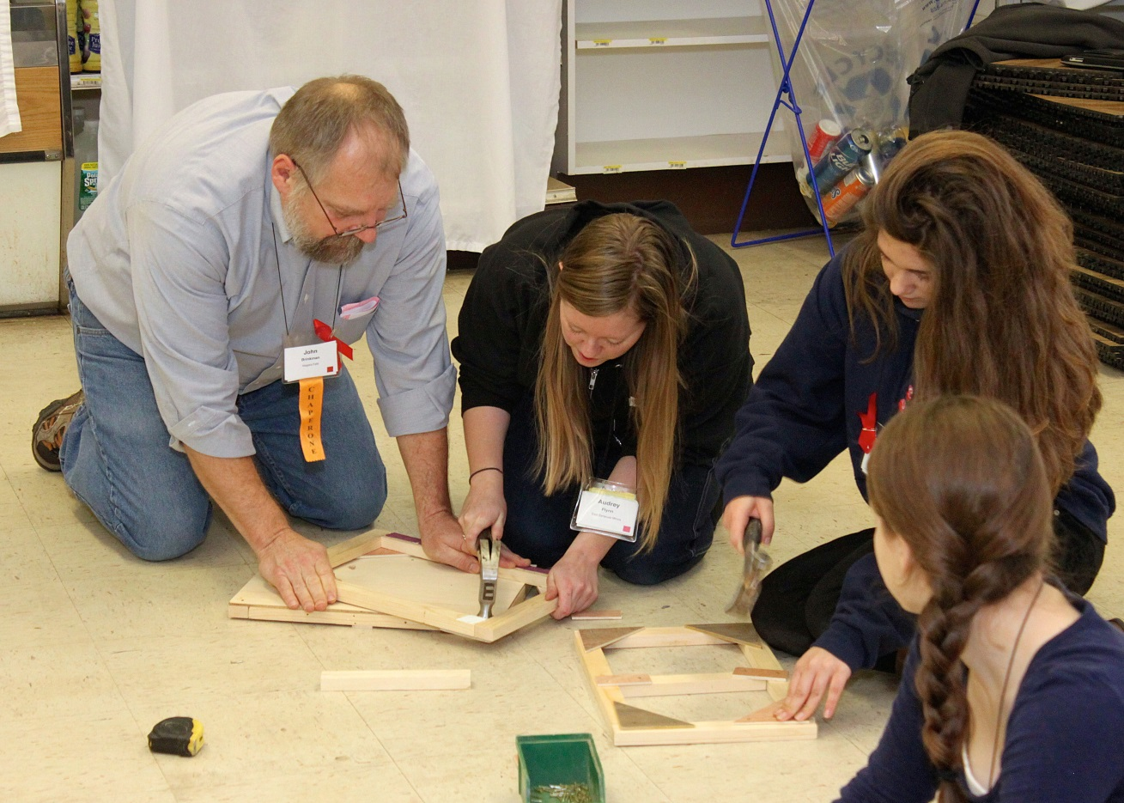
Work on a project that they can take home.

Slide 7
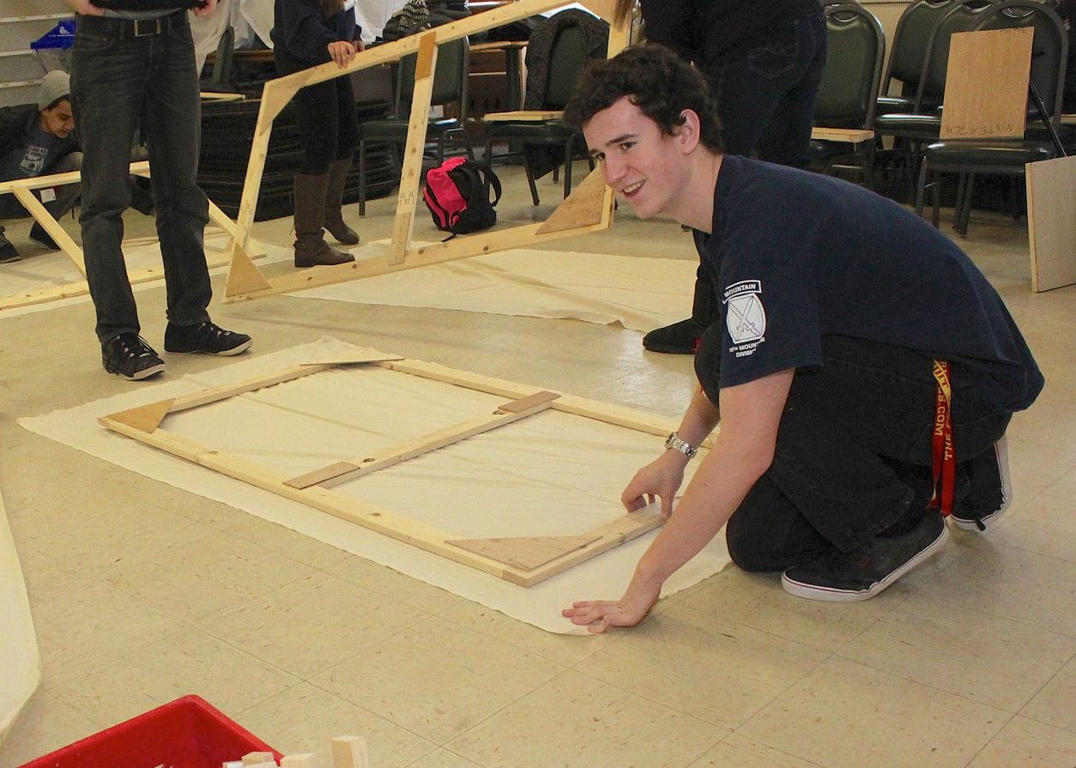
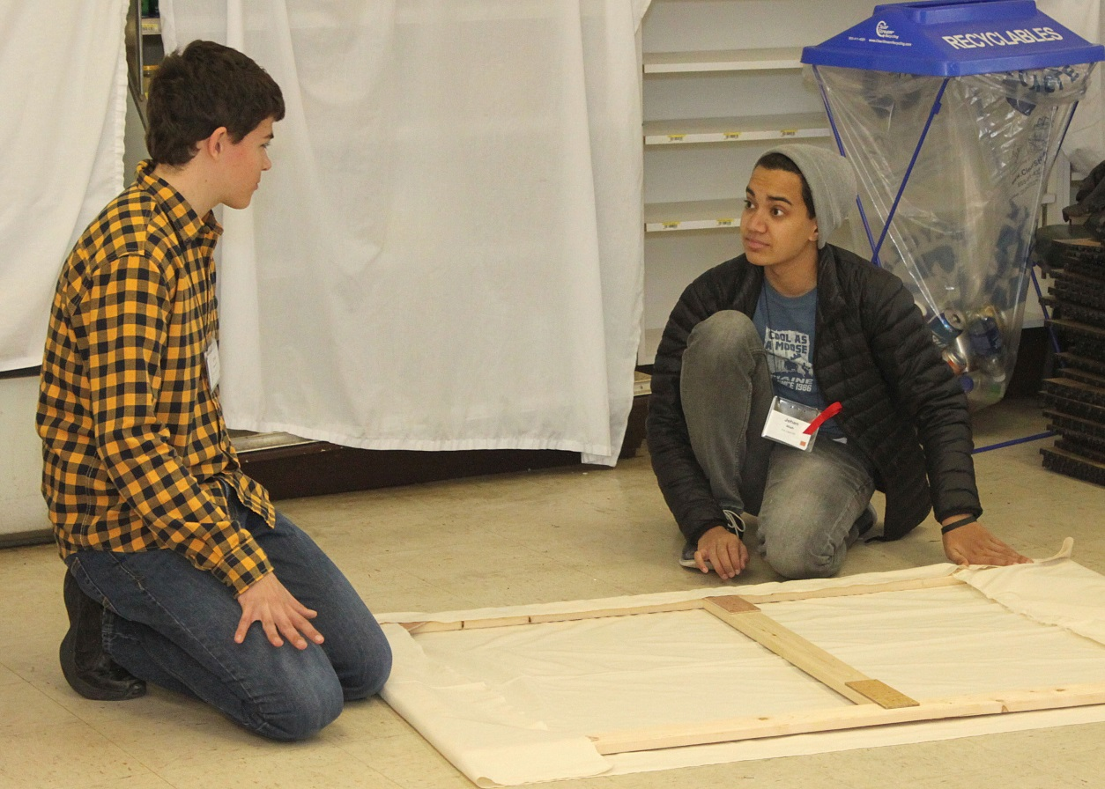
Work on a solo project and a group project.

Slide 8
Lesson Development (Step by Step Approach)
1. Introduction of teacher and his experience. 2. Inform class of the project. 3. how to use tools safely 4.Present parts of a flat, from 2’x4’ samples 5. Hand out materials, and explain the assembly process, of model flat 6. Have kids work on model flats 7. Explain soft cover flats 8. Have kids work on Soft covered, 3’x5’ flats 9. Question and Answer 10. Clean up.

Slide 9
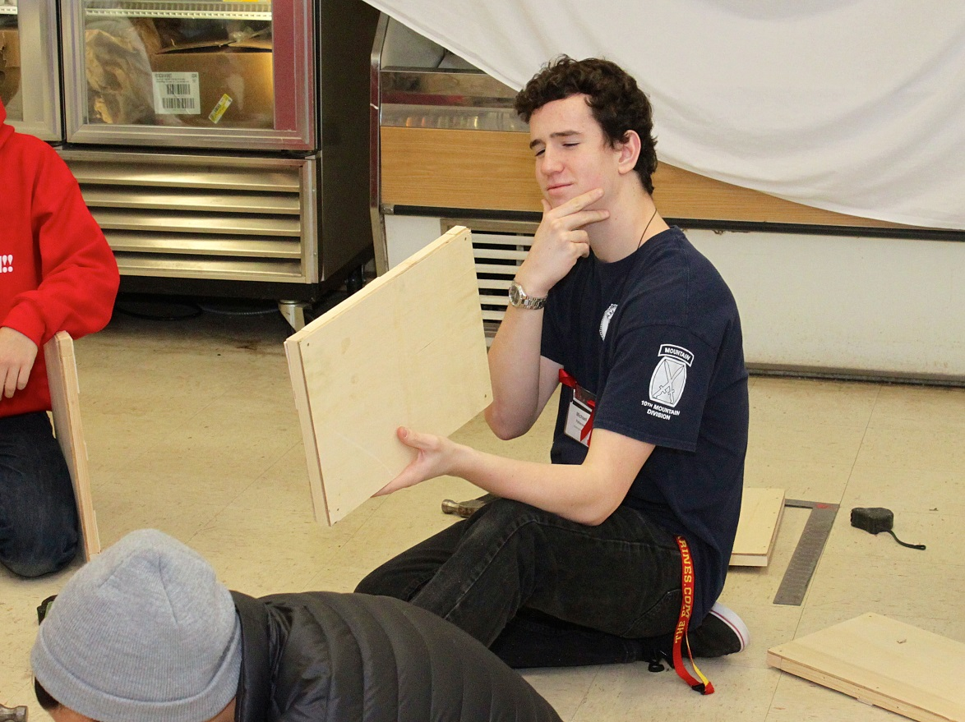
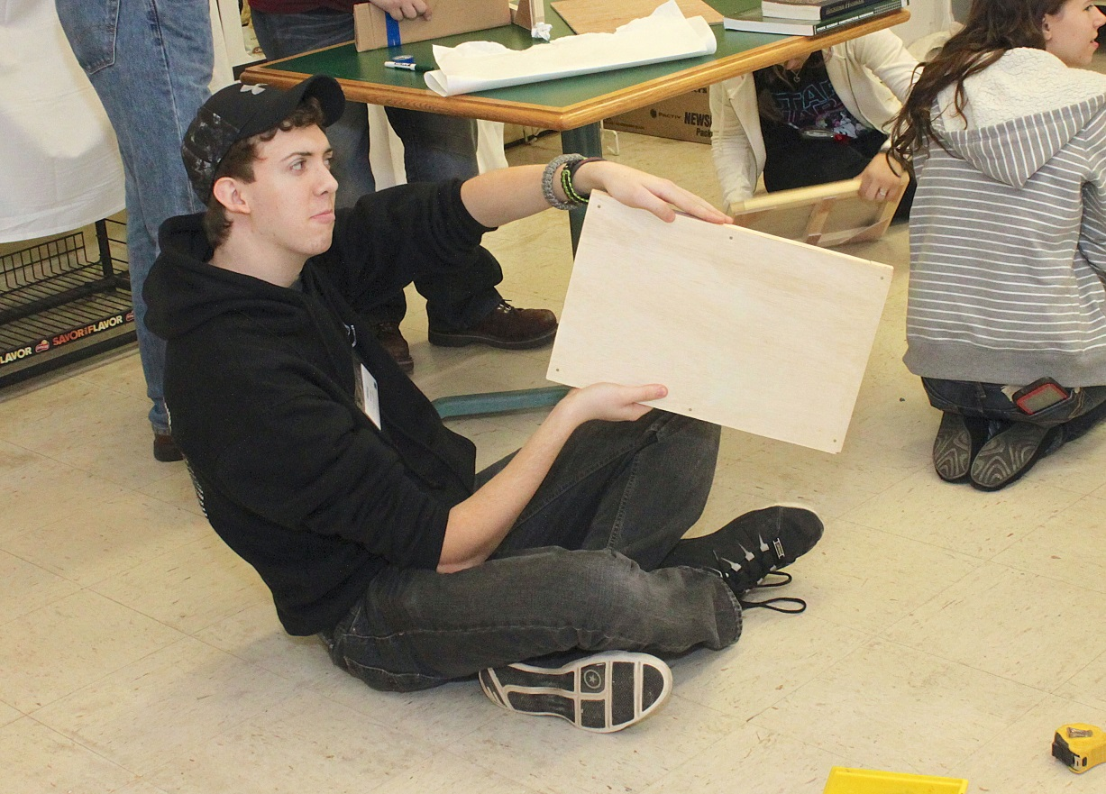
Summary (Application of Learning Experience)
1. Common Scenic Building Materials 2. Flat Types and Usage’s 3. Scenery Construction Technique: Building a Flat

Slide 10
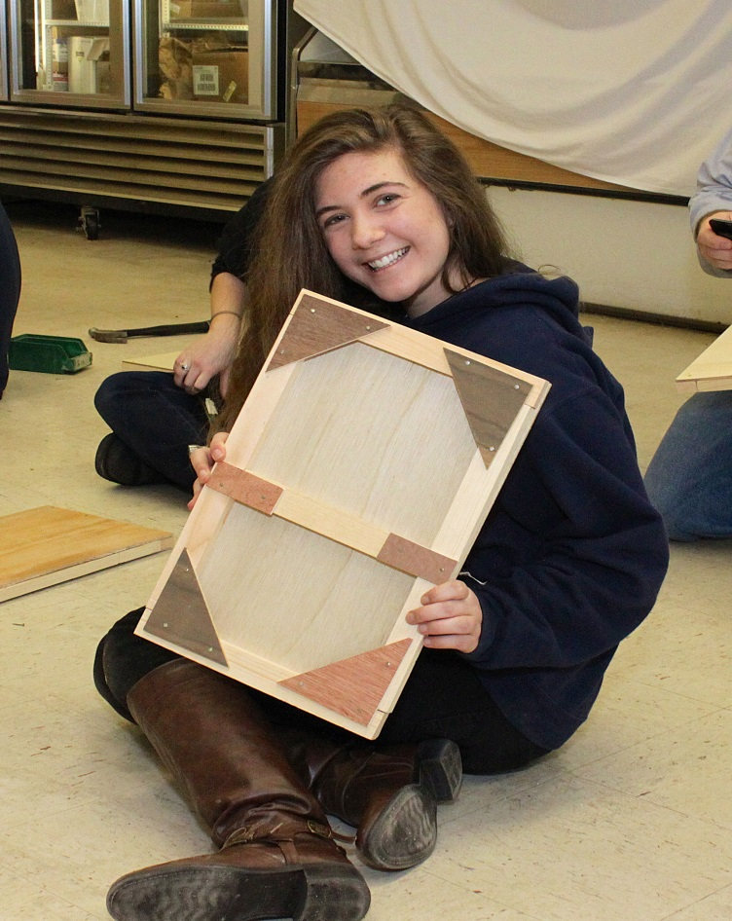
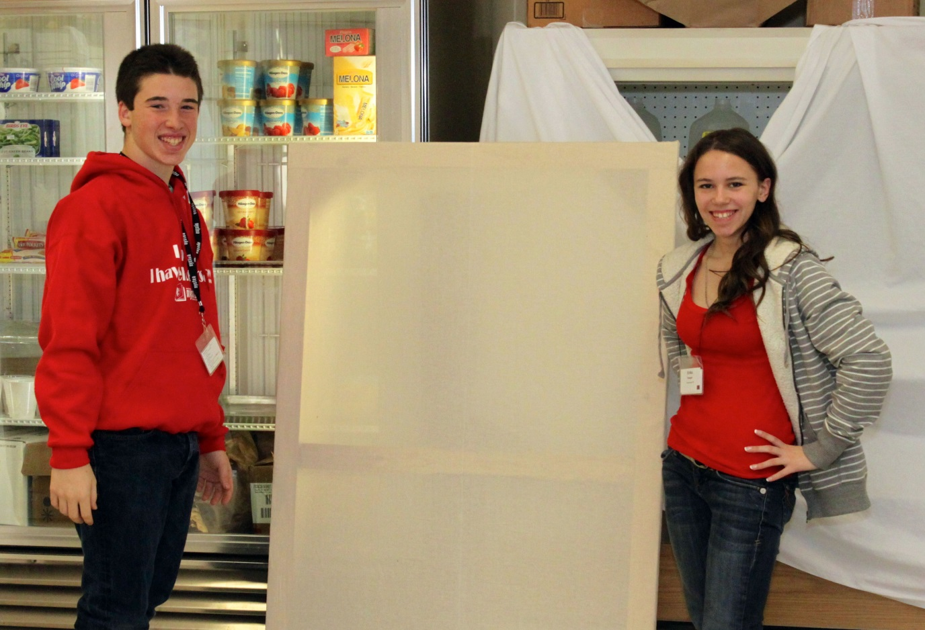
Results
The seminar was a huge success.
The students, and even the adults, had a really fun time in my class. I am considering pursuing a career in teaching.

Slide 11
Budget
Cost for Class materials $400
Cost for tests/samples/displays $80
Cost for tools $1320
Cost to go to NYSTEA $0.00 Labor 85 Hours
Total $1800

Slide 12
What I Would Do Differently
More Sketching and Testing before application During the planning/preparation phase, I will ask myself not only, “What do I need”, but also “How am I going to make what I need”.
Smile More!!

Slide 13
Unexpected Challenges
Table saw broke a few weeks before NYSTEA
Display “Jack” got lost, and I needed to improvise

Slide 14
My Outcomes
I improved my communication skills.
I built a series of jigs to safely and efficiently produce what I needed.
I’ve added a highly successful class to NYSTEA’s class offerings.
I improved my management skills by managing this group of students, making sure the lesson was being followed accurately and safely, when the students were using tools.

