Slide 1
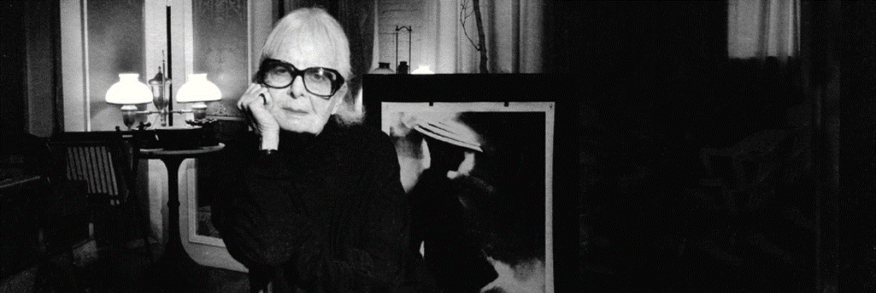
Lillian Violet Bassman
By Melissa Persaud

Slide 2
About ..
Lillian Violet Bassman was born June 15, 1917, in Brooklyn and later grew up in the
Bronx. She was born into a Jewish family from Russia, who raised her as a free thinking
intellectual.
At the age of 15, Bassman moved in with the man she who would later become her
husband, the documentary photographer Paul Himmel.
Bassman worked as a textile designer and fashion illustrator before working at Harper's
Bazaar magazine with art director, Alexey Brodovitch.
Brodovitch was impressed with her work, he waived tuition for her, he accepted her
into his Design Laboratory at the New School for Social Research. This is where she changed
her interests from fashion illustration to graphic design.

Slide 3
About her work ..
Bassman was known as a photographer, graphic designer and painter.
Bassman’s had a sophisticated style that was evolved and was bold, moody and elegantly expressed in fashion photography.
Bassman’s talent was highly sought after because she was considered a unique individual. She was full of mystery, sensuality, and expressionistic glamour.
Bassman had a thriving career as a fashion photographer for Junior Bazaar and Harper's Bazaar in the three decades that followed; she primarily created black-and-white images to offer a stronger contrast between her subjects and the clothes being displayed. This approach was unique at the time
She was considered one of photography’s “Grand Master” by Vanity Fair magazine. Bassman worked under Alexey Brodovitch, the renowned art director of Harper’s Bazaar. This is when she entered the world of magazine editing and fashion photography.

Slide 4
At Harper’s Bazaar, she had began visiting the darkroom on her lunch break to develop images by the great fashion photographer George Hoyningen-Huene.
She wanted to develop a method of printing on her own, even before she took photographs
She told B&W magazine in 1994. “I wanted everything soft edges and cropped.” She was interested in “creating a new kind of vision aside from what the camera saw.”

Slide 5
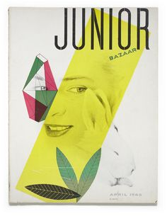
Her work for the Magazine..

Slide 6
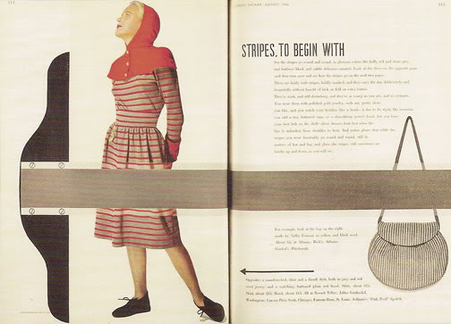
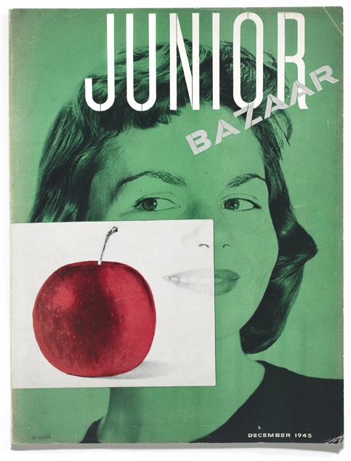
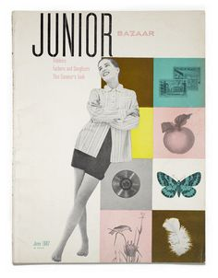

Slide 7
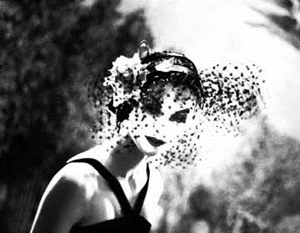
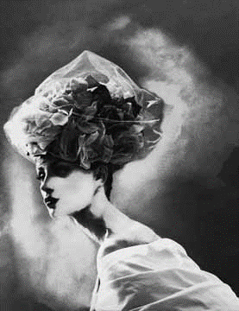
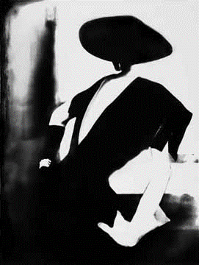
Photographs ..

Slide 8
Honors ..
In 1996, she received the Agfa Life Time Achievement Award
The Dem Art Directors Club Award.

Slide 9
Why I chose this person ..
She lived as an independent and unconventional woman because that’s how she was raised.
Bassman was began to dislike the way the fashion industry was changing and how high-maintenance the models were
“They were becoming superstars. They were not my kind of models. They were dictating rather than taking direction.”

Slide 10
Conclusion..
In developing these projects, Bassman adapted her skills to incorporate new technologies, using digital photography and photo manipulation software to enhance her work, always emphasizing the contrast between light and dark.
Her work has been displayed in prominent galleries such as the Stämpfli Gallery in New York, the Fashion Institute of Technology, and the Garden Prado in Madrid. Her final exhibition was entitled Retrospective, and was held at London's The Wapping Project in 2010. Bassman passed away in 2012.

