Slide 1
EAST NEW YORK, BROOKLYN
THIS IS WHAT I CONCIDER MY NEIGHBORHOOD. ITS MADE UP OF 4 MAIN STREETS. THIS AREA IS WHAT I CONSIDER WALKING DISTANCE AND EASY ACCESSABLE TO ANYTHING I MIGHT.
BY: JENNIFER REYES

Slide 3
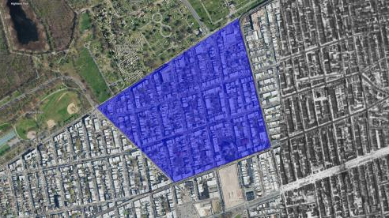
1952 MAP
2018 MAP

Slide 4
HERE THE TWO MAIN STREETS I MIGHT GO TO FIND THING I NEED LIKE THE SUPER MARKET, BANK, DELI, TRAIN, DRY CLEANERS, LAUNDROMAT, QUICK BIT TO EAT ETC IT ALL RUNS ALONG THE MAIN STREETS THAT ARE IN GREEN.

Slide 5
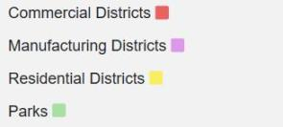
LAND ZONING

Slide 6
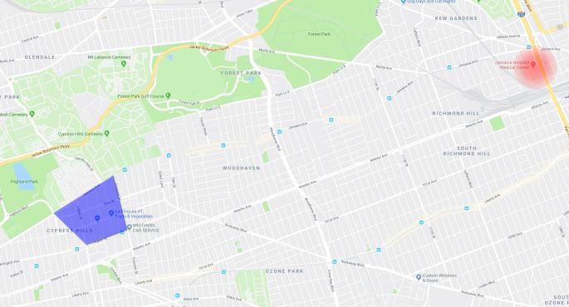
THE DISTANCE OF THE NEAREST HOSPITAL FROM MY NEIGHBORHOOD

Slide 7
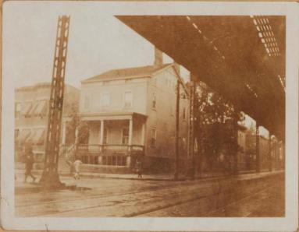
1800-2000 IMAGES

Slide 8
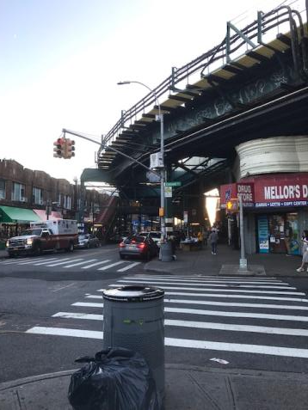
CORNER OF FULTON AND CRESENT

Slide 9
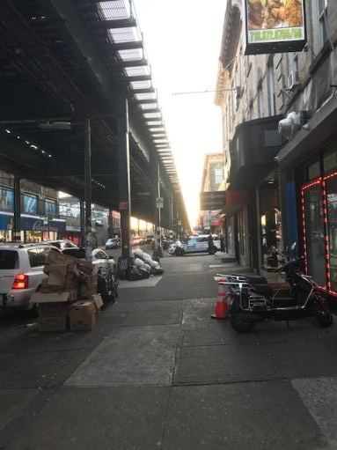
FULTON STREET

Slide 10
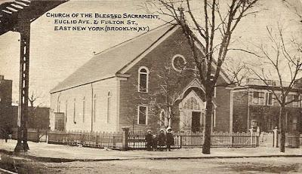
BLESSED SACARAMENT

Slide 11
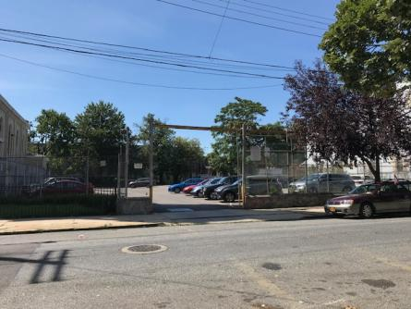

Slide 12
Citation
https://www.oldnyc.org/#704586f-a
https://www.oldnyc.org/#703876f-a
http://www.tapeshare.com/BlessedSac.html

