Slide 1
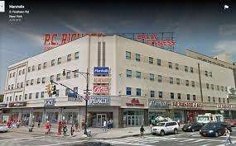
Welcome To My Neighborhood
Karmoko Sillah

Slide 2
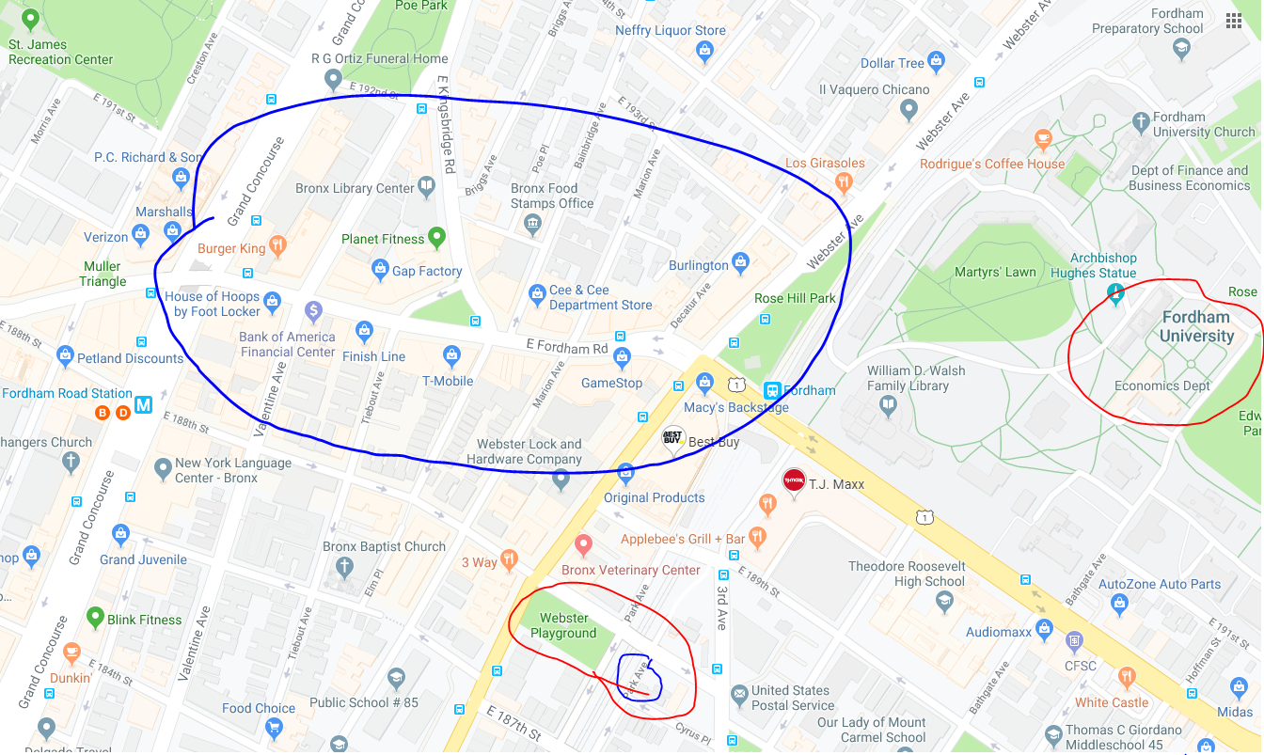
Neighborhood Map
Places of frequent visit
-House Of Hoops
-Gourmet Deli/Met
-Fresh Supermarket
-GameStop
-Playground(social gathering)
-Fordham University
-Best Buy
Source : http://www.oasisnyc.net/map.aspx

Slide 3
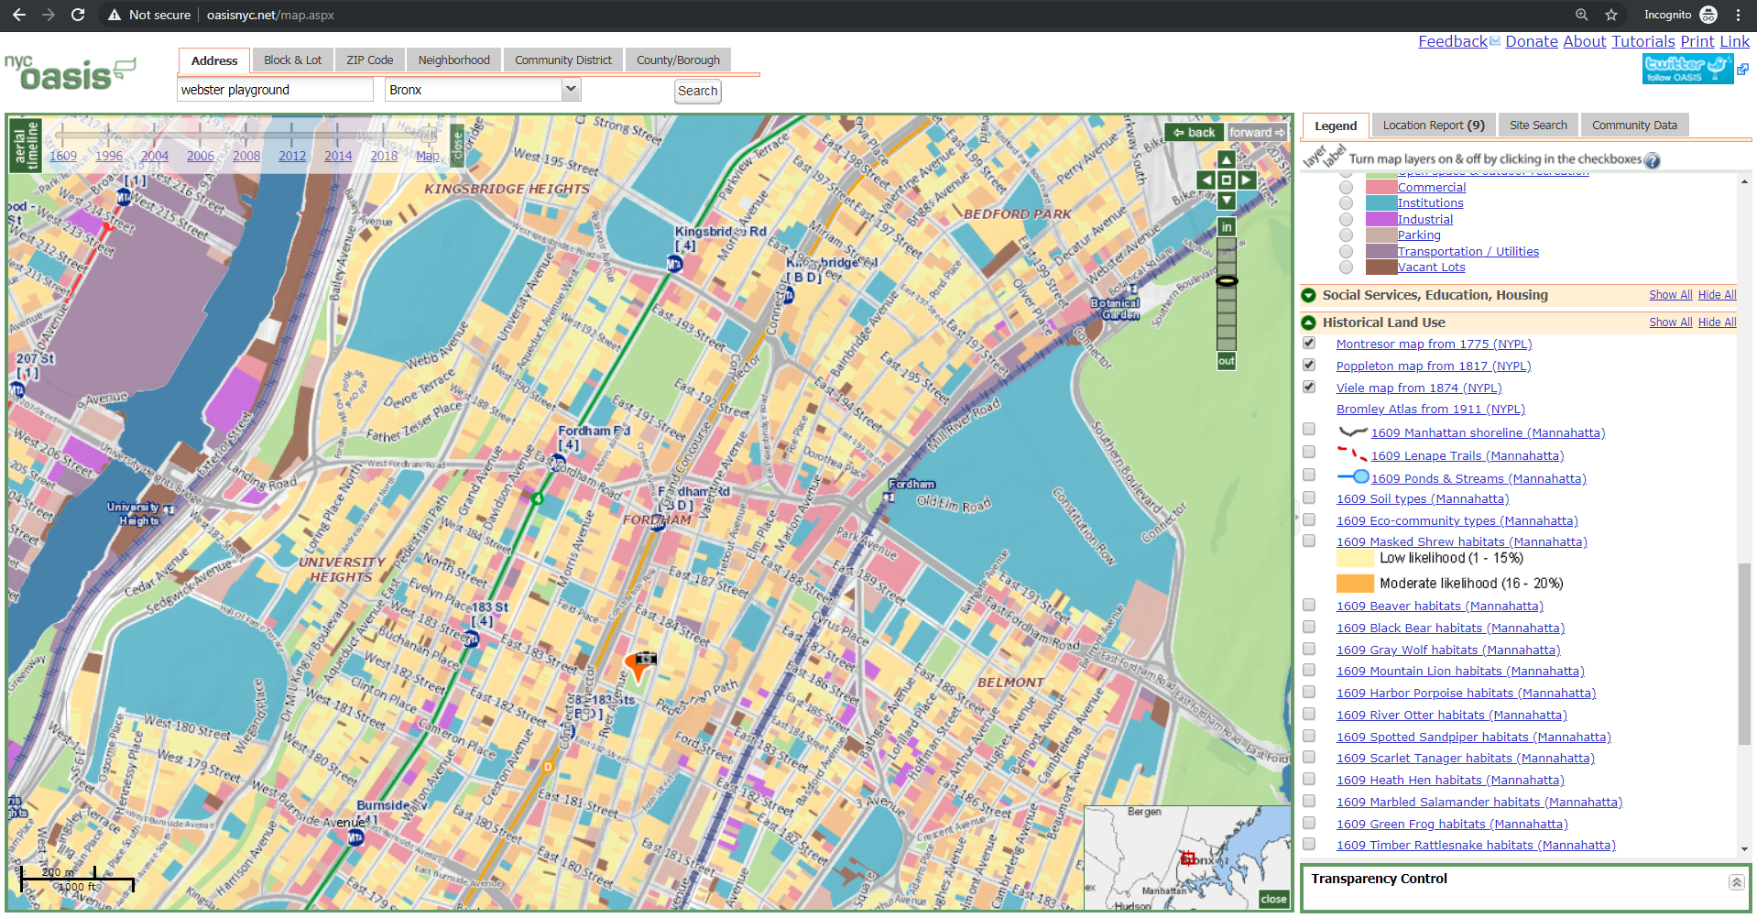
Neighborhood consists of
-Commercial
-Multi-family
-Industrial
-Institutions
-Recreational park( Social gathering )
Source : (n.d.). Retrieved October 2, 2019, from https://www.google.com/maps/place/Webster Playground, 389 E 188th St, The Bronx, NY 10458/@40.8596681,-73.8927934,3a,75y,204.45h,90t/data=!3m4!1e1!3m2!1sVyaYCLukQcf0hJtDx-9o2w!2e0!4m2!3m1!1s0x89c2f47f6cce0d87:0xe19dac4a478be6e8.

Slide 4
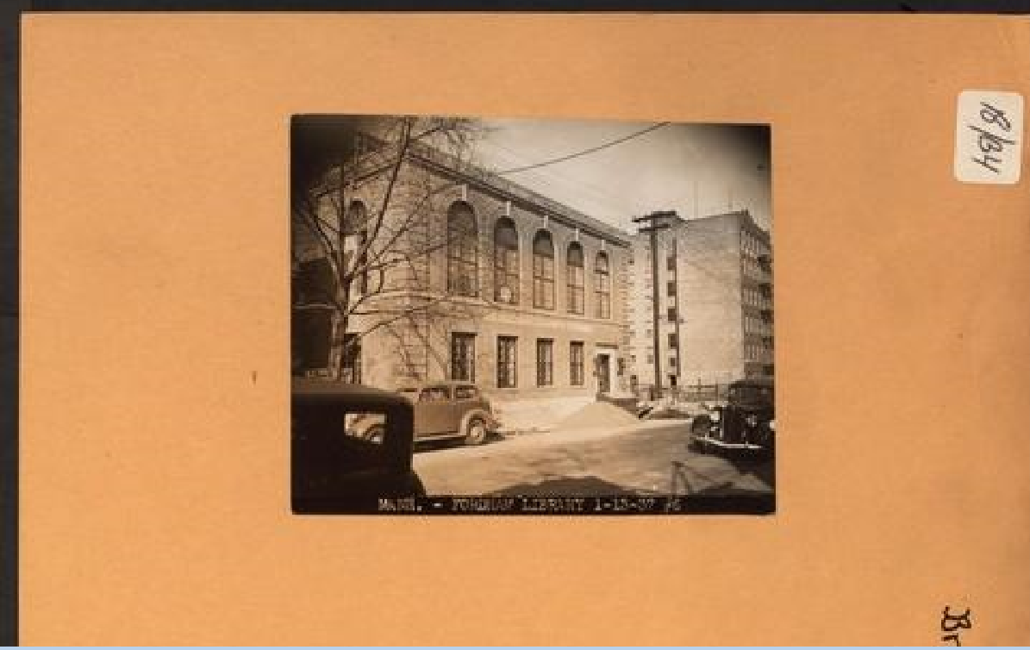
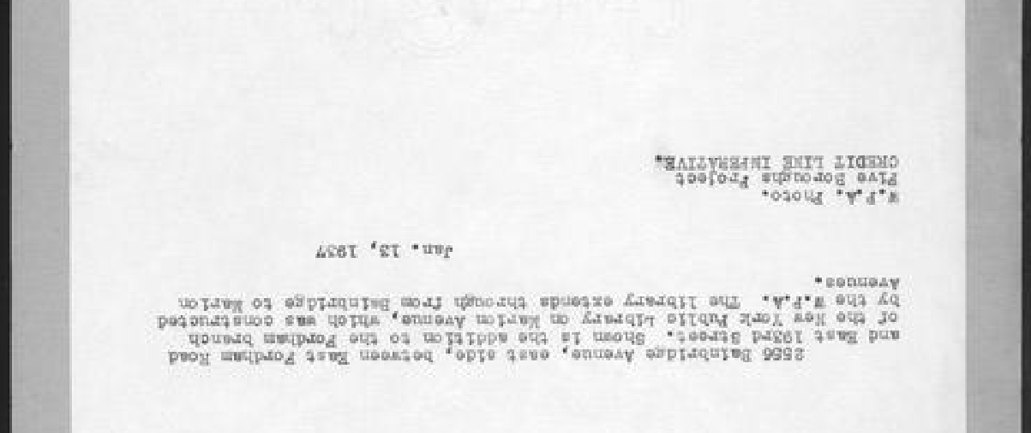
Pics: Bronx: Bainbridge Avenue - Fordham Road (East). (n.d.). Retrieved October 2, 2019, from https://digitalcollections.nypl.org/items/510d47dc-a3e3-a3d9-e040-e00a18064a99#/?uuid=510d47dc-a3e2-a3d9-e040-e00a18064a99.

Slide 5
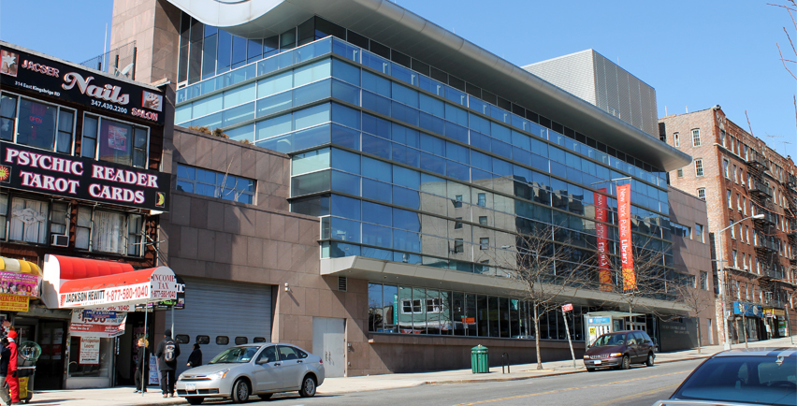

Slide 6
