Slide 1
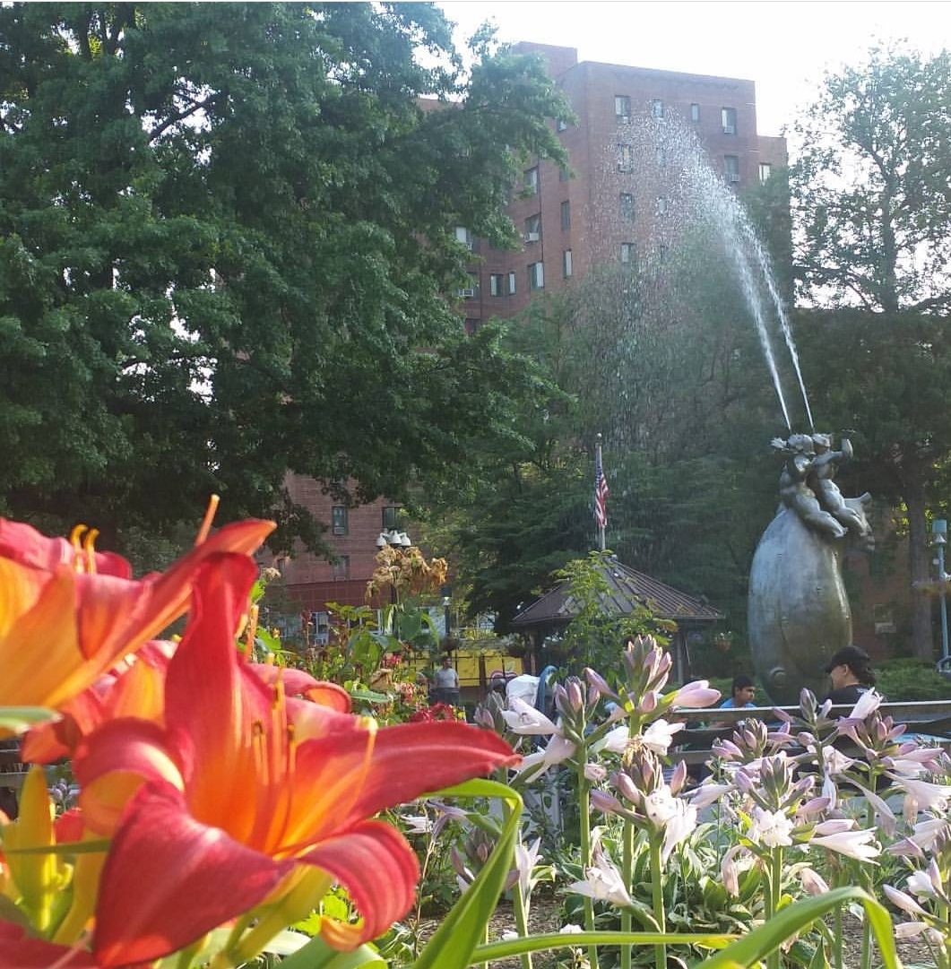
Neighborhood Assignment:
Parkchester
Bronx, New York
Diana Ferreyra
Photo Credit: Diana Ferreyra, Parkchester 2016

Slide 2
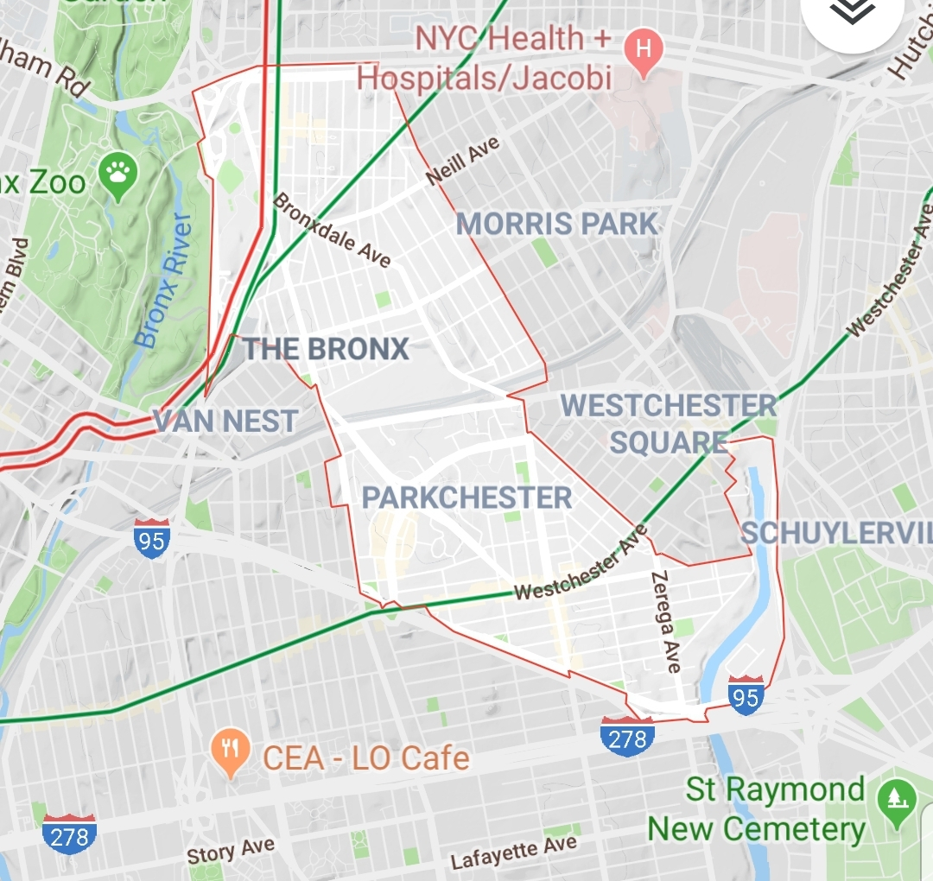
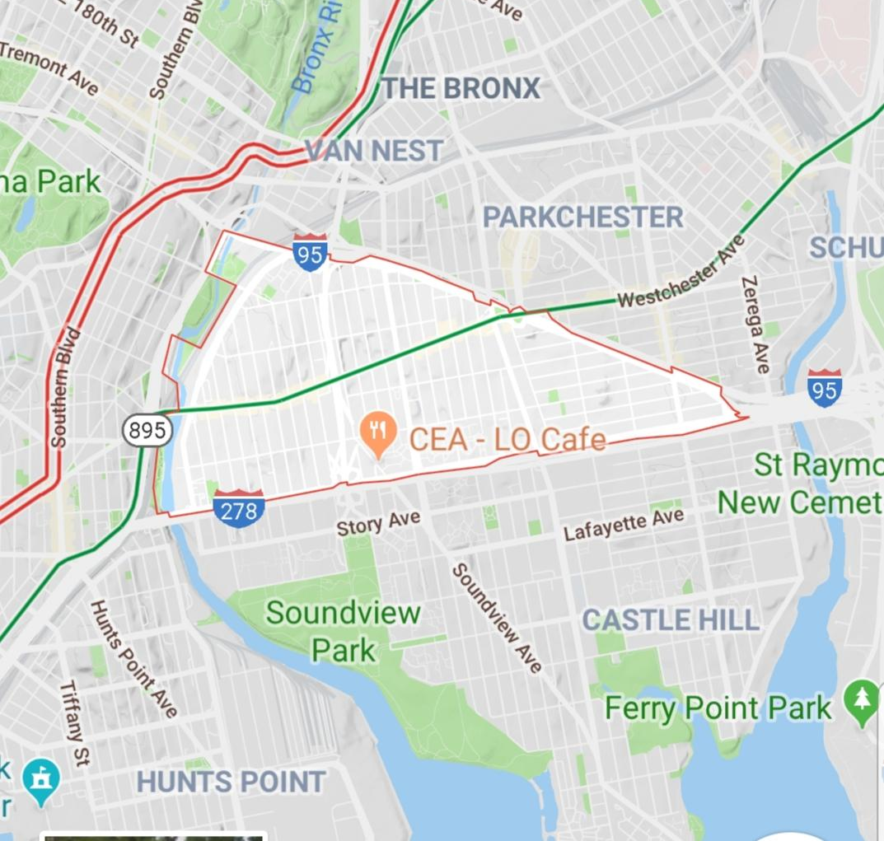
GOOGLE MAPS
Parkchester zip code - 10462
My zip code - 10472

Slide 3
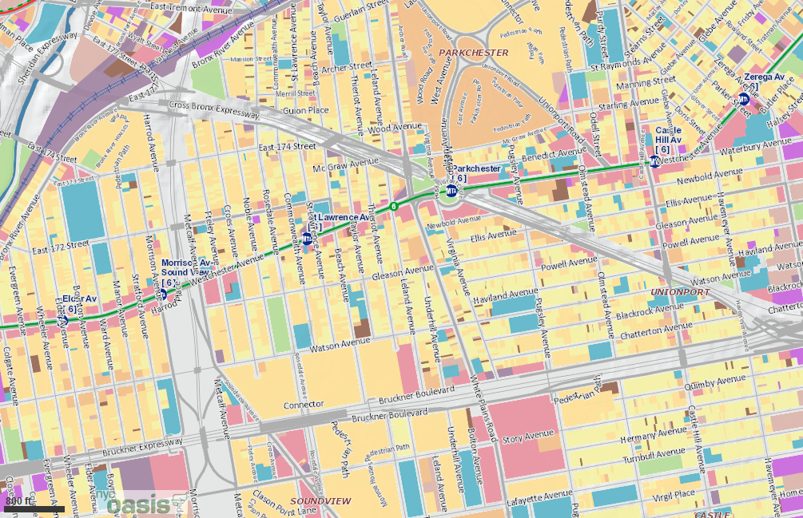
OASIS Map
-The 6 train runs along Westchester Ave. in my neighborhood.
-The closest subway station is a 5-minute walk from home, on
St. Lawrence Avenue
-Parkchester is the main subway station in the area. It is also an express stop during rush hour times.
-There are plenty of MTA bus routes that make this neighborhood accessible to many people. Including the Bx36, which crosses into Washington Heights in Manhattan & the Q44 bus which goes over the Whitestone Bridge into Queens.

Slide 4
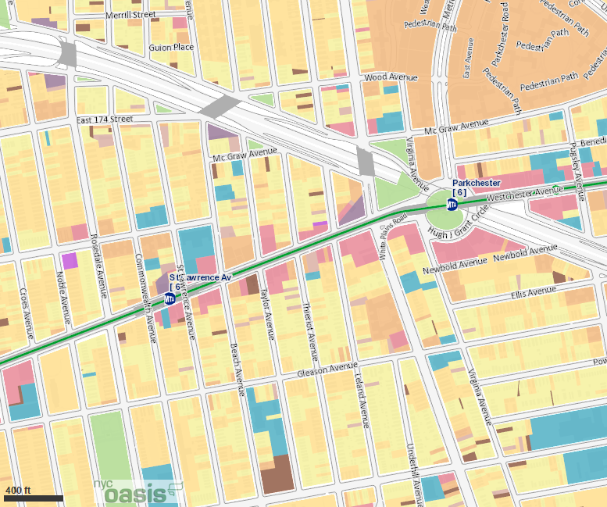
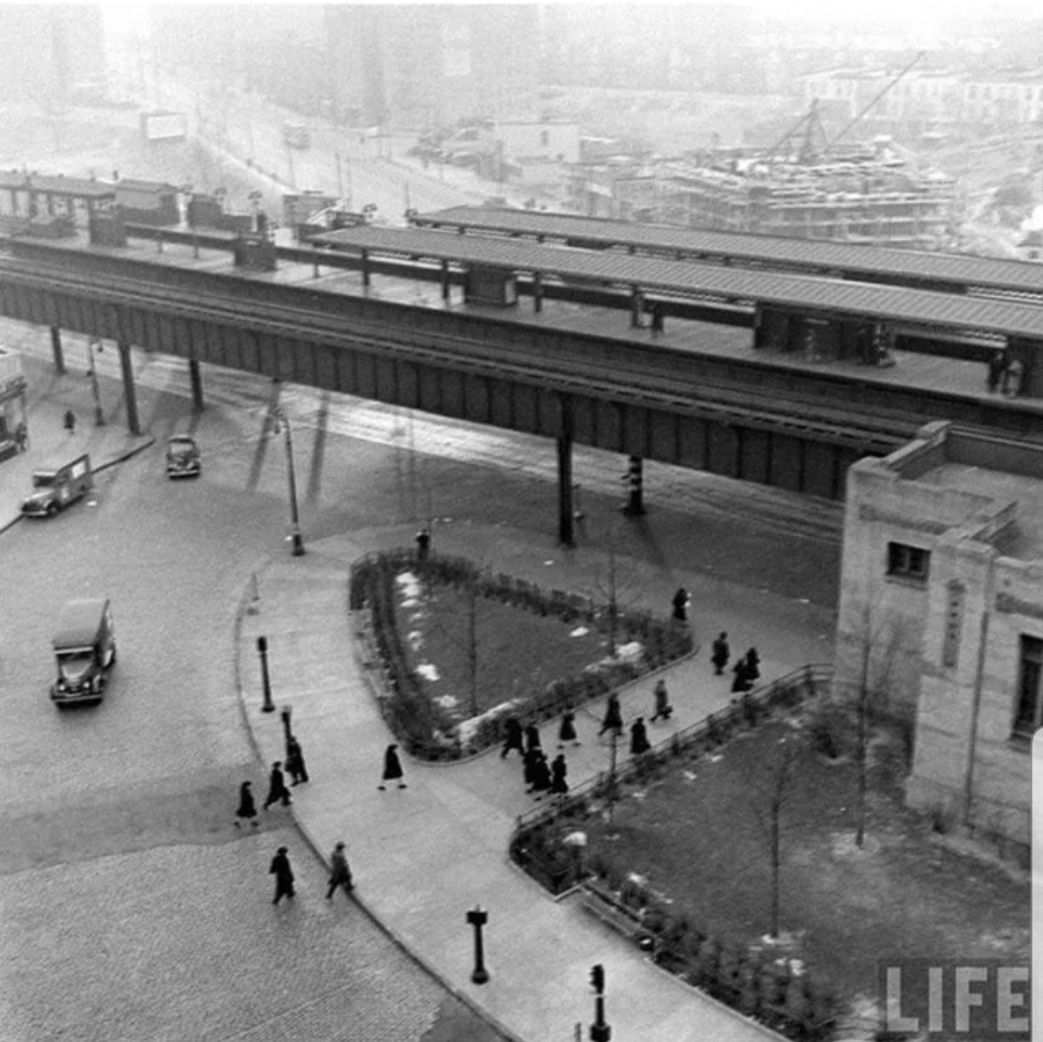
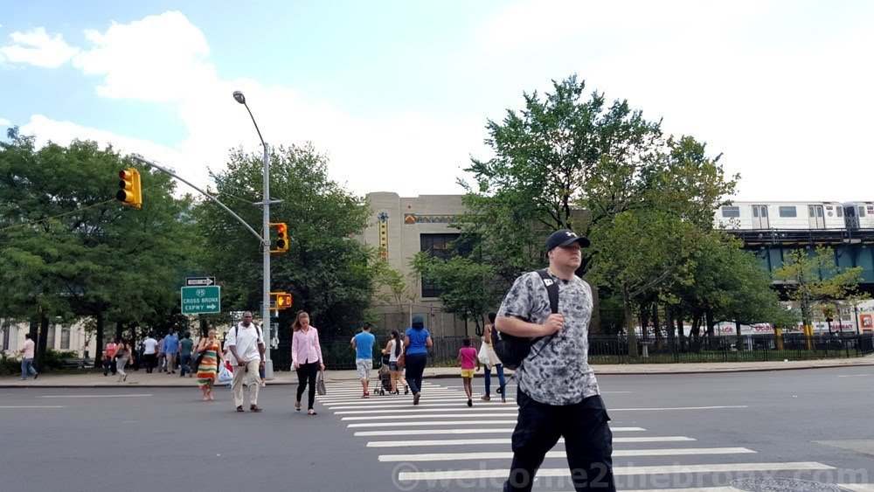
Parkchester Subway Station. Est. early 1950’s, LIFE Magazine.

Slide 5
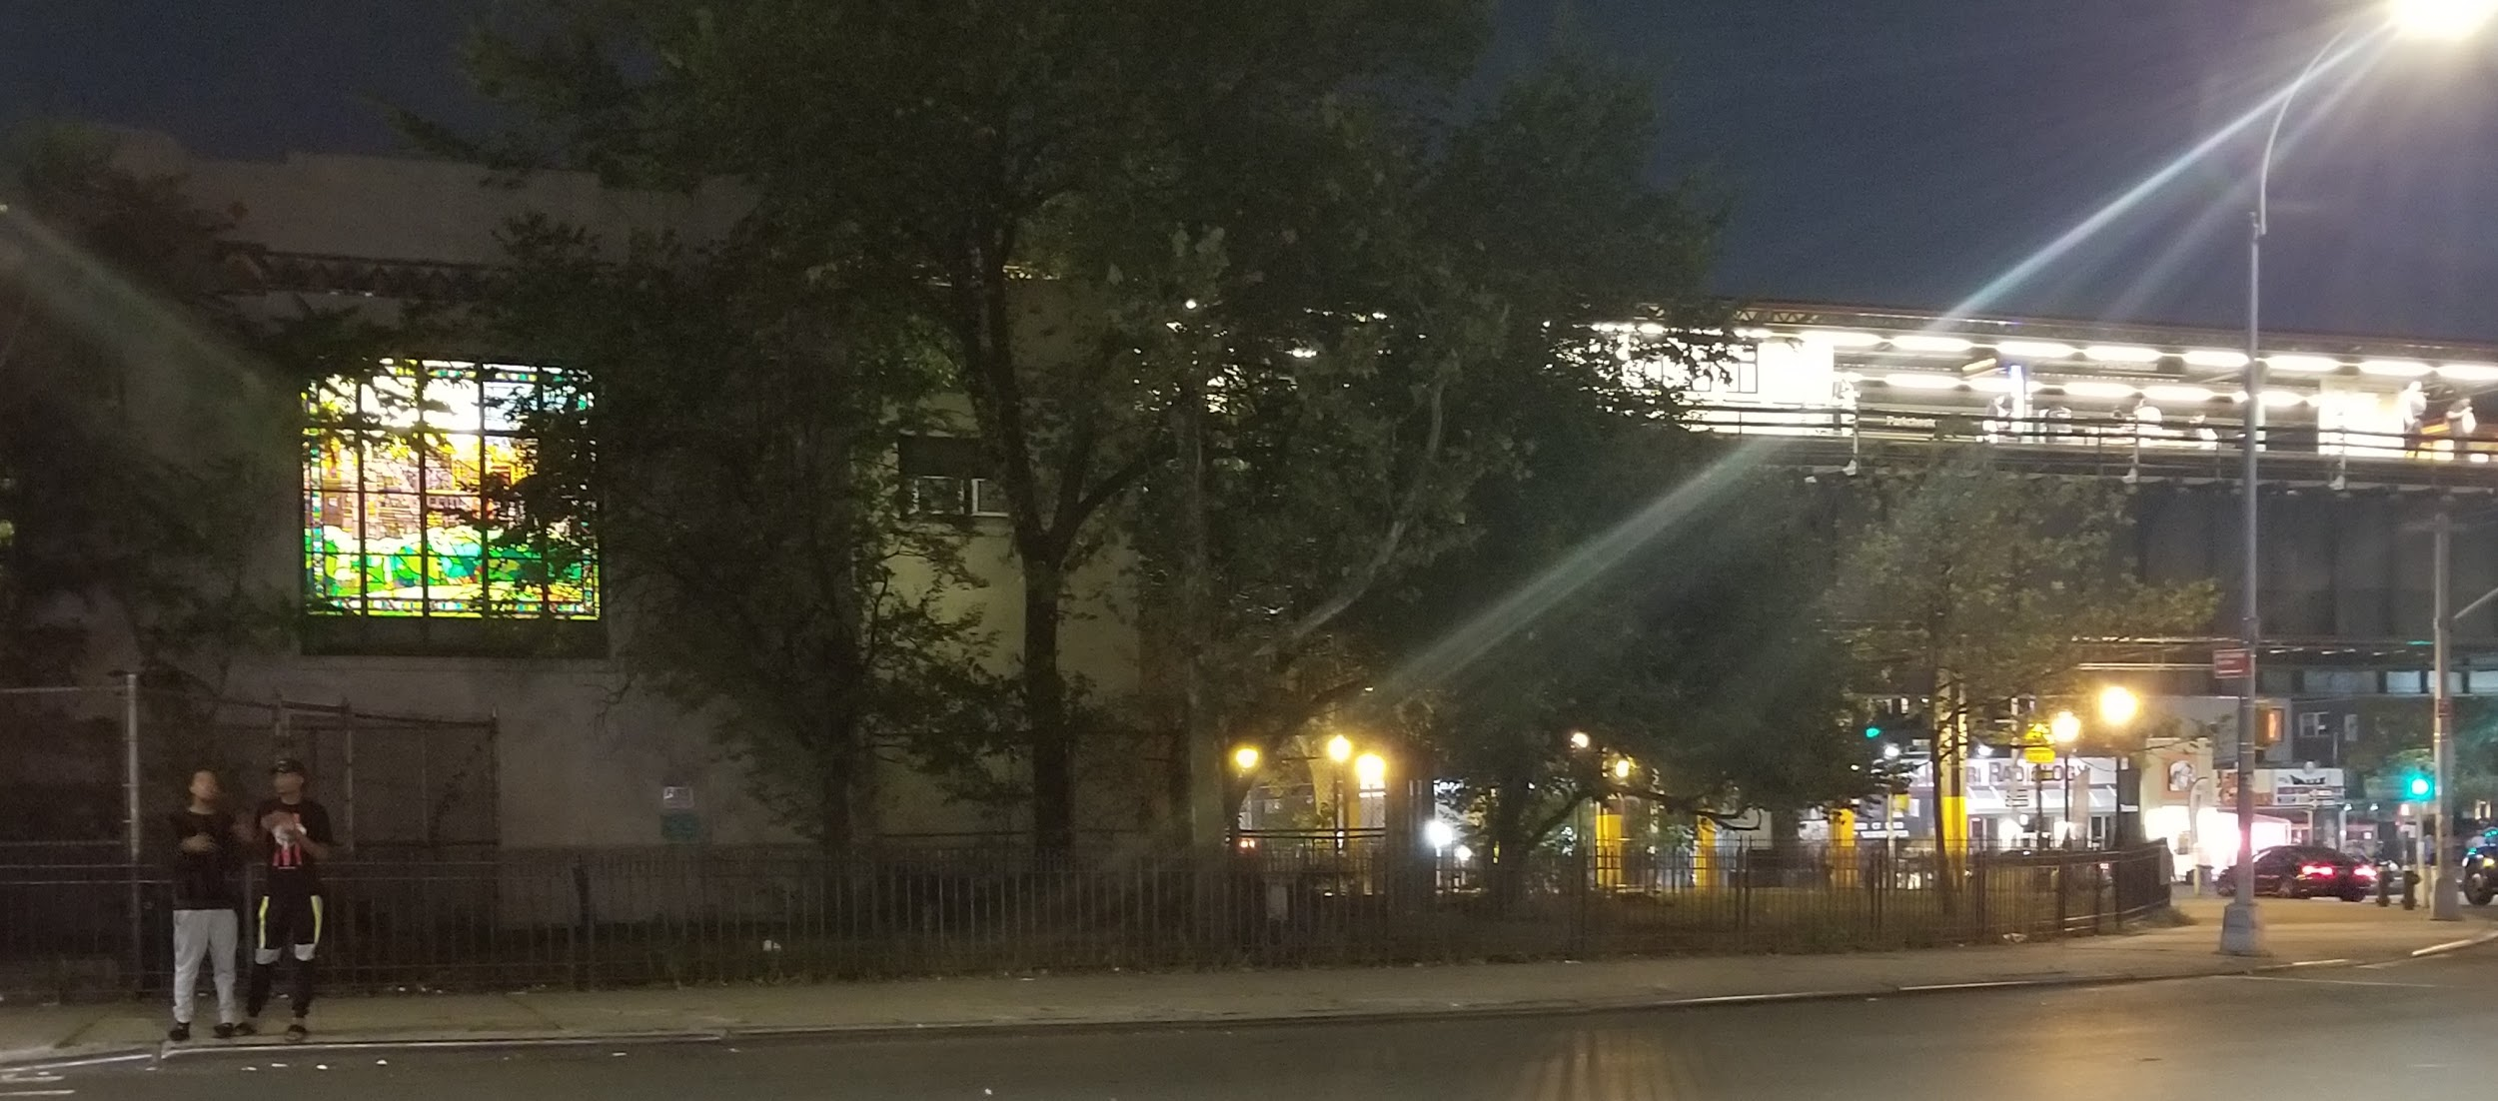
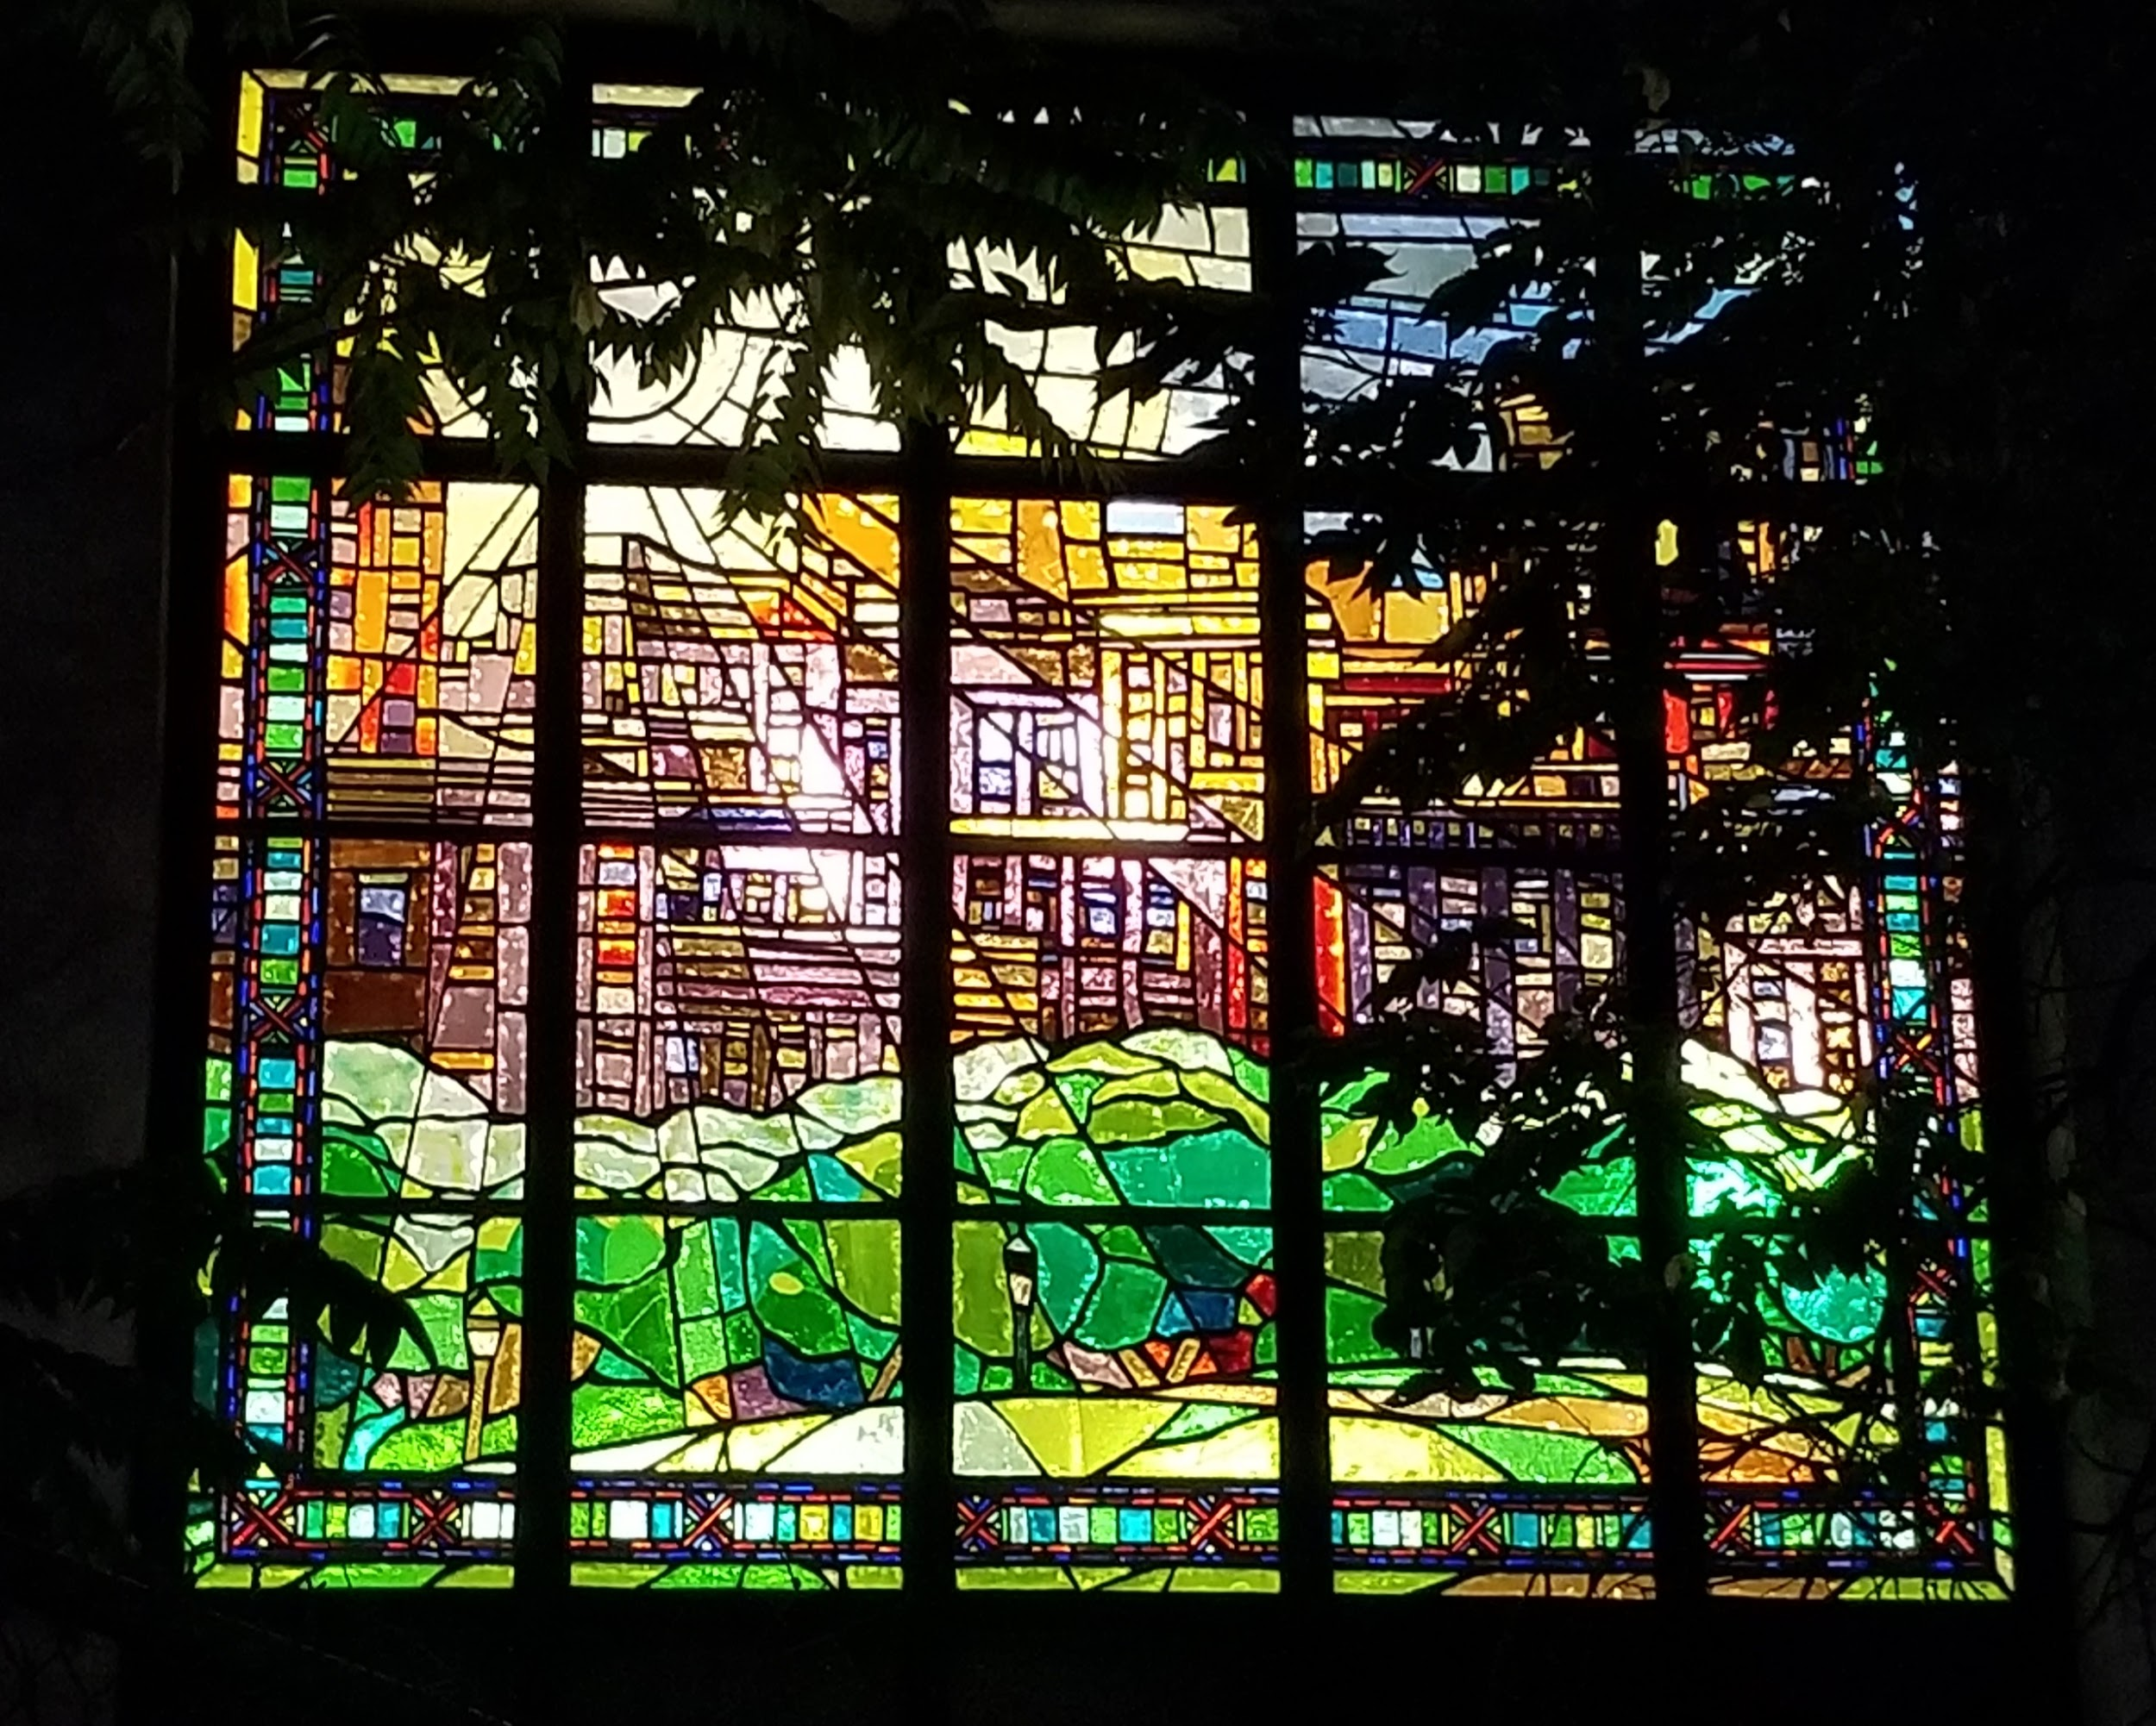
Photo Credit: Diana Ferreyra, 2019
Parkchester Subway Station at night.

Slide 6
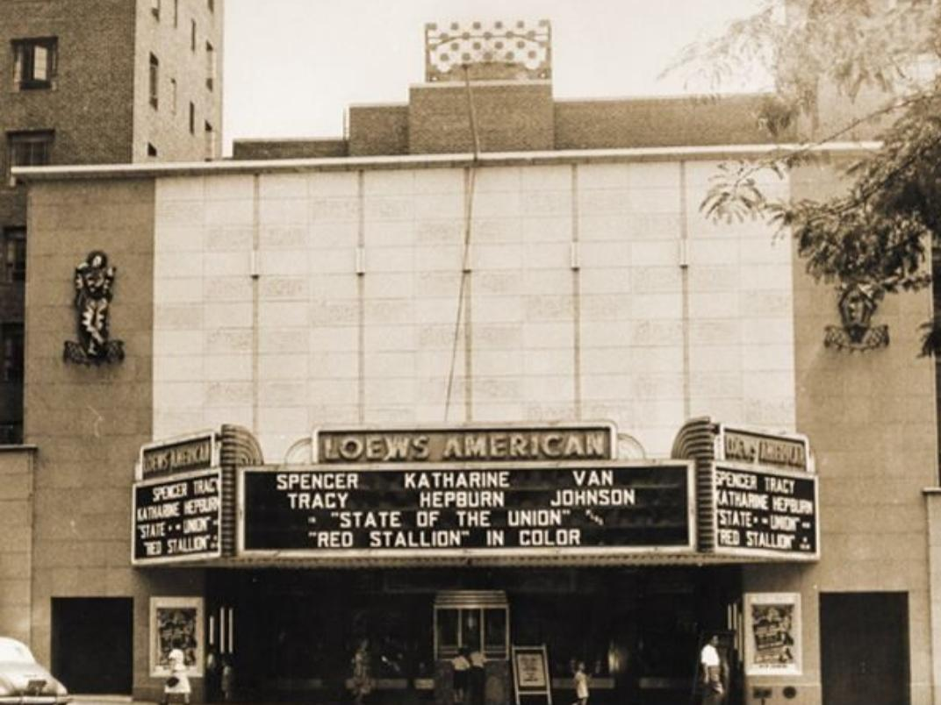
LOEW'S AMERICAN THEATER, Parkchester (1948)
Photo Credit: The Pelham Parkway Times

Slide 7
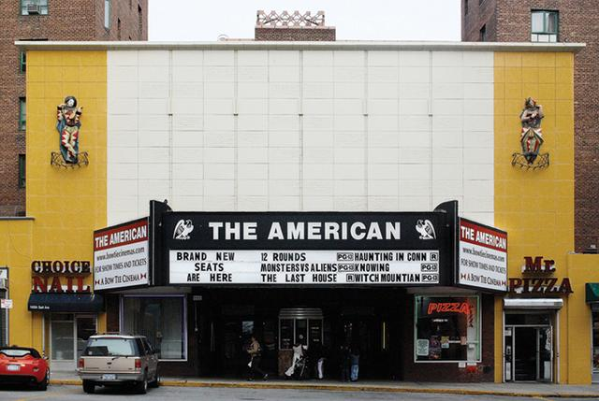
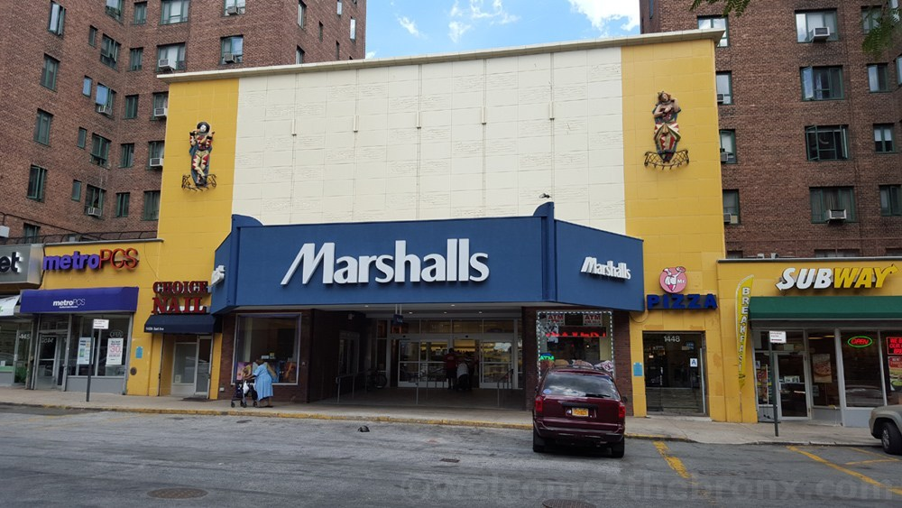
Welcome2thebronx.com, 2015
http://cinematreasures.org/theaters/700/photos
Picture by Ross Melnick, 2009

Slide 8
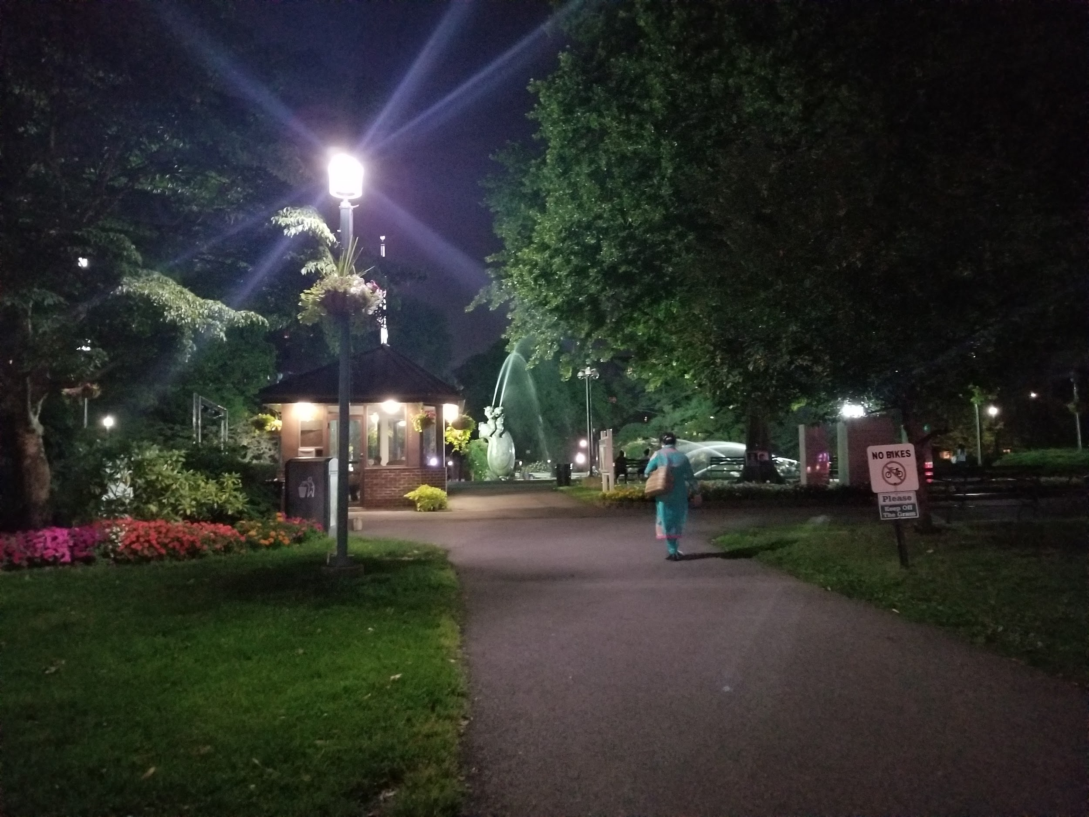
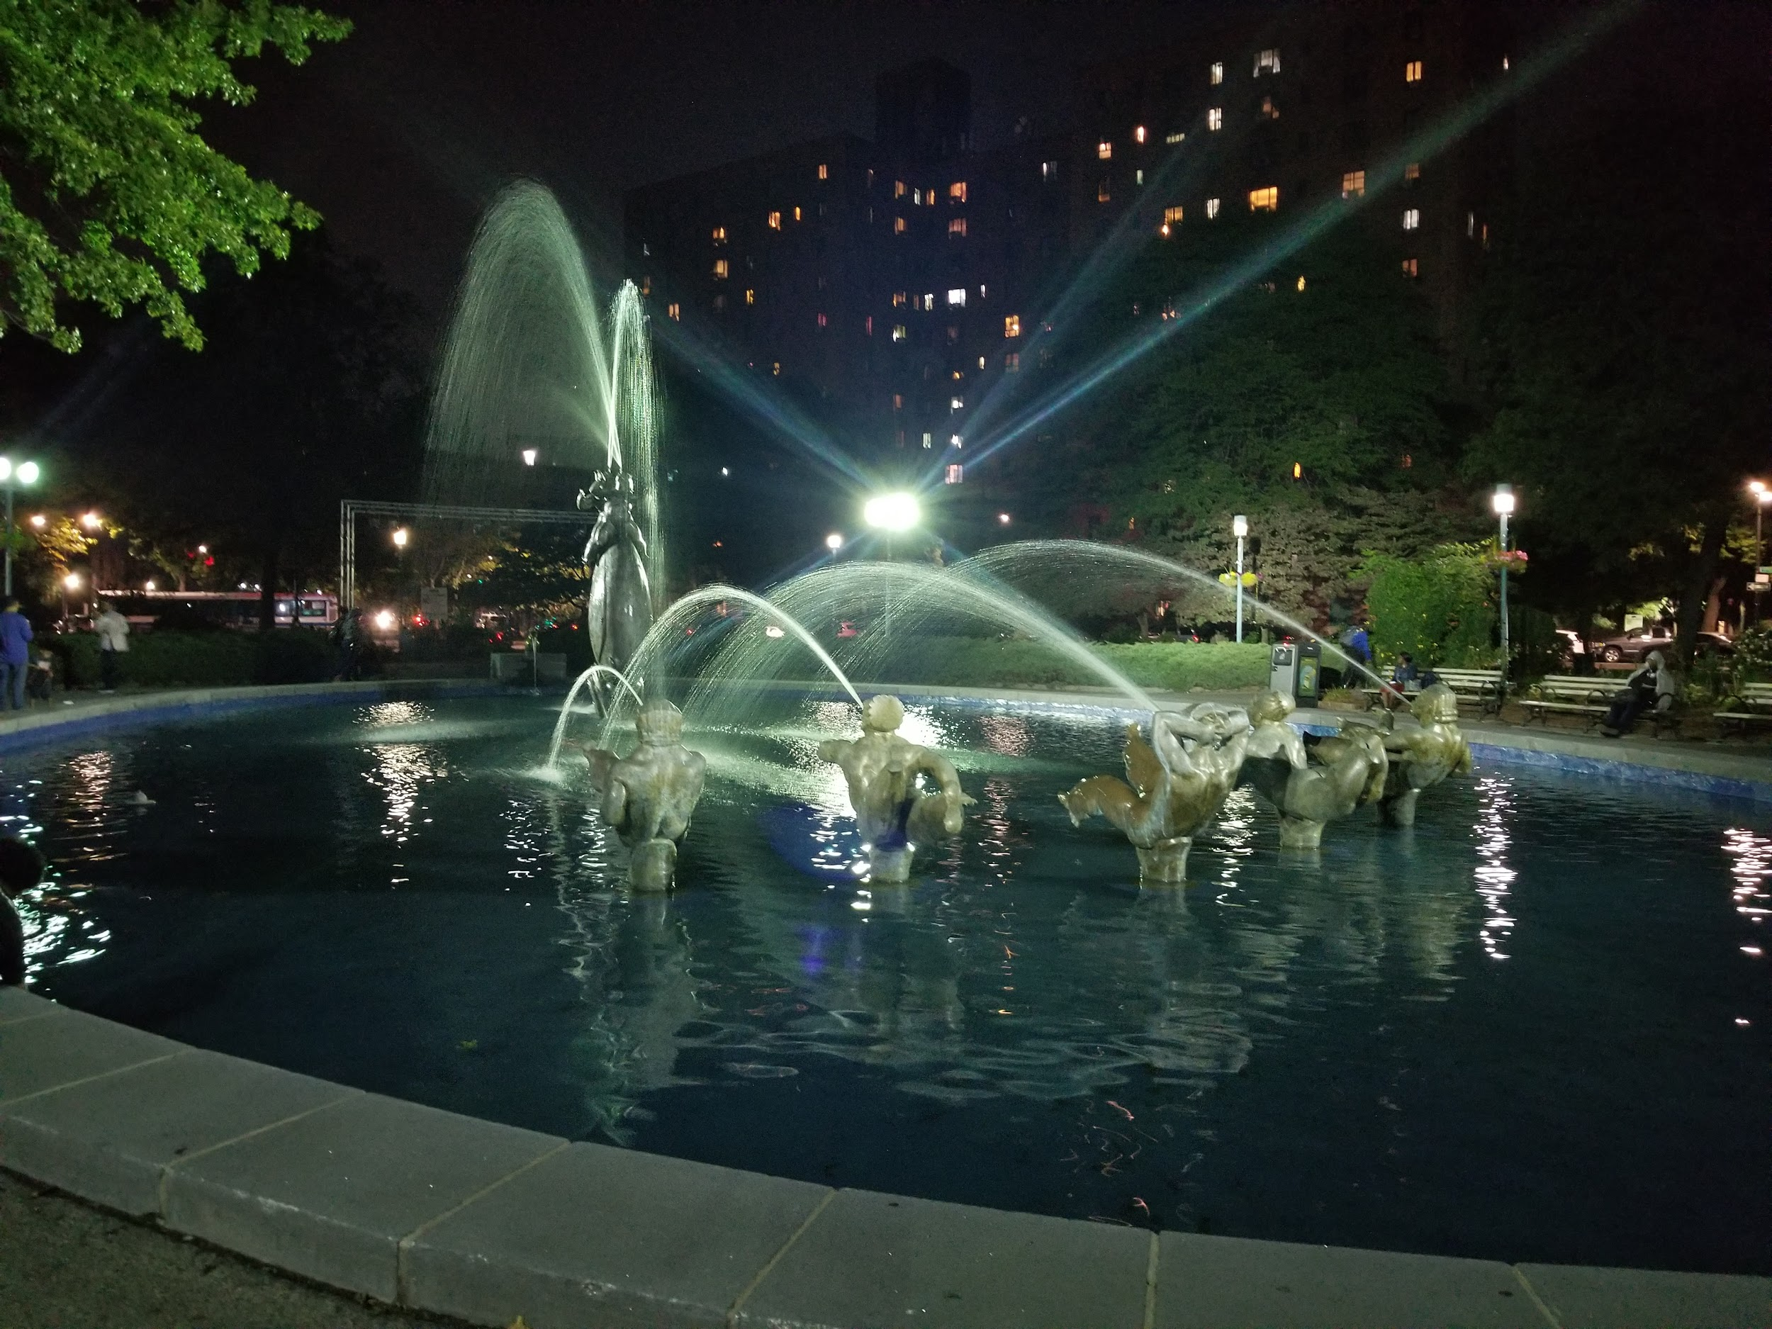
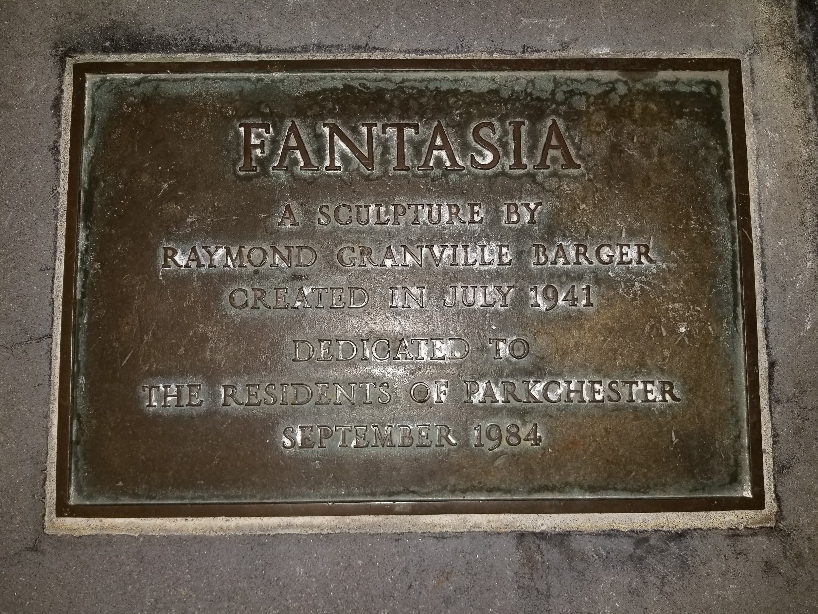
Photo Credit: Diana Ferreyra, 2019

Slide 9
Articles:
New York Times “Options Dwindle for Bronx Residents Trying to Escape to the Movies ”
https://www.nytimes.com/2014/05/26/nyregion/options-dwindle-for-bronx-residents-trying-to-escape-to-the-movies.html
Welcome 2 the Bronx “Parkchester 75 Years Later: A Brief History of a City Within a City”
https://www.google.com/amp/s/www.welcome2thebronx.com/2015/08/05/parkchester-75-years-later-a-brief-history-of-a-city-within-a-city/amp/

