Slide 1
My Neigborhood
Rikkie Ray Garcia

Slide 2
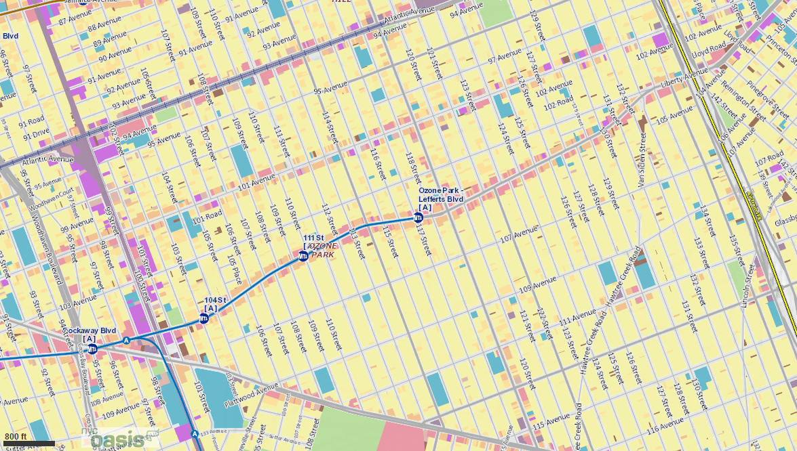

Slide 3
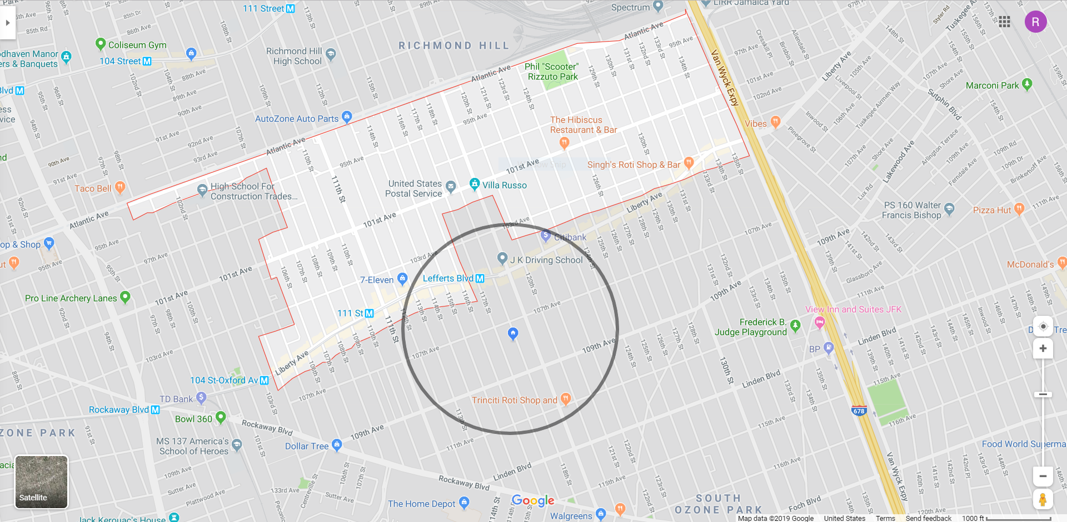

Slide 4
Time: 4:20am
Day: Sunday
Temperature: 60 degrees F
Description: At this time there were barely any people and cars in the area. This is the Lefferts Blvd A train station. This is also where the Q10 stops.

Slide 5
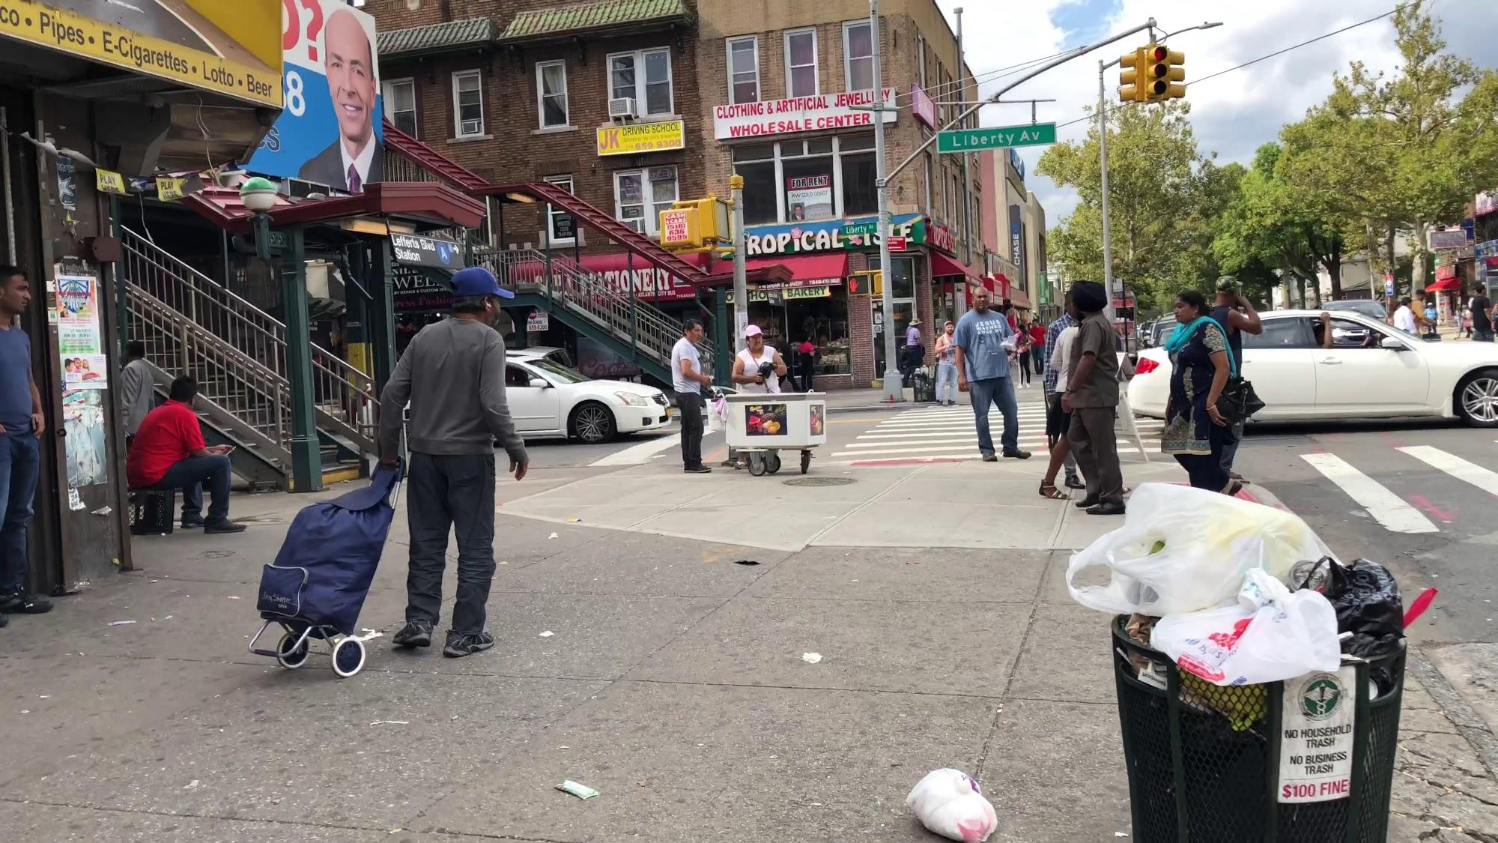
Time: 3:15pm
Day: Sunday
Temperature: 76 degrees F
Description: Due to the time most of the people are coming home from work. There isn’t as much diversity within the race. This area is predominantly made up of Indians, Guyanese, and Trinidadians.

Slide 6
History
The A train was built on September 25, 1915
The train station went through a number of name changes.
It opened as “Lefferts Ave” with “119th St.” underneath it.
In 1948, the name changed to “Lefferts 119”
In 1959, it changed to “119 St-Lefferts”
Later on it was changed to “Lefferts Boulevard” then it changed to its current name on the map which is “Ozone Park-Lefferts Boulevard”

