Slide 1
My neighborhood
MOTTHAVEN, BRONX, NY

Slide 3
Mott Haven, Bronx, NY
145th street Bridge
E138th avenue Bridge
Third Avenue Bridge
Magor Deegan Expressway
Willis Avenue Bridge

Slide 4
My Audio Observation

Slide 5
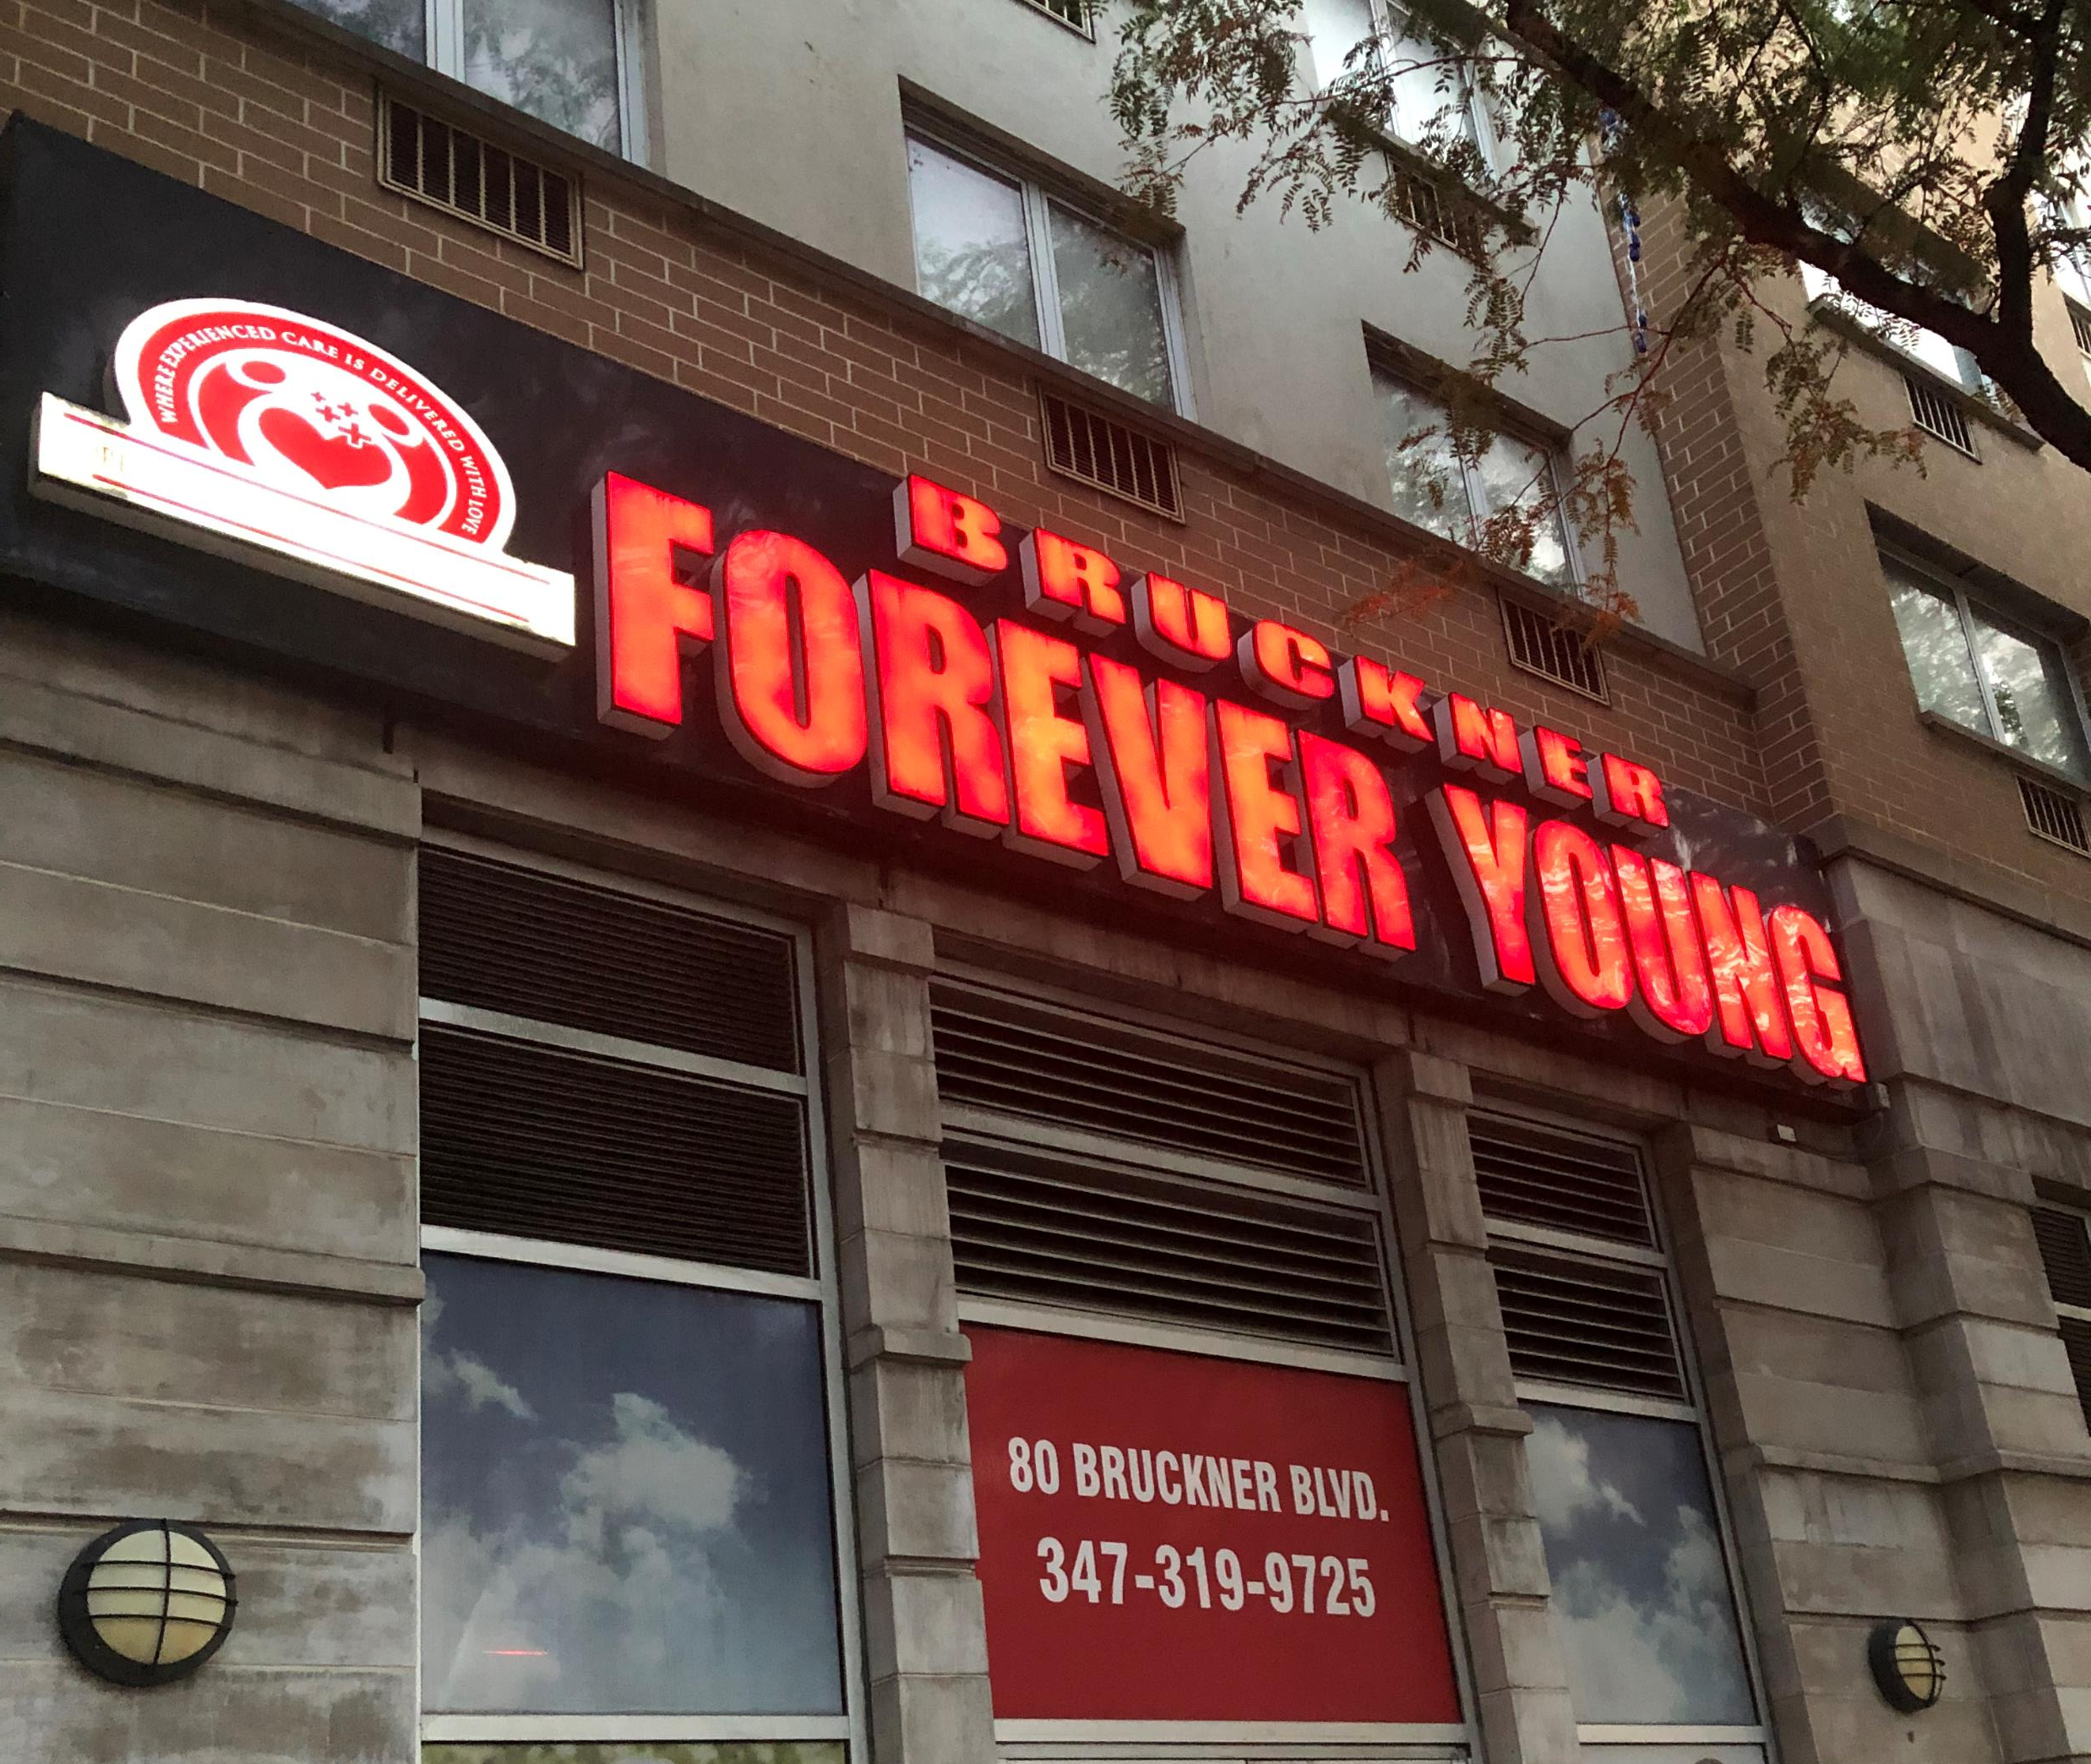
Mott Havens Landmark/Social points

Slide 6
History of Mott Haven, Bronx,NY
https://forgotten-ny.com/2013/11/mott-haven%E2%80%94port-morris-bronx/

