Slide 1
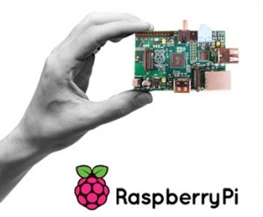
Raspberry pi Implementing Binary Counting
Marlon Myers
Computer Hardware Systems: EMT 2370
Instructor: Prof. Carranza

Slide 2
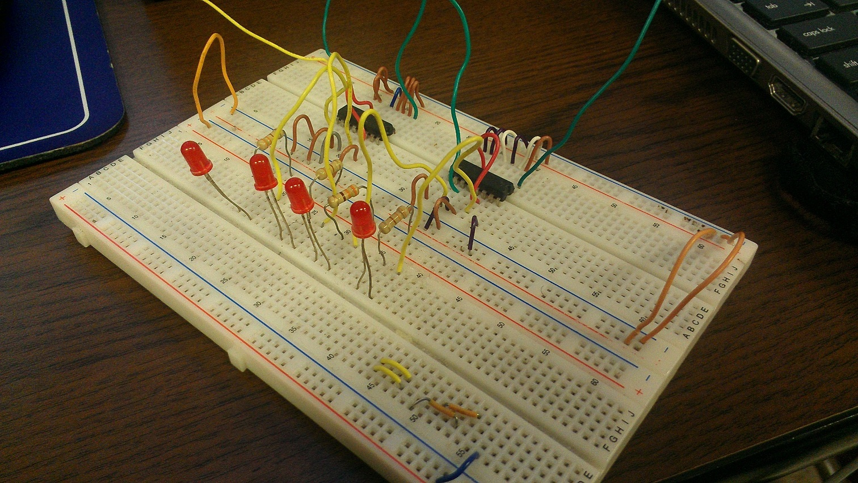
Objective:
To implement a Binary Counting sequence, using 7476 Dual JK Flip-Flop chips, LED lights and a Raspberry Pie.
To use C Programming Language to provide a clock impulse to the JK Flip-Flop chip, to either Increment or Decrement between 0 – 15 in binary numbers.

Slide 3
a Raspberry Pi
The purpose of this project is to display one of many uses of a Raspberry Pi. A Raspberry Pi is a low cost, credit-card sized computer that plugs into a computer monitor or TV, and uses a standard keyboard and mouse. It is capable of doing everything you’d expect a desktop computer to do, from browsing the internet and playing high-definition video, to making spreadsheets, word-processing, and playing games. In this Project, the Raspberry Pi is operated by the Noobs operating system; New Out Of the Box Software. Within the Noobs operating system, IDLE (Integrated Development Environment) is used as the default implementation of the C programming language. Connected to the Raspberry pi, is a circuit constructed to display a Binary Counting sequence. The word binary comes from "Bi-" meaning two. We see "bi-" in words such as "bicycle" (two wheels) or "binocular" (two eyes). A Binary Number is made up of only 0s and 1s. A collective use of 4 LED lights are used to implement a Binary counting sequence from 0 to 15. The circuit uses JK Flip-Flop chips; 7476 chips, to allow the circuit to count in a binary sequence.

Slide 4
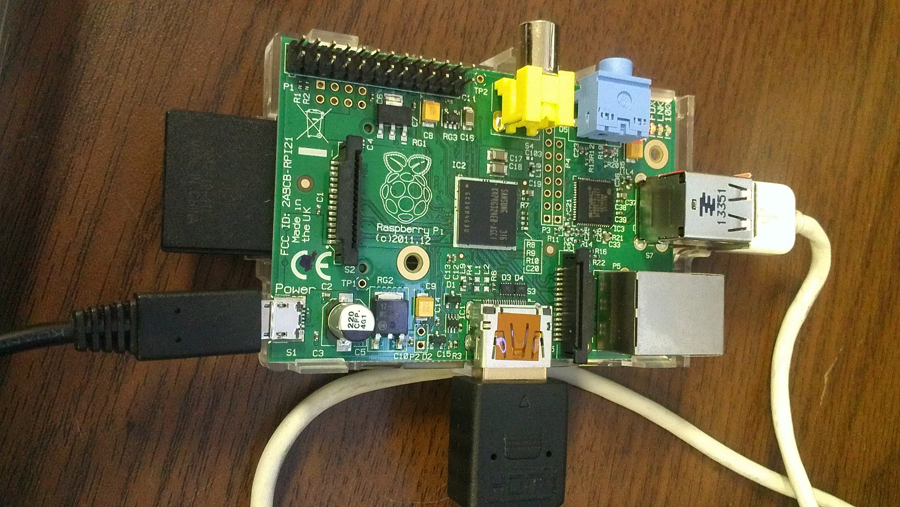
Equipment

Slide 5
C Programming
Import RPi.GPIO as GPIO //import the general purpose input output system on (RPi) Import time //import the use of time GPIO.setmode(GPIO.BOARD) //import general purpose input out output on Breadboard GPIO.setup(7,GPIO.OUT) //set the output pin to be Pin 7 on RPi For x in range (0,32): //the amount of times the code will repeat/loop GPIO.OUTPUT(7,true) //turning on or giving clock pulse to the output of pin 7 time.sleep(0.5) //turns on for 0.5 seconds GPIO.OUTPUT(7,False) //turning of or giving no clock pulse to the output pin 7 time.sleep(0.5) //turns off for 0.5 seconds GPIO.cleanup()

Slide 6
Binary Sequence
Binary Numbers | Decimal Numbers
0000 | 1
0001 | 2
0010 | 3
0011 | 4
0100 | 5
0101 | 6
0110 | 7
0111 | 8
1001 | 9
1010 | 10
1011 | 11
1100 | 12
1101 | 13
1110 | 14
1111 | 15

