Slide 1
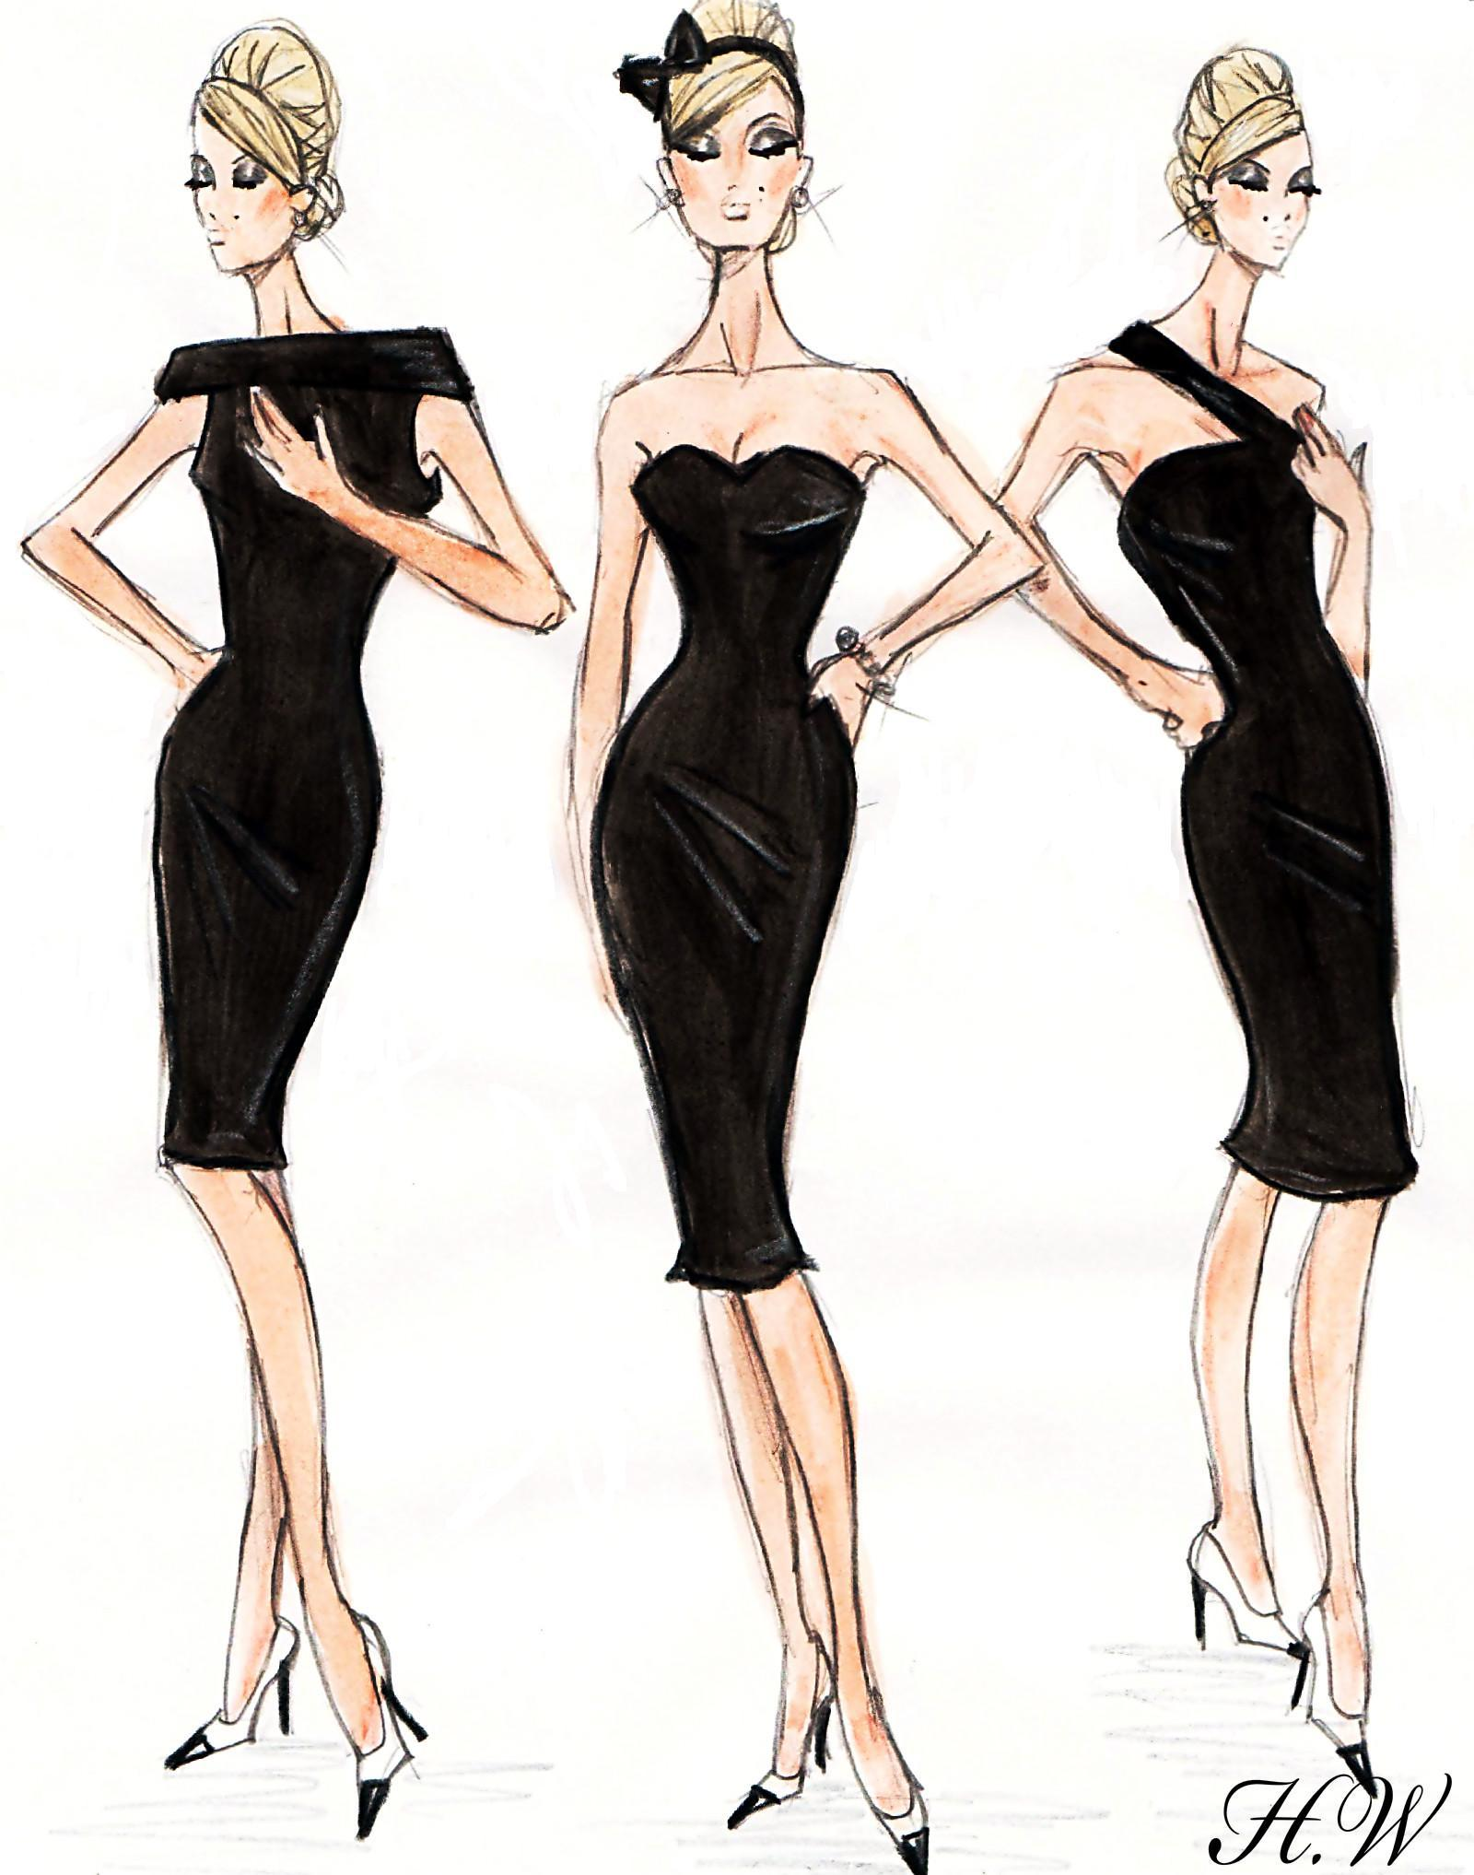
Minji Kim I BUF 3100 - Trend Forecasting I Professor Woods I December 04, 2018

Slide 2
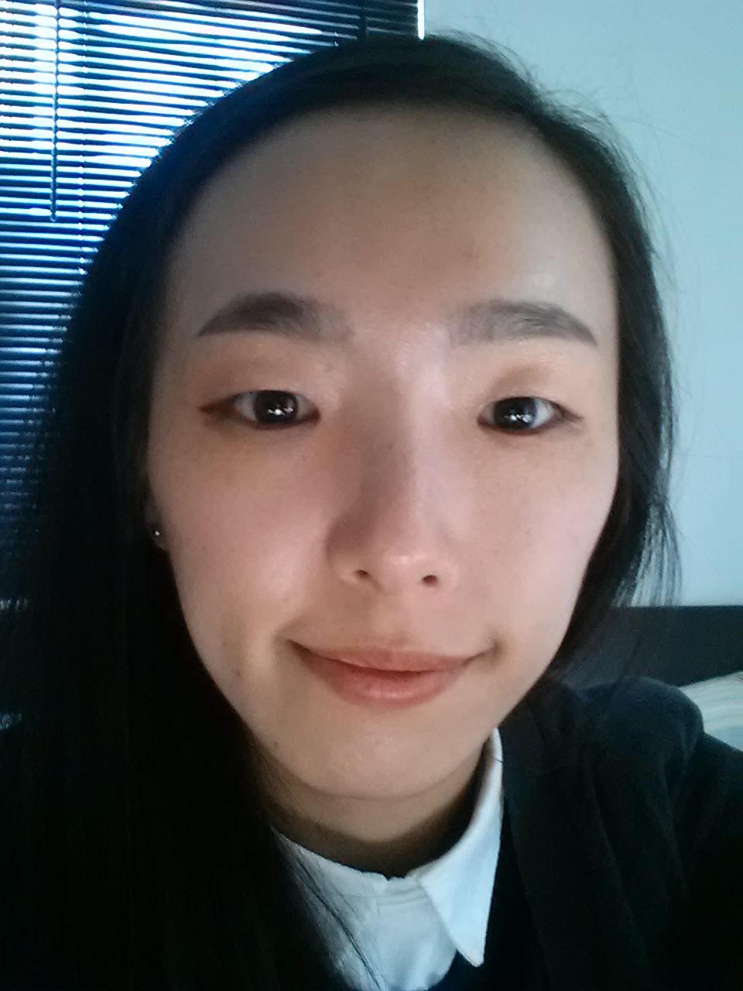
About Author
i
MINJI KIM
Is from Republic of Korea, a student at New York City College of Technology, majoring in Business and Skills of Fashion, Minji now operates her own business named Kim&Bantle located in Seoul, South Korea and Manhattan, NY, the US to know real business in the fashion industry. The company's name originates from the last name of her family and boyfriend. Also, the logo means her last name
in Korean.
From her youth, she has been naturally exposed to fashion by one of her aunts who designed and made Korea traditional clothing. However, Kim was more interested in art, particularly oil painting. So, she started studying oil painting first as a major. However, while studying oil painting, she suddenly changed her interest toward fashion by a big turning point when she was early of 20s. This time was right after 2 years she just decided to study oil painting.
Around that age, to make art portfolio to go to France, Kim went a professional art
Academy in South Korea. There, her teacher Ms. Choi suggested her to study fashion and showed her a French designer Jean Paul Gautier's fashion show because the teacher was sure Kim had talents for fashion as she was good at color matching, style match, drawing, painting, and she especially had an interest and a passion for fashion. After watching Gautier's fashion show, Kim changed her interest into fashion because the show was very impressive to her. From that moment, for her, fashion was not just a garment, but it was another art expressed through garments. From this time she began studying fashion.
In addition to what the teacher Ms. Choi felt from her, Kim is very sensitive for

Slide 3
About Author
ii
details and a change too. However, she believes having senses for fashion is not enough to study and to work in the fashion industry, but people who are in the fashion field as students and as workers need to have knowledge too. She has seen and learned all fashion people and
designers get ideas from knowledge like art, history, and current events. So, she is trying to keep studying current events, and a change in the fashion industry and in a society from her own business as well as other knowledge like history, art, science, and marketing from college too.

Slide 4
Contents
iii
PREFACE
TO THE READER
CONSUMER PROFILE
04 - 05
06 - 07
PART ONE
HISTORY OF THE BLACK DRESS
A TIME LINE OF THE BLACK DRESS
(SOCIAL, POLITICAL, ECONOMIC INFLUENCES)
08 - 14
15 - 22
PART TWO
TREND FORECAST FOR 2020 SPRING
COLOR PALETTES
THE LITTLE BLACK DRESS FORECAST
DAY BLACK DRESS FORECAST
EVENING BLACK DRESS FORECAST
23 - 31
25
26 - 27
28 - 29
30 - 31
SKETCHES
CONCLUSION
REFERENCES
APPENDIX
32 - 40
41
42
43

Slide 5
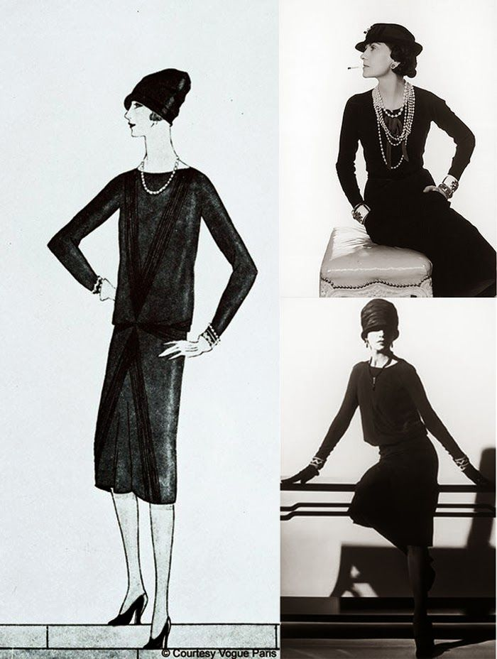
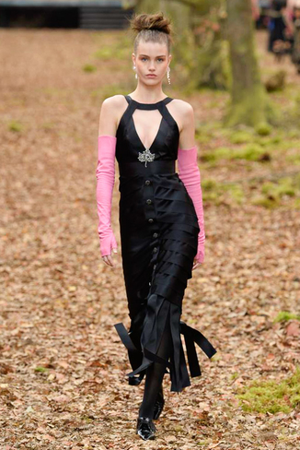
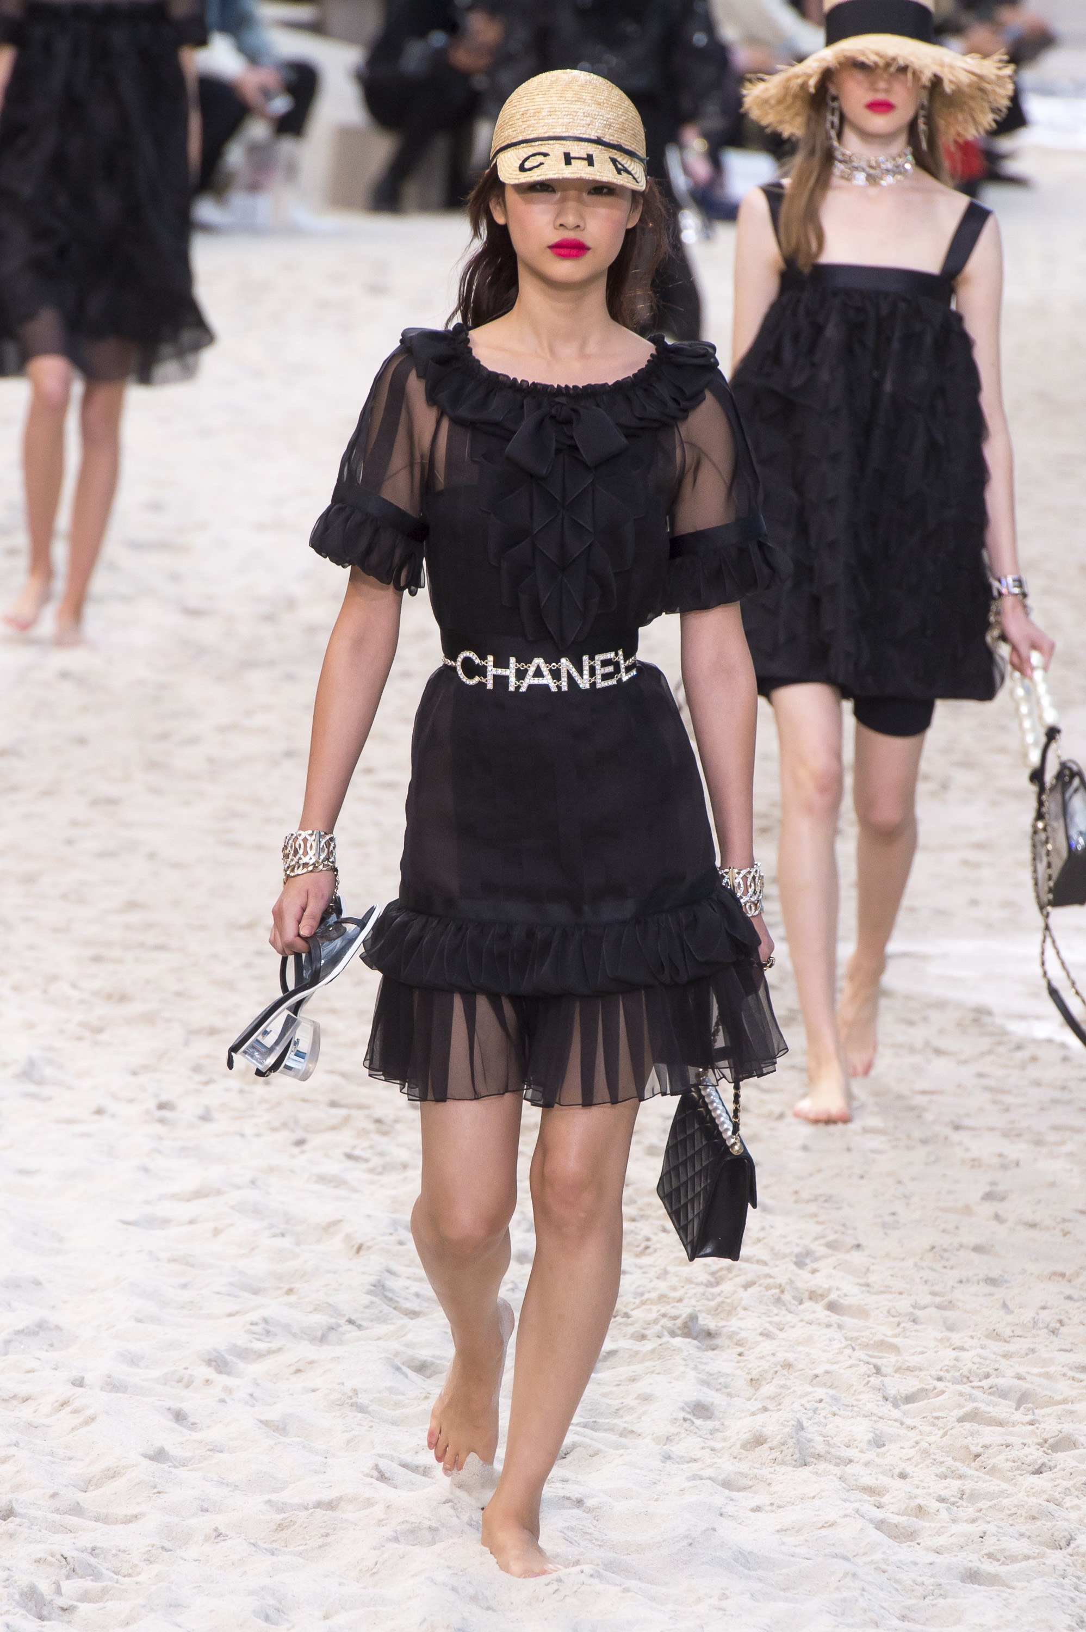
4
To The Reader
You and people surrounding you will have at least one black dress in different design and details, but originated from Gabrielle Coco Chanel. But, when you think of black dress in general, what things are coming in your mind first? In general in your mind, there are only black color and one style that is your favorite one.
Black dress is designed in many different style, with different textiles, details, and colors like white and red. Also, in every season black dress is changed. For instance,
https://www.pinterest.com/pin/437412182545381820/
in Fall/Winter 2018, Karl Lagerfeld, a creative director at Coco Chanel designed the black Dress with line revealing a model's body which made the model look sexy. He also matched pink colored gloves with the dress and added an accessory right under the breast line of the dress. In contrast, in Spring/Summer 2019, He designed the black dress more romantic; put more details like ruffles, used organza and silk, and matched with lovely hat and Chanel logo belt.
From the examples, now, you know there are more black dresses, but you may feel
https://en.vogue.fr/fashion-shows/shows/defile/pret-a-porter-femme-automne-hiver-2018-2019-paris-chanel/24729
https://www.vogue.com/fashion-shows/spring-2019-ready-to-wear/chanel

Slide 6
5
To The Reader
that black dress is uncomfortable as a daily look and it is for special days or for workplace because you see formal black dress in general in the condition surrounding you. However, based on the little black dress by Gabrielle Coco Chanel, the dress is designed for all the time and events like day time, and evening dress. So, to give you more information and help you to be more familiar with black dress, I'm writing this book.

Slide 7
Consumer Profile
6
Target Market
I’ll target a model based on one of my friends. Her name is Chloe Kwon, from Republic of Korea, a holy Christian, a student at Brooklyn college, and in the early of 20s. Basically she is a poor student; most international students who are studying here normally are supported by their parents for tuition. However, in her case, because her family in South Korea is very low class, she must study and make tuition herself at the same time; to make tuition, she has worked at beauty store in Upper East, Manhattan and she brings small snack, beverage and lunch from her relative’s store and house everyday. So, since she has no money, she resides in her relative’s house located in Elmhurst, Queens with her relatives and she has no hobby or interest because of her condition now, but although she has hobby or interest, she cannot enjoy them.
Product Plans
Based on my customer
profile, high priced products will lead to failure of my business, so I'll plan moderate
Price with nice quality
because my targets will want
low price, but with nice quality. However,
making Products with
low price, but with nice
quality will be difficult
in reality. So, make
garments with moderate price, but offer coupons and discounts to my targets very often. But, how to deliver these promotions to my targets?
Business Plans; Promotion, Advertising
Since my targets are busy to study and make money simultaneously, they won’t have time to watch TV shows or movies. However, all they have mobile device like smartphone at least and they will check their social networking service like Facebook, Instagram, or Youtube using their smartphones on the way their home, schools, or workplace. So, I’ll advertise my garments
through SNS and the influentials in social media as most customers, nowadays, are inspired by

Slide 8
7
Consumer Profile
the influentials of social media before purchasing. However, although the influentials advertise my garments and my targets watch advertising of my garments in social media, if my garments are not attractive to them, then they do not purchase them. So, to attract my customers, I need to know their preference.
Age group of the early 20s now seeks trends and to be looked unique and differentiate from others, not similar to others. So, I’ll get trends from designers and luxury brands, but design and produce garments very unique in my own ideas since most female customers want unique design, but also look similar to luxury brands.

Slide 9
PART ONE:
History of
The Black Dress

Slide 10
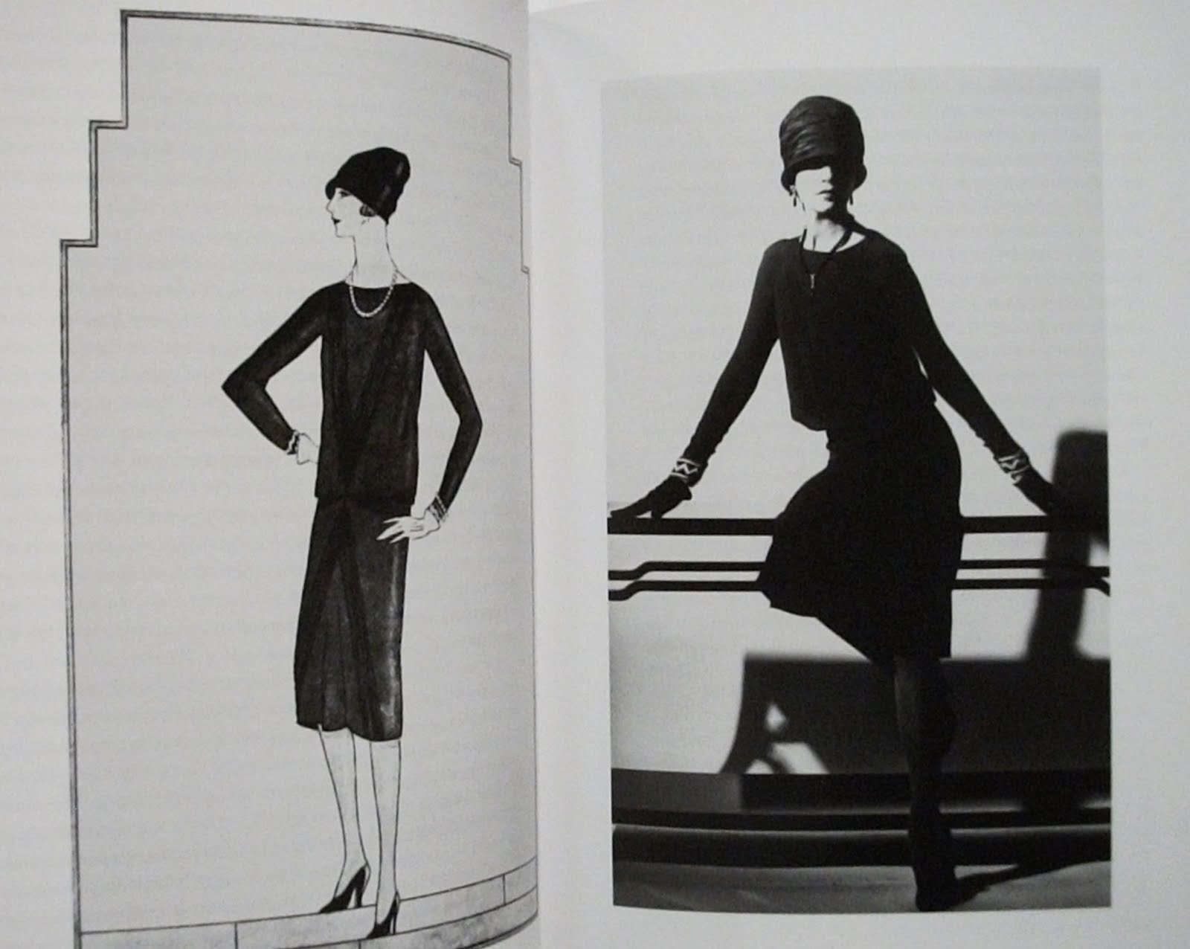
History of The Black Dress
8
Gabrielle Coco Chanel was born under very poor family and condition, but her poor family background inspired her to be successful of. While growing up under poor condition, she opened her eyes into men's clothing from a romance book that she read, but it was banned to read in a society in 1900s.
After her age 20, she showed her talents of fashion and her all the genius ideas were from her desire of men's clothing into her unique and genius style. There were also two men who noticed she was intelligent and could be an excellent business woman, so supported her to start her business. Her first lover Etienne, a high class in France helped her start her first business selling hat; let her use his department in Paris, introduced and connected high class and people to her. Her second lover named
Boy, a British man supported her
to start and expand her business bigger and it was; she in general got ideas from her lover Boy's closet; took his clothing, cut and patched them together, wore the new style clothing, showed people
in the street, and made them purchase her hat and clothing. By Boy's help,
while her business
was getting bigger,
the World War I occurred
on August 2, 1914.
By the war, Boy enlisted in military in the Great Britain and most high classes ran away from the War to other safe areas. So, at that time, Chanel was the only business woman, opening her boutique and most women went her shop to get clothing. But, the economy was still depressed, everything was almost shutdown, most women had to work in the hospitals and factories instead of men, joining in militaries for the war, and most high priced fabrics were used for supporting militaries, so kept opening the shop was not even easy for Chanel. So, what she did was purchasing inexpensive fabrics and manufacturing garments. She also thought she need to create a brand - new silhouette for women, working instead of men so that women could move freely while working. For the new silhouette

Slide 11
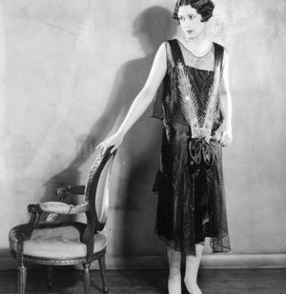
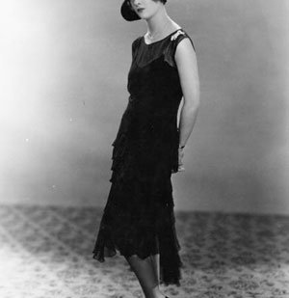
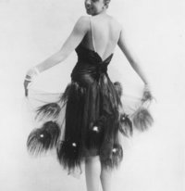
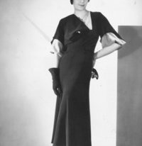
called The Little Black Dress later, she got ideas from men's clothing again; transferred the fabric of inexpensive machine-knit wool jersey, the kind used for men's underwear and nightshirts into chemise dresses; shortened hems to above ankle and the new-style was successful, so later she made the brand – new silhouette more and reshaped wool jersey to the soft jersey. It was a story how the Little Black Dress was created.
After Gabrielle Coco Chanel created the Little Black Dress, its silhouette, details, and materials have been changed by periods.
In 1920's – 1927 and 1928
In 1927, overall silhouette of black dress was narrowed, its semi-sheer top
created with layer and hemline was shorter.
In 1928, the dress with more stereotypical flapper ensemble - a tiered
Charleston style and cloche hat - wore by Actress Joan Bennett was
popular. Also, an evening dress designed handkerchief-hemmed, sleek, and
modern was trendy too.
In 1930's – 1930 to 1939
In 1930, overall styles of a shorter skirt decorated with peacock feathers
wore by entertainer Josephine Baker was famous.
In 1935 - the middle of 1930's, whole styles and silhouettes of black dress
were returned to softer, feminine cuts, full, and flowing hems fell below
the calf once again, but its neckline still looked like modern.
9
History of The Black Dress

Slide 12
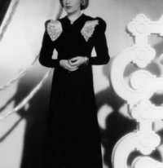
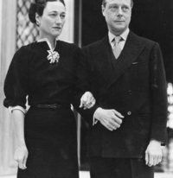
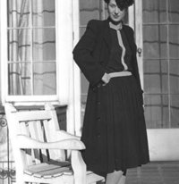
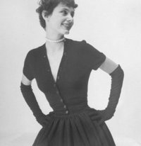
History of The Black Dress
In 1936, by a well-known Italian designer Elsa Schiaparelli,
who loved embellishment and strong shoulders, a glamorous
look influenced by her and this style became popular.
In 1939, a meticulous tailored style of the Black Dress worn by
the Duchess of Windsor became famous because she had a
nice sense of fashion.
In 1940's-1943 and 1948
In 1943, during the war, because most females had to work
instead of males, most women preferred minimalism and
practicality overall styles and silhouette became simple, boxy,
functional, and looked like military.
In 1948, after the war, style of Black Dress was changed by
Christian Dior; a New Look was created; wasp waist, lavishly
full skirt with knocked-off version.
10

Slide 13
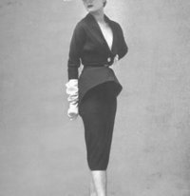
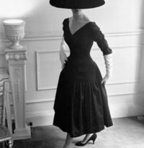
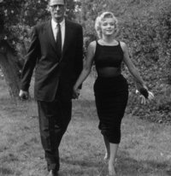
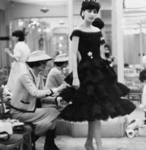
11
History of The Black Dress
In 1950's-1951 to 1959
In 1951, in general, most styles of Black Dress during 1950's was
dominated by Christian Dior; a plunging neckline, a pencil- slim
skirt combine for a cocktail dress.
In 1955, a graceful, but revolutionized style of Black Dress a
decade before came back.
In 1956, a new style of Black Dress - a wool-crepe cocktailed dress
with a bare chiffon midriff - worn by Marilyn Monroe became
famous.
In 1959, Chanel celebrated herself by putting the finishing touches
on the late 50's design – Mademoiselle Chanel; looked young,
pretty, cute, lovely with layered-frilled skirt.

Slide 14
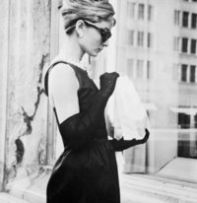
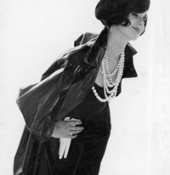
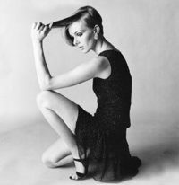
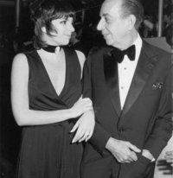
12
History of The Black Dress
In 1960's-1961 to 1965
In 1961, the Little Black Dress worn by Audrey Hepburn in her
movie "Breakfast at Tiffany's" and designed by Hubert de Givenchy
was extremely popular.
In 1962, a new style of Black Dress with the multiple ropes of pearls
probably inspired by first lady Jacqueline Kennedy and influenced
by Chanel became famous.
In 1965, a style of the mini black dress with beaded chiffon, hems
commenced and dramatically became trendy.
In 1970's - 1970 and 1977
In 1970, the simple, sexy wrap disco style of black dress worn by Liza
Minnelli in the Academy Awards was famous.

Slide 15
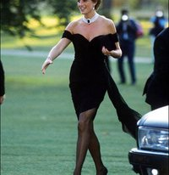
History of The Black Dress
13
In 1977, rock style of the Little Black Dress worn by Deborah Harry
became trendy; the dress emphasized "little".
In 1980's-1988
In 1988, a sleek gown with sleek updo style that showed elegant worn
by Iman became a new trend of Black Dress.
In 1990's – 1994 and 1999
In 1994, Mademoiselle style with miniskirts designed Karl Lagerfeld
and worn by Naomi Campbell on the catwalk for Chanel was
introduced.
In 1994, another style of Black Dress – emphasizing sexy and breast
line – worn by Princess Diana in the United Kingdom for her public
debut as Prince Charles' fiancee became one of trends.
In 1999, the New Look with the luxurious skirts, lowered hems that
reminded the original New Look came back again by Calista
Flockhart.

Slide 16
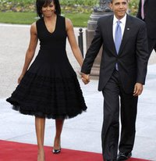
History of The Black Dress
14
In 2000's – 2002 to 2009
In 2002, minimalistic style of the Little Black Dress came back again;
overall minimal, short skirt, and showing breast line.
In 2009, a lovely, but showed 50's silhouette of Black Dress became
popular and worn by Michelle Obama.
In 2009, another style of Black Dress was famous; the look was like
everything was old, but simple and gorgeous sheath with the hem
below knee.
In 2010's – 2010 and 2015
In 2010, very little, sexy, and cute Black Dress worn by Heidi Klum
was one of the most popular dresses.
In 2015, see through, sexy Black Dress with a long skirt worn by
Jennifer Lawrence and many other celebrities became very trendy.
https://www.wmagazine.com/
gallery/best-black-dresses-2015-2/all

Slide 17
PART TWO:
Trend Forecasting
of The Black Dresses
In Spring/Summer 2020

Slide 18
Trend Forecast of Black Dress For 2020 Spring
23
Fashion Trends In The Past Years
Over the last years, most trends have reflected fashion circulation from the past and its history; for instance, in Spring/Summer 2010, utilitalian basics, futuristic, smart, chic styles, sportswear, and babydoll style were parts of trends. In Spring/Summer 2015, romantic design with lace, school look, denim, and transparent style called see though were trendy. In Spring/Summer 2017, designs using bralettes, deconstructed shirts, ballerinas style skirts called Tulle skirts and dresses, and sportswear were parts of trends. In the following Spring/Summer 2019, styles from the past like gladiator style will be one of trends. If so, how did the Little Black Dress and other black dresses reflect trends of each year?
Fashion Trends of Black Dress And The Little Black Dress In The Past Years
In Spring/Summer 2010, like other brands, Chanel also showed babydoll, chic, and romantic styles based on trends and Garbielle Coco Chanel's basic rules and thoughts. For the length of the Little Black Dress and other Black Dresses were designed to hang right above knee. In Spring and Summer 2015, the Little Black Dress and other black dresses were also designed with school look and see through styles. But, its length in this season was long and hung under knee. In Spring and Summer 2017, Sportic and ballerina styles were main lines in the Little Black Dress and other black dresses too, but the length of the Dress was different than in 2010 and 2015. If the length was short in 2010, but long in 2015, in Spring/Summer 2017, it was designed with both of short, long, and even middle lengths. If so, in the next Spring 2020, what kinds of the Little Black Dress and other black dresses will be trend?
Fashion Trends of Black Dress And The Little Black Dress In Spring/Summer 2020
According to data and images in some online websites like Pininterest.com, I expect in the

Slide 19
24
Trend Forecast of Black Dress For 2020 Spring
Spring/Summer 2020, overall fashion trends will be futuristic – powerful, modernized - like Spring/Summer 2010 and sport style, romantic like other past Spring/Summer seasons. However, there will be a big difference between Spring/Summer 2010 and 2020; futuristic style will be mostly made with plastic, metallic fabrics and technology will be grafted onto fabrics and garments. Also, many patterns, particularly geometric and nature like flower patterns will be used. On the other hand, diverse but familiar colors will be widely used.
For instance, very vivid colors like greenish, yellowish, reddish and pastel colors like pale pink, pale lavender, dark pale blue, light pale blue, pale gray, ivory, and black will be commonly showed in the fashion shows of designers, brands and come to the market. To make you understand better, I will graft expected fashion trends in Spring/Summer 2020 onto my drawings of the Little Black Dress and other Black Dresses.

Slide 20
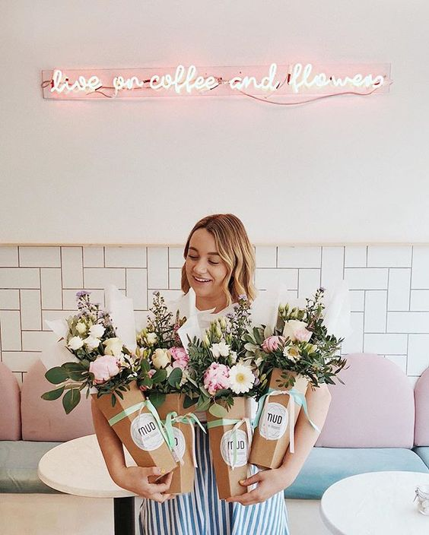
25
Color Palette For Spring/Summer 2020
Light blue Pale smoked blue gray
Pale blue Pale green blue
Dark pale blue Arcadia
Dark lemon Chilli oil Cherry Tomato
yellow
Black
Pale lavender Pale lavender Mauve mist Dusty rose pale pink
– pink soft (pale lavender)
To talk about overall trends in Spring/Summer 2020, colors' diverse lines – vivid and pastel (pale) - in particular: Light blue, Pale smoked blue gray, Pale green blue, Pale blue, Dark pale blue, Arcadia, Pale lavender – pink soft, Pale lavender, Mauve mist (pale lavender), Dusty rose pale pink, Dark lemon yellow, Chilli oil, and Cherry Tomato are expected as trend colors first.

Slide 21
The Little Black Dress Forecast
26
Based on expected fashion trends in Spring/Summer 2020 and based on the original Little Black Dress by Gabrielle Coco Chanel, I designed three the Little Black Dresses. Basically, all three of the Little Black Dresses are based on princess dress line and their lengths are short; hang above the knee. Also, all three have collars and lace as details.
The First Little Black Dress
In addition to the princess line and its length, long sleeves called between Angel, Trumpet, and Kimono are added to the first Little Black Dress. The dress also has collar called between Talloted and Wing.
With its design, because garments made with metallic fabrics will be showed in the fashion shows for Spring/Summer 2020, so I also use metallic fabrics for collar with lace and long sleeves, but the dress part is made with knit to maintain Chanel's original the Little Black Dress style.
As with design and fabrics, since vivid colors like red, yellow, green, and pastel colors like pale blue, pale green, pale pink, pale lavender, and black will be used in the garments as trend colors in Spring/Summer 2020, so I also use black color for dress part, mixed dark pale pink and red color for collar, and pale gray for long sleeves.
The Second Little Black Dress
Unlike the first Little Black Dress, this dress has no sleeves, but has a long length of collar with lace and beads. A big difference with other two dresses is that this dress is designed with top and skirt but connected them together as one dress. Also, the skirt part is designed as pleats.
With its design, like the first dress, this dress is also made with metallic fabric, but only for collar. The collar is made with metallic fabric, as well as lace and beads. For the dress line part, it is divided into top and skirt; top is made with knit and skirt is made with wool.

Slide 22
The Little Black Dress Forecast
27
For colors, the dress part basically has black color as the dress name is the Little Black Dress. However, the collar has white color with black colored lace, but beads in the collar has diverse trend colors like red, green, black, pale blue, and pale lavender.
The Third Little Black Dress
This Little black Dress has no long sleeves like the second dress, but its collar is designed like the first dress; between Talloted and Wing.
As with overall design, for fabric part, this dress has a big different than the other two dresses. If lace is used in the collar part in the other two dresses, lace is used in the dress part in this dress. The whole dress part is made with knit, lace with geometric patterns which will be one of trends in Spring/Summer 2020, the collar is made with metallic fabric.
For colors, as the dress name is the Little Black Dress, the whole dress's color is kind of black, but closer to dark gray. On the other hand, because the whole dress is dark gray color, I design collar with trend colors – gradation of pale pink and lavender.

Slide 23
28
Day Black Dress Forecast
From information and pictures in some websites like YouTube, I believe some jackets with geometric patterns and futurism will be showed in the fashion shows for Spring/Summer 2020.
So, although this section is for a day black dress, I'll design dresses with jackets because not only for the trends in Spring/Summer 2020, but many females also wear a dress with a jacket at schools and in their workplaces in general.
For the dresses, all three will have short lengths; hang above knee and all three jackets will have long sleeves.
The First Day Black Dress
The dress is designed with V-neck, Princess line, and long sleeve – between Trumpet and Kimono. The V-neck part is connected to black colored necklace with a red pointed beads. For the jacket, it is designed with princess line like the dress with long sleeves and big convertible collars.
As with design, the dress is made with knit and the black colored necklace part is made with knit too. However, in the case of jacket, it is made with a metallic fabric following trends in Spring/Summer 2020.
In addition to its design and fabric, a color of the whole dress is black, but the jacket is green to follow trends.
The Second Day Black Dress
Unlike the other two dresses, this dress with designed with Sheath to show body line. The dress has long sleeves and high-bias roll. About the jacket, it is designed like denim style with no collars, but with low-bias roll.
For the fabric, the black dress is made with jersey knit, but the jacket is made with a metallic

Slide 24
29
Day Black Dress Forecast
fabric with some buttons.
With design and fabric, the dress's overall color is black, but a color of the jacket is yellow.
The Third Day Black Dress
The dress is designed with A-line, high-bias roll, and long sleeves, whereas the jacket is designed with long sleeves, square neck-line with shawl collar, but with short top. In particular, to follow trends, the jacket is designed with geometric patterns.
For the fabric, the dress is made with knit, but the jacket is made with buttons, a metallic fabric patterned with geometric images
In addition to its design and fabric, the dress is black and the jacket is red with yellow colored geometric patterns.

Slide 25
Evening Black Dress Forecast
30
Most women in normal do not wear black dress for only their daily lives and for schools and workplaces, but they would like to wear some special black dresses to enjoy their lives more and to join in nice parties and clubs. When they participate in the parties or clubs, they cannot wear their daily dresses, but they need a special evening dress that can make them very stunning in the parties. So, for females who should be beautiful in the parties and festivals, I'll design three evening black dresses. The three evening black dresses have pretty long lengths –two are designed as maxi dresses and one is shorter than the other two - and are designed very fancy and showy. The three evening black dresses also describe nature, particularly flowers that are one of trends in Spring/Summer 2020.
The First Evening Black Dress
The overall style of the dress is between mermaid and trumpet, sweetheart, but closer to flowers. There is a big bow in the back of the dress, the big bow represents a butterfly.
The big wings that three of them are located in each side of hip part in the dress also describe leaves of flowers.
In addition to design, the overall body line (between mermaid and trumpet, flowers) is made with satin, but the top (flowers) is added with a metallic fabric. Top's inside that is touched with human's body is made with satin, outside is covered by the metallic fabric. The big bow in the back of the dress is also made with a metallic fabric decorated with colorful beads. For the part of the leaves of flowers, these parts are made with lace, embroidered, and organza decorated with colorful beads. To keep its shape, wires are attached inside.
For the color, the dress is basically black, trends colored beads are added as details in the parts of the leaves of flowers and flowers that are on the top.

Slide 26
Evening Black Dress Forecast
31
The Second Evening Black Dress
Like the first dress, overall design of this dress also represents flowers. However, its skirt part is designed with pouf (inside) and ball gown (outside). But, top and ball gown of this dress describe flowers and ball gown is designed with three layers.
As with the first dress, top and pouf of this dress are made with satin and metallic fabrics, in particular the top is decorated with beads. For the ball gown, it is made with three layered organza and embroidered.
For colors, like the first dress, overall color of this dress is black, but the top is decorated with colorful beads. The ball gown is also made with bright pale gray closer to white, pale gray, and dark gray from inside to outside of the three layers.
The Third Evening Black Dress
The overall design of this dress is based on halter dress, but the skirt part describes flowers like the other two dresses.
As with the other two dresses, the skirt part of the dress is made with a metallic fabric, but less shiny one. Also, to support and keep the skirt shape, wires or plastic sticks are added inside of the skirt. The waist part is made with satin, halter (top) is made with three layers of organza.
Unlike the other two dresses, the skirt part is a color mixed of lavender and dark pale blue that will be one of trends in Spring/Summer 2020. But, like the second dress, halter (top) of the dress is black, dark gray, and pale gray from inside to outside of the three layers. Likewise, colorful beads are added in the waist of this dress like the other two dresses.

Slide 27
SKETCHES:
• The Little Black Dress
• Day Black Dress
• Evening Black Dress

Slide 28
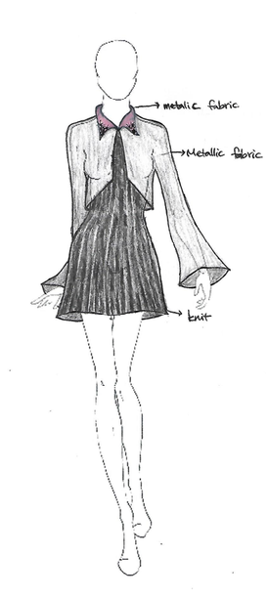
The Little Black Dress

Slide 29
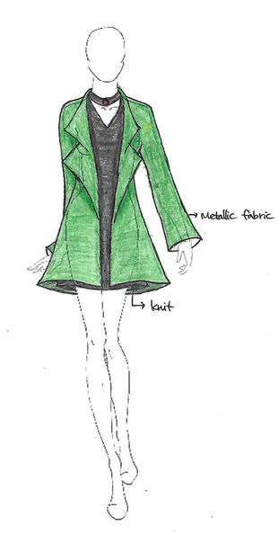
Day Black Dress

Slide 30
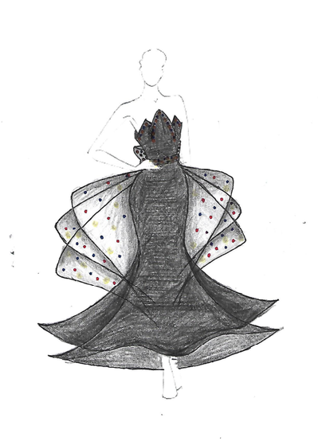
Evening Black Dress

Slide 31
Conclusion
41
Based on information and images what I've found and studied, I've tried to explain as much as possible I can to make you understand better about black dress and the Little Black Dress. Although my works in this book are not enough, I hope my works help you comprehend what I want to say and what I want to show you that black dress is not made in only one style or very few styles, but it can be designed in many different ways. Also, without using expensive fabrics, black dress, as well as other garments can be made in inexpensive ways using cheaper materials.
Many people think black dress should be only black color because its name is black dress as well. However, other colors can be added as details in black dress as I design. So, its meaning shouldn't be limited because it can block designers' creativities, as well as adaptation of new events or styles happening in a society among public who also can be called as customers.
So, from this book, I hope many readers can broaden their thoughts about black dress, as well as other garments, and other fields.

Slide 32
References
42
Fritz, M. (n.d.). A Short History of the Little Black Dress. Retrieved November 28, 2018, from
https://www.realsimple.com/beauty-fashion/clothing/dresses-skirts/little-black-dress- history
Pithers, E. (2017, February 23). Spring/Summer 2017 Fashion Trends To Know Now.
Retrieved December 01, 2018, from https://www.vogue.co.uk/gallery/spring-summer-
2017-fashion-trends
Rubin, S. G. (n.d.). Coco Chanel: Pearls, Perfume, and the Little Black Dress. Retrieved
October 18, 2018, from https://books.google.com/books?
id=iM1FDwAAQBAJ&printsec=frontcover&dq=coco chanel the little black
dress&hl=en&sa=X&ved=0ahUKEwjjt9GsspDeAhUEh-
AKHdJYCIUQ6AEILTAB#v=onepage&q=coco chanel the little black dress&f=false
Slowey, A. (2018, March 19). Runway Report: Top Trends From Spring/Summer 2010.
Retrieved December 01, 2018, from https://www.elle.com/fashion/a9055/runway-report-
springsummer-2010-389222/

Slide 33
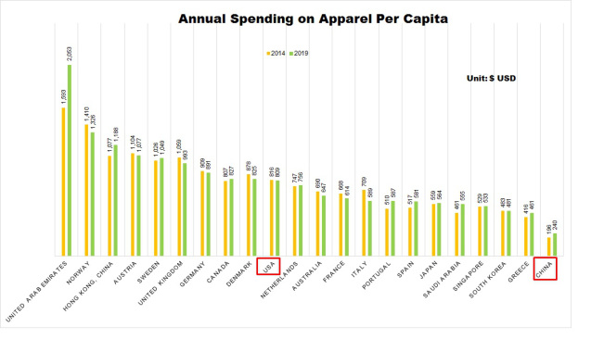
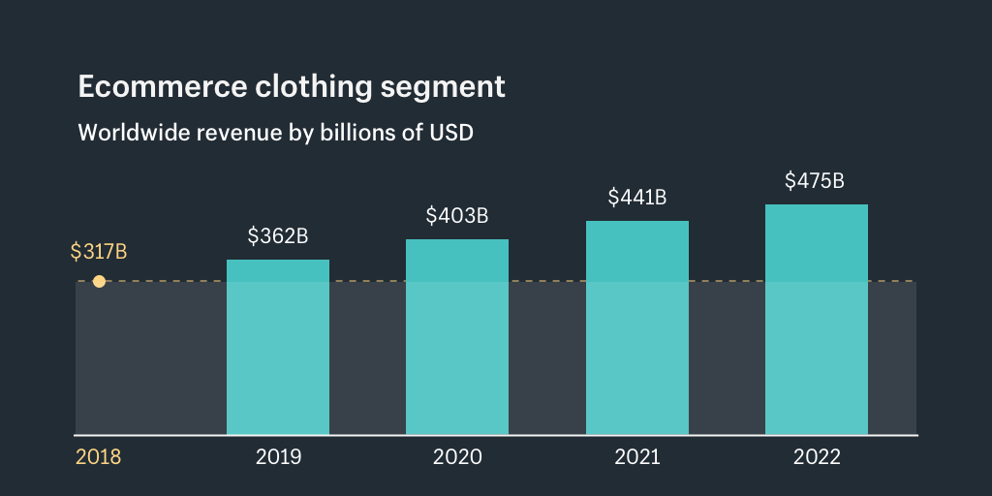
43
Appendix
http://www.bmagency.net/daily-digest/china-to-become-the-worlds-largest-apparel-market-in-2019
https://www.shopify.com/enterprise/ecommerce-fashion-industry

