Slide 1
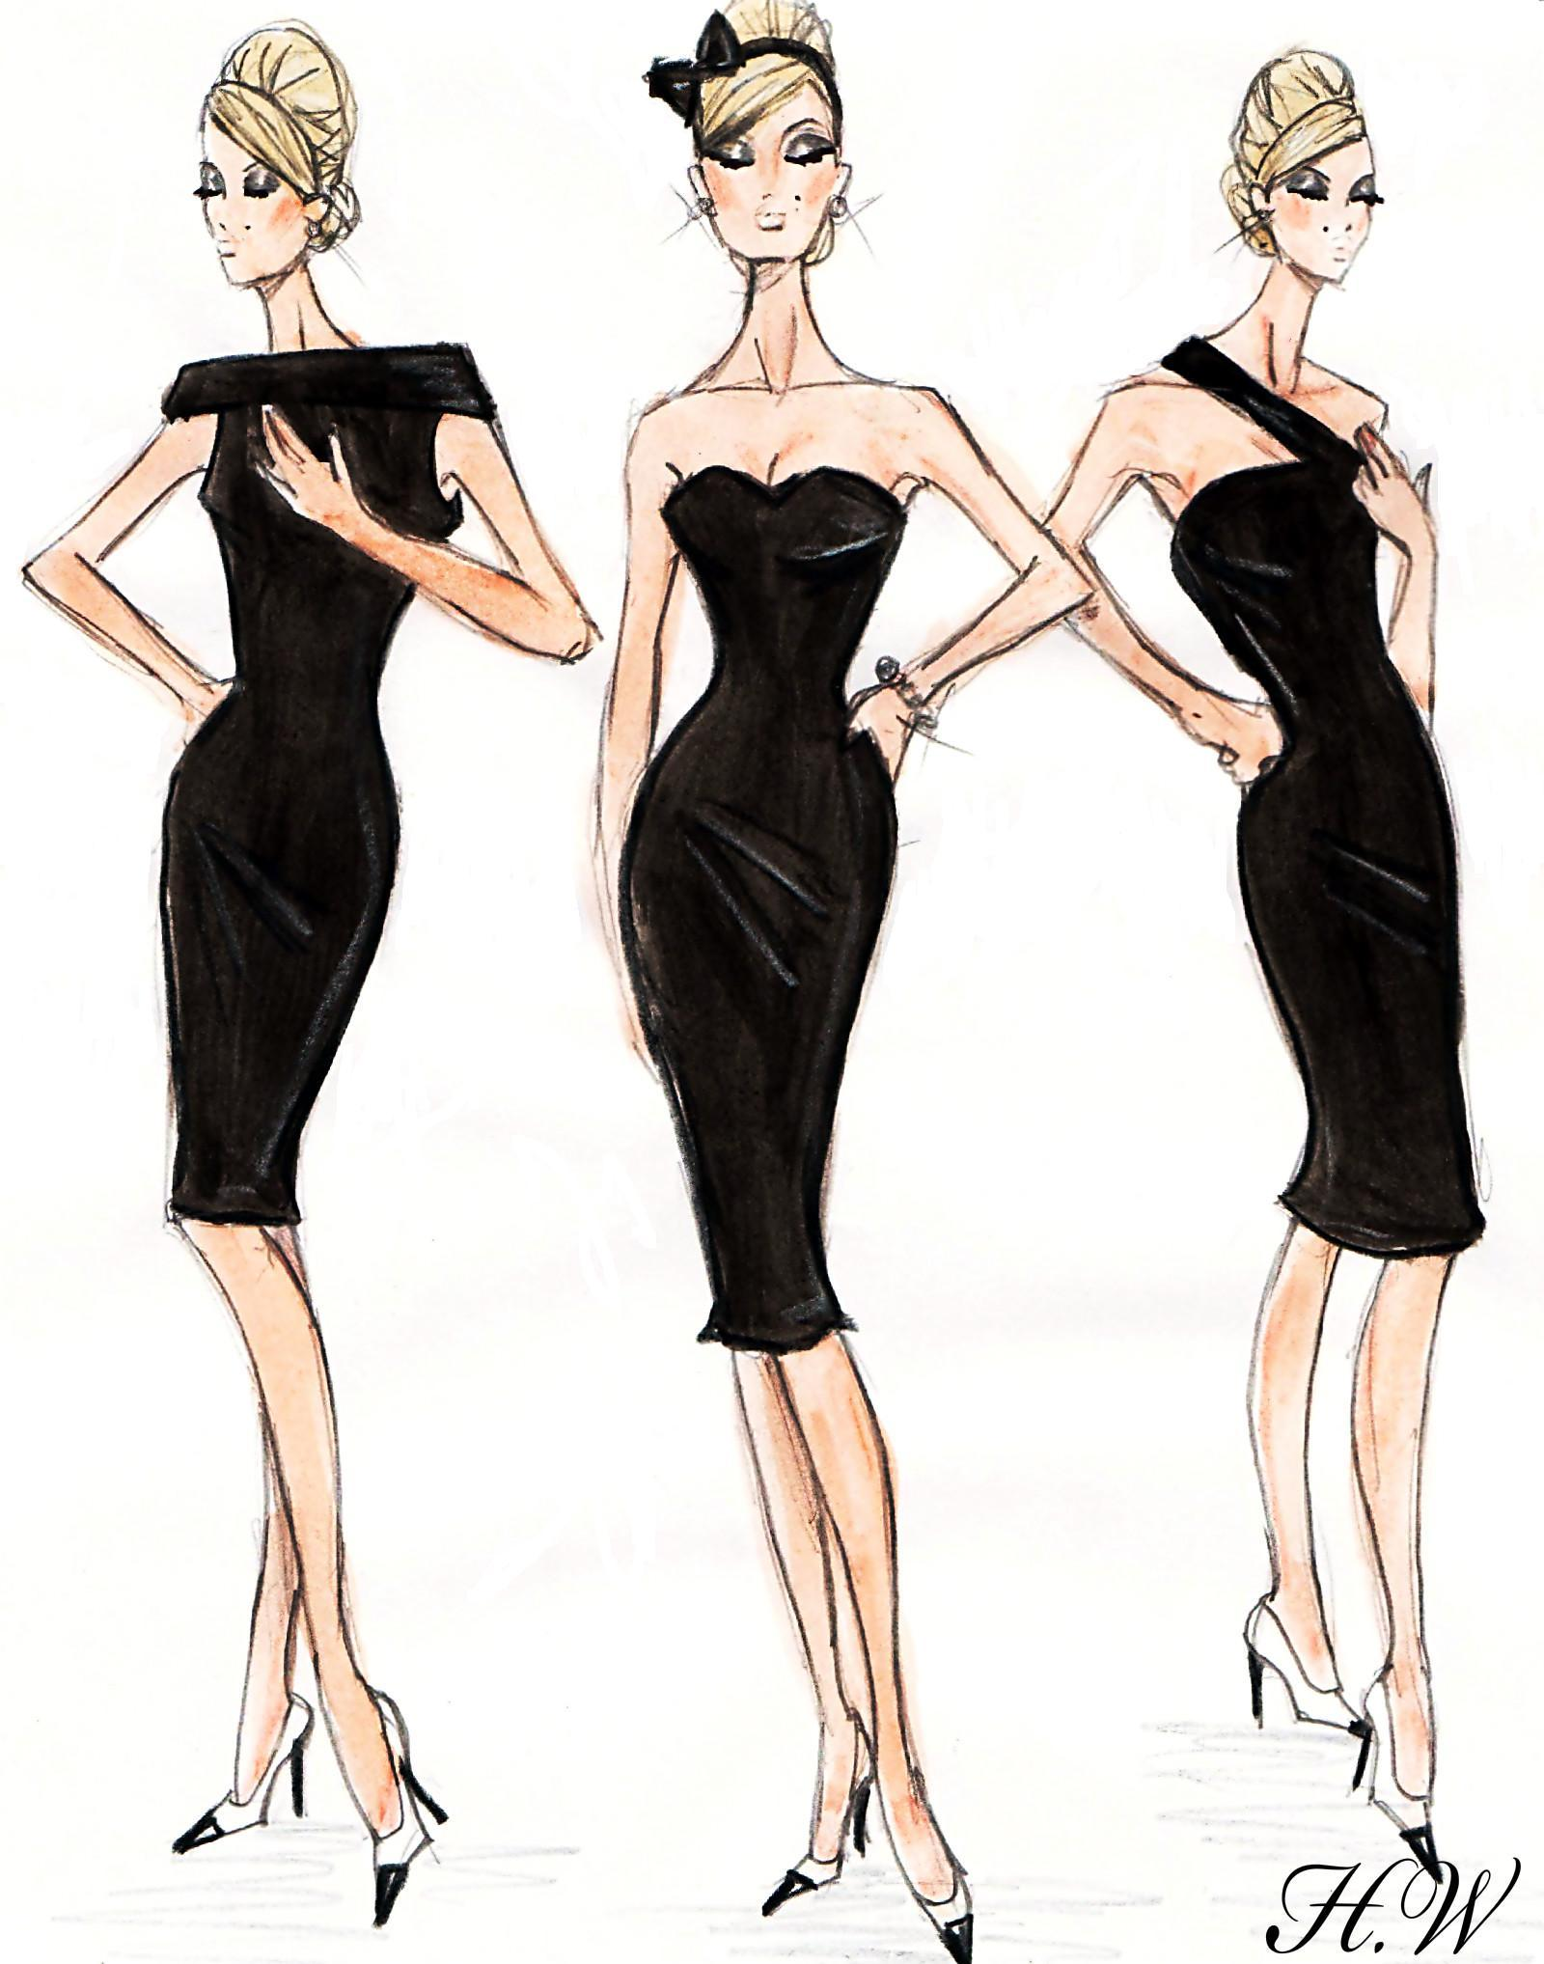
Black
Dress
By Kim & Bantle Ltd.

Slide 2
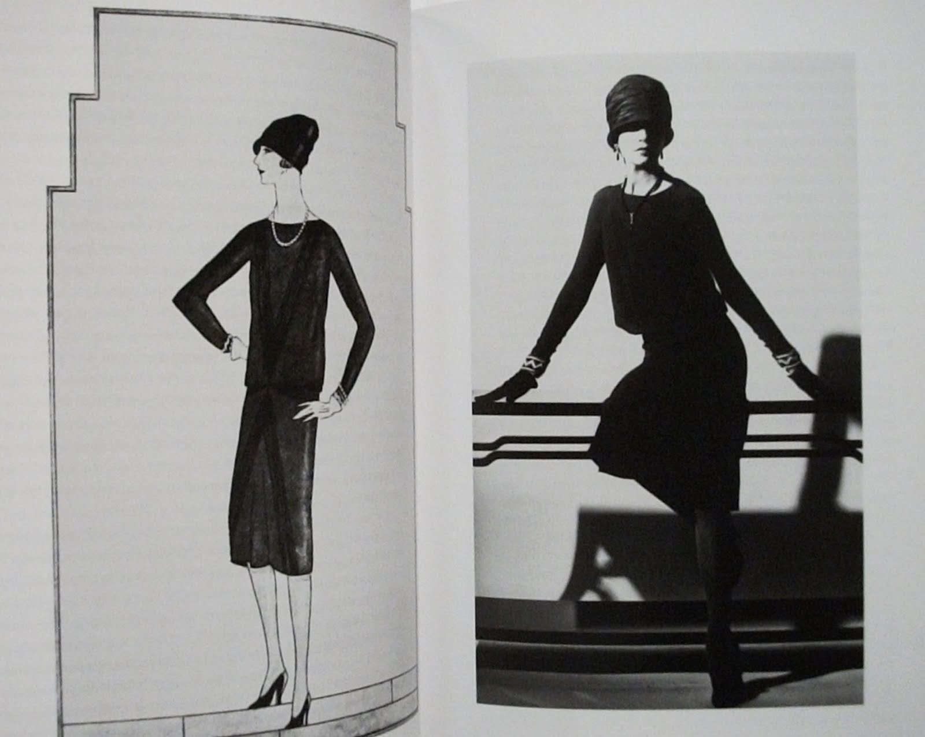
Contents
History of The Little Black Dress
and Black Dress
Target Market (Consumer Profile)
Trend Forecasting of Black Dress
In Spring/Summer 2020

Slide 3
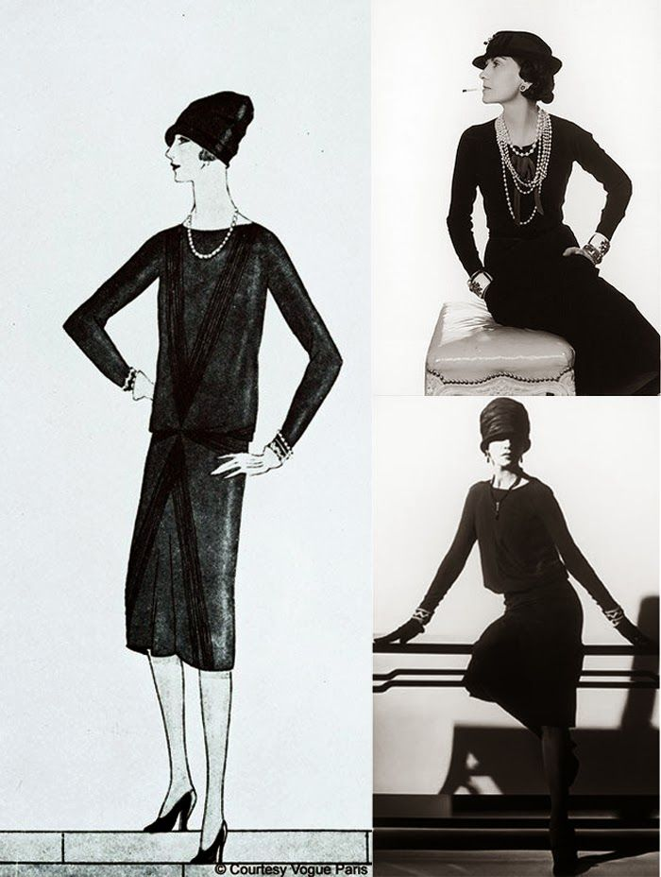
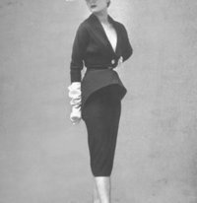
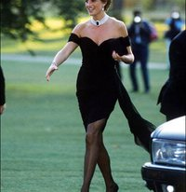
History of The Little Black Dress & Black Dress
1920s In 1927 Late of 1940s – 1950s 1960s ( In 1961 and In 1965)
By Gabrielle Coco Chanel By Christian Dior By Givenchy & Audrey Hepburn
1990s - In 1994 2000s ( In 2002 and In 2009) In 2010 In 2015
By Princess Diana By Kate Moss and Michelle Obama By Heidi Klum By Jennifer Lawrence

Slide 4
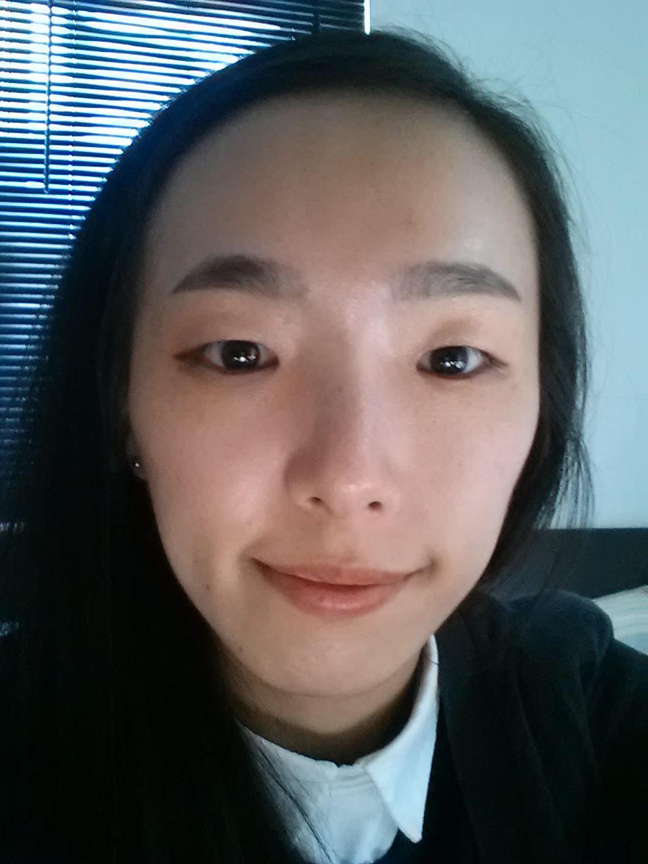
Consumer Profile
Between early and middle of 20's
A college student
Works as part-time job
Lives in her relative's house in Queens
Bring small snack, beverage, and lunch
from her relative's store
No hobby and interest

Slide 5
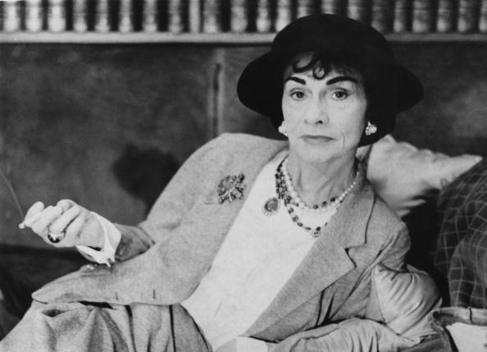
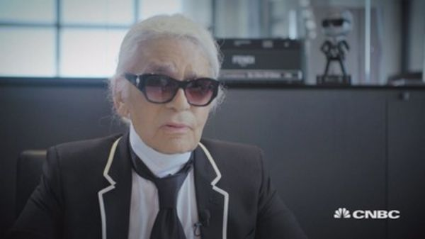
Trend Forecasting In Spring/Summer 2020
Hey Largerfeld!
You think what kinds of things will be trends in Spring/Summer 2020?
Well~ I think overall trends for design and fabrics will be futuristic with developed technology; geometric patterns, oversized fit. you know.
For colors, diverse colors will be trendy, but I think
you gotta focus on vivid, but tone downed colors like
Chilli Tomato, Lime Lemon, Arcadia, Pale colors, Black, and so on...You know.
And..... umm... hey, Minji! What do you think?

Slide 6
