Slide 1
Writing Syllabi that Promote and Embrace Diversity and Inclusion Part 1/a
Lucie Mingla
New York City College of Technology

Slide 2
AGENDA Hour 1
20XX
1- (5-min) Entry Ticket: “What’s one thing you do to make your syllabus more inclusive?” [Please type your response in the chat]
15-min) Presentation
3- (5-min) Poll activity: Polling yes/No question: Do you feel that your syllabus communicates diversity and inclusion?
Some of the major Items to be considered when writing the syllabus
Quick Interaction
Sample provided at: https://openlab.citytech.cuny.edu/mingla-writing-syllabus/
4- (15-min) Presentation
5- (10-min) Interactive
Q & A sharing ideas about the key concepts from the presentation
10-min) Interactive
Maximincto od essi sime voluptati ipis maximus liquatem voluptatur.
Show one example from your syllabus that communicates inclusion. Type on chat box. Share

Slide 3
Goal: Contributing and sharing ideas on creating effective syllabus that help us communicate better with our students, and help every student grow despite the background
I will try my best to bring some of the ideas, challenges and contributions, but you all are welcome to contribute and share your struggles and successes too.

Slide 4
Reasoning
Starting with an inclusive and up to date syllabus and making an ongoing effort to ensuring that every voice is heard, and every student can thrive and learn, can lead to a successful course outcome.

Slide 5
Objectives
Creating policies, statements, and information that establish communication and behaviors that are inclusive and consider such prospective as disabilities, mental health issues, transgender, financial challenges, underrepresented groups, etc.
Using inclusive resources such as texts, videos articles, films, that are inclusive considering racial, gender, geographic, socioeconomic, and ability status. Consider: Who is it, who it is directed to, who is the producer.
Communicating and setting expectations for a constructive dialogue despite differences, respecting each other's opinions, clarifying, explaining, and providing scientific facts for making the main conclusions and decisions.

Slide 6
Stages of designing for a good structure of the course
Stages of backward design
When you use UDL, you assume that barriers to learning are in the design of the environment, not in the student.
2-Identify the learning goals or desired outcomes
1
2-Determine acceptable evidence (asses)
2
3-Plan learning experience and instructions

Slide 7
Writing syllabus that promote inclusion overview
1
Plan the materials and resources that will help students meet the learning objectives for the course
2
Design the strategies that I will apply to know that students are making progress
3
Develop activities and assessments that will be organized during the semester.
The syllabus is an overview of learning objectives, content, resources assessment, and major guidelines and policies
(What activities will equip students with the desired knowledge and skills?)
(variety and depth of assessment tasks)

Slide 8
Ensuring multiple means of engagement, action and expressions, and representations for writing inclusive syllabus
Two sides of the coin
Syllabus gives students a first impression about what to expect.
Providing multiple means of engagement:
Outlining the learning goals and objectives, the relevance of the content, and any opportunities for choices within the course.
Providing multiple means of action and expression:
Using the syllabus to communicate routines to establish expectations, outline the timing and format of assessments, and offer resources.
Providing multiple means of representation:
Being explicit about the ways in which students can access content (e.g., textbook, slides, course website, videos, LMS).
Syllabus helps the instructor set the class climate, communicate specific learning expectations, and discuss various options and needs for all students .

Slide 9
An Overview of Curriculum Structure
Curriculum
Department outline
Course Objectives
Major
(degree)
requirements
Prerequisites
Corequisites
Technology and Online LMS systems
Course textbook & OER-s (videos, activities)

Slide 10
Faculty major responsibilities and presence
Faculty
Designing Syllabus & policies
Interacting with the Institution
Providing pedagogical
Instructions
Maintaining professional growth
Creating online content and activities
Interact with students Synchronously and As.

Slide 11
Student’s responsibilities and presence
Student
Interact with the institution seek help
Interact effectively with the peers
Respond promptly to assignments and maintain growth
Use the resources(textbook, OER-s, videos, LMS effectively
Self-pace, self esteem and responsibility
Proactively Interact with the Professor

Slide 12
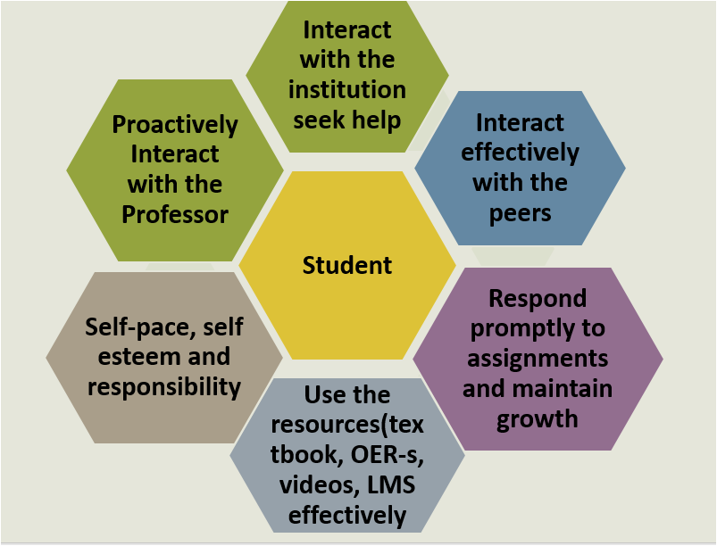
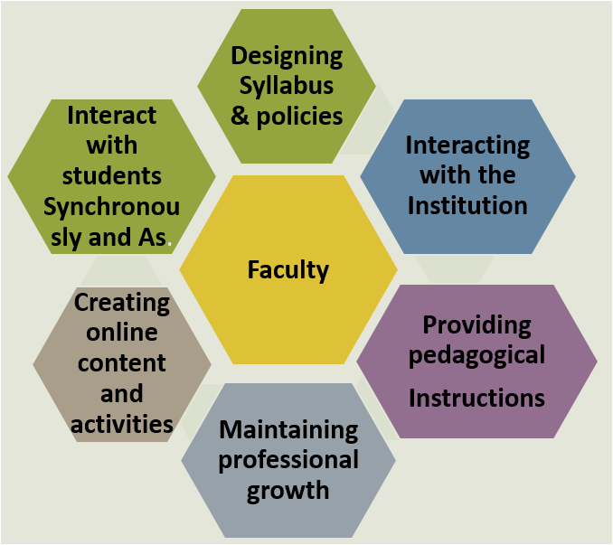
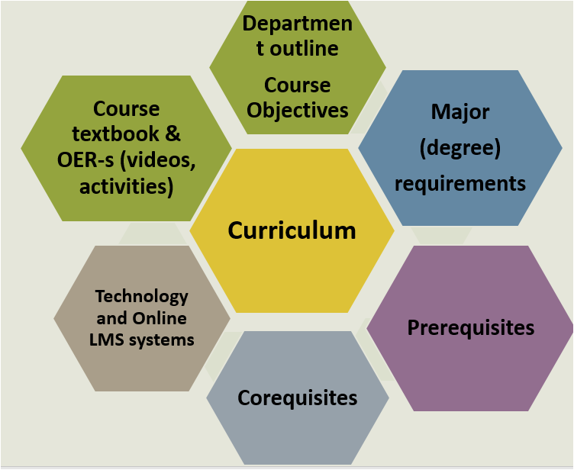
Why is it important that we consider all of it in the syllabus Consider student-centered and contributions here
Curriculum
Faculty
Student

Slide 13
3- (5-min) Poll activity
Polling yes/No question:
Do you feel that your syllabus communicates diversity and inclusion?
If you didn’t bring your syllabus, you can use any of the samples
provided on City Tech/Open Lab
Sample provided at:
https://openlab.citytech.cuny.edu/mingla-writing-syllabus/

