Slide 1
Tidal Waves Represented In a Cosine Function.
By : Anna Goncharova and
Jessica Herrera

Slide 2
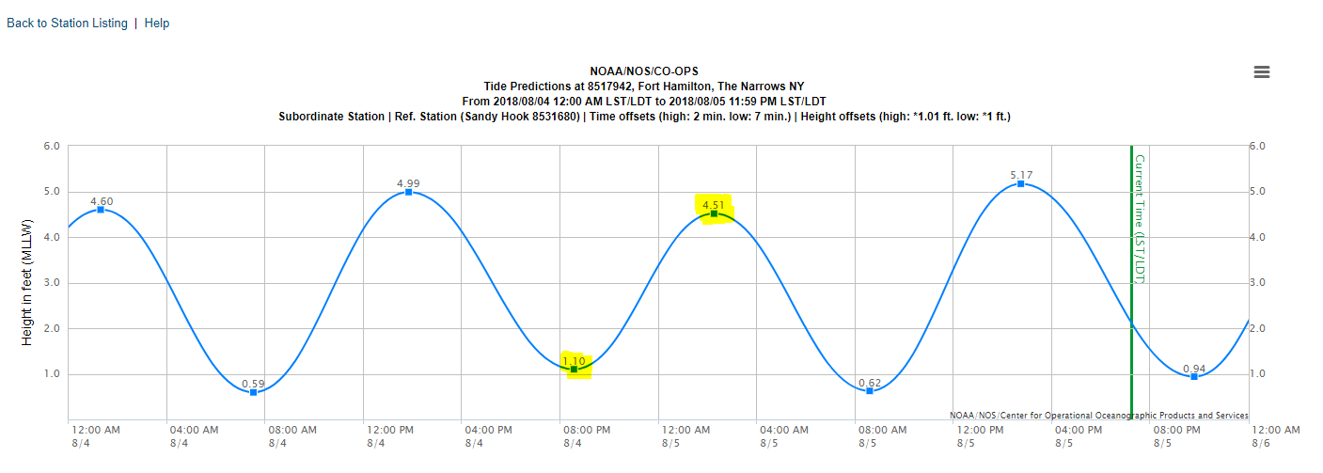
Agenda: to plot the following function using the criteria below: y(x)=A cos (B – x)+D ?
LOW TIDE: 8:33 p.m. @ 1.10 feet
HIGH TIDE: 2:15 a.m. @ 4.51 feet

Slide 3
We must first find the following three indicators of: y(x)=A cos (B – x)+D
A= Amplitude =1.705
B= Period = $\frac{π}{6}$
D= Midpoint = 2.805

Slide 4
Solving for the indicators of y(x)=A cos (B – x)+D we get:
Amplitude
Period
Midpoint
LOW: 1.10 feet
HIGH: 4.51 feet
2 $π$ = 12 HOURS
LOW: 1.10 feet
HIGH: 4.51 feet
4.51 - 1.10 = 3.41
3.41÷ 2 = 1.705
$$\left(\frac{2π}{b}\right)=\left(\frac{2π}{12}\right)=\frac{π}{6}$$
4.51 – 1.705 = 2.805
1.10 + 1.705 = 2.805
$$y\left(x\right)=1.705\cos\left(\frac{π}{6}x\right)+2.805$$

Slide 5
Cosine Graph of: y(x)=A cos (B – x)+D

Slide 6
Bibliography
“Desmos Graph.” Desmos Graphing Calculator, <www.desmos.com/calculator>
“NOAA Tides and Currennts.” Tides and Currents, NNOAA Tide Predictions, 8517942 Fort Hamilton, The Narrows, NY, https://tidesandcurrents.noaa.gov/noaatidepredictions.html?id=8517942&units=standard&bdate=20180804&edate=20180805&timezone=LST/LDT&clock=12hour&datum=MLLW&interval=hilo&action=dailychart Accessed data for 08/04/2018-08/05/2018
“Modeling Tides with Trigonometry” The Math Forum <http://mathforum.org/library/drmath/view/54163.html>

