Slide 1
Tadashi Shoji
Miranda Hiralall

Slide 2
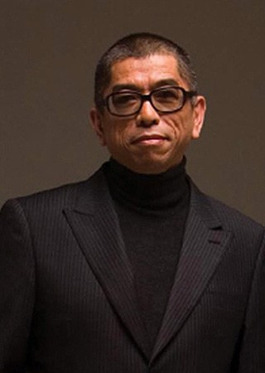
Designer
Source:http://asian-fusion.com/610/tadashi-shoji/

Slide 3
Company
Tadashi Shoji is a company headquarters in 3333 Bristol St. 3200 Las Vegas Blvd S. The company operates offices in Los Angeles and Shanghai, as well as showrooms in New York City, Tokyo, and Osaka. The Tadashi Shoji brand is carried in over 700 major department and specialty stores worldwide, with signature boutiques in the United States, Indonesia, and the Middle East. It is a company known for his evening dress and bridal collection.

Slide 4
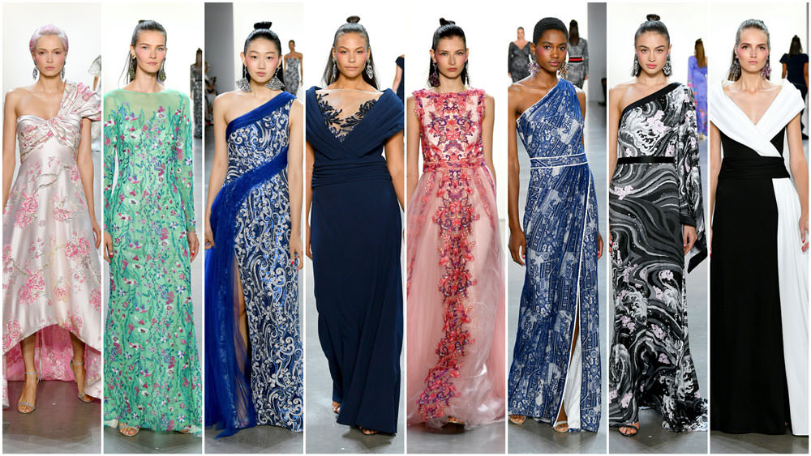
Mission Statement
Tadashi Shoji strives to push the boundaries of occasion dressing in the contemporary market while staying true to his brand's vision—beauty, ease, and enchantment, design for the spirit of celebration.

Slide 5
Analyzing Data on Instagram
Tadashishoji.com has a global rank of #111,217 which puts itself among the top 500,000 most popular websites worldwide. tadashishoji.com rank has increased 17% over the last 3 months. tadashishoji.com was launched on May 6, 2007 and is 12 years and 222 days. It reaches roughly 128,730 users and delivers about 283,230 pageviews each month. Its estimated monthly revenue is $821.40. We estimate the value of tadashishoji.com to be around $9,993.70.

Slide 6
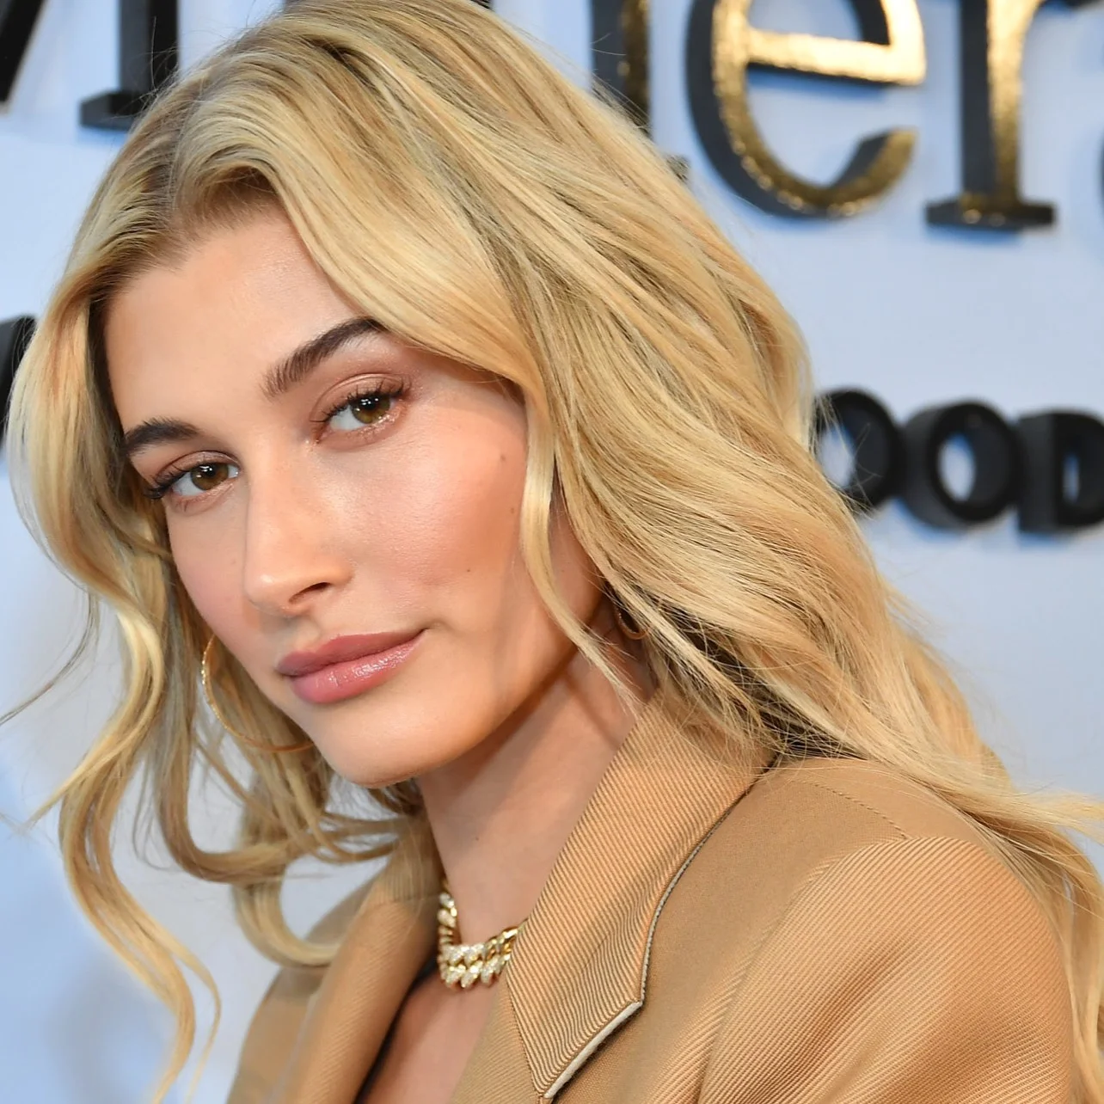
Influencer
Range of Followers: 23.8 million
Followers total: 23,847,541
Followers today: 4,947
Following total: 914
Following today: 4
Posts total: 1,813
Posts today: 0
Page views: 2,826
https://www.allure.com/story/hailey-baldwin-bieber-favorite-foundation-interview

Slide 7
Licensing with
Over the past two years, DCPI has added $11.3 billion in retail sales of licensed merchandise worldwide. The world’s No. 1 global licensor, according to License Global’s annual Top 150 Global Licensors study, reported an increase of $4.1 billion in 2016, pushing it to a record $56.6 billion in retail sales. This follows an increase of $7.2 billion in retail sales in 2015, and, in fact, over the last five years, Disney has added a remarkable $19.1 billion in retail sales of licensed merchandise worldwide, far exceeding the current combined total of its closest rivals in entertainment licensing. Over the last five years, DCPI has tripled its operating income, and it now has 11 franchises that generate more than $1 billion in retail sales worldwide under the leadership of Josh Silverman, executive vice president, global licensing, Disney Consumer Products and Interactive Media.

Slide 8
Thank You

Slide 9
Reference
Lutz, A. (2014, February 11). How Tory Burch Became A Fashion Billionaire In Less Than A Decade. Retrieved from https://www.businessinsider.com
Peterson, L., Lillie, & UC Santa Barbara. (2016, December 13). Alexander Wang on His Company's Future. Retrieved from http://www.catwalkyourself.com
Tadashi Shoji. (2019, November 29). Retrieved from https://en.wikipedia.org/wiki/Tadashi_Shoji.
Tadashi Shoji. (n.d.). Our Story. Retrieved from https://www.tadashishoji.com/about.

