Slide 1
Mental Health Issues in the Fashion Industry
Miranda Hiralall

Slide 2
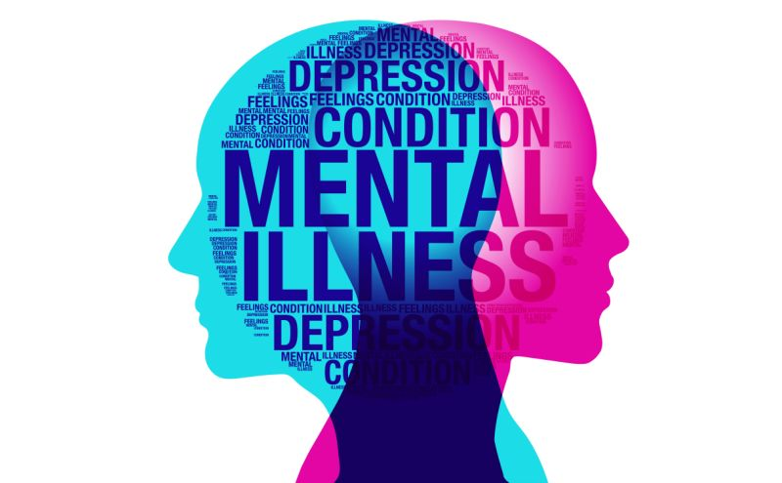
“Designers, models and journalists in fashion are also highly competitive careers where people may feel there is too much at stake to reveal perceived weakness.”
- Victoria Tischler, Psychologist and Professor at University of West London
Source: https://sg.news.yahoo.com/comment-mental-health-must-national-priority-singapore-101442243.html

Slide 3
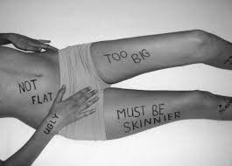
Factors that affects mental health issues in the industry.
“High pressure to be original and innovative and to work excessive hours. Constant pressure of the industry to come up with ‘next big thing’, cult of youth, and culture of working around the clock and therefore not getting enough rest that puts mental health at risk.”
“A woman’s experience of her own body arises from how she believes it compares with the magnified images of women that surround her on billboards, on television, in films, magazines and newspapers.” This statement authentically expresses the mentality brought out by women in societies all over the world when comparing their own body to unrealistic standards. This ideology of body image all starts in the minds of young girls and boys who are enveloped in a world full of impractical image standards. It’s a sense of brainwashing that most of society chooses to ignore, but as these messages grow stronger the statistics for disorders such as anorexia grow with them.

Slide 4
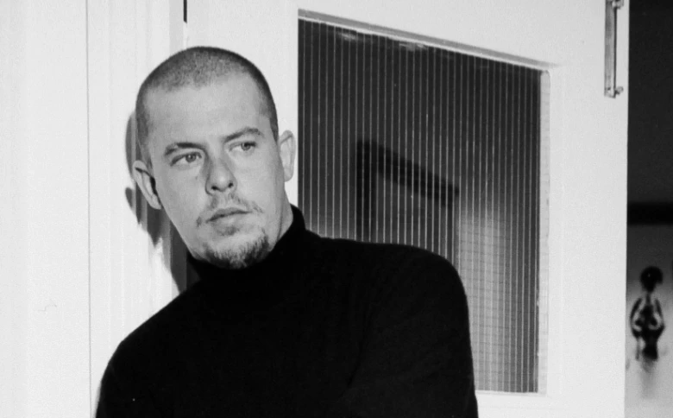
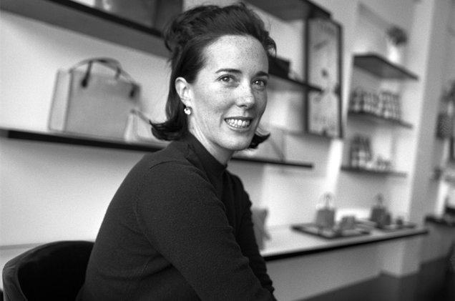
Designers who struggle with mental health issues
The fashion world was rocked in 2010 by the suicide of Alexander McQueen which led to the unveiling of his unpublicized history of depression, anxiety and insomnia. His death came three years after the suicide of fashion editor, Isabella Blow, who is credited with discovering McQueen.
Alexander McQueen
The creative mind behind the instantly recognizable feel-good bright colors and cheerful prints, Kate Spade, had been suffering from depression and anxiety for five years. “She was actively seeking help for depression and anxiety over the last five years, seeing a doctor on a regular basis and taking medication for both depression and anxiety,” her husband Andy Spade said in a statement to The New York Times.
Kate Spade

Slide 5
Is there a link between creativity and mental illness?

Slide 6
How is Creativity Associated?
Creativity reduces anxiety, depression, and stress… And it can also help you process trauma. Studies have found that writing helps people manage their negative emotions in a productive way, and painting or drawing helps people express trauma or experiences that they find too difficult to put in to words.
According to scientists like Andreasen and other researchers, it’s the former. People who are more creative tend to think more about small details, making connections and replaying images and scenes in their head to gain a better understanding of their world. This kind of thinking allows them to produce new and innovative ideas.

Slide 7
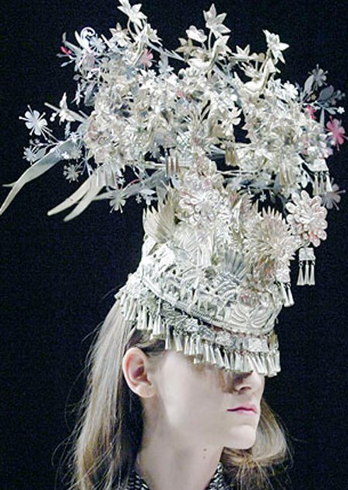
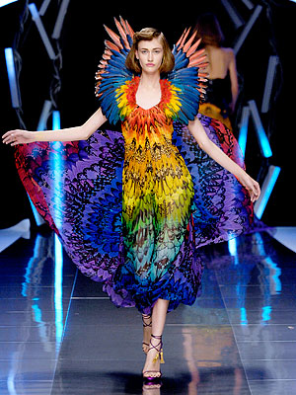
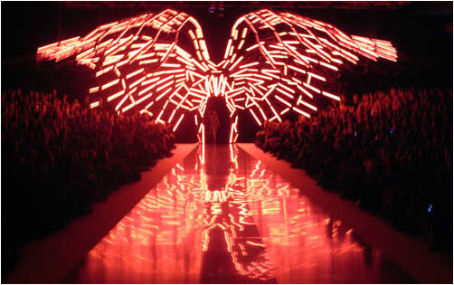
For Example: Alexander McQueen : S/S 2008 Isabella Blow Tribute
“I would go to the end of my dark side and pull these horrors out of my soul and put them on the catwalk,”
Source:https://mcqsavagebeauty.weebly.com/blog/mcqueens-process-of-creativity

Slide 8
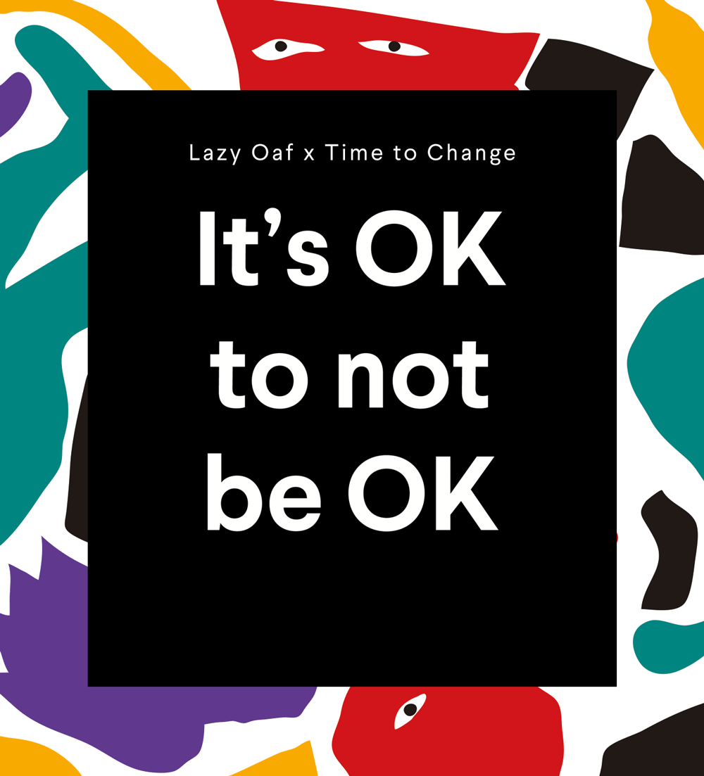
Fashion Awareness on Mental Health:
The collection aims to start a conversation surrounding mental health. The brand collaborated with Time To Change, a UK non-profit organisation that aims to end mental health discrimination. Lazy Oaf have recruited five different artists and illustrators from around the world to create a capsule featuring 7 styles across t-shirts, trousers and totes.
Lazy Oaf aims to “raise awareness, change attitudes and encourage speaking up about mental health through various forms of creative expression.”
“I wanted to create a project to address something that affects me and many people that I know,” shared Gemma Shiel, Founder and Creative Director of Lazy Oaf. “Creativity and mental health are intrinsically linked in my world. I lose myself in creativity, for me, it is where I find a source of therapy, it’s often how I communicate and it is my safety net.”
London streetwear brand called Lazy Oaf
Source:https://dontboreus.thebrag.com/lazy-oaf-mental-health/

Slide 9
Conclusion
Based on my research I concluded that the fashion industry mental health issues help to develop creativity. Creative people have long been associated with mental illness. But the real question is, does the creative industry attract such individuals or does it create them? Alexander McQueen was a perfect example to show how his emotions express into his work. He knew how to detail his work based on his lost friend. He was always this detail oriented person but using his emotions help to boost his designs. As of the fashion industry today it has been more aware of mental health issues. It helps to send a positive message out and create good content for their consumers.

Slide 10
References
Acollins.wwd. (2019, May 15). How Beauty and Fashion Brands Are Shining a Spotlight on Mental Health. Retrieved from https://wwd.com/business-news/business-features/how-beauty-and-fashion-brands-are-shining-a-spotlight-on-mental-health-1203128013/.
Bobb, B. (2018, August 29). Finally, a Holistic Approach to Combating Mental Health Issues in the Fashion Industry. Retrieved from https://www.vogue.com/article/humans-of-fashion-app-mental-health.
Cox, A. (2016, November 22). "How the Fashion Industry Affects the Bodies of Young Women". Retrieved from https://medium.com/@analisa97/how-the-fashion-industry-affects-the-bodies-of-young-women-2c735fc6cec7.
Davis, S., & Ihnatova, N. (2018, October 7). Mental Health in the Fashion Industry Has Us Going Crazy. Retrieved from https://nygal.com/mental-health-in-the-fashion-industry-has-us-going-crazy/.

