Slide 1
By Haruhi Kato, Minji Kim,
Miranda Hiralall, Moeko Hashimoto

Slide 2
About Diesel
Mission Statement
“to create an apparel line perfect for individual people who follow their own unique path in life and for those style matters who express their individuality by the way they dress”
Brand Audit
Factors suffering bankruptcy:
Mainly focus on Denim
Not trendy and high price
Wasted a large amount of money on Flagship store events/parties
Suffered multiple incidents (thefts and frauds) over the past three years
An Italian luxury brand, located in Breganze, Italy and founded in 1978
Two different lines-Diesel and Diesel Black Gold
Offers clothing, footwear, and accessories, but mainly focuses on denim under each line
An innovative lifestyle company producing a wide- ranging collection of jeans, clothing and accessories
Embodies modernity, creativity, bravery, anticonformity.
Vision Statement
“to bring back the business they once had before”

Slide 3
Background
In 1994, Supreme opened its first store on Lafayette Street in downtown Manhattan became the home of New York City skate culture. Supreme grew to embody downtown culture, such as skaters, punks, hip-hop heads.
The 4ps
PLACE/ Limited quantity and boutique style
PRICE/$ 50-$200
PRODUCT/Luxury male streetwear
PROMOTION/Celebrity Endorsement
Consumer Segmentation
Demographic
Psychographic
16-35 years old males who along with male teenage skaters
Later, developed female after increasing female skate culture
Interest on urban hip hop music
A creative personality and interest on both fashion and art
Tech savvy and enjoy social media

Slide 4
Background
Ihe palace was launched by Lev Tanju born in London has started their business in 2009. They have developed alongside the similar street brand such as Supreme, Stussy, and Bape for nine years. The palace gets inspiration from skating and popular culture.
The 4ps
PLACE/ Online store and shops in urban city
PRICE/$50-$250
PRODUCT/Simple styles, reflecting aesthetic of Palace and its identity
PROMOTION/Collaborations with other brands(Umbro, Reebok, and Adidas)
Consumer Segmentation
Demographic
Psychographic
16-30 years old males who along with male teenage skaters.
Expanding to female who likes street wear
Interest on 90’s pop culture, fashion and art
Enjoy Instagram and social media.

Slide 5
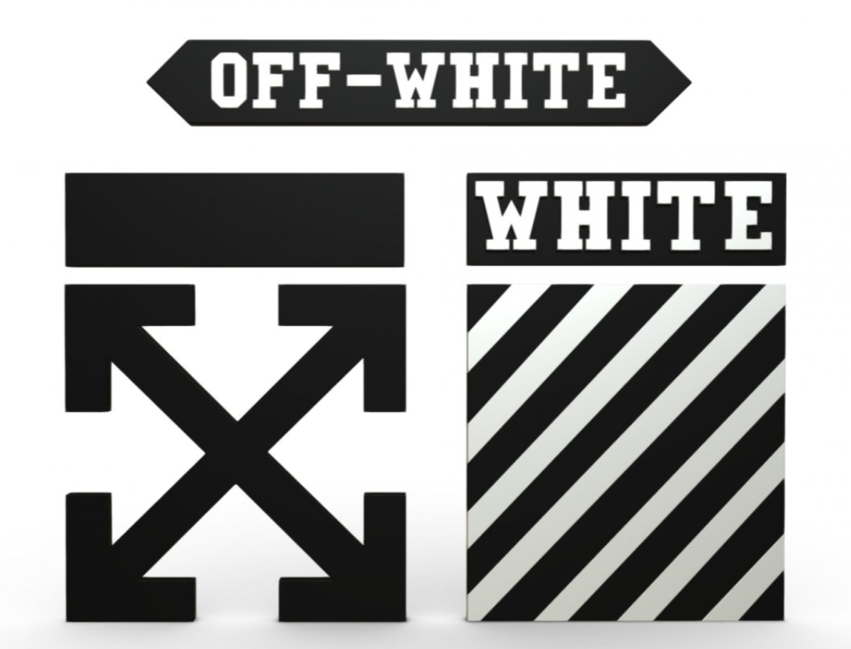
Background
Off-White is a luxury streetwear fashion brand based in Milan in 2013. The founder of Off-White, Virgil Abloh, explained the brand as “the grey area between black and white as the color Off-White”
The 4ps
PLACE / Pop-up store in the world
PRICE/$ 300-$800
PRODUCT/ The highest quality clothing with innovative design
PROMOTION/AIDA models and collaboration
Consumer Segmentation
Demographic
Psychographic
25-35 years old male
Off-White uses mass marketing and mass customization. By using social media effectively, especially they focus on youth generation
Enthusiastic fashion people
Someone likes trend and innovative fashion, rather than fashion follower.
Tech savvy and enjoy Instagram and social media.

Slide 6
Target Marketing
Demographic
Age:16-35 years old
Gender: Male and female
Ethnicity: All ethnic people living in urban
Marital status: Single or married but no kids
Occupation: College Students who have part time job or internship or Full-time workers
Income: Over 12K for students
Over 40K for full-time workers
Psychographics
Interests on art; Photography, architecture, museums, sculptures, or paintings
Love music: Pop, R&B
Fashion enthusiasm: People always check fashion magazine, fashion post on Instagram, and other medias about fashion.
Strong desire for self-actualization
Esteem for celebrities or high brand
Tech savvy: Use of several social media and check over five times in a day

Slide 7
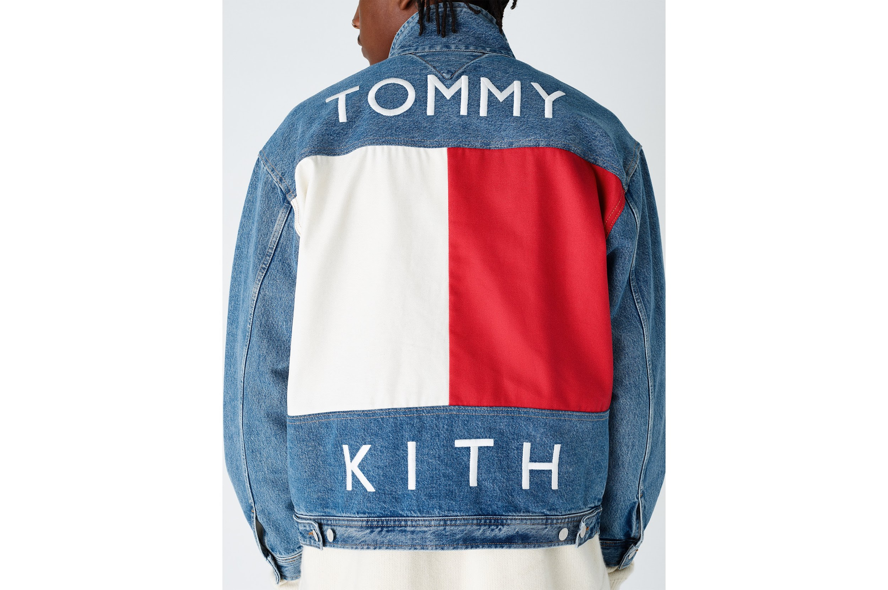
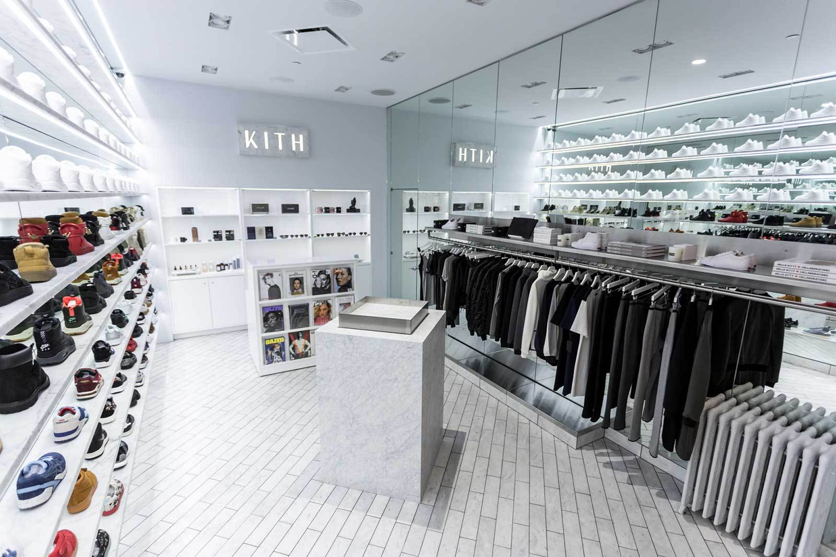
Brand Repositioning, Relaunching,
and Revitalization
Growth Strategy
Co-branding with KITH
Diesel needs a brand which is something very unique, new, and has diverse lines, but has collaborated with many brands

Slide 8
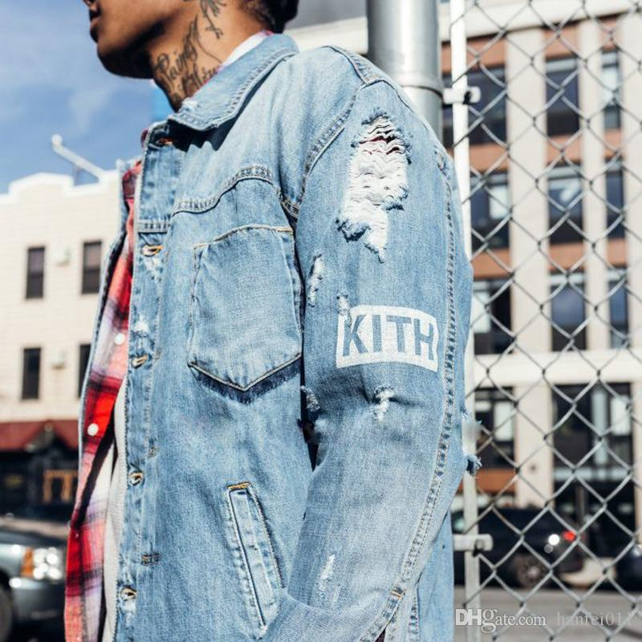
Brand Repositioning, Relaunching,
and Revitalization
About KITH
KITH has expanded to eight locations in fashion capital cities such as Los Angeles, Miami and London as well as an online store. KITH sells a range of its own apparel, footwear and accessories. Especially the brand is known for collaborations with a number of renowned streetwear brands and major athleisure brands such as PUMA, ASICS, New Balance and more. Many of collaborations bearing the KITH name have proved popular, leading to recurring collaborations. Recently KITH collaboration expanded into luxury markets and even beauty industry to help brands repositioning into streetwear trend and market younger demographic.

Slide 9
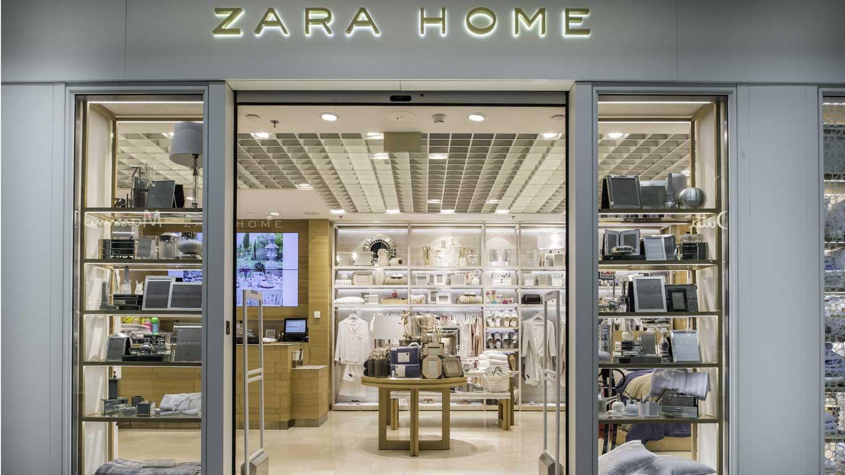
Proposal
Co-branding with KITH
Change Brand Image from Luxury to Premium
: As Diesel actually offers its systems as Premium, its luxury image is not matched
Brand Extension
: Mainly focus on denim, but since customers’ interest and lifestyle are changed, need to expand from denim to Home:
-Furniture; sofa, table, etc
-Stuff for kitchen, bathroom, living room, and bedroom

Slide 10
Editorial Ad Campaign
($250,000)
Advertising (Digital)
: Hypebeast (Cost per page: $4,000),
Highsnobiety
: Focus on keeping the same image of Diesel which is a message of showing originality and personality.
In-store Party/Event ($50,000)
: Heavily focuses on its flagship store events/Parties;
-For opening new flagship stores in big cities in countries. E.g) Re-opening a store in Dusseldorf, Germany
-For Diesel Black Gold flagship store cocktail parties for new collections
E.g) in London, UK in 2014
Influencers
: -Micro influencer : Anna Nadim Saber
Cost per post: $800
-Macro influencer : Luka Sabbat
Cost per post: $4000

Slide 11
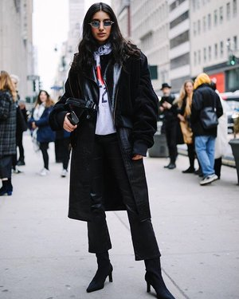
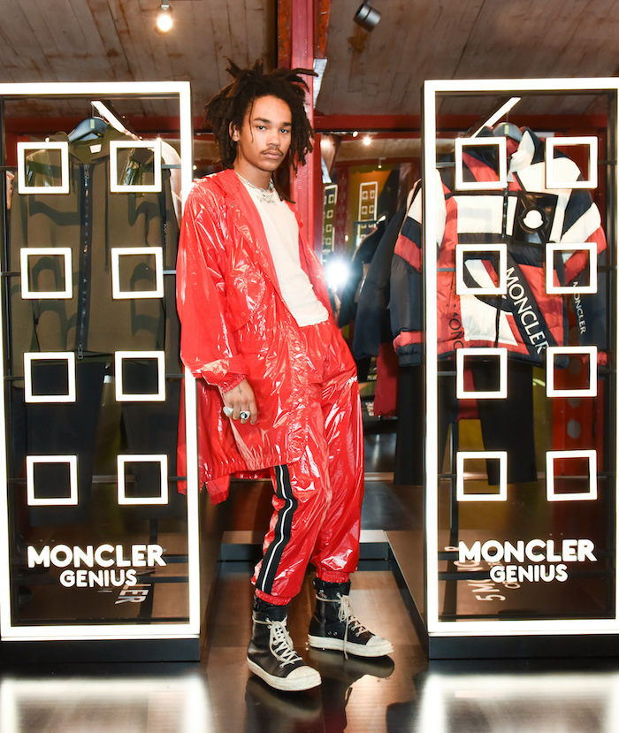
- Micro influencer : Anna Nadim Saber
- Followers: 24.2K
- Niche: Fashion
- Cost per post: $800
- Macro influencer : Luka Sabbat
- Followers: 1.8M
- Niche: Fashion
- Cost per post: $4000

Slide 12
for Diesel!

