Slide 1
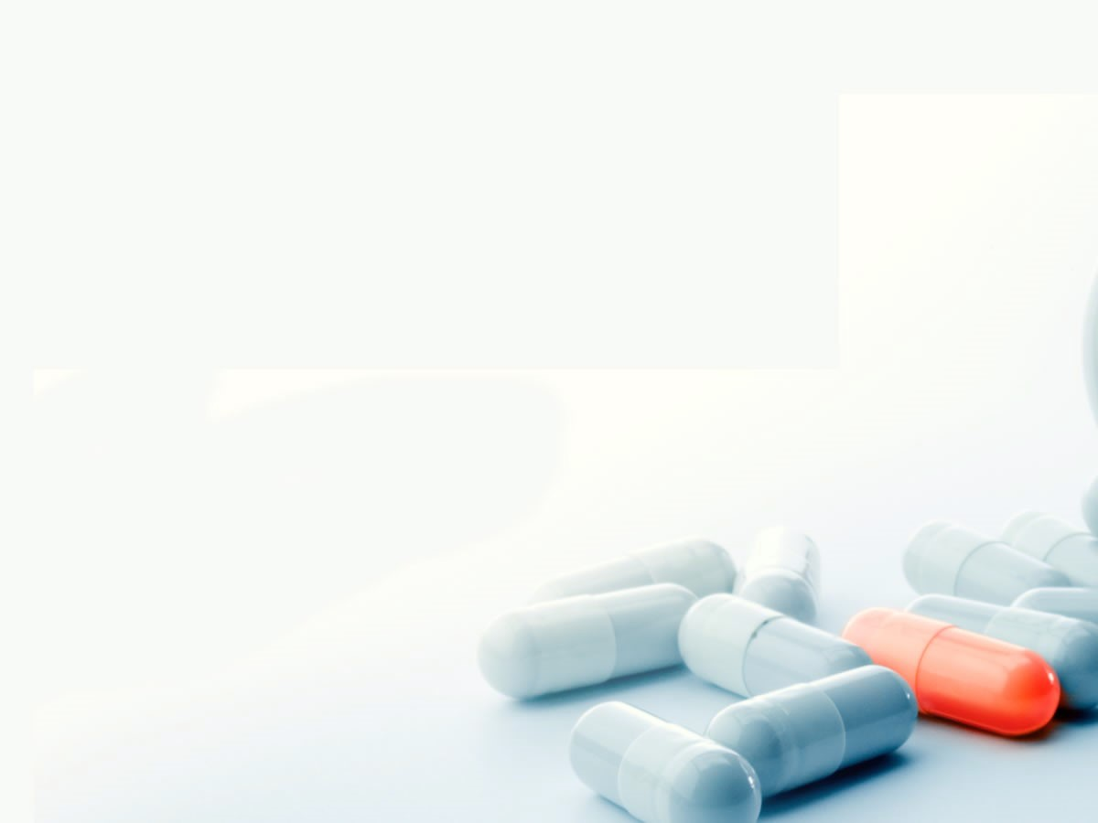
Systemic and Topical Antifungal Medications
Systemic and Topical Antifungal Medications
Cristiane Del Cioppo
Meily Gomez
Mindy Huang
Mary Lewis
Rebekah Philogene

Slide 2
Introduction
First antifungal drugs:
Until the late 1940’s fungal infections were treated with potassium iodide
Nystatin discovered on 1949 by E. Hazen and R. Brown¹
“Systemic antifungal chemotherapy effectively began with the introduction of amphotericin B-deoxycholate in 1958 by Squibb Laboratories”²
1969 -the discovery of azole antifungal agents
1990 - introduction of fluconazole, excellent oral bioavailability; lower risk of drug interactions and toxicity in critically ill patients²
2002 - The introduction of the broader-spectrum triazoles voriconazole
2006 - posaconazole²
The echinocandins were the newest class of antifungal drugs developed³
¹ Thomas M. Daniel, Gerald L. Baum. Drama and Discovery: The Story of Histoplasmosis. Greenwood Publishing Group, 2002 .Pag.116
²Russell E. Lewis. Current Concepts in Antifungal Pharmacology. Mayo Clin Proc. 2011 Aug; 86(8): 805–817. http://www.ncbi.nlm.nih.gov/pmc/articles/PMC3146381/
³E.Doods S2006. Pharmacology of Systemic Antifungal Agents. The Infectious Diseases Society of America 2006
http://cid.oxfordjournals.org/content/43/Supplement_1/S28.full
Meily Gomez

Slide 3
TOPICAL AND SYSTEMIC ANTIFUNGAL DRUGS
Topical Antifungal Drugs
Are applied in direct contact with the skin and mucous membranes
Applied in the form of creams, oils, shampoos, gels, sprays, pessaries and solutions
Have direct interaction with the fungus¹
Systemic Antifungal Drugs
Required for:
-Extensive or severe fungal infection
-Resists topical antifungal therapy
Available in tablets, capsule and injectable forms
Systemic drugs work best when there is a steady dosage in the body
¹Dupont B .Use of topical antifungal. Agents. 2006 May-Jun;61(3):251-4. gov. http://www.ncbi.nlm.nih.gov/pubmed/16989127
Meily Gomez

Slide 4
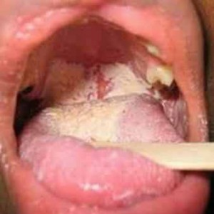
Diseases AND Conditions treated
OROPHARYNGEAL CANDIDIASIS (Candida albicans)
1. Acute Pseudomembranous Candidiasis (Thrush)
• white plaque that is easily wiped off with gauze, leaving a red, raw, bleeding connective tissue surface
• associated with uncontrolled diabetes, immunocompromised patients, use of broad-spectrum antibiotics, young children, older adults and pregnant women
• Tx: topical anti-fungal agents
Weinberg, Mea A., Cheryl M. Westphal. Theile, and James Burke. Fine. Oral Pharmacology for the Dental Hygienist. 2nd ed. p. 139-155. Boston: Pearson, 2013.
Cristiane Del Cioppo

Slide 5
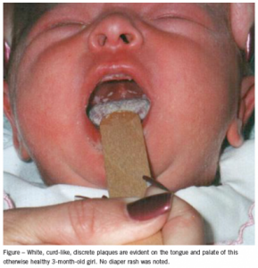
Diseases AND Conditions treated
1. Acute Pseudomembranous Candidiasis (Thrush), continued
Children:
• incidence in infants of 5% to 10%
• it may start as early as seven days after birth
• newborns do not have an established oral flora or fully developed immune system
• response to treatment in neonates is usually good, but a prolonged course may be required
• recurrences are common
• use of an infant soother increases the incidence of thrush
• Tx: Nystatin suspension is well tolerated and is used frequently; however, first generation imidazoles (ex: miconazole) are more effective than Nystatin
• second generation imidazoles (ex: fluconazole) may be considered if conventional topical treatments fail, especially among immunocompromised patients
http://www.ncbi.nlm.nih.gov/pmc/articles/PMC2532582/
Cristiane Del Cioppo

Slide 6
Diseases AND Conditions treated
1. Acute Pseudomembranous Candidiasis (Thrush), continued
HIV/AIDS Patients:
• oral yeast colonization and symptomatic infections remain common in patients with HIV/AIDS, even with ART (antiretroviral therapy)
• major cause of HIV-related mortality globally
• 1 million deaths annually
• 50% of all AIDS-related deaths
• C. albicans is the most common species isolated in patients
• clinical outcomes with fluconazole were favorable although higher doses are needed due to resistance to medication
Patel, Payal K., et. al. “The Changing Epidemiology of Oropharyngeal Candidiasis in Patients with HIV/AIDS in the Era of Antiretroviral Therapy.” AIDS Research and Treatment, 2012 (2012): n. pag. Web. 30 July 2016.
Armstrong-James, Darius, Graeme Meintjes, and Gordon D. Brown. “A Neglected Epidemic: Fungal Infections in HIV/AIDS.” Trends in Microbiology, Vol. 22 (3), 2014: 120-27. Web. 30 July 2016.
Cristiane Del Cioppo

Slide 7
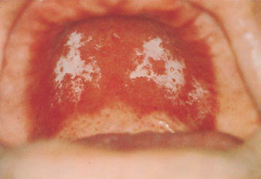
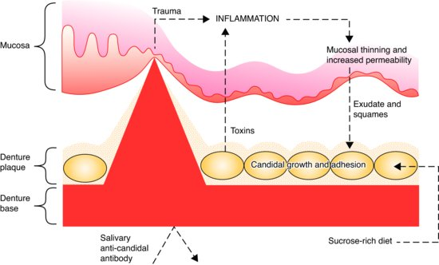
Diseases AND Conditions treated
2. Chronic Atrophic Candidiasis (Denture mouth sore / Denture-related stomatitis)
• maxillary denture
• not painful, ranging from red spots in the palate (mild form) to an entire red palate (severe cases), outlining the shape of the denture
• associated with patients that do not remove the dentures to clean regularly
• Tx: topical anti-fungal agents
Weinberg, Mea A., Cheryl M. Westphal. Theile, and James Burke. Fine. Oral Pharmacology for the Dental Hygienist. 2nd ed. p. 139-155. Boston: Pearson, 2013.
Cristiane Del Cioppo

Slide 8
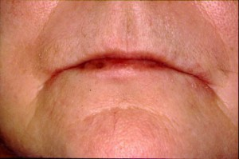
Diseases AND Conditions treated
3. Angular Cheilosis or Angular Cheilitis
• commissures of the lips
• also associated with B-vitamin complex deficiency
• moist skin folds due to a decrease in vertical dimension, causing drooling and overclosure
• Tx: topical anti-fungal agents
Weinberg, Mea A., Cheryl M. Westphal. Theile, and James Burke. Fine. Oral Pharmacology for the Dental Hygienist. 2nd ed. p. 139-155. Boston: Pearson, 2013.
Cristiane Del Cioppo

Slide 9
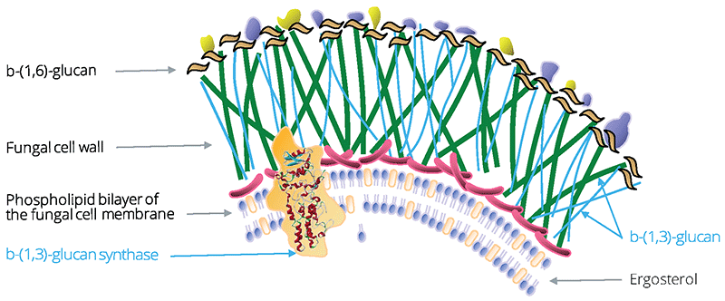
How do these drugs work?
The Fungal Cell Wall
• Mostly consists of interwoven chitin and glycoprotein chains
• Contains ergosterol, which plays the same role as cholesterol in the human plasma membrane. It helps to regulate the fluidity, asymmetry, and integrity of the cell wall. It also has a hormone-like role (it stimulates growth).
Bowman, S., & Free, S. (2006). The structure and synthesis of the fungal cell wall. BioEssays, 28(8), 799-808.
Mindy Huang

Slide 10
How do these drugs work?
Polyene Antifungal Agents
• Fungicidal (kills fungal cells)
• Binds to ergosterol and forms complexes which disrupts the cell membrane. This causes the leakage of essential cellular components and leads to cell death.
• Has a greater affinity for ergosterol than cholesterol, which increases its selectivity and reduces adverse effects.
• Examples: Nystatin, Amphotericin B
Bowman, S., & Free, S. (2006). The structure and synthesis of the fungal cell wall. BioEssays, 28(8), 799-808.
Kathiravan, Muthu K, Salake, Amol B, Chothe, Aparna S, Dudhe, Prashik B, Watode, Rahul P, Mukta, Maheshwar S, & Gadhwe, Sandeep. (2012). Biology and chemistry of antifungal agents: A review. Bioorganic & Medicinal Chemistry, 20(19), 5678-5698.
http://www.ncbi.nlm.nih.gov/books/NBK8263/
https://www.researchgate.net/profile/Alistair_Brown3/publication/10693167_Antifungal_agents_mechanisms_of_action_TRENDS_in_Microbiology/links/0046353ba508c3da86000000.pdf
Mindy Huang

Slide 11
How do these drugs work?
Azole Antifungal Agents
• Fungistatic (inhibits fungal growth)
• Disrupts the synthesis of ergosterol by targeting cytochrome P-450-dependent enzymes (CYP51P)
• Alters the permeability and fluidity of the cell wall; also interrupts membrane functions, such as cell wall synthesis.
• Examples: Ketoconazole, Clotrimazole, Fluconazole
Bowman, S., & Free, S. (2006). The structure and synthesis of the fungal cell wall. BioEssays, 28(8), 799-808.
Kathiravan, Muthu K, Salake, Amol B, Chothe, Aparna S, Dudhe, Prashik B, Watode, Rahul P, Mukta, Maheshwar S, & Gadhwe, Sandeep. (2012). Biology and chemistry of antifungal agents: A review. Bioorganic & Medicinal Chemistry, 20(19), 5678-5698.
http://www.ncbi.nlm.nih.gov/books/NBK8263/
https://www.researchgate.net/profile/Alistair_Brown3/publication/10693167_Antifungal_agents_mechanisms_of_action_TRENDS_in_Microbiology/links/0046353ba508c3da86000000.pdf
Mindy Huang

Slide 12
How do these drugs work?
Flucytosine
• Fungistatic
• Effective only against pathogenic yeasts, such as Candida albicans
• Not used as primary therapy due to narrow spectrum; used in adjunctive therapy with Amphotericin B
• Inhibits DNA synthesis by incorporating into RNA and causing premature chain termination.
Bowman, S., & Free, S. (2006). The structure and synthesis of the fungal cell wall. BioEssays, 28(8), 799-808.
Kathiravan, Muthu K, Salake, Amol B, Chothe, Aparna S, Dudhe, Prashik B, Watode, Rahul P, Mukta, Maheshwar S, & Gadhwe, Sandeep. (2012). Biology and chemistry of antifungal agents: A review. Bioorganic & Medicinal Chemistry, 20(19), 5678-5698.
http://www.ncbi.nlm.nih.gov/books/NBK8263/
https://www.researchgate.net/profile/Alistair_Brown3/publication/10693167_Antifungal_agents_mechanisms_of_action_TRENDS_in_Microbiology/links/0046353ba508c3da86000000.pdf
Mindy Huang

Slide 13
How do these drugs work?
Echinocandins
• Fungicidal
• Inhibits synthesis of fungal cell wall β-1, 3 glucan polysaccharides
• Causes swelling of the cell wall and lysis
• Minimal toxicity since their target doesn’t exist in mammalian cells.
• Examples: Caspofungin, Micafungin
Bowman, S., & Free, S. (2006). The structure and synthesis of the fungal cell wall. BioEssays, 28(8), 799-808.
Kathiravan, Muthu K, Salake, Amol B, Chothe, Aparna S, Dudhe, Prashik B, Watode, Rahul P, Mukta, Maheshwar S, & Gadhwe, Sandeep. (2012). Biology and chemistry of antifungal agents: A review. Bioorganic & Medicinal Chemistry, 20(19), 5678-5698.
http://www.ncbi.nlm.nih.gov/books/NBK8263/
https://www.researchgate.net/profile/Alistair_Brown3/publication/10693167_Antifungal_agents_mechanisms_of_action_TRENDS_in_Microbiology/links/0046353ba508c3da86000000.pdf
Mindy Huang

Slide 14
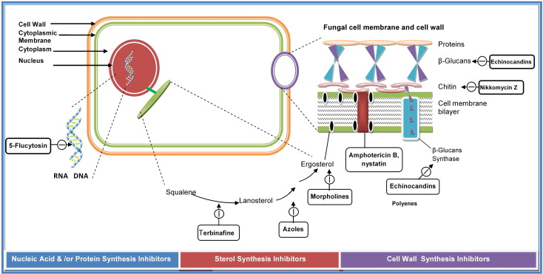
How do these drugs work?
Mindy Huang

Slide 15
Antifungal medications
Ingredients of Antifungal Medications
Clioquinol 3%;
Miconazole nitrate 2%;
Haloprogin 1%;
Povidone-iodine 10%;
Tolnaftate 1%;
Clotrimazole 1%;
Calcium undecylenate;
Undecylenic acid;
Copper undecylenate;
Zinc undecylenate.
Antifungal medications are drugs which interfere with the reproduction and growth of fungal cells; they also decrease the number of already present fungi.
Mary Lewis

Slide 16
Brand and generic names
Topical Antifungal
drugs:
Mycostatin, Nilstat (Nystatin Cream);
Lotrimin, Mycelex (Clotrimazole 1% Cream).
Systemic antifungal drugs (oral):
Diflucan (Fluconazole);
Sporanox (Itraconazole);
Nizoral (Ketoconazole);
Ancobon (Flucytosine);
Noxafil (Posaconazole);
Vfend (Voriconazole oral).
Mary Lewis

Slide 17
Mechanism of action/interactions
Interactions with:
benzodiazepines;
cyclosporin;
cimetidine;
hydrochlorothiazide;
oestrogens and progestogens;
phenytoin;
rifampicin;
cyclosporine and tacrolimus;
theophylline;
tricyclic antidepressants;
zidovudine.
Mary Lewis
MOA:
Antifungal drugs interfere with cell wall integrity;
inhibit 1.3 beta-D-glucan synthase

Slide 18
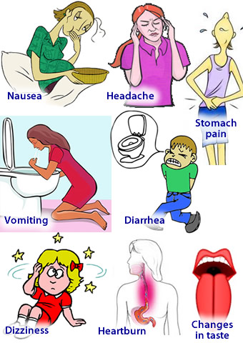
Major adverse/oral effects of antifungal medications
Nystatin (Systemic)
Gastrointestinal: Diarrhea, mild stomach upset, nausea
Nystatin (Topical)
Dermatitis
Stevens-Johnson syndrome
Nystatin and Triamcinolone (Topical)
Burning, Itching, Irritation
Dermatologic: acne, allergic dermatitis, dryness, folliculitis (inflammation of hair follicles), hypertrichosis (excessive hair growth), hyperpigmentation, perioral dermatitis
Increased incidence of secondary infection
References: Drug Information Handbook for Dentistry Hygienist, 21 Edition
https://s-media-cache-ak0.pinimg.com/236x/10/06/5b/10065b67bbe779a905ebdff14cef4f24.jp g
Rebekah Philogene

Slide 19
Major adverse/oral effects of antifungal medications
Amphotericin B (Conventional)
CNS: fever, chills, headache, generalized pain,
Gastrointestinal: Anorexia
Hematologic: Anemia
Renal: Nephrotoxicity
Endocrine & metabolic: Hypokalemia (potassium deficiency), hypomagnesemia (magnesium deficiency)
Clotrimazole (Topical)
Hepatic: Abnormal liver function
Dermatologic: Pruritus (severe itching)
Gastrointestinal: Nausea, vomiting
References: Drug Information Handbook for Dentistry Hygienist, 21 Edition
http://www.everydayhealth.com/rheumatoid-arthritis/treatment/ra-medication-side-effects/
http://www.essentialoilspedia.com/wp-content/uploads/stomach_ache_woman.jpg
Rebekah Philogene

Slide 20
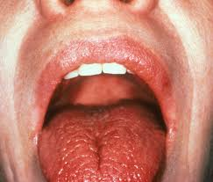
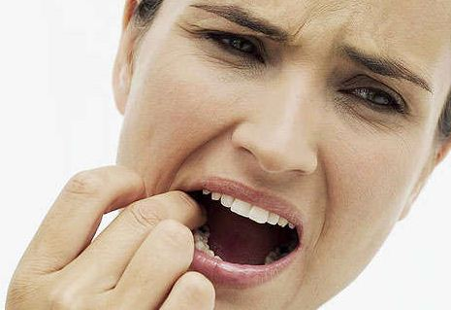
Major adverse/oral effects of antifungal medications
Ketoconazole (Topical)
Stinging, local burning
Contact dermatitis, discharge
Dizziness, dryness, facial swelling, erythema, headache
Ocular irritation/swelling, pustules, pyogenic granuloma (benign vascular lesions of the skin)
Ketoconazole (Systemic)
Gastrointestinal: nausea/vomiting/abdominal pain
Dermatologic: Pruritus (severe itching)
References: Drug Information Handbook for Dentistry Hygienist, 21 Edition
http://img.medscape.com/pi/emed/ckb/rheumatology/329097-1339496-332125-1582480.jpg
http://www.usefulhomeremedies.com/wp-content/uploads/2014/11/Tooth-Ache-home-remedy.jpg
Rebekah Philogene

Slide 21
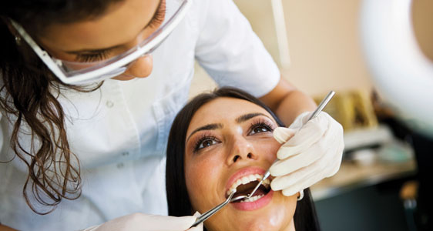
Major adverse/oral effects of antifungal medications
Fluconazole (Systemic)
CNS: Headache and dizziness
Gastrointestinal: Nausea, abdominal pain, vomiting, diarrhea
Dermatologic: Rash
Abnormal taste
Iitraconazole (Systemic)
Gastrointestinal: Diarrhea, constipation, bloating, mild nausea
CNS: Headache, dizziness
Dermatologic: mild itching or skin rash
Joint/muscle pain, abnormal taste
References: Drug Information Handbook for Dentistry Hygienist, 21 Edition
http://www.digitaldentalmagazine.com/wp-content/uploads/2014/06/oral-care.jpg
http://dailyplateofcrazy.com/wp-content/uploads/2012/08/Young-Woman-with-Headache.png
Rebekah Philogene

Slide 22
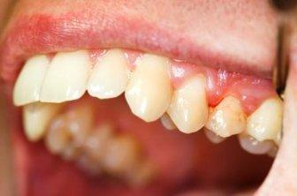
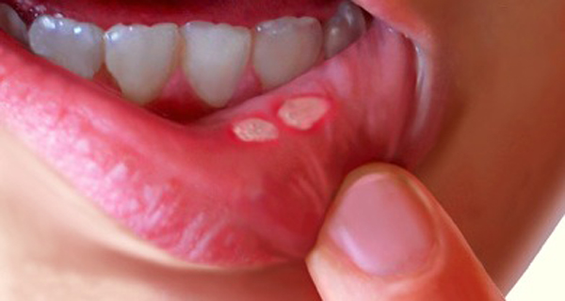
effects of antifungal medications on dental treatment
Miconazole (Systemic)
Application site reactions include burning, discomfort, edema, glossodynia (burning sensation in the mouth), pain, pruritus (severe itching), toothache, ulceration, abnormal taste and xerostomia, oral discomfort
CNS: Headache, fatigue
Gastrointestinal: Diarrhea, nausea, vomiting, abnormal taste
References: Drug Information Handbook for Dentistry Hygienist, 21 Edition
http://www.healthyveganstyle.com/wpcontent/uploads/2015/10/cankersore_Mouth_ulcer.jg
https://s3.amazonaws.com/healthtap-public/ht-staging/user_answer/avatars/289150/large/open-uri20120709-25963-1b9kwm8.jpeg?1357699484
Rebekah Philogene

Slide 23
references
Thomas M. Daniel, Gerald L. Baum. Drama and Discovery: The Story of Histoplasmosis. Greenwood Publishing Group, 2002 .Pag.116
Russell E. Lewis. Current Concepts in Antifungal Pharmacology. Mayo Clin Proc. 2011 Aug; 86(8): 805–817. http://www.ncbi.nlm.nih.gov/pmc/articles/PMC3146381/
E.Doods S2006. Pharmacology of Systemic Antifungal Agents. The Infectious Diseases Society of America 2006 http://cid.oxfordjournals.org/content/43/Supplement_1/S28.full
Dupont B .Use of topical antifungal. Agents. 2006 May-Jun;61(3):251-4. gov. http://www.ncbi.nlm.nih.gov/pubmed/16989127
Weinberg, Mea A., Cheryl M. Westphal. Theile, and James Burke. Fine. Oral Pharmacology for the Dental Hygienist. 2nd ed. p. 139-155. Boston: Pearson, 2013.
http://www.ncbi.nlm.nih.gov/pmc/articles/PMC2532582/
Patel, Payal K., et. al. “The Changing Epidemiology of Oropharyngeal Candidiasis in Patients with HIV/AIDS in the Era of Antiretroviral Therapy.” AIDS Research and Treatment, 2012 (2012): n. pag. Web. 30 July 2016.

Slide 24
References
Armstrong-James, Darius, Graeme Meintjes, and Gordon D. Brown. “A Neglected Epidemic: Fungal Infections in HIV/AIDS.” Trends in Microbiology, Vol. 22 (3), 2014: 120-27. Web. 30 July 2016.
Weinberg, Mea A., Cheryl M. Westphal. Theile, and James Burke. Fine. Oral Pharmacology for the Dental Hygienist. 2nd ed. p. 139-155. Boston: Pearson, 2013.
Bowman, S., & Free, S. (2006). The structure and synthesis of the fungal cell wall. BioEssays, 28(8), 799-808.
Kathiravan, Muthu K, Salake, Amol B, Chothe, Aparna S, Dudhe, Prashik B, Watode, Rahul P, Mukta, Maheshwar S, & Gadhwe, Sandeep. (2012). Biology and chemistry of antifungal agents: A review. Bioorganic & Medicinal Chemistry, 20(19), 5678-5698.
http://www.ncbi.nlm.nih.gov/books/NBK8263/
https://www.researchgate.net/profile/Alistair_Brown3/publication/10693167_Antifungal_agents_mechanisms_of_action_TRENDS_in_Microbiology/links/0046353ba508c3da86000000.pdf
Antifungal Medicines - Side effects & interactions - NHS Choices. 2016. http://www.nhs.uk/Conditions/Antifungal-drugs/Pages/Side-effects.aspx

Slide 25
references
Kalyoussef, S. Pediatric Candidiasis Medication. Emedicine.medscape.com. 2016. http://emedicine.medscape.com/article/962300-medication
Food and Drug Administration. Antifungal Active Ingredients. 2004. http://www.fda.gov/ohrms/dockets/ac/04/briefing/4036b1_07_final%20monographtopical.pdf
Drug Information Handbook for Dentistry Hygienist, 21 Edition

