Slide 1
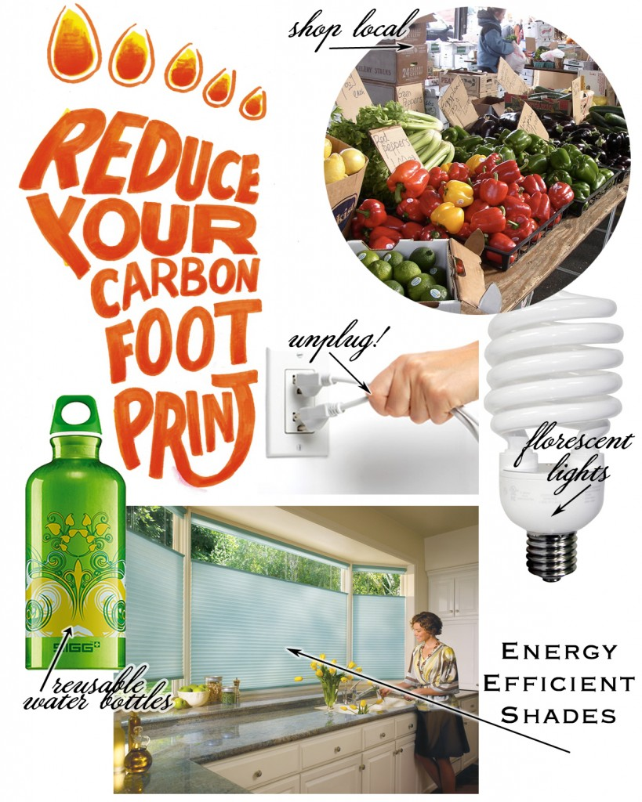
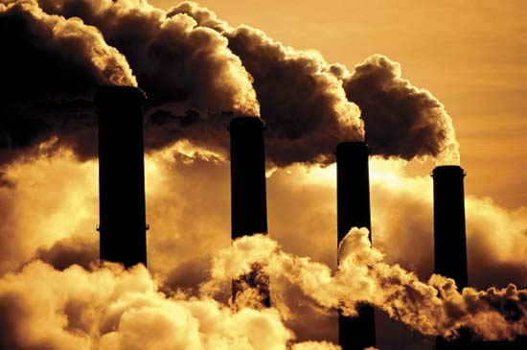
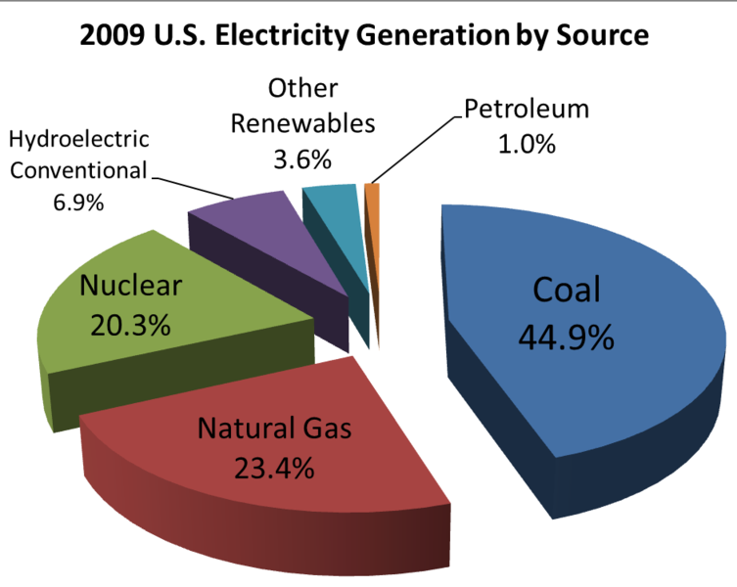
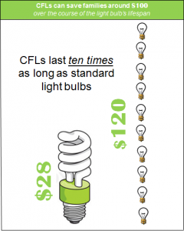
Energy Consumption Maria Fuzailov and Vicky Syatkina
Following our experiment we successfully concluded that our data reflects our initial hypothesis. By making slight alterations in our homes, such as switching our incandescent light bulbs to compact fluorescent ones, we are capable of significantly reducing the amount of carbon dioxide emitted each year. The lights in NYC take up roughly 33% of all carbon gases emitted annually, by switching to energy saving light bulbs we can reduce that to anywhere between 28 and 19%. Approximately 1190049.622 pounds of carbon dioxide is produced by New York City based society each year, the light we consume can decrease this number to about 261810.9168 pounds of carbon dioxide. Generally, aside from saving us a substantial amount of money (approximately 13-25$ a year, more or less) we greatly benefit our environment.
Following our experiment we successfully concluded that our data reflects our initial hypothesis. By making slight alterations in our homes, such as switching our incandescent light bulbs to compact fluorescent ones, we are capable of significantly reducing the amount of carbon dioxide emitted each year. The lights in NYC take up roughly 33% of all carbon gases emitted annually, by switching to energy saving light bulbs we can reduce that to anywhere between 28 and 19%. Approximately 1190049.622 pounds of carbon dioxide is produced by New York City based society each year, the light we consume can decrease this number to about 261810.9168 pounds of carbon dioxide. Generally, aside from saving us a substantial amount of money (approximately 13-25$ a year, more or less) we greatly benefit our environment.
Following our experiment we successfully concluded that our data reflects our initial hypothesis. By making slight alterations in our homes, such as switching our incandescent light bulbs to compact fluorescent ones, we are capable of significantly reducing the amount of carbon dioxide emitted each year. The lights in NYC take up roughly 33% of all carbon gases emitted annually, by switching to energy saving light bulbs we can reduce that to anywhere between 28 and 19%. Approximately 1190049.622 pounds of carbon dioxide is produced by New York City based society each year, the light we consume can decrease this number to about 261810.9168 pounds of carbon dioxide. Generally, aside from saving us a substantial amount of money (approximately 13-25$ a year, more or less) we greatly benefit our environment.
Following our experiment we successfully concluded that our data reflects our initial hypothesis. By making slight alterations in our homes, such as switching our incandescent light bulbs to compact fluorescent ones, we are capable of significantly reducing the amount of carbon dioxide emitted each year. The lights in NYC take up roughly 33% of all carbon gases emitted annually, by switching to energy saving light bulbs we can reduce that to anywhere between 28 and 19%. Approximately 1190049.622 pounds of carbon dioxide is produced by New York City based society each year, the light we consume can decrease this number to about 261810.9168 pounds of carbon dioxide. Generally, aside from saving us a substantial amount of money (approximately 13-25$ a year, more or less) we greatly benefit our environment.
Following our experiment we successfully concluded that our data reflects our initial hypothesis. By making slight alterations in our homes, such as switching our incandescent light bulbs to compact fluorescent ones, we are capable of significantly reducing the amount of carbon dioxide emitted each year. The lights in NYC take up roughly 33% of all carbon gases emitted annually, by switching to energy saving light bulbs we can reduce that to anywhere between 28 and 19%. Approximately 1190049.622 pounds of carbon dioxide is produced by New York City based society each year, the light we consume can decrease this number to about 261810.9168 pounds of carbon dioxide. Generally, aside from saving us a substantial amount of money (approximately 13-25$ a year, more or less) we greatly benefit our environment.
Following our experiment we successfully concluded that our data reflects our initial hypothesis. By making slight alterations in our homes, such as switching our incandescent light bulbs to compact fluorescent ones, we are capable of significantly reducing the amount of carbon dioxide emitted each year. The lights in NYC take up roughly 33% of all carbon gases emitted annually, by switching to energy saving light bulbs we can reduce that to anywhere between 28 and 19%. Approximately 1190049.622 pounds of carbon dioxide is produced by New York City based society each year, the light we consume can decrease this number to about 261810.9168 pounds of carbon dioxide. Generally, aside from saving us a substantial amount of money (approximately 13-25$ a year, more or less) we greatly benefit our environment.
Following our experiment we successfully concluded that our data reflects our initial hypothesis. By making slight alterations in our homes, such as switching our incandescent light bulbs to compact fluorescent ones, we are capable of significantly reducing the amount of carbon dioxide emitted each year. The lights in NYC take up roughly 33% of all carbon gases emitted annually, by switching to energy saving light bulbs we can reduce that to anywhere between 28 and 19%. Approximately 1190049.622 pounds of carbon dioxide is produced by New York City based society each year, the light we consume can decrease this number to about 261810.9168 pounds of carbon dioxide. Generally, aside from saving us a substantial amount of money (approximately 13-25$ a year, more or less) we greatly benefit our environment.
Following our experiment we successfully concluded that our data reflects our initial hypothesis. By making slight alterations in our homes, such as switching our incandescent light bulbs to compact fluorescent ones, we are capable of significantly reducing the amount of carbon dioxide emitted each year. The lights in NYC take up roughly 33% of all carbon gases emitted annually, by switching to energy saving light bulbs we can reduce that to anywhere between 28 and 19%. Approximately 1190049.622 pounds of carbon dioxide is produced by New York City based society each year, the light we consume can decrease this number to about 261810.9168 pounds of carbon dioxide. Generally, aside from saving us a substantial amount of money (approximately 13-25$ a year, more or less) we greatly benefit our environment.
Introduction
Design of Experiment
Scaling (analysis)
In order to sustain modern American existence, our life styles have a very high demand for energy. From fueling our cars and keeping our homes at a comfortable temperature to the manufacturing of the products we find value in, energy is something that we use at every moment in our lives. Since the invention of the computer and our constant increase in technological advancement, we have become perpetrators of a society that takes part in abusing the sources of energy that we are privileged with, without really evaluating the consequences of our actions. In reality, the amount of energy we use up on a daily basis is increasingly detrimental to our environment. Through the consumption of fossil fuels, such as gasoline, oil, and coal, we emit immense amounts of carbon dioxide into the atmosphere. Being the greatest contributor in the man made greenhouse effect, carbon dioxide is harmful not only because we emit it in such large amounts, but also because it takes a long time to vanish from the atmosphere. (6)
Carbon dioxide is naturally released from rotting life forms in non harmful amounts, as it is absorbed by plants during photosynthesis in order to create oxygen. Creating a large imbalance in our environment, human activity has become the primary instigator on a non healthy environment. (9) Carbon dioxide indirectly affects us by increasing pollution and global warming. A greenhouse gas such as carbon dioxide is responsible for trapping heat inside the atmosphere which is necessary in order to maintain a livable temperature in which we can reside in. When there is too much carbon trapped within the atmosphere it collects heat from the sun, making our climate increase in heat. (7) This directly affects many factors including melting of ice caps and removing fresh water from the environment.
The United States, being a very industrialized country has one of the highest effects on carbon emissions today. (8) There are many simple ways in which society can contribute to the preservation of our environment. A small reduction in our daily use of electronics can greatly affect the overall outcome of released carbon emissions. Factors such as light bulbs, water supply, and use of electronics all affect the overall carbon footprint in very significant ways. The constant increase in the world’s population and the progression of today’s technology calls for a significant uprising in the demand for energy, without putting in effort to help sustain a healthy environment, we are placing ourselves under an immense amount of danger.
One of the best and easiest ways in which one can help preserve our environment is by switching to energy saving light bulbs which would be our independent variable. Light bulbs themselves do not let off any carbon dioxide emissions, but the electricity that goes into the powering of these light bulbs has a direct effect on carbon let off into our atmosphere. Usually powered by gas, coal or oil these electricity generating stations let off far more emissions then rational or sensible. The article titled Compact Fluorescent Light Bulbs: Change a Light Bulb and Change the World says
“According to the Union of Concerned Scientists, if every U.S. household replaced just one regular incandescent light bulb with a compact fluorescent light bulb, it would prevent 90 billion pounds of greenhouse gas emissions from power plants, the equivalent of taking 7.5 million cars off the road. And the U.S. Environmental Protection Agency says that by replacing regular light bulbs with compact fluorescent light bulbs at the same minimal rate, Americans would save enough energy to light more than 2,5 million homes for a year.”
With many liable advantages, energy saving light bulbs not only helps cut out a substantial amount of energy used to light our homes but also save us money. The electricity conserved from this process automatically reduces carbon dioxide emissions, and lasting almost ten times longer than normal bulbs, directly affects our income as we reduce the amount of money spent on light bulbs, and on our energy bill. In today’s society, a lot of light bulbs, primarily energy saving ones, are made of recycled material. This is beneficial to the environment because it prevents cutting into other sources. Energy saving light bulbs, help improve the quality of the environment and reduce money on our energy bills.
Our dependent variables are electricity bill, the amount of coal which was burned to produce the energy, and carbon emissions which is exposed into our atmosphere. We chose these variables because we want to test them in order to receive a result of how much energy was consumed. The electricity bill will be looked at because we want to see if there was a decrease in the amount of money that the electricity costs. The less money the bill is, the less energy was consumed. This leads to the amount of coal which had to be burned in order to create the energy to be supplied to our homes. The burning of coal leads to the amount of carbon emissions that is let out into our atmosphere and can be harmful to our health as well as the rest of the environment. If all of us were to conserve energy by unplugging electronics out of outlets and turning off lights wherever they are not needed, then less energy would be needed therefore less coal would be burned and less carbon emissions would be in our environment.
In New York State, there are approximately 19.2 million people. According to our research, 33% of electricity comes from households. In years to come, if each one of us was to save from .185 to 2.64 pounds of CO2, we would be ridding the atmosphere of carbon emissions. Annually, 1190049.622 lbs of CO2 is emitted into the air from just NYC alone. If we all save energy and implement changes into our daily lives, then less carbon emissions would be emitted into our atmosphere.
Conclusion
Data
Following our experiment we successfully concluded that our data reflects our initial hypothesis. By making slight alterations in our homes, such as switching our incandescent light bulbs to compact fluorescent ones, we are capable of significantly reducing the amount of carbon dioxide emitted each year. The lights in NYC take up roughly 33% of all carbon gases emitted annually, by switching to energy saving light bulbs we can reduce that to anywhere between 28 and 19%. Approximately 1190049.622 pounds of carbon dioxide is produced by New York City based society each year, the light we consume can decrease this number to about 261810.9168 pounds of carbon dioxide. Generally, aside from saving us a substantial amount of money (approximately 13-25$ a year, more or less) we greatly benefit our environment.
Works Cited
Lightbulb Activity
According to The Home Depot prices, the cost of a 12 pack of compact fluorescent light bulbs costs $26.97 and a 6 pack of incandescent light bulbs cost $8.98 which when multiplied by 2 to get 12 lightbulbs equals to 17.96.(2,3) This means that even though the fluorescent light bulbs cost more then the incandescent ones, judging by the amount of hours they last, overall we would be saving money. On average, fluorescent light bulbs last 6,000-15,000 hours meanwhile incandescent light bulbs last only 800-1,000 hours.(4)
Energy being wasted
We found the change in our energy usage from our electric bill from the comparison of our October to November bills. Maria's change was 236 kWh and Vicky's change was 1,156 kWh. To calculate the amount of coal burned to produce our energy, we found that 0.813 pounds of coal is burned to produce 1 kWh of electricity.(5) We multiplied 0.813 by the kWh of our electricity use found in our electric bill. Maria's calculations were, (0.813)(236 kWh)=191.868 pounds of coal. Vicky's calculations were, (0.813)(1156 kWh)=939.828 pounds of coal. To calculate carbon emissions we found that 1 pound of coal is equal to 26.4 moles of CO2.( Maria's calculations were, (26.4mols)(191.868 lbs of coal)=5065.3152 mols of CO2. Vicky's calculations were, (26.4 mols)(939.828 lbs of coal)=24811.4592 mols of CO2.
Energy being saved
In order to find out how much money we are saving on strictly the light portion of our electricity bill as well as the amount of carbon emissions we are conserving. According to our sources, the lights take up 25% of our electricity bill. Since Maria saved $4.41 on her bills from october and november, we found 25% of $4.41 which was $1.10 judging that the same cycle continues for twelve months (disregarding significant downfalls or uprises), she should be saving approximately $13.02 a year. For Vicky, she saved $7.72 and 25% of $7.72 is $1.93 multiplied by twelve months, she should be saving approximately $23.16 per year. According to our calculations, since each pound of coal produces 3.7 lbs of CO2, we will be conserving somewhere between .185 to 2.64 lbs of CO2.
Less coal was burned in our areas as well as carbon emissions had a less effect on our environment. “Compact fluorescent light bulbs are generally rated to last from 6,000 to 15,000 hours, with most having an expected life of 10,000 hours. Used for 5 hours per day, this is equivalent to 4 to 8 years of use. In comparison, typical incandescent light bulbs are usually rated to last from 800 to 1,000 hours”.(http://www.efi.org/factoids/cfl_faq.html) This means that these light bulbs last longer then regular light bulbs as well as save energy at the same time. Taub states, “when it’s said that a standard light bulb will last 1,000 hours, that is the mean time to failure: half the bulbs will fail by that point. And because lamp manufacturing has become so routine, most of the rest will fail within 100 hours or so of that point”.(New York Times, Web) This means that the incandescent light bulbs will burn out much faster then the fluorescent ones and wouldn't even last up to 1,000 hours.
Aaron, Tali. EPA Revises Carbon Emission Regulation Proposals for "Small Emitters" N.d. Photograph. Buildaroo.com. Buildaroo.com. Web. 2 Dec. 2012. <http://buildaroo.com/news/article/epa-carbon-emission-regulation-small-emitters/>.
Brahic, Catherine. "Climate Myths: Human CO2 Emissions Are Too Tiny to Matter." - Environment. N.p., 16 May 2007. Web. 03 Dec. 2012. <http://www.newscientist.com/article/dn11638-climate-myths-human-co2-emissions-are-too-tiny-to-matter.html>. (9)
BOT Design Team. Tips To Reduce Carbon Footprint: Kitchen Edition. 2012. Photograph. Design on Time. Word Press, 12 Sept. 2012. Web. 2 Dec. 2012. <http://www.blindsontime.com/blog/2012/09/tips-to-reduce-carbon-footprint/>.
"Carbon Dioxide." Carbon Dioxide. N.p., n.d. Web. 28 Nov. 2012. <http://www.lenntech.com/carbon- dioxide.htm>.
"Carbon Dioxide Emissions." EPA. Environmental Protection Agency, n.d. Web. 28 Nov. 2012. <http://www.epa.gov/climatechange/ghgemissions/gases/co2.html>.
"Carbon Dioxide Emissions from Industrialized Countries." Carbon Dioxide Emissions from Industrialized Countries. CBS, 1997. Web. 03 Dec. 2012. <http://eetd.lbl.gov/newsletter/cbs_nl/nl15/cbs-nl15-ghg.html>. (8)
"Chemical Fact Sheets -- Carbon Dioxide (CO2)." Chemical Fact Sheets -- Carbon Dioxide (CO2).N.p.,n.d.Web.28.Nov.2012. <http://www.dhs.wisconsin.gov/eh/chemfs/fs/carbondioxide.htm>.
Cardenas, Daniel. File:2008 US Electricity Generation by Source V2.png. N.d. Photograph. Wikimedia Commons.Web.3Dec.2012. <http://commons.wikimedia.org/wiki/File:2008_US_electricity_generation_by_source_v2.png>.
"Causes of Climate Change." EPA. Environmental Protection Agency, n.d. Web. 03 Dec. 2012. <http://www.epa.gov/climatechange/science/causes.html>. (7)
"CFL FAQs." CFL FAQs. COMPACT FLUORESCENT FAQs, n.d. Web. 30 Nov. 2012. <http://www.efi.org/factoids/cfl_faq.html>. (4)
"CFL Light Bulbs." The Home Depot. The Home Depot, n.d. Web. 30 Nov. 2012. <http://www.homedepot.com/webapp/catalog/servlet/Navigation?storeId=10051&langId=- 1&catalogId=10053&N=5yc1vZbmatZ1z0xeui#/?c=1&1z0xeui=1z0xeui>. (2)
"Compact Fluorescent Light Bulbs: Change a Light Bulb and Change The World."About.com Environmental Issues. N.p., n.d. Web. 28 Nov. 2012. <http://environment.about.com/od/greenlivingdesign/a/light_bulbs.htm>.
"Comparison Chart LED Lights vs. Incandescent Light Bulbs vs. CFLs." N.p., n.d. Web. 30 Nov. 2012. <http://www.designrecycleinc.com/led%20comp%20chart.html>.
"Energy-saving Light Bulbs." Energy-saving Light Bulbs. N.p., n.d. Web. 28 Nov. 2012. <http://www.linanwindow.com/light/index.htm>.
"ENERGY STAR Qualified Products." : ENERGY STAR. U.S. Environmental Protection Agency, n.d. Web.30Nov.2012.<http://www.energystar.gov/index.cfm? fuseaction=find_a_product.showProductGroup>.
Hieb, Monte. "America Is the "Saudi Arabia" of Coal." Planet Fossils of West Virginia. N.p., 12 Feb. 2011. Web. 26 Nov. 2012. <http://www.geocraft.com/WVFossils/Energy.html>.
Houldson, Natasha. "Carbon Emissions: Putting It into Perspective." Green Resources. Glumac, n.d. Web. 26 Nov. 2012. <http://www.glumac.com/greenresources/gr_carbon_emissions.html>.
"How Do Carbon Emissions Affect the Environment? - Curiosity." Curiosity. N.p., n.d. Web. 28 Nov.2012.<http://curiosity.discovery.com/question/how-carbon-emissions-affect- environment>.
"How Much Coal Is Required to Run a 100-watt Light Bulb 24 Hours a Day for a Year?"
HowStuffWorks. HowStuffWorks,Inc, n.d. Web. 30 Nov. 2012.
<http://science.howstuffworks.com/environmental/energy/question481.htm>.(5)
"Incandescent Light Bulbs." The Home Depot. The Home Depot, n.d. Web. 30 Nov. 2012.
<http://www.homedepot.com/h_d1/N-5yc1vZbmgl/h_d2/Navigation? catalogId=10053&langId=-1&storeId=10051>.(3)
Lemonick, Michael. "About Half Of Carbon Emissions Have Been Absorbed, But It Won't Continue Forever." The Huffington Post. TheHuffingtonPost.com, 03 Aug. 2012. Web. 26 Nov. 2012. <http://www.huffingtonpost.com/2012/08/03/carbon-emissions-absorbed_n_1735069.html>.
"Low Energy Light Bulbs." Carbon Footprint Ltd -. N.p., n.d. Web. 28 Nov. 2012. <http://www.carbonfootprint.com/lightbulbs.html>.
"NaturalGas.org."NaturalGas.org. N.p., n.d.Web.28 Nov. 2012.
<http://www.naturalgas.org/environment/naturalgas.asp>.
Nazar, Jessica. Light Bulbs Savings. 2012. Photograph. Bread for the City: Helping People. Bread for the City, 28 Aug. 2012. Web. 2 Dec. 2012. <http://www.breadforthecity.org/2012/08/givingligh/light-bulb-savings/>.
"New York QuickFacts from the US Census Bureau." New York QuickFacts from the US Census Bureau. U.S. Census Bureau, n.d. Web. 01 Dec. 2012. <http://quickfacts.census.gov/qfd/states/36000.html>.
Promchertchoo, Pichayada. Carbon Emissions. 2011. Photograph. Tech Week Europe. NetMediaEurope, 24 Jan. 2011. Web. 2 Dec. 2012. <http://www.techweekeurope.co.uk/news/half-of-uk-companies-clueless-about-carbon-18915/attachment/carbonemissions>.
Revkin, Andrew C. "Carbon Dioxide Extends Its Harmful Reach to Oceans." The New York Times. The New York Times, 20 July 2004. Web. 28 Nov. 2012.
<http://www.nytimes.com/2004/07/20/science/carbon-dioxide-extends-its-harmful-reach-to- oceans.html>.
Save Energy Save Earth! 2009. Photograph. My Life on Earth. Stylist Backgrounds, 20 Sept. 2009. Web. 3 Dec. 2012. <http://13oldlife.blogspot.com/2009/09/save-energy-save-earth.html>.
Taub, Eric. "How Long Did You Say That Bulb Would Last?" Bits How Long Did You Say That Bulb Would Last Comments. The New York Times, 11 Feb. 2009. Web. 30 Nov. 2012. <http://bits.blogs.nytimes.com/2009/02/11/how-long-did-you-say-that-bulb-will-last/>.
"Virtual Nonsense." Virtual Nonsense RSS. Wordpress, 12 Nov. 2008. Web. 30 Nov. 2012. <http://renaud.ca/wordpress/?p=49>.
West, Larry. "What Is the Greenhouse Effect?" About.com Environmental Issues. N.p., n.d. Web.
"Impact of Energy Saving Light Bulbs on the Environment." HubPages. N.p., n.d. Web. 28 Nov. 2012. <http://lindsays5624.hubpages.com/hub/-impact-ofr-energy-saving-light-bulbs-on-t he-environment>.
"What Are Carbon Emissions?" The Carbon Account. Torchbox Ltd, n.d. Web. 26 Nov. 2012. <http://thecarbonaccount.com/carbonexplained/>. (1)
White, Deborah. "The Causes of Global Warming." About.com US Liberal Politics. N.p., n.d. Web. 03 Dec. 2012. <http://usliberals.about.com/od/environmentalconcerns/a/GlobalWarm3.htm>. (6)
Background
We had come up with the idea of saving energy for thirty days to conserve energy and help the environment. The way in which saving energy helps the environment is because there is less coal burning which leads to less carbon emissions. Carbon emissions are caused by the burning of fossil fuels such as gas, coal, or oil.(1) Carbon dioxide is then released into the atmosphere. Carbon emissions relate to energy in the aspect that both require the burning of coal. The more energy that is used, the more coal is burned. Since more coal is burned, the more carbon emissions are released into the air. Energy effects society by ruining the environment and causing people to spend so much money on their electricity bill. If we had less usage of energy, then our environment would be healthier and less carbon emissions would be in the air, which is damage to our health. Conserving energy in your house by unplugging electronics, turning off lights when not in use, and switching to energy saving light bulbs, contribute to less energy usage which leads to a healthier lifestyle for our society as well as more money in your pocket. Houldson stated, “the national average is about 1.3 pounds of carbon dioxide for every kilowatt-hour of electricity used in your home. For an average home, that results in about 15,000 pounds of carbon dioxide emissions per year for electricity.” (Houldson, “Carbon Emissions: Putting it into Perspective”) This means that, just for electricity alone in our homes, 15,000 pounds of carbon emissions are exposed to our environment each year and the number keeps increasing. This causes a great amount of coal to be burned which leads to more carbon emissions in the air. Plants as well as the ocean take up some of these carbon emissions but scientists believe that this cannot go on forever. Especially with deforestation that is going on, these carbon emissions would stay around even longer in our environment. “The United States as a whole has more recoverable coal resources than any other country on the planet-- over 262 billion tons-- enough to last over 200 years!” (Hieb) This means that the U.S. alone, burns the greatest amount of coal per year compared to other countries. In our experiment, we cut down on our energy usage in our daily lives which contributes to less coal burning and less carbon emissions put into our environment.

