Slide 1
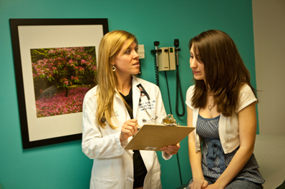
Benefits of the project to the community
It provides information about communicable diseases that can be prevented with vaccines.

Slide 2
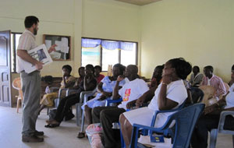
Benefits
It teaches the community about signs and symptoms of those diseases, who are usually affected by them, and how they are spread between people.

Slide 3
Benefits
It informed the community about “Vaccine Basics” including information on the vaccine, who should receive it, and how many doses are recommended.

Slide 4
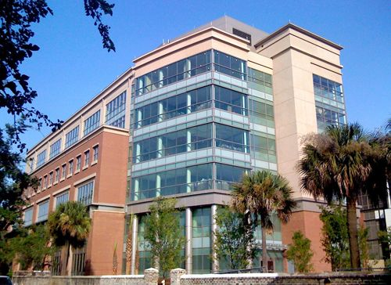
Benefits
It directs clients to resources for getting vaccinated, provides the Vaccine Information Statement (VIS), and gives in-depth information available on other federal Web sites

Slide 5
References
U.S department of health and human Services CDC 42 U.S.C. 300aa-26 101/22/2014
Morbidity and Mortality Weekly Report, Centers for Disease Control and Prevention, 4/2/99, 11/12/10

